Slide 1
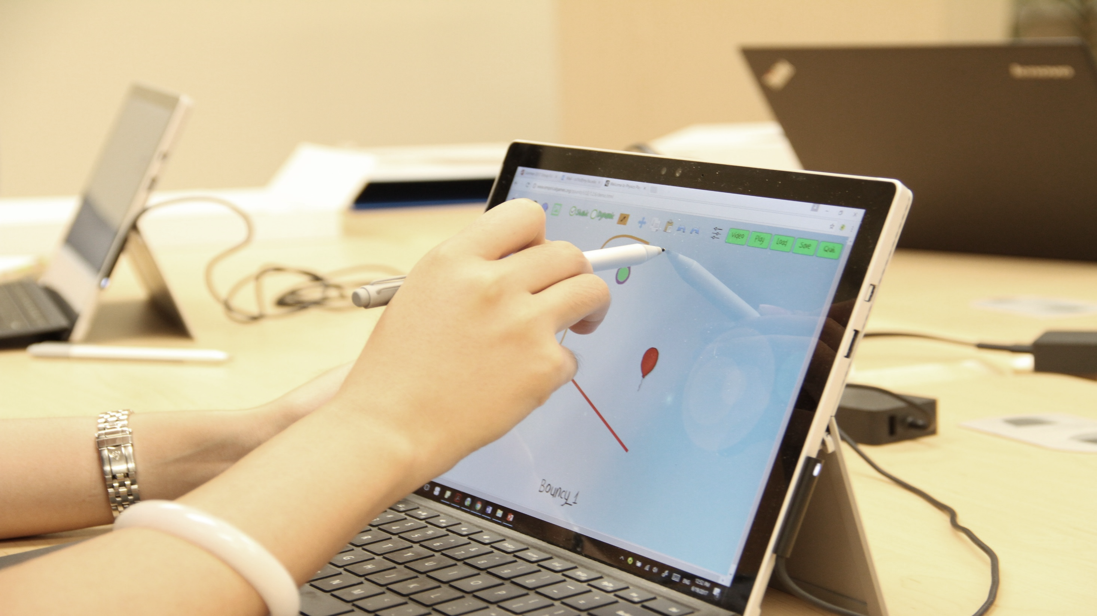
How to Increase Learning
& Diversity in STEM:
Stealth Assessment
ISLT@50
(April 4, 2024)
Valerie Shute
Florida State University

Slide 2
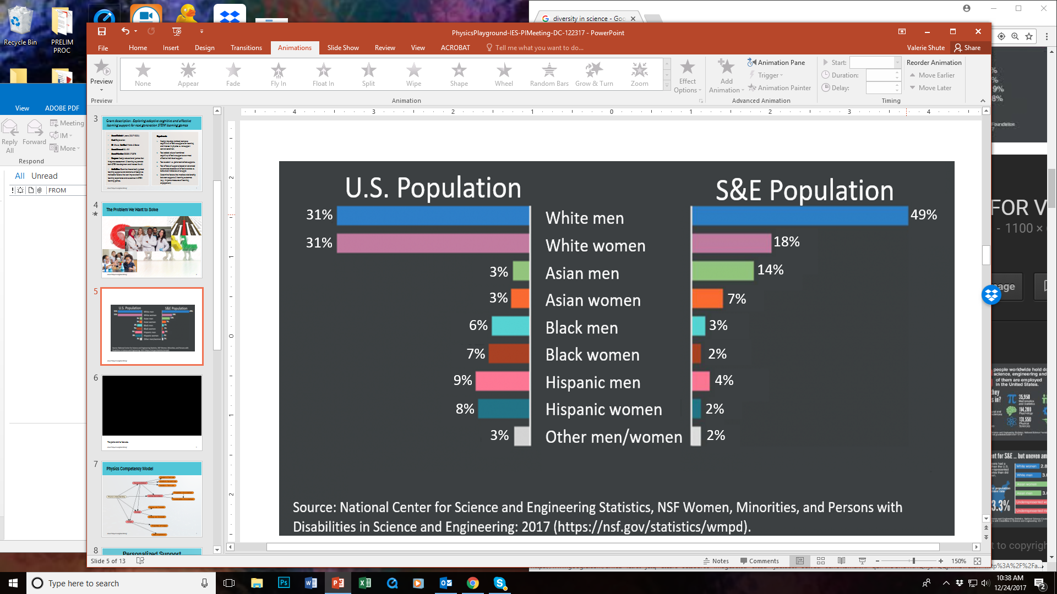


Problem to Resolve
The Problem: Need to increase diversity in STEM-related workforce.
The Goal: Get more girls and minorities excited about learning physics. Well-designed digital games can do both.

Slide 3
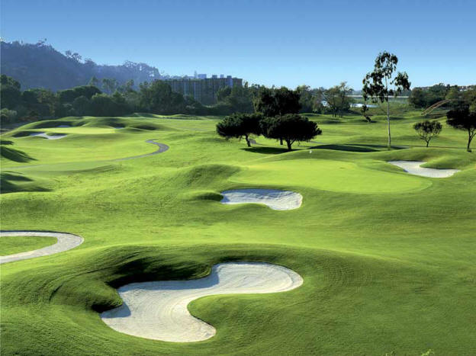
Games

Slide 4
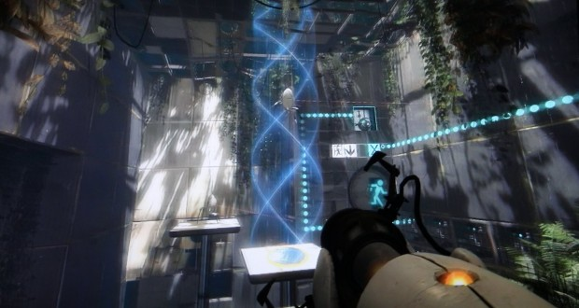
Why Games as Assessment?
Good games are engaging and require a player to apply knowledge & skills to succeed.
Games are also ubiquitous. 75% of all U.S. households have at least one person who plays video games regularly (ESA, 2020).

Slide 5

Good Game Elements
Interactive problem solving
Specific goals/rules
Adaptive challenges
Control
Ongoing feedback
Sensory Stimuli
Notes:
5

Slide 6
Gestalt of Games
Challenges
Control
Stimuli
Interactivity
Goals
Feedback

Slide 7

The Hard Part
How can we measure & support learning in games without decreasing the fun?

Slide 8
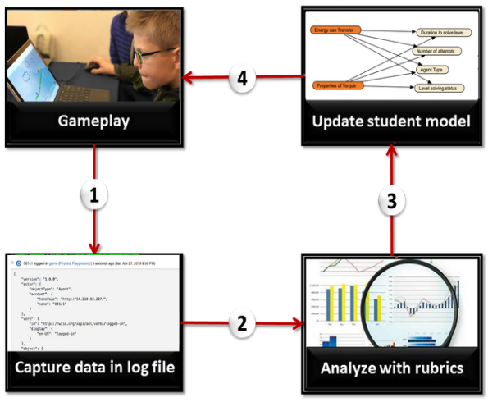
Stealth Assessment Cycle

Slide 9
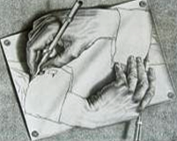

Stealth Assessment Features
When the cook tastes the soup, that’s formative; when the guests taste the soup, that’s summative.
Seamless &
Ubiquitous
Formative as
main purpose
Accurate & Rich Learner Models
Invisible assessment, transparent support!

Slide 10
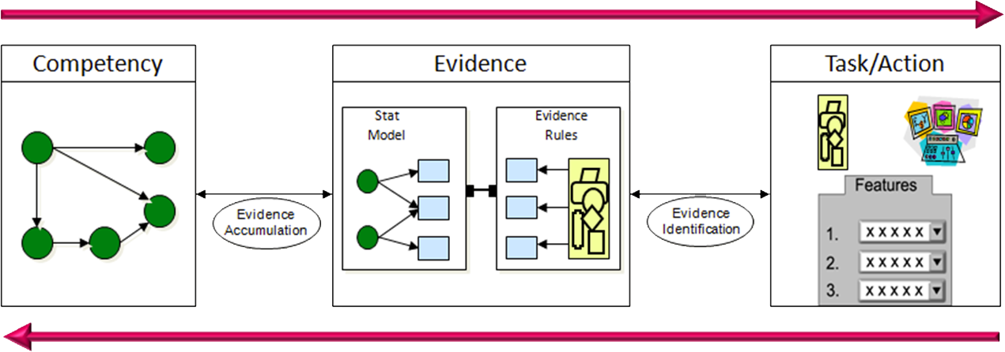
Stealth Assessment Models (ECD)
Assessment Models & Metrics
Monitor & Diagnose Success
(adapted from Mislevy, Steinberg, & Almond, 2003)

Slide 11
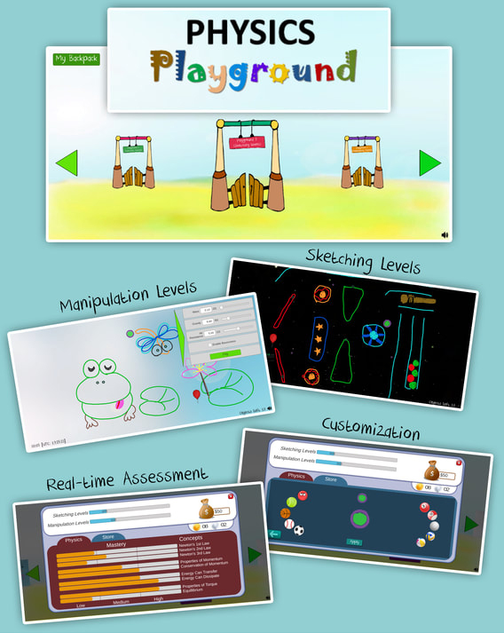




Physics Playground
Goal: guide a to a . Everything obeys basic rules of physics (e.g., gravity, Newton’s 3 laws).
Two types of levels:
Sketching: player draws objects that "come to life" (e.g., pendulums, levers)
Manipulation: player changes physics parameters to solve levels.
The Team!
Notes:
11

Slide 12

Physics Playground Video
The game
Notes:
1:23 min.

Slide 13
Physics Playground—Competency Model
Newton’s 1st Law
Force & Motion
Newton’s 2nd Law
Newton’s 3rd Law
Newtonian
Physics
Linear Momentum
Properties of Momentum
Conservation of Momentum
Energy Can Transfer
Energy
Energy Can Dissipate
Properties of Torque
Torque
Static Equilibrium

Slide 14
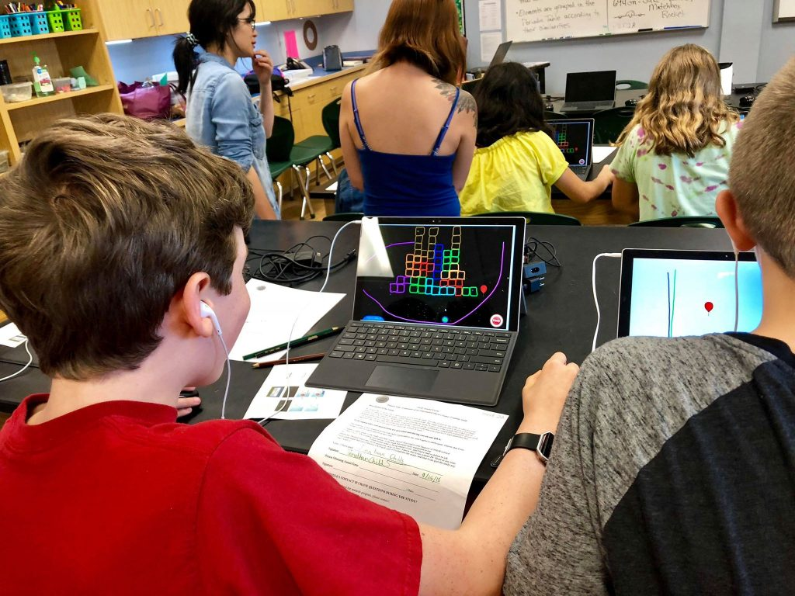
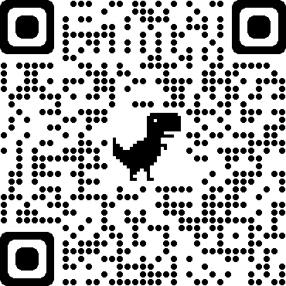
Part of the Research Study
N = 263 (9th - 11th graders), science class, 6 days with ~4 hr gameplay
Sketching and manipulation levels (91 levels total), with learning supports available
Physics pretest and posttest
Game and support questionnaire
For details, see: https://myweb.fsu.edu/vshute/pdf/JCAL2020.pdf

Slide 15
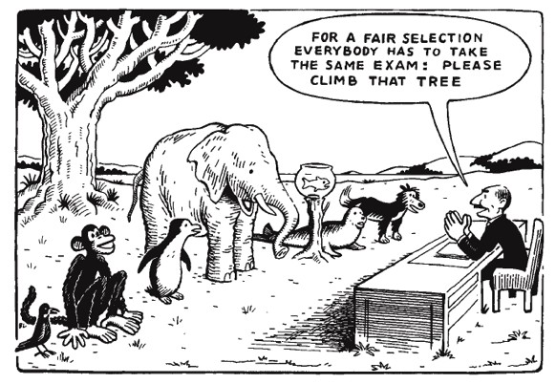
Learning
Gender & Ethnicity. Same number of males & females with wide range of ethnicities.
Pretest scores were higher for males than females; and for whites vs. persons of color.

Slide 16
Learning
Overall. Students scored signif higher on posttest than pretest: F(1, 198) = 9.53; p = .002 after gameplay. Control group (no game) showed no pre/post diffs.
By Gender. ANCOVA: post (DV), gender (IV), pre (Cov): No signif outcome diffs by gender holding pretest constant: F(1, 195) = 0.04; NS.
By Ethnicity. ANCOVA: post (DV), ethnicity (IV), pre (Cov): No signif outcome diffs by ethnicity holding pretest constant: F(2, 154) = 1.32; NS.

Slide 17
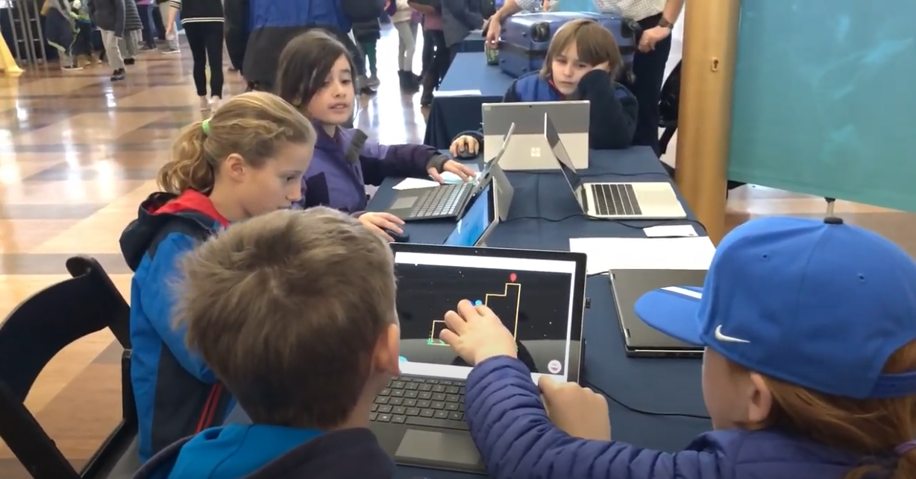
Enjoyment
Overall Enjoyment. Students really enjoyed the game (M = 4.03) on a 1-5 scale (1=hated; 5=loved).
By Gender: Males (M = 4.05) and females (M = 4.00) enjoyed it equally!
By Ethnicity: Whites (M = 4.0), Blacks (M = 4.0), and Hispanics (M = 4.3) enjoyed it equally!

Slide 18
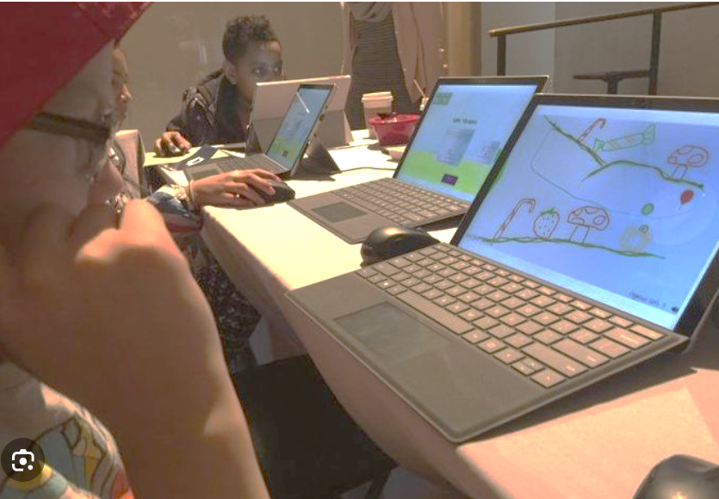
Conclusion
Numerous studies show:
(a) Game-based stealth assessment has good psychometric qualities.
(b) Using such games is an engaging and effective tool for assessing and supporting diverse learners.

Slide 19
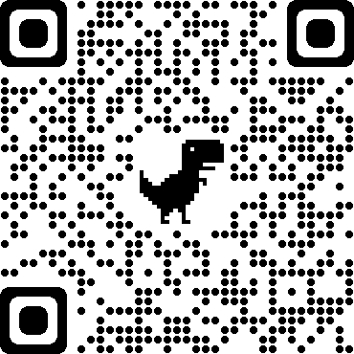
Thank you!
Questions?
Email: vshute@fsu.edu
Website:

Slide 20
Women physicists
Black physicists
Hispanic physicists

Slide 21




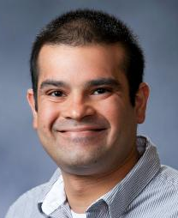






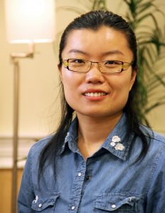



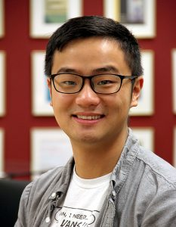

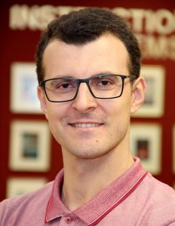


PI
Co-PI
Co-PI
Co-PI
Co-PI
Our Team!
SMEs
Post docs
Most recent Research Assistants

Slide 22
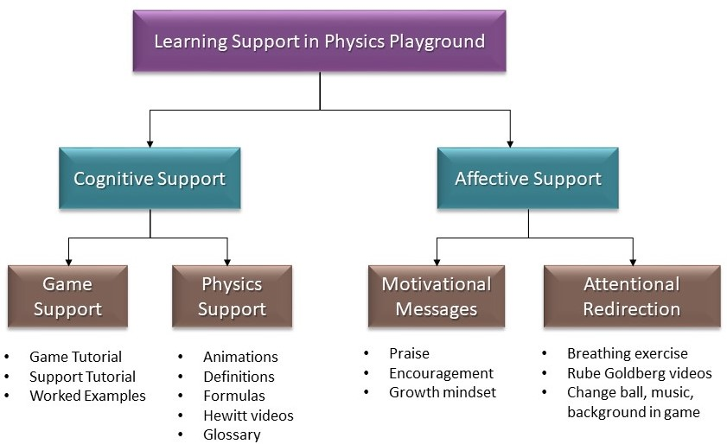
Learning Supports
Worked examples
Game tutorial
Hints
Support tutorial
Physics videos
Interactive def’s
Animations
Formulas
Hewitt videos
Glossary
Encouragement
Growth mindset
Praise
Breathing exercise
Store—change ball, music, background
Rube Goldberg videos

Slide 23
Learning Supports
Worked examples
Game tutorial
Hints
Support tutorial
Physics videos
Interactive def’s
Animations
Formulas
Hewitt videos
Glossary
Encouragement
Growth mindset
Praise
Breathing exercise
Store—change ball, music, background
Rube Goldberg videos

Slide 24
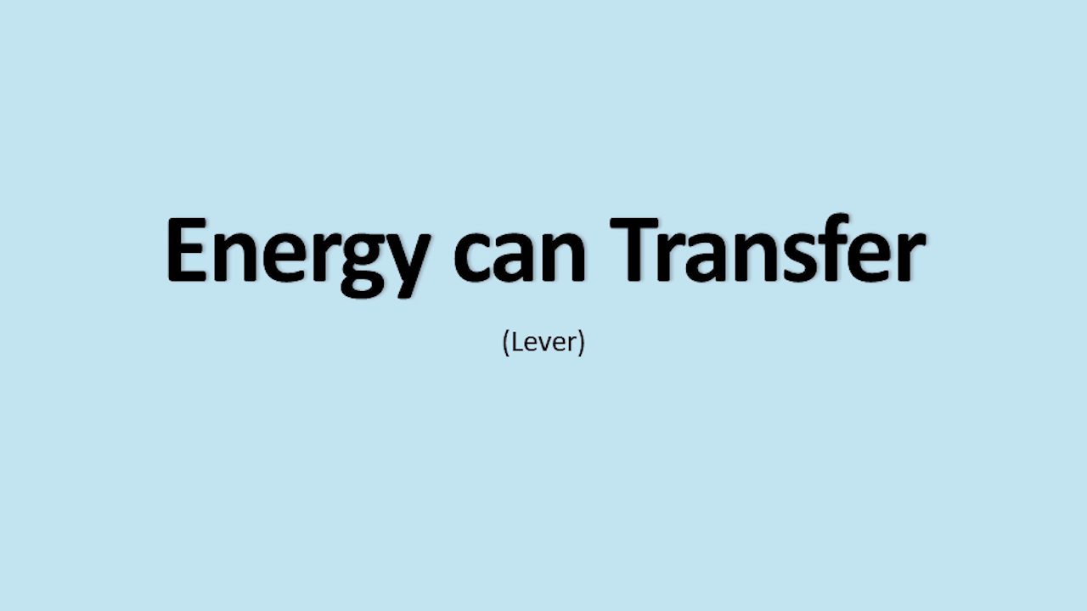
Learning Supports—Physics videos

Slide 25
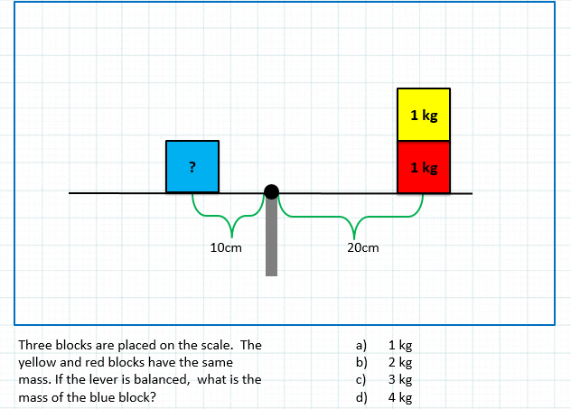
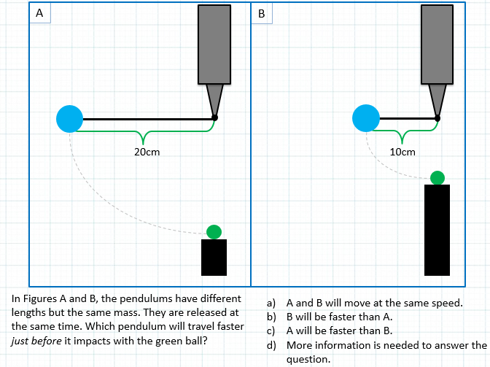
Physics Test (examples)
Get Back!

Slide 26
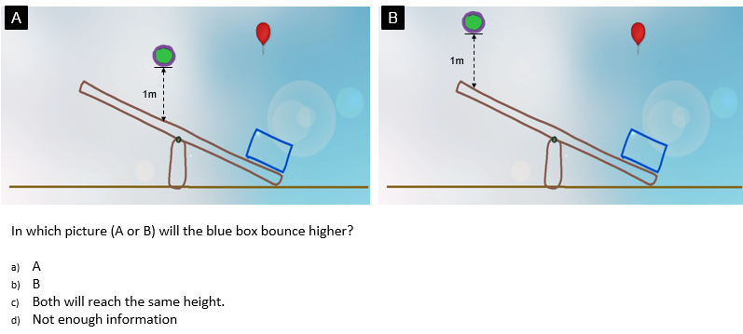
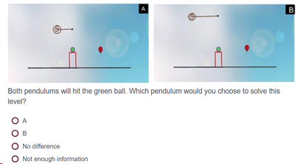
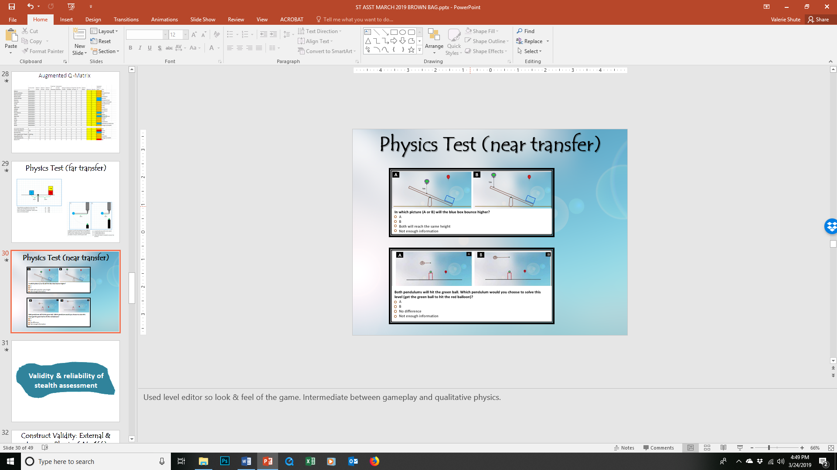
Physics Test (near transfer)
A
B
In which picture (A or B) will the blue box bounce higher?
A
B
Both will reach the same height
Not enough information
A
B
Both pendulums will hit the green ball. Which pendulum would you choose to solve this level (get the green ball to hit the red balloon)?
A
B
No difference
Not enough information

Slide 27
Expected A Posteriori (EAP)
For every node in physics CM, there’s a triplet of current estimates: p(High), p(Medium), p(Low) with values summing to 1.
To get a single number from triplets, we can assign weights (e.g., +1 * p(H); 0 * p(M); -1 * p(L)) which reduces to p(H) – p(L).
EAPs range from -1 to +1 like correlations.
Get Back!

Slide 28
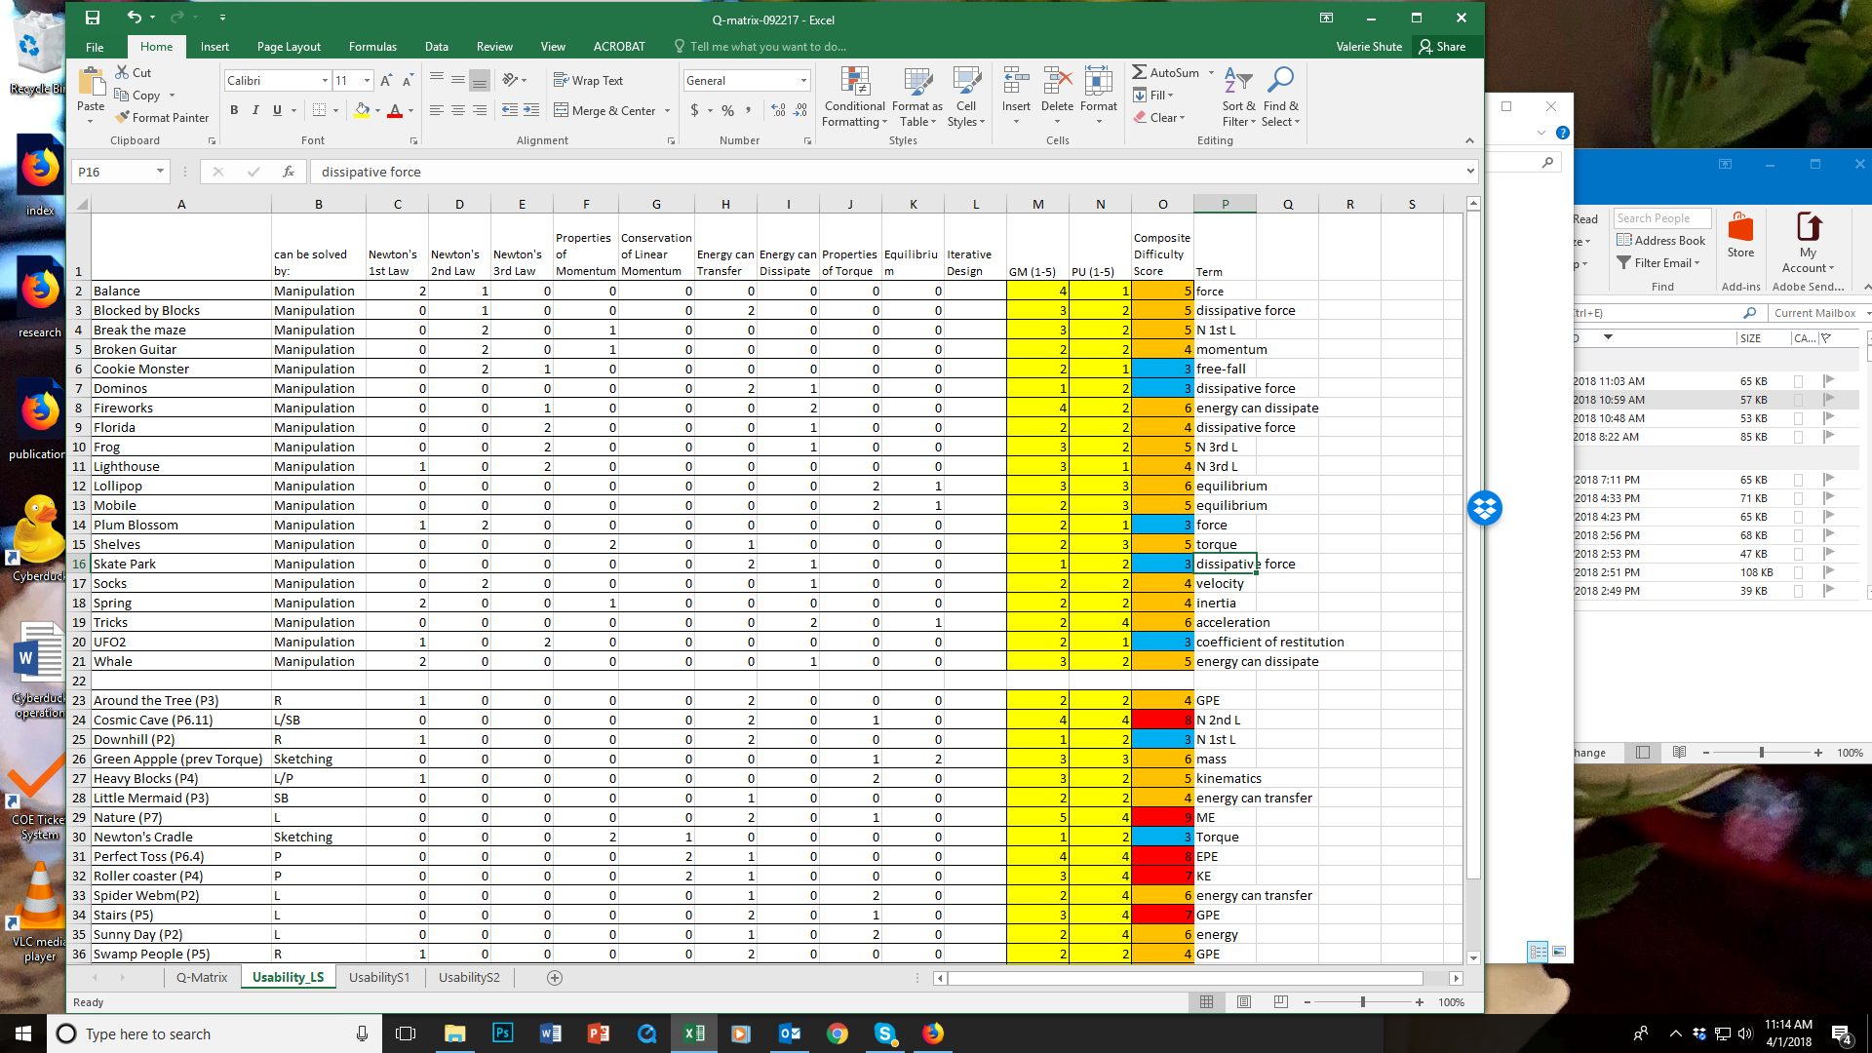
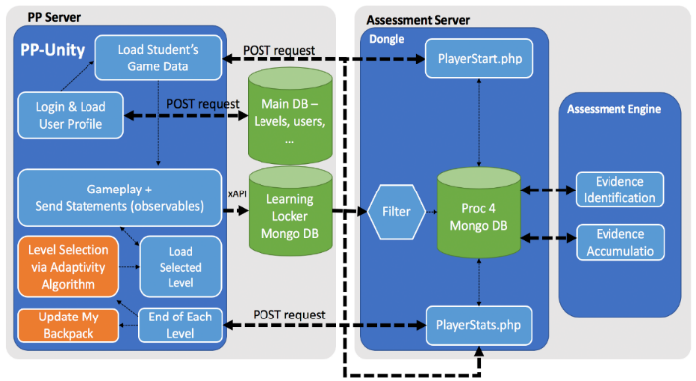
Augmented Q-Matrix → Bayes nets
Q-matrix: Set up relations among all levels (> 150), their targeted physics concept, difficulty, etc.
Indicators: Specify “indicators” (measurable behaviors in the game) per task type (sketching vs. manipulation)
Evidence Identification (EI): Establish rubrics to automatically score raw data per level from log files (e.g., number restarts, gold trophy <0/1>).
Cut Scores: Determine cut scores from frequency distributions of raw observables.
Evidence Accumulation (EA): For each indicator, create Low, Med, High levels to feed into Bayes net.
Generation of BNs. Used Almond’s Peanut suite of tools to generate BNs (https://pluto.coe.fsu.edu/RNetica).
(not expected to be viewable)

Slide 29
Augmented Q-Matrix
Get Back!

Slide 30
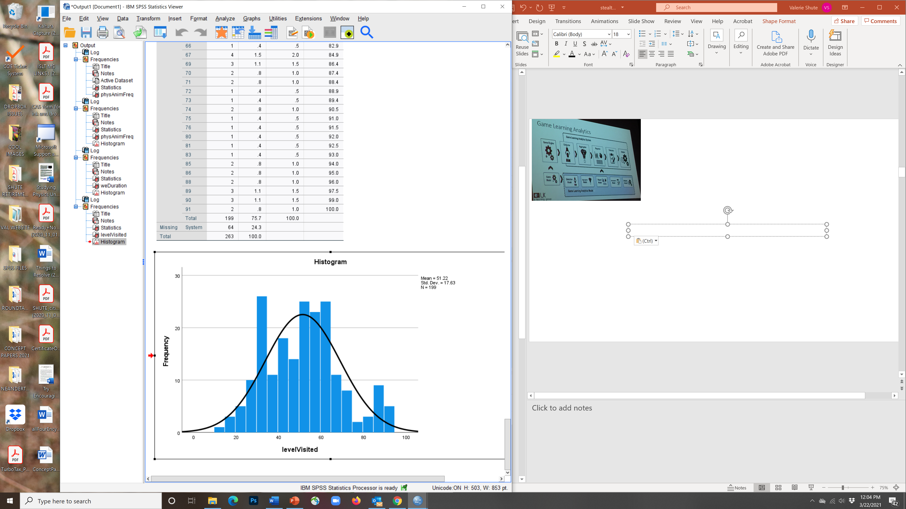
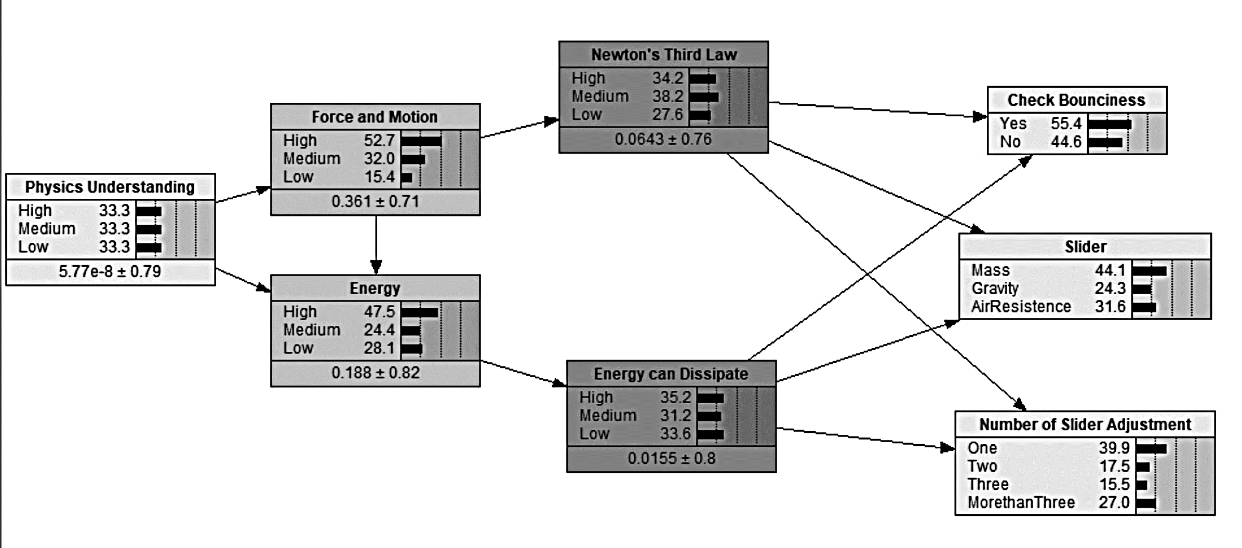
PP—Evidence Model
Time to solve, object(s) drawn, sliders adjusted, # restarts, gold coin, levels solved, etc. (by level & session).
Evidence Identification (EI): Establish rubrics to auto-score raw data (observables, aka “indicators”) per level from log files.
Low
Medium
High
Cut Scores: Determine cut scores from frequency distributions of indicators.
Levels Solved
Evidence Accumulation (EA): During gameplay, data per indicator feeds into Bayes net (one BN per level).
Indicators
For more, see R. Almond’s Peanut suite of tools to generate BNs (https://pluto.coe.fsu.edu/RNetica).

Slide 31
Stealth Assessment Steps
Develop Competency Model (CM)
Select (or design) game to embed asst.
List indicators (evidence to inform CM)
Develop new tasks in game, if necessary
Setup Q-matrix (link levels to CM facets)
Determine “scoring rules” for indicators (the EM)
Pilot test BNs and modify parameters
Validate stealth asst. with external measures
Use asst. data for feedback and learning support
Set statistical relations (indicators & CM var’s)

Slide 32
RQ1
Reliability (n = 263)
Reliability of external measure: (Cronbach’s α values), pretest = .77; posttest = .82; n = 263.
Reliability of stealth assessment measures: CFA – Gold coins by four agents: X²/df < 3, CFI > .95, RMSEA < .05, SRMR < .05
Intraclass correlation = .85 (Ramp, Level, Pendulum, Springboard gold coins)
Cronbach’s α of stealth assessment = .87
(Data: gold coin info (NA, 0, 1);
Valid Cases: 110 (out of 169); Levels: 29 (out of 74)
Physics
Competency
.82
.80
.80
.80
Ramp
gold
Lever
gold
Pendulum
gold
Springboard gold
.33
.35
.37
.37

Slide 33
Validity
RQ1
Stealth Ass’t Estimates | Pretest | Posttest
Physics (Overall) EAP | 0.36** | 0.40**
Force and Motion | 0.29** | 0.30**
Linear Momentum | 0.27** | 0.27**
Energy | 0.22** | 0.35**
Torque | 0.14* | 0.18**
Physics Facets
Note. * p < .05; ** p < .01

