Slide 1
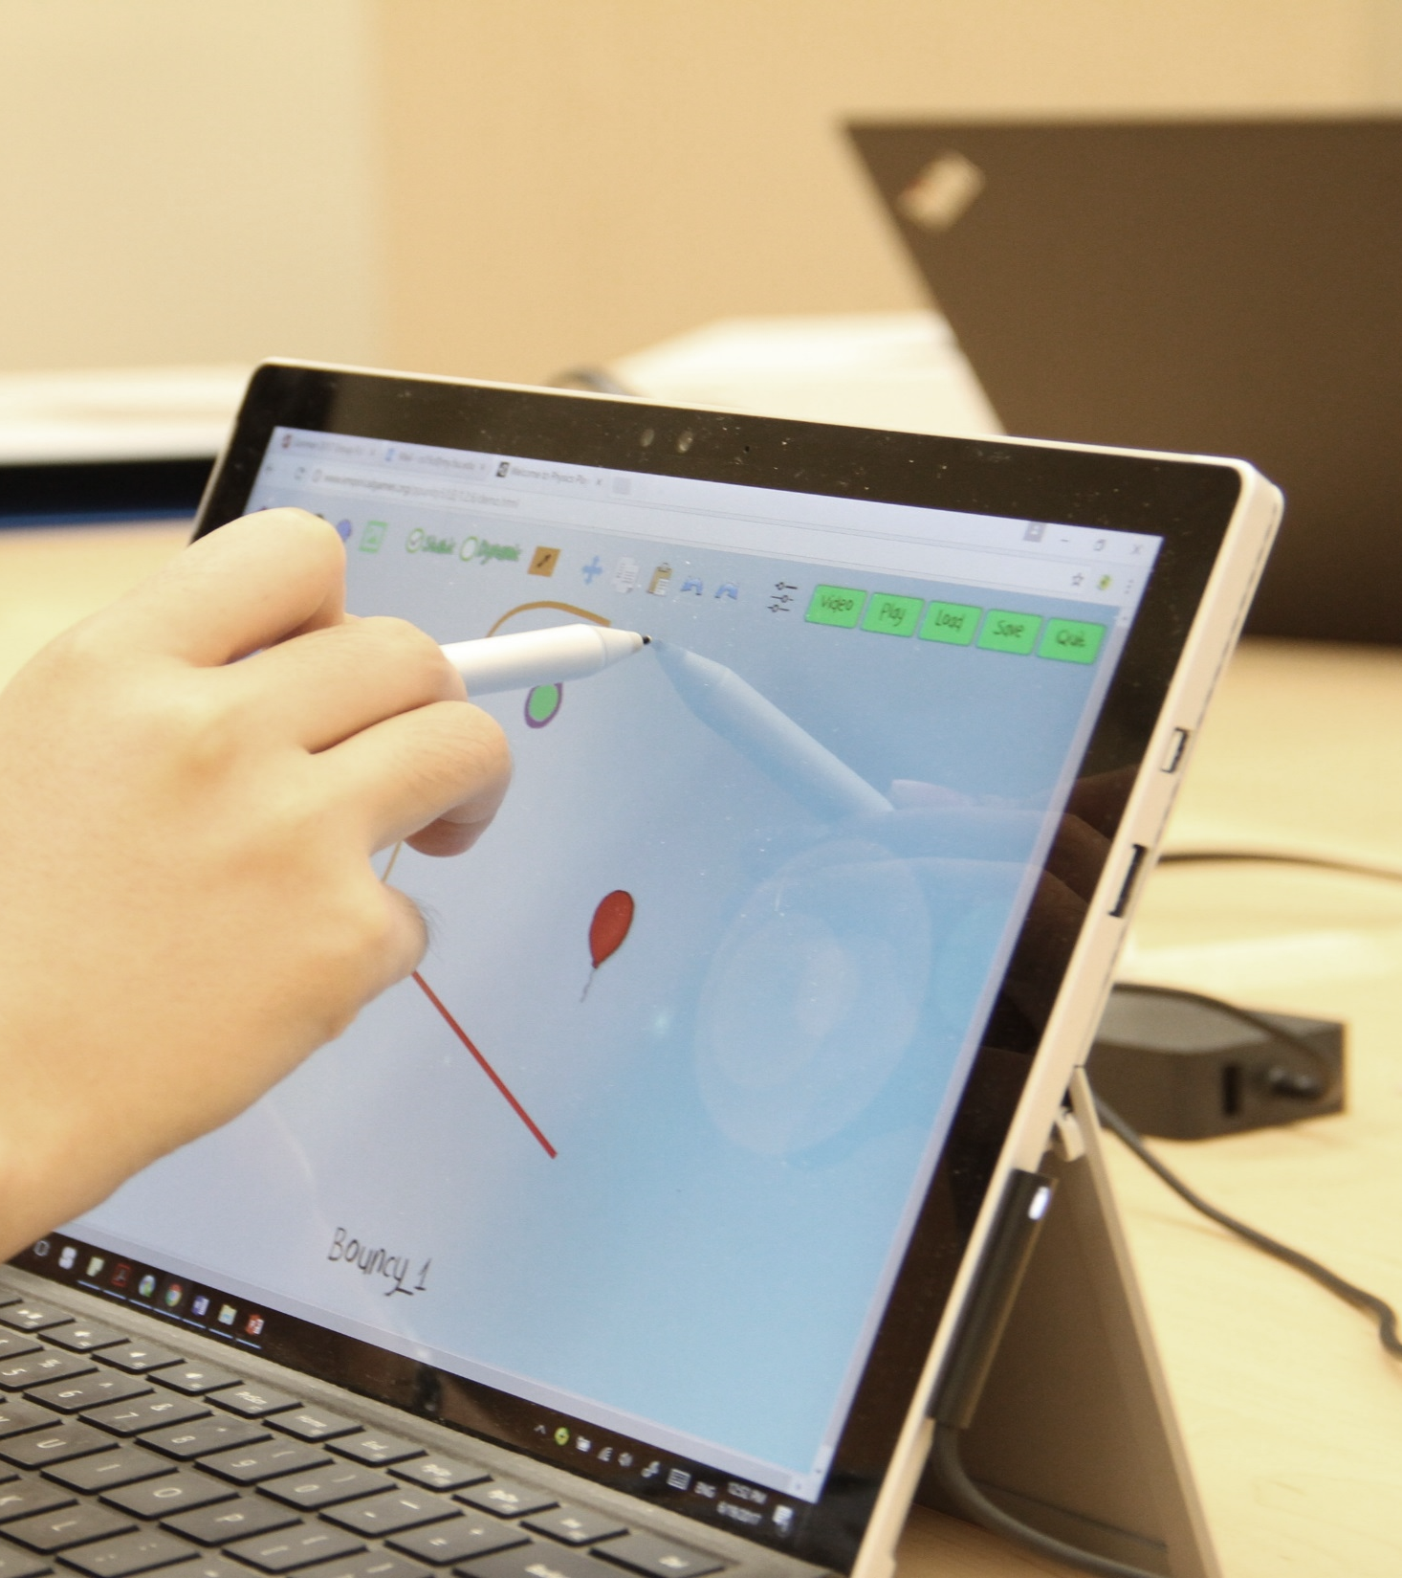
Stealth Assessment in Games to Measure and Support Learning
HKU Center for Information Technology in Education Research Symposium
May 19, 2023
Valerie Shute
Florida State University

Slide 2

Games, Learning, Assessment
Claim 1
Claim 2
Claim 3
Good games can act as transformative environments to support skill development and deep, meaningful learning.
Learning is best when active, interesting, goal-oriented, and contextualized (i.e., features of good games).
Stealth assessment can collect dynamic evidence of learning in real-time, at various grain sizes (and use info to support learning).
+
+
+

Slide 3

Games

Slide 4
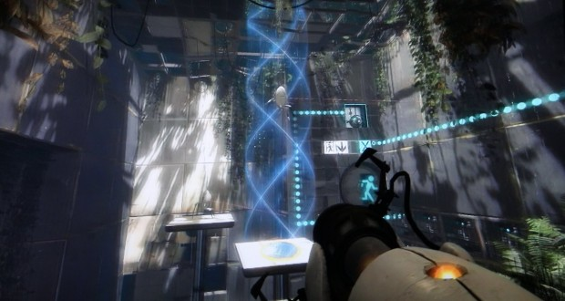
Why Games as Assessment?
Good games are engaging and require a player to apply knowledge and skills to succeed.
Games are also ubiquitous. 75% of all U.S. households have at least one person who plays video games regularly (ESA, 2020).

Slide 5

Good Game Elements
Interactive problem solving
Specific goals/rules
Adaptive challenges
Control
Ongoing feedback
Sensory Stimuli
Notes:
5

Slide 6
Gestalt of Games
Challenges
Control
Stimuli
Interactivity
Goals
Feedback

Slide 7

The Hard Part
How can we increase learning in games without decreasing the fun?

Slide 8
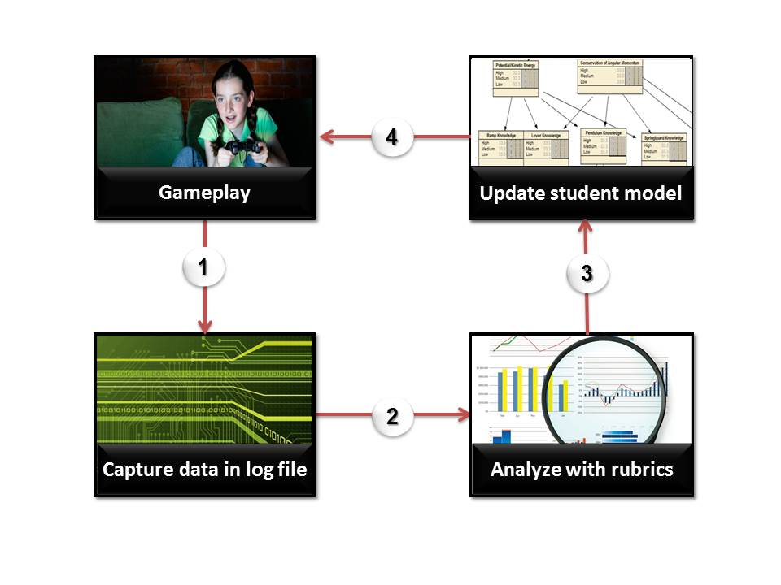
Stealth Assessment Cycle
4
1
3
2

Slide 9
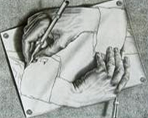

Stealth Assessment Features
When the cook tastes the soup, that’s formative; when the guests taste the soup, that’s summative.
Seamless &
Ubiquitous
Formative as
main purpose
Accurate & Rich Learner Models
Invisible assessment, transparent support!

Slide 10
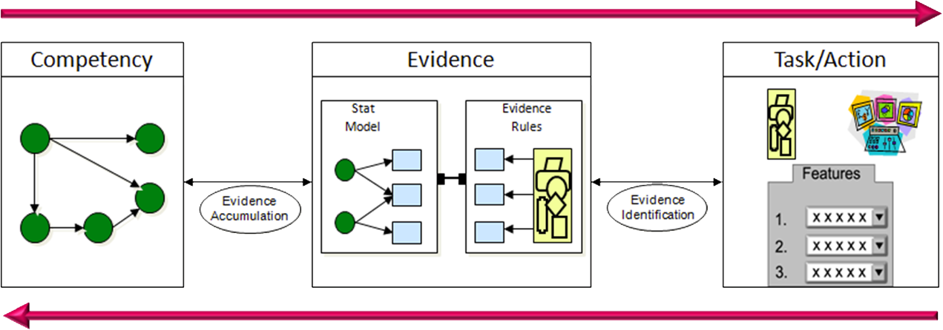
Stealth Assessment Models (ECD)
Assessment Models & Metrics
Monitor & Diagnose Success
(adapted from Mislevy, Steinberg, & Almond, 2003)

Slide 11
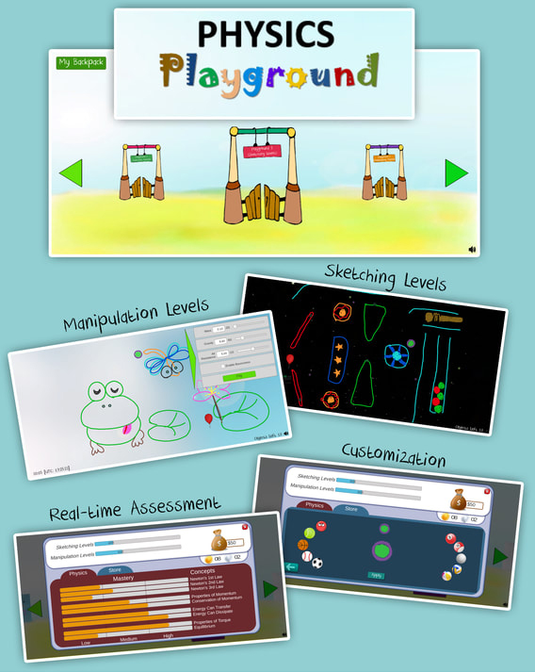




Physics Playground
Goal: guide a to a . Everything obeys basic rules of physics (e.g., gravity, Newton’s 3 laws).
Two types of levels:
  Sketching: player draws objects that "come to life" (e.g., pendulums, levers)
  Manipulation: player changes physics parameters to solve levels.
The Team!
Notes:
11

Slide 12

Physics Playground Video
The game
Notes:
1:23 min.

Slide 13
Physics Playground—Competency Model
Newton’s 1st Law
Force & Motion
Newton’s 2nd Law
Newton’s 3rd Law
Newtonian
Physics
Linear Momentum
Properties of Momentum
Conservation of Momentum
Energy Can Transfer
Energy
Energy Can Dissipate
Properties of Torque
Torque
Static Equilibrium

Slide 14
Automated
Scoring

Slide 15
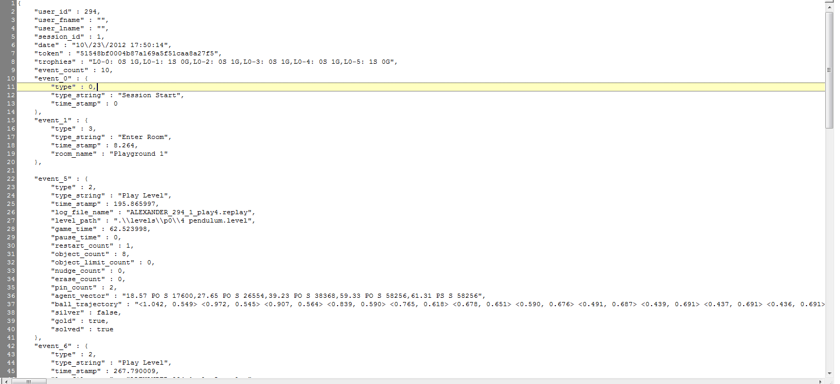
Log Snapshot

Slide 16
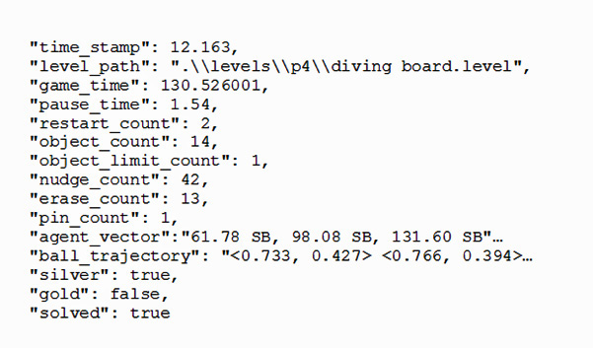
Level-level log data
Level-level log data
149.53,

Slide 17
Agent ID system
Agent | Monitor Trigger | Identify Trigger
Ramp | Event Ball touches Primary Object (PO) Conditions Object has never rotated > 20 degrees | Event Positive ID conditions met OR ball stops touching PO Conditions Object has never rotated > 20 degrees Ball moves along object: (>25% in horiz.) OR (>11% horiz. AND >4% vert.) OR (>4% horiz. AND >11% vert.)
Lever | Event Secondary Object falls on Object Conditions Secondary object has elevated downward momentum (vertical momentum < -.05 kg m/s) Object has <= 1 pin (attached to static object) Object has not moved much recently (less than 2% of screen in ⅓ sec) | Event ¾ seconds pass from Monitor Trigger Conditions Object has touched ball since Monitor Trigger Object has rotated > 20 degrees since Monitor Trigger Ball has reached an apex 4% higher than at Monitor Trigger
Pendulum Strike | Event Object touches ball Conditions Object has 1 pin Object has rotated > 20 degrees Object has non-zero rotational velocity | Event ¾ seconds pass from Monitor Trigger Condition Ball moved moderately since Monitor Trigger (> 15% screen)
Springboard | Event Object has elevated rotational velocity (>1.5 m/s) Conditions Rotating toward 12 o’clock (as opposed to 6 o’clock) Object has 2+ pins (attaches to a static object) | Event ¾ seconds pass from Monitor Trigger Conditions Object has touched ball since Monitor Trigger Ball has reached an apex 6% higher than at Monitor Trigger

Slide 18
Agent ID system
Agent | Monitor Trigger | Identify Trigger
Ramp | Event Ball touches Primary Object (PO) Conditions Object has never rotated > 20 degrees | Event Positive ID conditions met OR ball stops touching PO Conditions Object has never rotated > 20 degrees Ball moves along object: (>25% in horiz.) OR (>11% horiz. AND >4% vert.) OR (>4% horiz. AND >11% vert.)
Lever | Event Secondary Object falls on Object Conditions Secondary object has elevated downward momentum (vertical momentum < -.05 kg m/s) Object has <= 1 pin (attached to static object) Object has not moved much recently (less than 2% of screen in ⅓ sec) | Event ¾ seconds pass from Monitor Trigger Conditions Object has touched ball since Monitor Trigger Object has rotated > 20 degrees since Monitor Trigger Ball has reached an apex 4% higher than at Monitor Trigger
Pendulum Strike | Event Object touches ball Conditions Object has 1 pin Object has rotated > 20 degrees Object has non-zero rotational velocity | Event ¾ seconds pass from Monitor Trigger Condition Ball moved moderately since Monitor Trigger (> 15% screen)
Springboard | Event Object has elevated rotational velocity (>1.5 m/s) Conditions Rotating toward 12 o’clock (as opposed to 6 o’clock) Object has 2+ pins (attaches to a static object) | Event ¾ seconds pass from Monitor Trigger Conditions Object has touched ball since Monitor Trigger Ball has reached an apex 6% higher than at Monitor Trigger

Slide 19
Agent ID System
Agent ID system
Agent | Monitor Trigger | Identify Trigger
Pendulum Strike | Event Object touches ball Conditions Object has 1 pin Object has rotated > 20 degrees Object has non-zero rotational velocity | Event ¾ seconds pass from Monitor Trigger Condition Ball moved moderately since Monitor Trigger (> 15% screen)

Slide 20
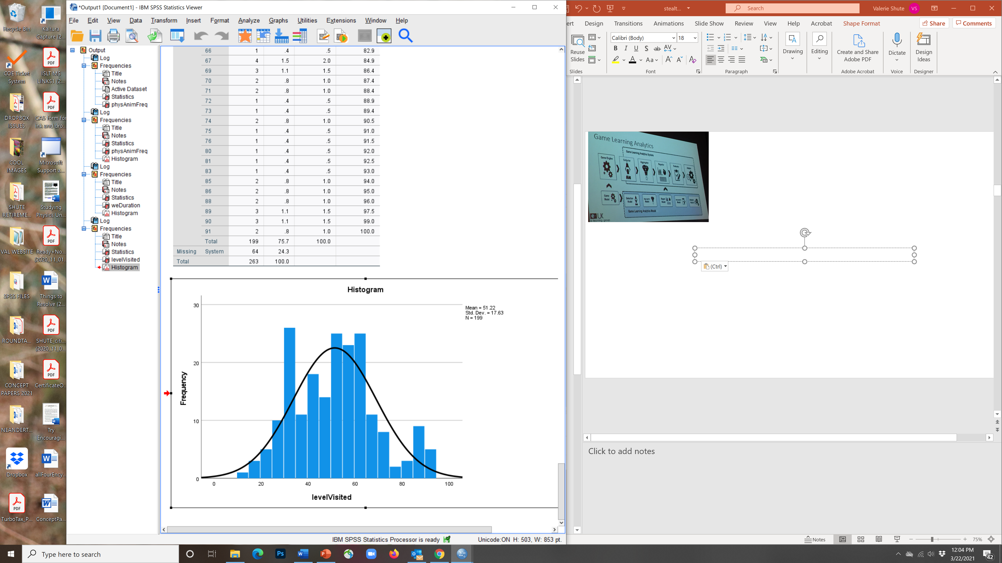
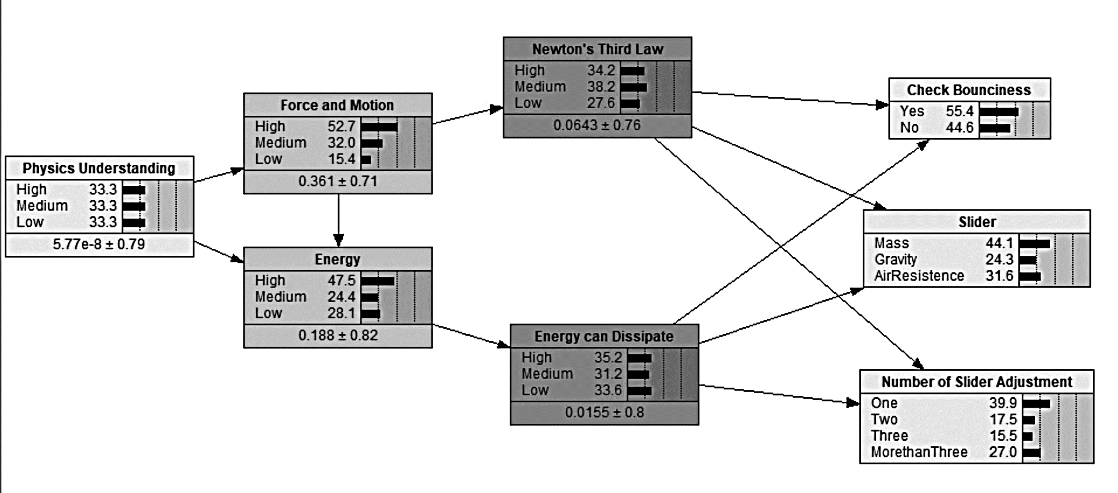
PP—Evidence Model
Time to solve, object(s) drawn, sliders adjusted, # restarts, gold coin, levels solved, etc. (by level & session).
Evidence Identification (EI): Establish rubrics to auto-score raw data (observables, aka “indicators”) per level from log files.
Low
Medium
High
Cut Scores: Determine cut scores from frequency distributions of indicators.
Levels Solved
Evidence Accumulation (EA): During gameplay, data per indicator feeds into Bayes net (one BN per level).
Indicators
For more, see R. Almond’s Peanut suite of tools to generate BNs (https://pluto.coe.fsu.edu/RNetica).

Slide 21
Stealth Assessment Steps
Stealth Assessment Steps
Develop Competency Model (CM)
Select (or design) game to embed asst.
List indicators (evidence to inform CM)
Develop new tasks in game, if necessary
Setup Q-matrix (link indicators to CM facets)
1
2
3
4
5

Slide 22
Stealth Assessment Steps
Stealth Assessment Steps (cont.)
Determine “scoring rules” for indicators (the EM)
Pilot test BNs and modify parameters
Validate stealth asst. with external measures
Use asst. data for feedback and learning support
Set statistical relations (indicators & CM var’s)
6
7
8
9
10

Slide 23
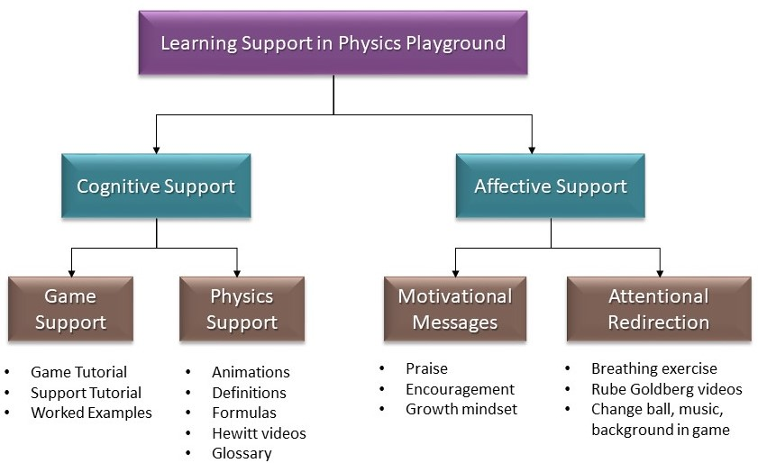
Learning Supports
Worked examples
Game tutorial
Hints
Support tutorial
Physics videos
Interactive def’s
Animations
Formulas
Hewitt videos
Glossary
Encouragement
Growth mindset
Praise
Breathing exercise
Store—change ball, music, background
Rube Goldberg videos

Slide 24
Learning Supports
Worked examples
Game tutorial
Hints
Support tutorial
Physics videos
Interactive def’s
Animations
Formulas
Hewitt videos
Glossary
Encouragement
Growth mindset
Praise
Breathing exercise
Store—change ball, music, background
Rube Goldberg videos

Slide 25
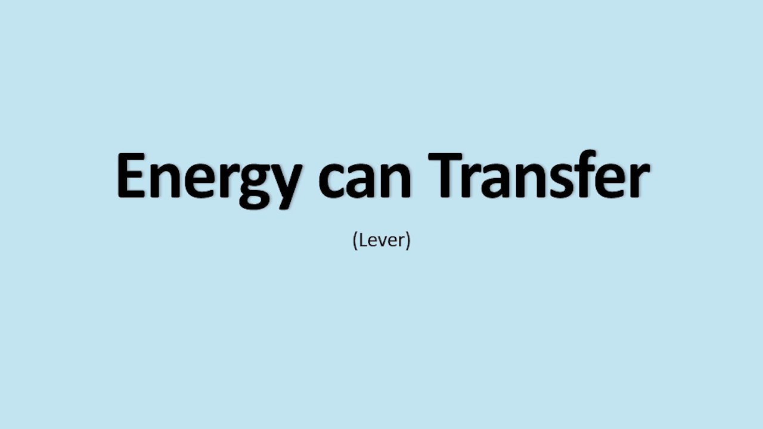
Learning Supports—Physics videos

Slide 26
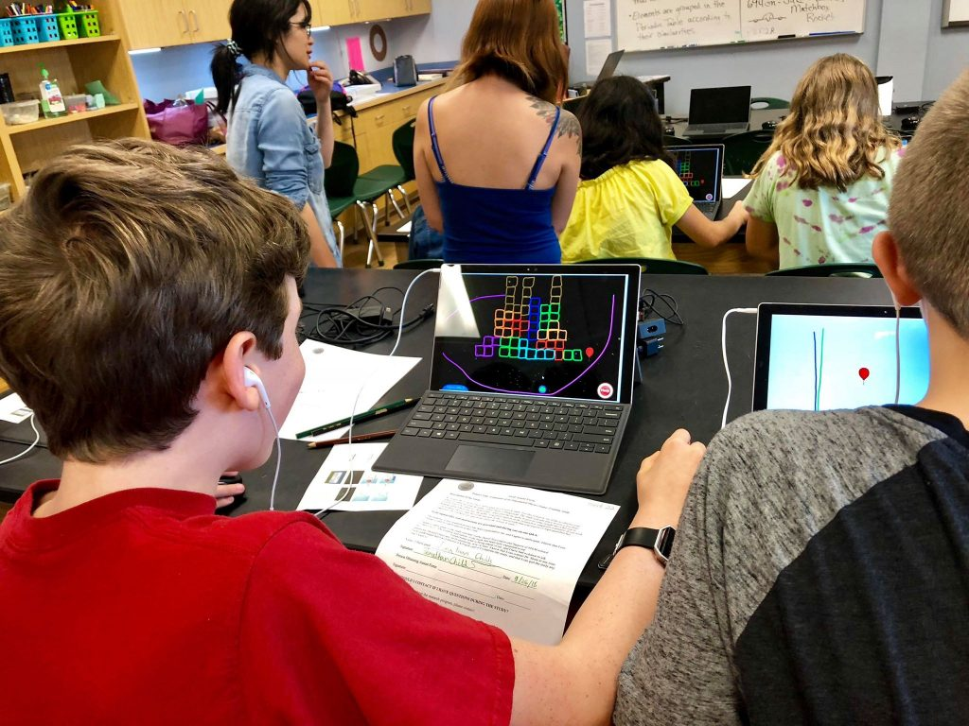
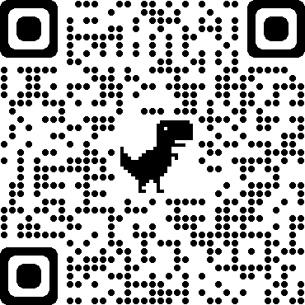
Research Study
N = 263 (9th - 11th graders), science class, 6 days with ~4 hr gameplay
Sketching and manipulation levels (91 levels total)
Full set of (8 different) learning supports
Physics pretest and posttest
Game and learning support questionnaire
For details, see: https://myweb.fsu.edu/vshute/pdf/JCAL2020.pdf

Slide 27
Research Questions
  Psychometric qualities. Are stealth assessment measures reliable, valid, and fair?
  Learning & enjoyment. Do kids, overall, learn physics from PP? Did they enjoy the game?
  Learning supports. Which learning supports most effectively enhance learning and game performance?
RQ1
RQ2
RQ3

Slide 28
RQ1
Reliability (n = 263)
Reliability of external measure: (Cronbach’s α values), pretest = .77; posttest = .82; n = 263.
Reliability of stealth assessment measures: CFA – Gold coins by four agents: X²/df < 3, CFI > .95, RMSEA < .05, SRMR < .05
Intraclass correlation = .85 (Ramp, Lever, Pendulum, Springboard gold coins)
Cronbach’s α of stealth assessment = .87
(Data: gold coin info (NA, 0, 1);
Valid Cases: 110 (out of 169); Levels: 29 (out of 74)
Physics
Competency
.82
.80
.80
.80
Ramp
gold
Lever
gold
Pendulum
gold
Springboard gold
.33
.35
.37
.37

Slide 29
Validity
RQ1
Stealth Ass’t Estimates | Pretest | Posttest
Physics (Overall) EAP | 0.36** | 0.40**
Force and Motion | 0.29** | 0.30**
Linear Momentum | 0.27** | 0.27**
Energy | 0.22** | 0.35**
Torque | 0.14* | 0.18**
Physics Facets
Note. * p < .05; ** p < .01

Slide 30
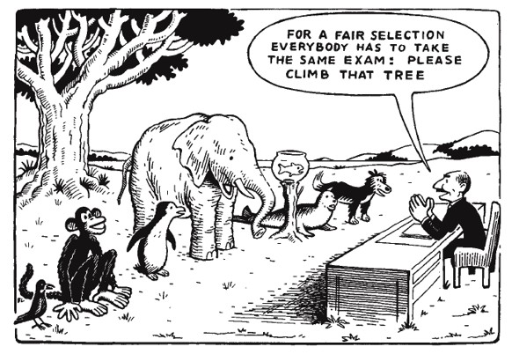
Fairness (re: learning)
RQ1
Same number of males and females with wide range of ethnicities.
Learning by Gender. ANCOVA: post (DV), gender (IV), pre (Cov): Results showed no significant outcome differences by gender holding pretest constant: F(1, 195) = 0.04; p = .85.
Learning by Ethnicity. ANCOVA: post (DV),
ethnicity (IV), pre (Cov): Results showed no significant outcome differences by ethnicity holding pretest constant: F(2, 154) = 1.32; p = .27.

Slide 31
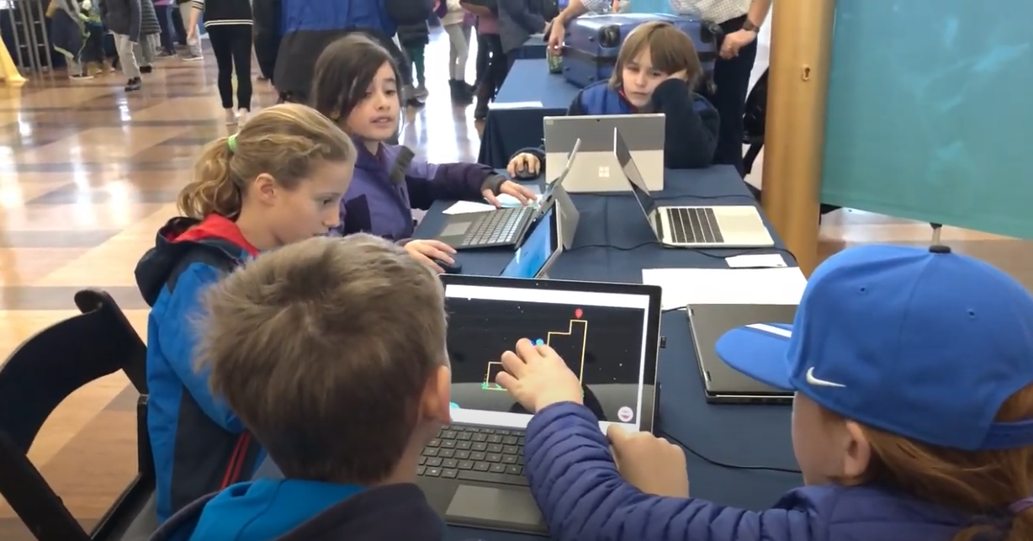
Learning & Enjoyment
RQ2
Overall Learning. Students scored significantly higher on posttest than pretest: F(1, 198) = 9.53; p = .002 after gameplay. Control group (no game) showed no pre/post diff (M_{pre} = 11.6; M_{post} = 11.6).
Overall Enjoyment. Students really enjoyed the game (M = 4.03) on a 1-5 scale (1=hated; 5=loved).
    By Gender: Males (M = 4.05) and females (M = 4.00) enjoyed it equally!
    By Ethnicity: Whites (M = 4.0), Blacks (M = 4.0), and Hispanics (M = 4.3) enjoyed it equally!

Slide 32
Learning Supports
RQ3
Favorite supports. Hints, physics videos, and worked examples.
Predicting learning. Regression: Posttest (DV), with pretest & all 8 support freqs in equation: Only pretest (β = .66) and Physics videos (β = .11) significantly predicted outcome: R² = .50; F (2, 198) = 97.6 (p < .001)
Predicting gameplay. Those watching more Physics videos also did significantly better in the game than those watching fewer videos (re: levels completed, gold, and silver coins earned).
Supports don’t detract from fun. Students who watched more Physics videos reported higher levels of enjoyment than watching fewer. Enjoyment (β = .18, F(1, 193) = 6.23, p = .01).

Slide 33
Bonus Question!
Can stealth assessment be used in existing games to measure students’ abilities?

Slide 34
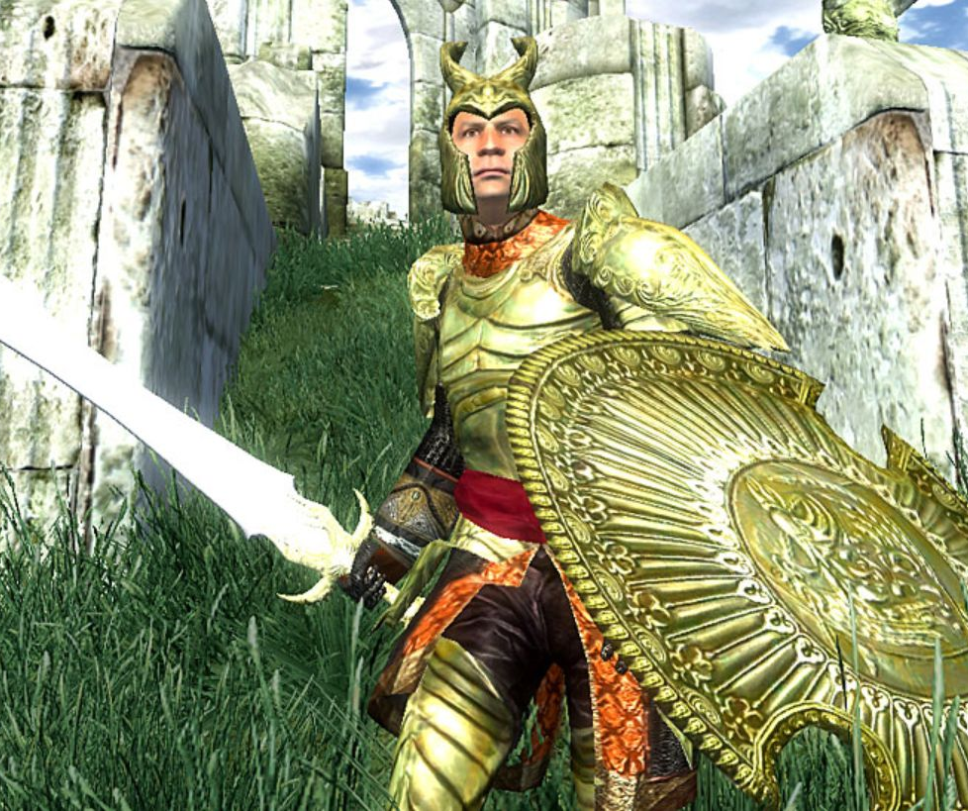
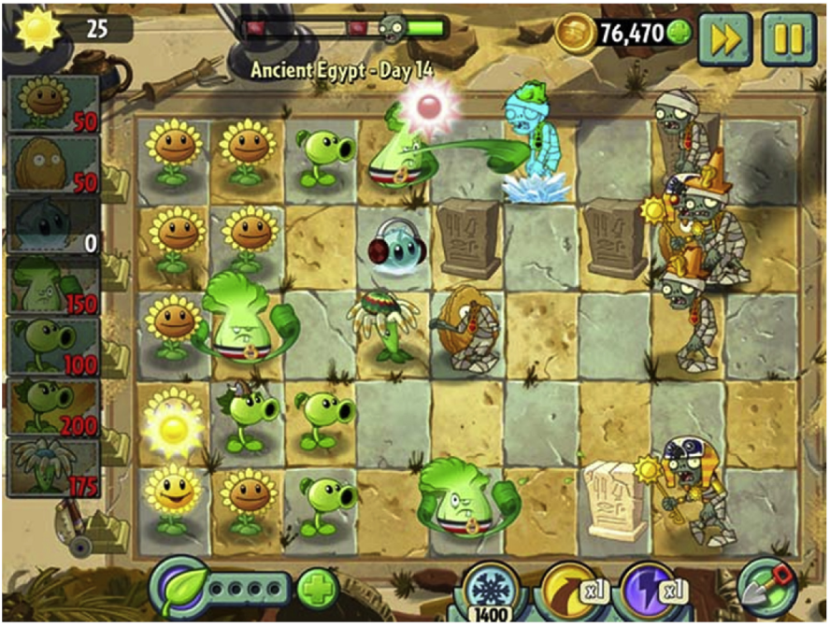
Stealth Assessment in Commercial Games
Oblivion
Plants vs. Zombies 2
1st stealth assessment (proof of concept)
Measured creative problem-solving skills
Merged cog & non-cog variables
Used Bayes nets to accumulate estimates
Shute et al. (2009). Melding the power of serious games and embedded assessment to monitor and foster learning: Flow and grow.
Love this game!
Measured problem-solving skills
Used Bayes nets to accumulate estimates
Validated stealth assessment to external measures
Shute, et al. (2016). Measuring problem solving skills via stealth assessment in an engaging video game.

Slide 35
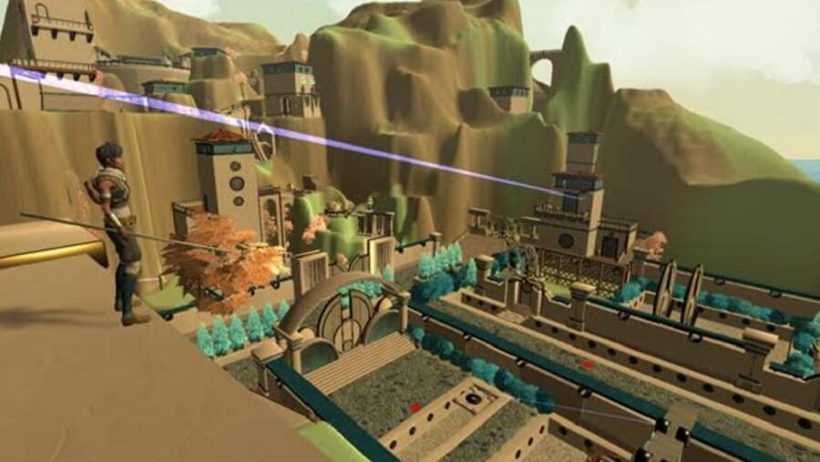
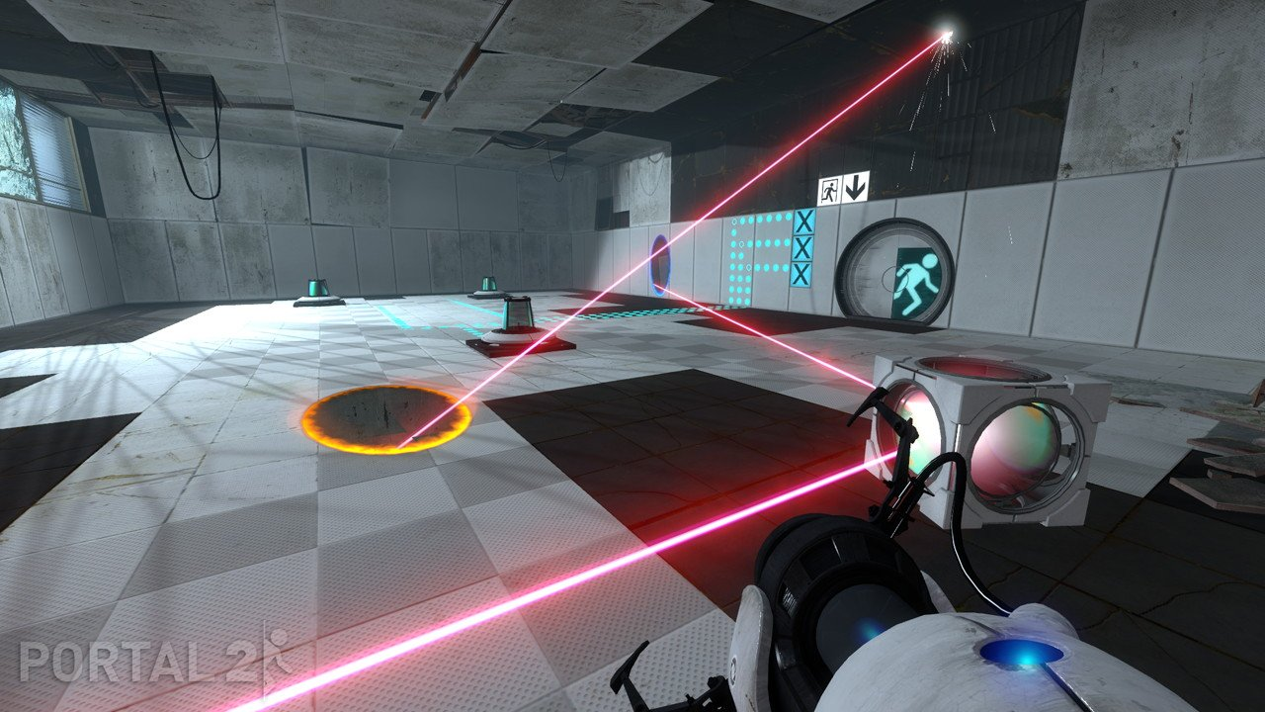
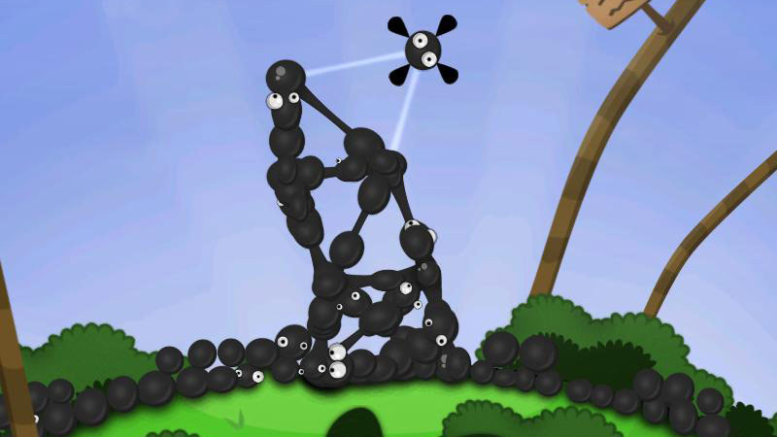
Stealth Assessment in Commercial Games
Oblivion
Portal 2
World of Goo
Variant: Limits
Measured calculus knowledge
Validated the stealth asst measure.
Smith, G., Shute, V. J., & Muenzenberger, A. (2019). Designing and validating a stealth assessment for calculus competencies.
Measured problem solving, spatial skill, & persistence before/after game <compared to Lumosity>
Shute, V. J., Ventura, M., & Ke, F. (2015). The power of play: The effects of Portal 2 and Lumosity on cognitive and noncognitive skills.
Measured prob solving, causal reasoning, static equilibrium.
Qualitative study supporting importance of failure re: learning.
See: Shute, V. J., & Kim, Y. J. (2011). Does playing the World of Goo facilitate learning?.
LESSON LEARNED—Stealth assessment can be included in existing commercial games to measure important competencies!

Slide 36
Current & Next Steps
Student vs. Computer Control of Supports. Recently tested student vs. computer-delivery of supports on learning/engagement (IES). When optional, students don’t get enough dosage so default now = computer delivered.
Timing of Support Delivery. Should supports be delivered before a relevant game level (e.g., advance organizer) or after (for reflection & consolidation)? Currently tested 146 Ss with slight advantage for after (see: https://myweb.fsu.edu/vshute/pdf/TIMING.pdf).
Affective Supports. Designed/developed/tested multiple affective supports to reduce frustration and increase persistence (e.g., music change, fun videos, motiv messages, mindfulness, secret store) (https://myweb.fsu.edu/vshute/pdf/affect_support.pdf)
Implement quit prediction model in the game. Who is likely to quit a level? The model features 37 behavioral indicators with different weights. Will test the quit model in PP to trigger affective supports (https://myweb.fsu.edu/vshute/pdf/ICQE_PP_Quit.pdf).

Slide 37

Take-aways!
(Most) everything is teachable. Some things we didn’t think could be instructed (e.g., spatial ability, creativity, empathy, collaborative problem solving, persistence, etc.) can be! So, after perfecting meas’t of competencies, focus on interventions to improve learning.
Feedback. One of the most important parts of learning anything is feedback! But the type and timing of feedback used is key. More research is needed here.
Make learning fun. Test anxiety is real, engagement leads to learning, and current standardized tests are limited. Consider using games (or engaging immersive environments) to measure & support targeted competencies!
Theoretical foundation is key. For both measurement and support of learning, develop CMs at the outset, then associated “learning indicators” (evidence) and real-time scoring/updating methods (e.g., ECD for top-down approach). Later, exploratory methods can find additional learning indicators (e.g., EDM). Together these can support of learning.
1
2
3
4

Slide 38
Take-aways!
Bayesian networks. The most effective way to measure/estimate (in real time) competency states at various grain sizes is via Bayes nets (I’ve used them since 1995). Measurements should be probabilistic & cumulative, not black/white (pass/fail). May use tallies, which are simpler.
Psychometric qualities. Talk is cheap. Always validate your instruments if you want to make solid claims about learning!
Embrace principles of instruction & learning. When designing learning supports in games/engaging environments, make sure to pay attention to first principles of instruction (Merrill), multimedia (Mayer), and motivation (Keller)!
5
6
7

Slide 39
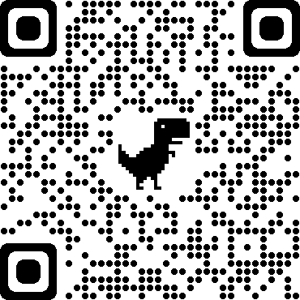
Thank you!
Questions?
Email: vshute@fsu.edu
Website:

Slide 40
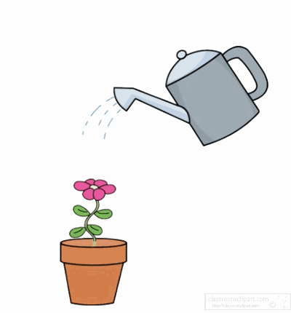
If we think of our children as plants... summative assessment of the plants is the process of simply measuring them. The measurements might be interesting to compare and analyze, but, in themselves, they do not affect the growth of the plants. On the other hand, formative assessment is the garden equivalent of feeding and watering the plants—directly affecting their growth.”
Clarke (2001, p. 2)

Slide 41




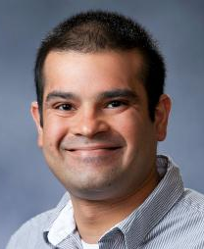








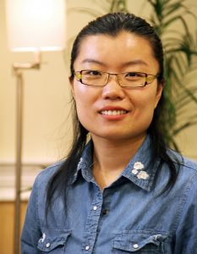



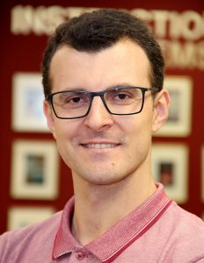


PI
Co-PI
Co-PI
Co-PI
Co-PI
Our Team!
SMEs
Former RAs, now Profs
RAs

Slide 42
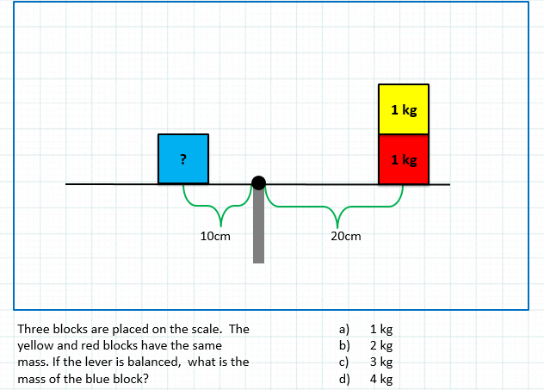
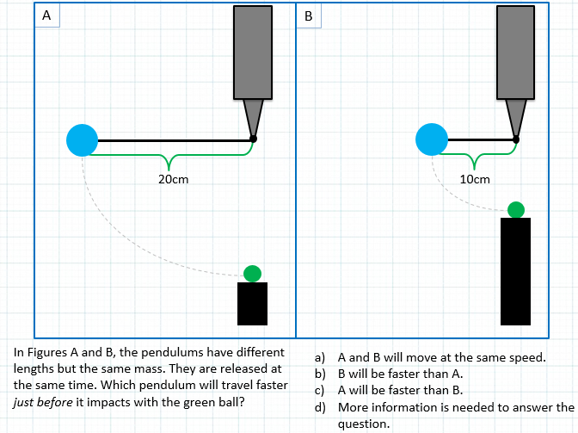
Physics Test (examples)
Get Back!
Notes:
Inspired by FCI (gold standard test of this content); 18 items per test (counterbalanced); 9 items each measured in duplicate

Slide 43
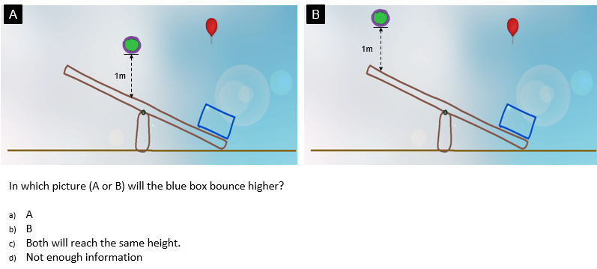
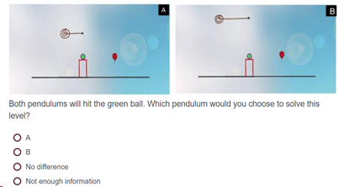
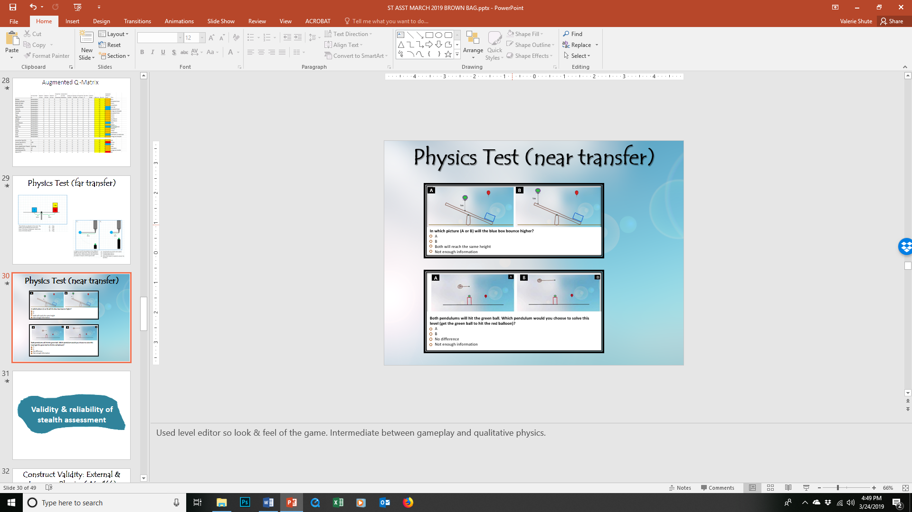
Physics Test (near transfer)
A
B
In which picture (A or B) will the blue box bounce higher?
A
B
Both will reach the same height
Not enough information
A
B
Both pendulums will hit the green ball. Which pendulum would you choose to solve this level (get the green ball to hit the red balloon)?
A
B
No difference
Not enough information
Notes:
Also developed a set of near-transfer items using the feel-of-the-game.

Slide 44
Start
PP Adaptivity Algorithm—Simplified
Level’s Topic +
Student’s PL
End of the Level
Yes
Easy Level + TM
Play the Easiest Level
End
PL < TM
No
No
Yes
Easy Level
Change Topic
Play that level
Yes
Any silver
level?
TM < PL < M
Yes
Yes
No
Yes
Topic Left?
Any unsolved level?
M < PL < H
Medium Level
No
No
No
check the proficiency level of the student on the concept at hand and give him/her an easy, medium, or difficult level until the student graduated from that concept (either there is no concept left or the students' proficiency level is greater than high).
PL > H
Yes
Difficult Level
No
Notes:
PL = proficiency level; TM = Twitch Mode; M = Medium; H = High
If under TM threshold, then, play an easy level + learning support (TM: if help needed (PL < .30), start next level with a forced physics video. ​
If greater than TM and less than medium threshold, then, play an easy level
If between medium and H PL, then, play a medium level
If greater than H PL, then play a difficult level
If no level from the topic (concept) at hand is left, then, change topic and play the easiest level in that topic
…

Slide 45
Physics Playground—4 Conditions
Concepts arrayed by difficulty. Within a concept, levels differed by difficulty (combined game mechanics and physics). All Ss completed tutorials for both Sketching and Manipulation types. About 10 levels for each of the 9 concepts.
  Linear (lockstep order): <N1L> Levels 1, 2, 3, … 10; <EcT> Levels 11, 12… 21; …
  Adaptive (based on BN estimates): <N1L> Levels 1, 4, 10; <EcT> Levels 11, 13, 18 ….
  Nonlinear: (free choice): <N1L> Level 1; <N3L> Level 80; <PoM> Level 35 …
  Control: pretest and posttest only (no game).
Newton’s 1st Law
Energy Can Transfer
Energy Can Dissipate
Properties of Momentum
Difficulty
Conservation of Momentum
Properties of Torque
Static Equilibrium
Newton’s 2nd Law
Newton’s 3rd Law
Notes:
Here are the 4 conditions of PP used in the study. Our physics experts arrayed concepts by difficulty.
In Adaptive, st asst checks proficiency level of student on concept at hand, and gives easy, medium, or difficult level relative to their current status until the student graduates from that concept (e.g., if concept prob of high > .70, move to next concept, if prob of low > .70, give physics support).

Slide 46
Learning
RQ2
Condition | Pretest M (SD) | Posttest M (SD)
Adaptive (n = 64) | 11.77 (3.4) | 12.23 (3.7)
Linear (n = 68) | 11.82 (3.4) | 12.41 (4.0)
Nonlinear (n = 67) | 11.88 (3.8) | 12.72 (3.9)
Control (n = 64) | 11.61 (3.6) | 11.60 (4.2)
Learning by Condition. ANCOVA with posttest as DV, condition as IV, and pretest as covariate showed no significant outcome differences by condition, holding pretest constant: F(2, 195) = 0.34; p = .71.
Gain = 0 .46
Gain = 0 .59
Gain = 0 .84
Gain = -0 .01

Slide 47
Learning Supports
RQ3
Favorite supports. Hints, physics videos, and worked examples.
Predicting learning. Regression: Posttest (DV), with pretest & all 8 support freqs in equation: Only pretest (β = .66) and Physics videos (β = .11) significantly predicted outcome: R² = .50; F (2, 198) = 97.6 (p < .001)
Dosage. Students who watched more Physics videos learned significantly more physics and did better in the game than those who watched fewer animations (for DV’s: posttest, levels completed, gold, and silver coins earned).
Supports don’t detract from fun. Students who watched more Physics videos reported higher levels of enjoyment than watching fewer. Enjoyment (β = .18, F(1, 193) = 6.23, p = .01).
Posttest (holding pre constant): (β = .11; t = 2.11, p = .04, R² = .50).
Levels completed (β = .43, F(1, 197) = 45.15, p < .001, R² = .18),
Gold coins earned (β = .35, F(1, 197) = 27.84, p < .001, R² = .12)
Silver coins earned (β = .31, F(1, 197) = 21.42, p < .001, R² = .10).
Notes:
NOTE: none of the other supports predicted outcomes besides physics videos!

Slide 48
Expected A Posteriori (EAP)
For every node in physics CM, there’s a triplet of current estimates: p(High), p(Medium), p(Low) with values summing to 1.
To get a single number from triplets, we can assign weights (e.g., +1 * p(H); 0 * p(M); -1 * p(L)) which reduces to p(H) – p(L).
EAPs range from -1 to +1 like correlations.
Get Back!

Slide 49
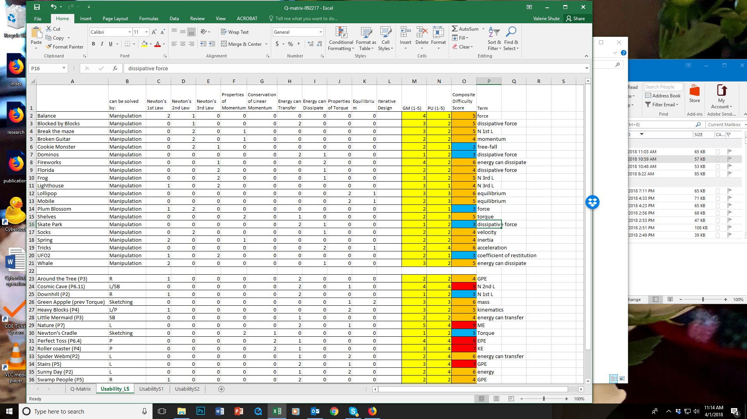
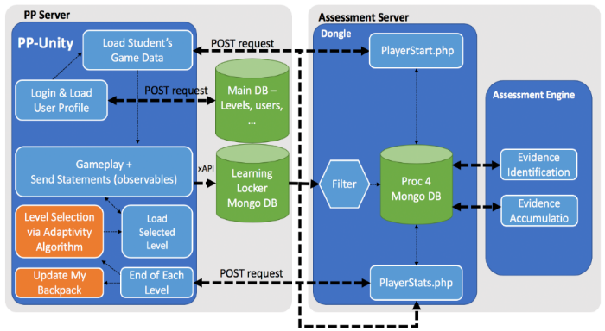
Augmented Q-Matrix → Bayes nets
Q-matrix: Set up relations among all levels (> 150), their targeted physics concept, difficulty, etc.
Indicators: Specify “indicators” (measurable behaviors in the game) per task type (sketching vs. manipulation)
Evidence Identification (EI): Establish rubrics to automatically score raw data per level from log files (e.g., number restarts, gold trophy <0/1>).
Cut Scores: Determine cut scores from frequency distributions of raw observables.
Evidence Accumulation (EA): For each indicator, create Low, Med, High levels to feed into Bayes net.
Generation of BNs. Used Almond’s Peanut suite of tools to generate BNs (https://pluto.coe.fsu.edu/RNetica).
(not expected to be viewable)
Notes:
So how do we get from the CM to actually scoring and estimating competency states in real time in the game? We started by setting up an augmented q-matrix (levels in the rows with 9 comps & difficulty as columns). [SEE SLIDE]

Slide 50
Augmented Q-Matrix
Get Back!

