Slide 1
The Question of Resource Exhaustion

Slide 2
Forecasts of Resource Exhaustion

Slide 3
Is the World Running out of Resources?
Economic growth and the technological advances that help to fuel it, have accelerated the use of many natural resources.
Population growth has also added to the rate of resource use.
Many fear that the world will soon run out of key resources.
What does economics have to say about the answer to this question?

Slide 4
Forecasts of Resource Exhaustion
Many doomsday forecasts have occurred through the years …
In 16th-century England, fear arose that the supply of wood – widely used for energy – would soon be exhausted.
Higher wood prices, however, encouraged conservation and led to the development of coal which dissipated the crisis.

Slide 5
Forecasts of Resource Exhaustion
America’s first oil crisis took place in the middle of the 18th century, when fear arose that the world would soon run out of whale oil, the primary source of artificial light.
Whale oil prices rose sharply, causing both consumers and suppliers to search for alternatives.
The crisis ended with the development of kerosene, which was first produced from coal and later from petroleum.
By the 1890s whale oil was a small fraction of its earlier price, but few still used it.

Slide 6
Forecasts of Resource Exhaustion
After people switched to petroleum, dire predictions about petroleum oil depletion soon arose.
In 1914 the Bureau of Mines reported the U.S. supply of oil was 6 million barrels -- less than 2 years of U.S. production.
In 1926 the Federal Oil Conservation Board announced that oil would be depleted in the U.S. within 7 years.
In 1939, the Interior Department predicted petroleum supplies in this nation would run out within 20 years.
In the 1972 report “The Limits of Growth,” the authors used large computer models to project that the world would run out of several key minerals in the 1980s and 1990s.

Slide 7
Why Have the Forecasts of Resource Crises Been Wrong?

Slide 8
Why Have the Forecasts of Resource Crises Been Wrong?
When resources are allocated by markets, increased scarcity leads to higher prices.
Higher prices strengthen the incentive for …
users to reduce their consumption,
suppliers to search for ways to expand future supply, and,
both producers and users to search for substitutes.
All of these adjustments will increase future supply relative to demand and make it highly unlikely that the resource will be actually depleted.

Slide 9
Why Have the Forecasts of Resource Crises Been Wrong?
Proved reserves have often been used by doomsday forecasters to calculate the future date when we exhaust a resource. But this is a misapplication of the concept.
Proved reserves are the verified quantity of a resource available given current prices and assuming today’s technology.
Proved reserves are quite different than the total quantity of the resource in the ground.
Proved reserves can be expanded with improvements in technology and will increase with higher prices.

Slide 10
Proved Reserves and Running Out of Resources

Slide 11
World Reserves and Cumulative Production, 1950-2015
For most mineral resources, while existing proved reserves are constantly being used, they are being amply replaced by the “proving” of new reserves from existing resources in the ground.
World Reserves and Cumulative Production (select minerals -- millions of metric tons)
Reserves 1950
Production 1950-2000
Reserves 2000
Reserves 2015
Mineral
Tin
6
11
10
4.8
Copper
100
339
340
720
Iron Ore
19,000
37,583
140,000
186,000
Lead
40
150
64
89
Zinc
70
266
190
200

Slide 12
Are Resources Becoming Less Abundant?

Slide 13
Resource Prices and Information About Scarcity
Resource price trends provide information about how a resource’s scarcity is changing.
If the scarcity of a resource is increasing relative to demand, the price of the resource will rise when it is allocated by markets.
The trend in the price of most mineral resources has been downward for at least a century, indicating that the relative scarcity of those resources has been declining.
A classic study by Barnett & Morse found the real price of resources fell during 1870-1963.
A recent study by Baumol & Blackman found a composite index of mineral prices declined from 185 in 1905 to 100 in 2000, a reduction in mineral prices, on average, of 46%.

Slide 14
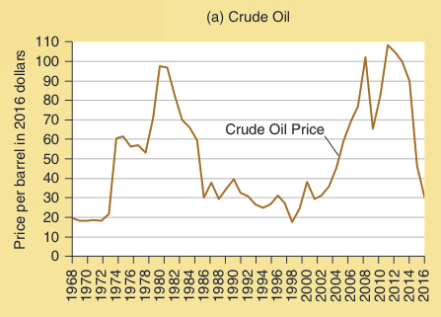
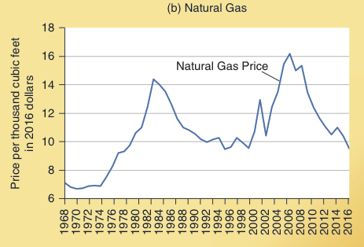
Real Crude Oil and Natural Gas Prices, 1949 to 2015
The real prices of crude oil and natural gas show a similar pattern of rising in the 1970s, falling in the 1980s & 1990s, and rising sharply again in the 2000s.
Recent technological innovations in fracking technology have greatly expanded natural gas reserves and production, resulting in natural gas prices declining sharply in recent years to by almost a third of the real 2008 price.

Slide 15
Renewable Resources

Slide 16
Property Rights and the Supply of Renewable Resources
Renewable resources are those that can be renewed in nature, like water flows, and those that can be grown, like timber.
When property rights are well defined and market forces used to allocate resources, the future supply of renewable resources like forests will be ample.
Several commentators have concerns about the future availability of forests.
Are forests disappearing?

Slide 17
Property Rights and the Supply of Renewable Resources
The United States has about the same amount of land today devoted to forest as it did in 1920 – and far more timber is growing on it.
A study by two natural resource economists (Roger Sedjo & Marion Clawson) found that timber volume in the temperate climates, including countries such as the U.S., former Soviet Union, and Canada, is growing rapidly.

Slide 18
Technology and Land Management
Innovation and improvements in technology make larger outputs possible from the base of renewable resources.
Indur Goklany has estimated that if agricultural technology had been frozen at 1961 levels, the 1998 level of food production would have required more than double the amount of land used today for farming.

Slide 19
Natural Resources When Markets Are Not Allowed to Function Fully

Slide 20
Absence of Property Rights
When property rights are poorly defined or regulations make a resource non-tradable, waste will result because the resource will often be directed toward less valuable uses.
Water supply problems often arise because water markets are missing or are incomplete.
The smoothly functioning market that might bring more effective cooperation among users & suppliers (buyers and sellers) is absent.
As we learn from the small (but increasing) number of water trades allowed, economists and thoughtful environmentalists are working to introduce more market trading to displace the environmentally destructive and high-cost alternatives when water shortages develop.

Slide 21
Questions for Thought:
If the world were about to run out of a highly-valued resource, what would happen to its price? How would this affect the future supply of the resource relative to demand?
“If China and India continue their economic expansion, the world cannot provide enough raw materials without terrible shortages worldwide.”
-- Evaluate this statement.

Slide 22
Questions for Thought:
3. Why have cotton fields retreated and forests returned in many areas of the southeastern United States? With fewer acres farmed, will the nation continue to be able to provide food and fiber for itself? Why or why not?
4. “Water is a necessity of life. It should not be bought and sold, or traded in markets!”
Use the economic way of thinking to evaluate this statement.

Slide 23
Questions for Thought:
5a. The data below indicate the proved world oil reserves, current rates of consumption, and estimated years until depletion for crude oil.
How many years do you think it will it be before the world runs out of oil?
See next slide for answer to the question.
Proved Crude Oil Reserves | Annual Rate of Consumption
531 billion barrels | 16.5 billion barrels per year

Slide 24
Questions for Thought:
5b. We expect that many of you answered 32 years. The data in the table on the previous slide were the actual forecast data from 1970.
If you thought the world was going to run out of oil in 32 years, how did that forecast work out?
The data from 2014 are shown below.
How did the (a) proven reserves and (b) the proven reserves divided by consumption in 2014 compare with the figures of 1970?
Proved Crude Oil Reserves | Annual Rate of Consumption
1.7 trillion barrels | 34 billion barrels per year

Slide 25
End of
Special Topic 10

