Slide 1
Earnings Differences Between Men and Women

Slide 2
Employment Discrimination and the Earnings of Women

Slide 3
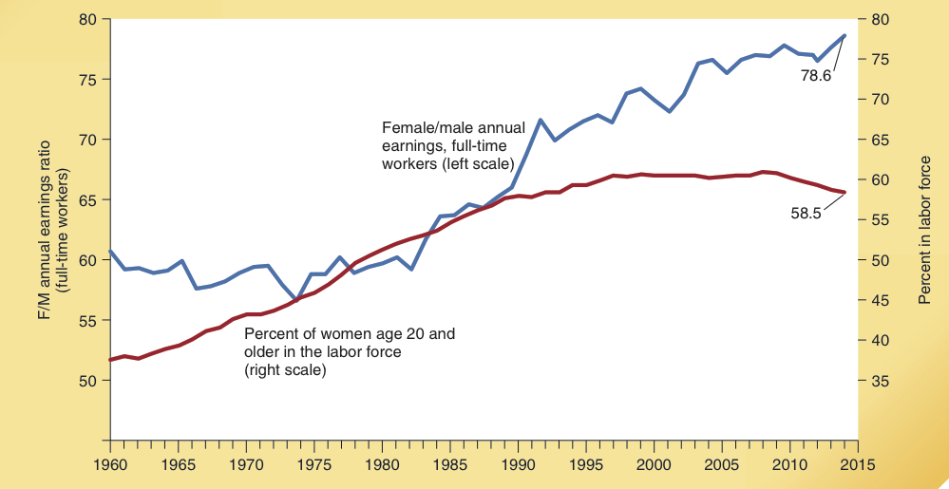
Employment Discrimination and Earnings of Women
The labor force participation rate of women has been increasing for several decades (right scale).
The earnings of women remained around 60 % that of men during the 1960’s and 1970’s (left scale).
Labor Force Experience of Women
Since 1980 the earnings of women have been rising relative to men.

Slide 4
Marital Status and the Earnings of Women

Slide 5
Marital Status and the Earnings of Women
Median Female/Male Annual Earnings Ratio (%) 2013-2014
The earnings of married female workers are about 66% those of married men. The earnings of single female workers are about 83% those of single men.
For full-time workers, the female-male earnings ratio is 93% for those never married and 73% for those who are married.
All workers:
Married
66 %
(spouse present)
Total
71 %
Never Married
83 %
Full-time, full-year workers:
Married
73 %
(spouse present)
Total
79 %
Never Married
93%

Slide 6
Earnings Differences
Possible sources of earnings differences between men and women:
Employment discrimination
Specialization of roles within the family has traditionally caused gender differences in educational choices and types of jobs held.
Women typically worked jobs …
with more flexible and shorter hours
within occupations where skills were transportable across employers.
Continuity of work force participation

Slide 7
The Changing Career Objectives of Women

Slide 8
Women Earning Professional Degrees
The career goals and educational choices of women have changed dramatically during the last 43 years.
Does this help explain the rising earnings of women relative to men since 1980?
What are the implications of this trend for the future earnings of women relative to men?
Women as a % of Persons Earning Selected Professional Degrees, Selected Years
Field of study
1970–71
1987–88
2012–13
Engineering
0.8
15.3
17.8
Dentistry
1.2
26.1
48.1
Optometry
2.4
34.3
63.4
Law
7.3
40.4
46.4
Veterinary medicine
7.8
50.0
77.3
Medicine
9.2
33.0
48.0
Business
9.1
56.7
48.0
Architecture
12.0
38.7
42.8
Pharmacy
25.2
59.7
61.6

Slide 9
Women as a Share of Persons Graduating from College: 1961-2015
Over the last 4 decades, the % of women as a share of new college graduates has increased dramatically. Today, almost three of every five graduating seniors are women.
Does this indicate that colleges discriminate against men?
What does it mean?
Female Share of College Graduating Classes
57 %
57 %
53 %
49 %
43 %
39 %
1961
1970
1980
1990
2000
2015

Slide 10
Implications for the Future

Slide 11
Implications for the Future
Women are increasingly acquiring schooling and training for professional occupations, indicating an increasing commitment to full-time work.
This will tend to increase the future earnings of women relative to men.

Slide 12
Questions for Thought:
1. During the last three decades, the labor force participation rate of married females has almost doubled. What impact has this influx of married workers into the labor force had on:
a. the average years of work experience of women relative to men,
b. the mean hours of work time of women relative to men, and,
c. the female/male earnings ratio?
2. Physical strength is important on some jobs. Do you think differences in physical strength between men & women contribute to earnings differences according to gender?

Slide 13
Questions for Thought:
3. In recent years, the median earnings of single men working full time, year round were only two thirds the income levels of married men working full time. Does this indicate that employment discrimination existed against single men and in favor of married men?

Slide 14
End of
Special Topic 8

