Slide 1
The Economics of Health Care

Slide 2
The Structure of the Health-Care Industry

Slide 3
Expenditures on Health Care
U.S. expenditures on health care have soared from 5.2% of GDP in 1960 to 8.9% in 1980 and 17.5% in 2014.
Medicare and Medicaid were established in the mid-1960s.
Medicare covers the bulk of the hospitalization expenditures of the elderly.
Medicaid covers health-care expenditures for those with low incomes.
Medicare and Medicaid spending have soared.
Even after adjusting for inflation, Medicare expenditures in 2014 were 13 times the figure for 1970.
Real Medicaid spending in 2014 was 15 times its 1970 level.

Slide 4
The Growth of Expenditures on Health Care, 1960-2014
Health-Care Expenditures as a % of GDP
(including both private and government)
17.3 %
17.5 %
Since 1960, health-care expenditures have grown to become a larger and larger share of the U.S. economy.
13.3 %
12.1 %
8.9 %
6.9 %
5.0 %
1960
1970
1980
1990
2000
2010
2014

Slide 5
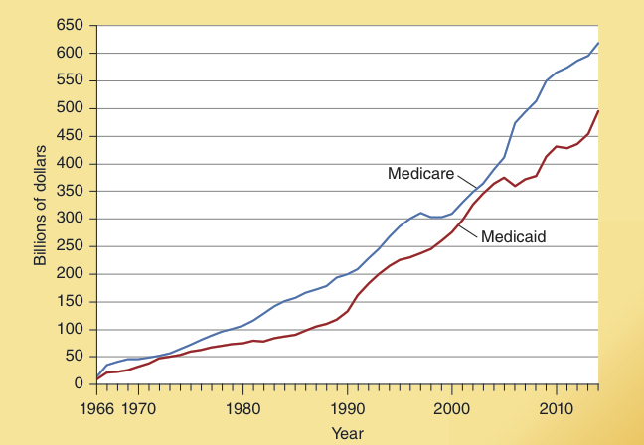
Real Expenditures on Medicare and Medicaid, 1966-2014
Real Expenditures on Medicare & Medicaid (billions of 2014 dollars)
As shown here, real expenditures on both Medicare & Medicaid have soared during the last several decades.

Slide 6
Socialized Health Care
In many countries, health care is a socialized industry.
Hospitals and medical clinics are run by the government and financed by taxes.
Doctors, nurses, and other medical personnel are government employees.
No country is wealthy enough to provide unlimited free health care to all.
When price plays a secondary role, non-price factors such as waiting lists and the absence of expensive treatments will be present.
Wealthy patients in countries with socialized medicine often travel to countries for treatment unavailable in their home country.

Slide 7
Structure of Health Care in the U.S
Both private and government operated enterprises are important in the U.S. health-care industry.
Physician services are generally provided privately;
Hospitals are often operated by local governments.

Slide 8
Structure of Health Care in the U.S
In 2014 87.2% of U.S. health-care spending is paid for by a third party, either the taxpayer or a private insurance company.
Medicare and Medicaid cover the bulk of the health-care cost of the elderly and the poor.
Health insurance is highly important for the non-elderly.
About two-thirds of the non-elderly have health insurance through their employer.

Slide 9
Structure of Health Care in the U.S
The U.S. tax system favors the purchase of health insurance through employers (health care benefits are not counted as income) and discriminates against both direct payment of medical expenses and the out-of-pocket purchase of medical insurance.
This discriminatory tax treatment …
encourages employees to demand and employers to provide low-deductible, small co-payment health insurance policies, and,
discourages direct payment of medical bills and the purchase of high-deductible insurance plans.

Slide 10
Third Party Payments and Health-Care Inflation

Slide 11
The Growth of Third-Party Medical Service Payments
Both the tax system and the Medicare and Medicaid programs have contributed to the growth of third-party payments.
In 2014, third-party payments accounted for 87.2% of the medical-care purchases, up from 44.8% in 1960.
Out-of-pocket spending of consumers accounted for only 12.8% of health-care spending in 2014, down from 55.2% in 1960.

Slide 12
Out-of-Pocket vs 3rd-Party Payments for Medical Care, 1960 and 2014
Out of pocket
Public 22.1%
12.8%
Out of pocket
Public 47.9%
Private health insurance 22.7%
55.2 %
Private health insurance 39.3%
1960
2014
The share of medical expenses covered by a 3rd party (either by insurance or the government) and the share paid directly by the consumer are shown here for both 1960 and 2014.
Note the growth of the third-party payments.

Slide 13
Subsidies, Third-Party Payments, and Health-Care Inflation
Economic theory indicates that the growth of subsidies to health-care consumers and expansion in third-party payments will push the prices and expenditures of medical services upward.
Growth of subsidies, like those provided by Medicare and Medicaid, will increase the demand for medical care.
The stronger demand will lead to higher prices, particularly if the supply is inelastic.

Slide 14
Subsidies, Third-Party Payments, and Health-Care Inflation
Growth of third-party payments reduces the incentive of both consumers and producers to economize.
Consumers have less incentive to economize because someone else is paying the bill.
Producers have less incentive to economize because consumers are insensitive to the prices charged.

Slide 15
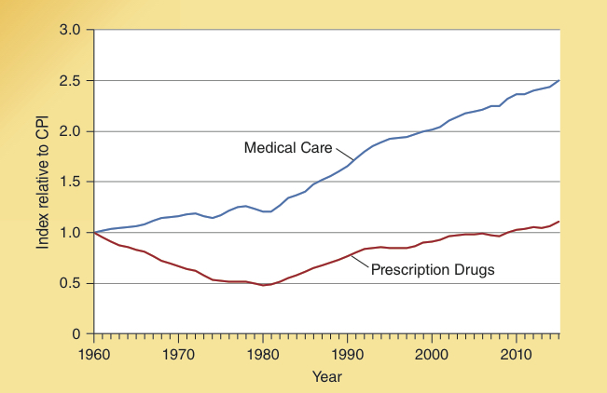
Ratio of Health-Care Price Indexes to the Consumer Price Index, 1960-2015
Ratio of Health-Care Price Index to CPI
Since 1960, the prices of medical services have risen more than twice as rapidly as the general price level.

Slide 16
Subsidies, Third-Party Payments, and Health-Care Inflation
In summary, both subsidies and third-party payments have pushed health-care prices upward.
The rising health-care prices and expenditures are not surprising. They are an outgrowth of the policies and changing incentive structure of the last five decades.

Slide 17
The Growth of the Elderly Population and Health Care

Slide 18
The Future
As more and more of the baby boom generation reaches 70 during the years following 2015, the elderly population of the U.S. will grow rapidly.
The growth of the elderly population during 2015 – 2035 will increase both subsidy levels and third party payments. Under the current structure, this will push both health-care prices and expenditures upward.

Slide 19
Growth in the U.S. Population Age 70 and Over: 2000-2040
Number of Americans Age 70 and Over (millions)
The U.S. population more than 70 years old will soar in the decades immediately ahead.
This factor will make it very difficult to control the growth of health-care prices and spending.
63.6
53.7
38.2
28.0
25.6
2000
2010
2020
2030
2040

Slide 20
What Accounts for the Poor Performance of the Health Care Industry?

Slide 21
Four Reasons for Poor Performance of the Health Care Industry
There are four major reasons for the poor performance of the health care industry:
Government programs promote a third-party payment system that erodes the incentive to economize.
The tax advantage provided for the purchase of health insurance through one’s employer undermines competition and makes it very costly for individuals or families to purchase a health insurance policy that fits their preferences.

Slide 22
Four Reasons for Poor Performance of the Health Care Industry
There are four major reasons for the poor performance of the health care industry: (continued…)
state regulations drive up cost by forcing insurers to cover numerous items such as in vitro fertilization, drug rehabilitation, marriage counseling, acupuncture, and massage therapy.
Federal regulations reduce competition by preventing consumers from purchasing a health insurance plan offered in another state

Slide 23
The Affordable Care Act: Major Provisions and the Expected Impact

Slide 24
Major Provisions of the Affordable Care Act
Everyone is required to purchase an approved health insurance policy. Tax penalties are imposed annually on those who do not comply.
In 2016, the tax penalty was $695 for individuals and up to three times that amount for families.
Employers with 50 or more employees are required to either provide approved health insurance or pay a $2,000 fine annually for each full-time equivalent employee.
This mandate does not apply to part-time employees – those working less than 30 hours per week.

Slide 25
Major Provisions of the Affordable Care Act
The act establishes health-care exchanges operated by either the state or federal governments and provides subsidies for the purchase of health care insurance for those with incomes up to 400% of the poverty level.
Those with incomes of 133% of the poverty level will be covered by Medicaid.
As income increases from 134% to 400% of the poverty level, the subsidy will be reduced by about 25% of additional earnings.
Insurers are required to cover children of policyholders up to age 26 and prohibited from charging higher rates or rejecting anyone because of a pre-existing health condition.

Slide 26
Major Implications of the Affordable Care Act
The act is highly complex and unpredictable secondary effects are likely. But the following 3 effects are predictable:
Part-time work will grow relative to full-time, because employers will not have to pay the $2,000 penalty if health insurance is not provided to employees working less than 30 hours per week.
Many employers with a high proportion of middle- and low-income employees will drop their health insurance because the heavily subsidized exchange plans will be more attractive to persons with incomes less than 250% of the poverty level. This response will increase the number receiving subsidies and drive up future cost.

Slide 27
Major Implications of the Affordable Care Act
When payroll and income taxes are combined with the phase-out of health insurance subsidies, the effective marginal tax rate of those making between 134% and 400% of the poverty level often soars to 50% or more.
Because many individuals in this income range get to keep less than half of an increase in earnings, their incentive to develop skills and take steps to move up the income ladder is substantially reduced.
Growth will slow, income mobility will decline, and the size of the underground economy will grow.

Slide 28
Impact of Affordable Care Act (ACA) on Health-Care Costs
The third-party payment system drives health care prices upward. If anything, the ACA will increase the share paid for by a third party, either an insurer or the government.
Mandating the purchase of more comprehensive plans will increase the demand for health-care services and the cost of health insurance.
The increased administrative requirements of the ACA has caused some doctors to retire earlier than planned, reducing the supply of health care services.
Summary: Within the framework of demand and supply, there is little reason to expect that the ACA will decrease either the price or cost of health-care services.

Slide 29
How Can the Performance of the Health Care Industry be Improved?

Slide 30
Health-Care Reform
There is considerable current pressure to modify and reform the ACA.
Economic analysis indicates the following reforms would improve performance and control the growth of health-care spending:
Equalize the tax treatment of out-of-pocket medical expenses and the direct purchase of health insurance with that of health insurance purchased through the employer.
Allow residents of each state to purchase health care from out-of-state providers.
Encourage health savings accounts (HSAs) and direct payment of medical bills from such accounts.

Slide 31
Health-Care Reform continued…
Encourage the purchase of catastrophic health insurance and discourage the purchase of policies with first-dollar coverage and small co-payments.
Place more emphasis on the supply side of the health-care market.
While the five proposals outlined here will not solve all of the health care problems, economic analysis suggests they are a major move in the right direction.

Slide 32
Questions for Thought:
Why have the prices of medical services risen so much more than other prices during the last several decades?
Does it make any difference whether medical services are paid for directly by consumers or by a third party such as the government or an insurance company?
-- Why or why not?
“Low deductible health insurance coverage encourages health-care consumers to search for the best prices for medical services.” -- Is this statement true or false?

Slide 33
Questions for Thought:
4. “If consumers do not have much incentive to shop for value per dollar of expenditures on medical services, producers will not have much incentive to keep prices low.” -- Is this statement true or false?
5. Currently, health insurance purchased through an employer is tax deductible (it is not counted as taxable income), while the direct purchase of health insurance and payment of medical expenses are generally not. Do you think this is sound policy? Why or why not?
6. When an employer provides health insurance benefits as part of the compensation package, does this represent a gift by employers to their employees? Why or why not?

Slide 34
End of
Special Topic 7

