Slide 1
Keynes and Hayek: Contrasting Views on Sound Economics and the Role of Government

Slide 2
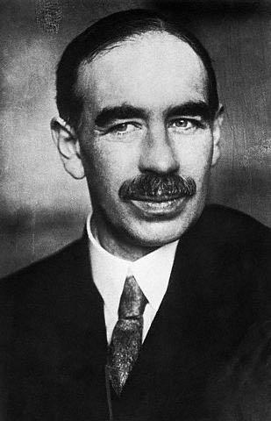
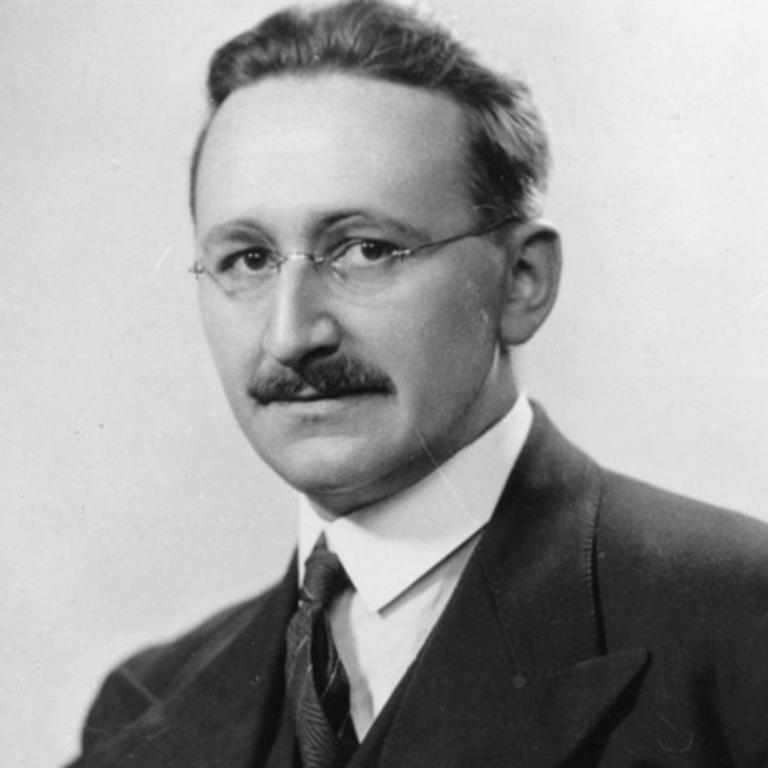
Keynes versus Hayek
John Maynard Keynes and Friedrich Hayek are two of the giants of the economics profession. This special topic compares and contrasts their views.
1883-1946
1899-1992

Slide 3
Keynes versus Hayek
John Maynard Keynes and Friedrich Hayek are two of the most important economists of the 20th century.
Their scholarly work represents alternative theories and ideas about the central issues of our day, including economic instability, central planning, and the operation of the political process.
In this special topic, the contrasting views of Keynes and Hayek will be generalized to highlight three of the most important debates in economics.

Slide 4
Keynes-Hayek Rap Videos
Keynes-Hayek rap videos:
Russell Roberts, a Professor of Economics at George Mason University and filmmaker John Papola developed two exciting rap videos that highlight the alternative views of Keynes and Hayek in an entertaining manner.
The lyrics of the initial video “Fear the Boom and Bust” highlight the alternative views of Hayek and Keynes on the business cycle. http://www.youtube.com/watch?v=d0nERTFo-Sk
The wildly popular initial rap led to a follow-up … “Fight of the Century: Keynes vs. Hayek Round Two” http://www.youtube.com/watch?v=GTQnarzmTOc

Slide 5
Great Debates in Economics: Keynes versus Hayek

Slide 6
Three Great Debates in Economics
Debate #1: What is the cause and cure for the business cycle?
Keynesians believe markets are inherently unstable, but prudent use of government fiscal policy can moderate the ups-and-downs of the business cycle.
Keynesians argue that government policy is an effective tool that will help maintain aggregate demand at a level consistent with full employment and thereby help promote economic stability.

Slide 7
Three Great Debates in Economics
Debate #1: What is the cause and cure for the business cycle?
In contrast, Hayekians believe the business cycle results from perverse government policies, particularly excessive credit expansion. Stability will be improved if policy makers merely pursued stable policies.
According to the Hayakian view, the primary source of economic instability is government intervention and that a more hands-off policy would result in more stability, investment, and long-term growth.

Slide 8
Three Great Debates in Economics
Debate #2: Should an economy be directed by government planning or decentralized individual planning and the invisible hand of market prices?
The Keynesian view holds that government intervention is needed not only to keep the macroeconomy on track but also to correct market failures and ensure an equitable distribution of income.
Keynesians are more likely to view potential market failures such as externalities, information problems, public goods and lack of competition as widespread and damaging to the overall economy.

Slide 9
Three Great Debates in Economics
Debate #2: continued…
Further, they believe that policy-makers will be able to selectively intervene in ways that will improve market outcomes. In Keynesian models, government is often portrayed as a benevolent social planner that can step in whenever market outcomes are less than ideal and implement an idealized correction.
In contrast, Hayekians argue that government planners do not have sufficient information to direct the economy and their efforts to do so will do more damage than good.
According to Hayekians, decentralized decision-making, directed by market prices, will be a more reliable method of directing resources into productive projects and away from ones that are counterproductive.

Slide 10
Three Great Debates in Economics
Debate #2: continued…
Moreover, dynamic competition provides decision-makers with a strong incentive to discover better ways of doing things, improve technologies, and institute practical innovations that will improve our lives.
According to Hayekians, the proper role of government is simply to provide the rule of law, enforce contracts, and protect property rights, leaving the rest to market forces.

Slide 11
Three Great Debates in Economics
Debate #3: Can democratic decision-making be counted on to allocate resources efficiently?
Keynesians argue that the job of the economist is to derive ideal solutions and once developed, political decision-makers can be expected to adopt them.
The Keynesian perspective seldom addresses the impact of incentives on the decision-making of voters, bureaucrats, and elected political officials. Instead, it is assumed that the job of the economists is to figure out the ideal or optimal solutions, and once these are developed, political decision-makers can be expected to adopt them.

Slide 12
Three Great Debates in Economics
Debate #3: continued
Many Keynesians charge that analysis of how government works is beyond the scope of economics.
Hayekians argue that incentives exert a major impact on how government works and that political incentives will often result in government failure and impede the adoption of sound policies.
Hayekians recognize that the political incentive structure often caters to well-organized interest groups and results in the adoption of shortsighted policies. Thus, they stress the importance of legal and political institutions that will provide both market participants and political decision-makers with incentives to engage in productive rather than counterproductive actions.

Slide 13
Conclusion
While there are many different schools of thought in economics, they can be grouped roughly into
(1) those that view market outcomes as often problematic and government interventions as effective and
(2) those that alternatively view market outcomes as generally efficient and government interventions as suffering from various shortcomings.
As a student of economics, it is important to develop an understanding of both of these perspectives and the foundations of the alternative views they represent.

Slide 14
Questions for Thought:
Summarize the views of Keynes and Hayek on the following:
(a) What is the cause and cure for the business cycle?
(b) Should an economy be directed by government central planning or decentralized individual planning and the invisible hand of market prices?
(c) Can democratic decision-making be counted on to allocate resources efficiently?

Slide 15
Questions for Thought:
2. In the main chorus of the Keynes-Hayek rap lyrics, Keynes states “I want to steer markets” and Hayek replies “I want them set free.”
These statements are referring to the tendency of …
(a) Keynesians to favor government intervention and central planning and Hayekians to favor free markets.
(b) Keynesians to favor restrictive fiscal policy and Hayekians to favor expansionary fiscal policy.
(c) Keynesians to favor budget deficits and Hayekians to insist on budget surpluses.

Slide 16
Questions for Thought:
3. “The man of system is apt to be very wise in his own conceit. He seems to imagine that he can arrange the different members of a great society with as much ease as the hand arranges the different pieces upon a chess-board; he does not consider that the pieces upon the chess-board have not another principle of motion besides that which the hand impresses upon them; but that, in the great chess-board of human society, every single piece has a principle of motion of its own, although different from that which the legislature might choose to impress upon it. If those two principles coincide and act in the same direction, the game of human society will go on easily and harmoniously, and is very likely to be happy and successful. If they are opposite or different, the game will go on miserably, and the society must be at all times in the highest degree of disorder.”
(a) State in your own words the central message of Smith in this quotation.
(b) Does this quote indicate that Smith was a Keynesian or Hayekian? Explain your response.

Slide 17
End of
Special Topic 4

