Slide 1
The Stock Market: Its Function, Performance, and Potential as an Investment Opportunity

Slide 2
The Economic Functions of the Stock Market

Slide 3
Stocks and Bonds
Stock
Stocks represent ownership of corporate businesses. Stock owners are entitled to the fraction of the firm’s future revenues represented by their ownership shares. If the business generates attractive future revenues, the stockholders will gain.
There is no assurance the business will be successful. If unsuccessful, the value of the firm’s stock will decline.
Equity is another term used for stock.

Slide 4
Stocks and Bonds
Bond
Bonds provide businesses, governments, and other organizations with a convenient way to borrow money. These organizations acquire funds from bond purchasers in exchange for the promise to pay interest and repay the entire principal (amount borrowed) at specified times in the future.
As long as the organization issuing the bond is solvent, the bondholder can count on the funds being repaid with interest.

Slide 5
The Economic Functions of the Stock Market
The stock market provides investors, including those who are not interested in participating directly in the operation of the firm, with an opportunity to own a fractional share of the firm’s future profits.
New stock issues are often an excellent way for firms to obtain funds for growth and product development.
Stock prices provide information about the quality of business decisions.

Slide 6
Stock Market Performance: The Historical Record

Slide 7
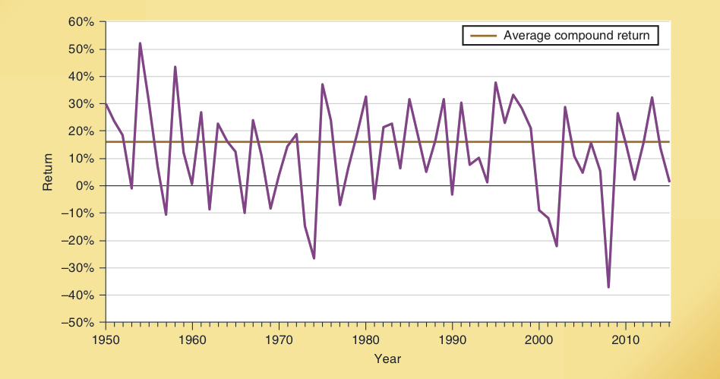
The Economics of the Stock Market
The stock market allows investors to participate in the risks and opportunities of corporate America.
Real returns for the past 2 centuries have averaged 7% per year.
During the last 65 years, the S&P 500 indicates investors earned a 10.6% compound annual rate of return.
Double-digit returns were earned during 40 of 65 years, while returns were negative during only 14.
S&P 500 Annual Return

Slide 8
The Interest Rate, the Value of Future Income, and Stock Prices

Slide 9
Stock Prices
Underlying the price of a firm’s stock is the present value of the firm’s expected future net earnings, or profit.
The value of a share depends on:
the expected size of future net earnings,
when these earnings will be achieved, and,
the interest rate by which the investor discounts the future income.

Slide 10
Stock Prices
The present value of a future income stream is dependent upon:
D – dividends (and gains from higher stock prices) earned during various future years (as indicated by the subscripts).
i – the discount or interest rate
It is calculated as:
D₁
D₂
D₃
. . . . .
D _{n}
+
+
+
+
(1 + i)
(1 + i)²
(1 + i)³
(1 + i) ^{n}

Slide 11
Long-Term Government Bond Rate
The nominal interest rate on the ten-year Treasury bond is shown here. Note that the rate rose gradually during the two decades following World War II and increased still more rapidly during the 1970s and early 1980s.
Since the early 1980s, it has trended downward and declined to less than 3 percent during 2012–2015. What is the expected impact of the recent low interest rates on stock prices?
Ten-Year Treasury Bond Interest Rate, 1900-2015

Slide 12
The Random Walk Theory of the Stock Market

Slide 13
Random Walk Theory
When considering the future of stock prices, many economists stress the implications of the random walk theory.
According to this theory:
current stock prices already reflect known information
future changes in stock prices are determined by surprise occurrences
therefore, no one can forecast future stock prices with any degree of precision

Slide 14
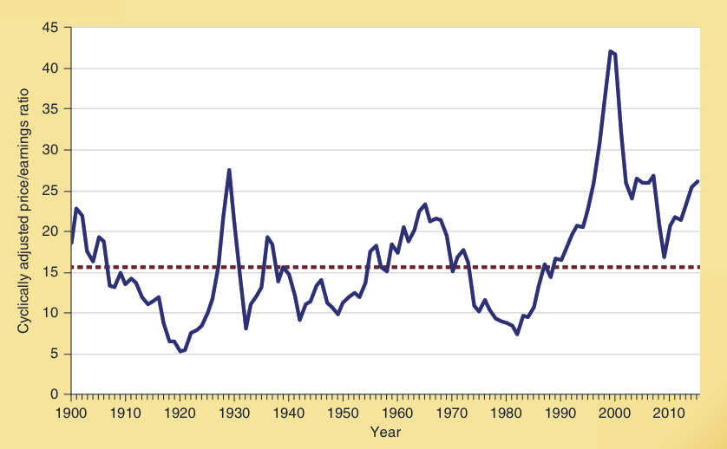
The Cyclically Adjusted Price to Earnings Ratio, 1900-2015
The cyclically adjusted price/earnings (CAPE) for the S&P 500 is shown here. This ratio is the stock price divided by the ten-year average of earnings adjusted for inflation.
It is an indicator of whether stock prices are high or low. Note that the ratio signaled that stock prices were exceedingly high in the late 1920s, late 1960s,
and late 1990s. Each of these periods was followed by a decline in the stock market.
Cyclically Adjusted Price to Earnings Ratio, 1900-2015
Similarly, the CAPE ratio indicated that stocks were relatively cheap during 1918–1923, 1932, 1942–1944, and 1978–1984. Each of these periods was followed by a substantial upward move in stock prices.

Slide 15
How the Ordinary Investor Can Beat the Experts

Slide 16
How the Ordinary Investor Can Beat the Experts
Savers invest in the stock market as a strategy to build wealth.
Investors that buy a diverse portfolio of shares and hold them over long periods of time, substantially reduce their risks.
Small investors can purchase stock in an equity mutual fund, a corporation that buys & holds shares of stock in many firms.
Equity mutual funds have reduced the risk of stock ownership and attracted large amounts of funds into the market.

Slide 17
Stocks are Less Risky When Held for a Lengthy Time Period
Highest and Lowest Period Annualized Total Real Return (%)
S&P 500 Index
This graphic highlights the best and worst annualized performance for each holding period from 1871 – 2015.
There is less risk of a low or negative return when a portfolio of S&P 500 stocks is held for a longer period of time.
47.2%
29.8%
13.8%
9.5%
2.7%
- 1.1%
- 16.7%
- 40.8%
1-year periods
5-year periods
20-year periods
35-year periods

Slide 18
The Advantages of Indexed Mutual Funds
A managed equity mutual fund is one with a portfolio manager who tries to pick stocks that maximize the fund’s rate of return.
An indexed equity mutual fund holds a portfolio of stocks that matches their share in a broad index like the S&P 500.
Indexed mutual funds have substantially lower operating costs than managed funds as they engage in less trading and have no need for either a market expert or research staff.
Historically, indexed funds have outperformed managed funds.

Slide 19
Should You Invest in a Fund Because of its Past Performance?
Should you invest in a fund because of its past performance?
No.
Past performance is not a reliable indicator of future performance.
Why?
Some of the mutual funds with above-average returns during a period were merely lucky.
A strategy that works well in one environment (inflationary conditions, for example) is often disastrous when conditions change.

Slide 20
Questions for Thought:
1. A friend who just inherited $50,000 asks for your advice about how to invest it in the stock market for her retirement (in 30 yrs). Is the stock market a good place for her funds? What do you think is the best plan for her to attain a high rate of return at a relatively low risk? Explain.
2. What is the random walk theory of stock prices? What does it imply about the ability of the “experts” to select stocks that will increase in price and avoid those that will decline in price.

Slide 21
Questions for Thought:
Many personal finance magazines such as Money and Smart Money routinely give advice as to which stocks to buy. -- Should you take their advice?
The Cyclically Adjusted Price Earnings (CAPE) ratio at year end 2015 was at its third highest level in more than 100 years. See graphic above. Does this mean that a correction leading to lower stock prices is imminent? Why or why not? If interest rates rise, how will this influence the likelihood of a correction?

Slide 22
End of
Special Topic 3

