Slide 1
Income Inequality and Poverty

Slide 2
How Much Income Inequality Exists in the United States?

Slide 3
Share of Money Income by Quintile, 1970-2011/2014
During the last four decades, the share of income earned by the top quintile has steadily risen, whereas that earned by the lowest has fallen.
In 2014, the top quintile of families earned slightly more than 13 times as much before tax money income as the bottom quintile of families.
After taxes and transfers the top quintile of households earns slightly more than 7 times the bottom quintile.
–––– Share of Money Income, by Quintile ––––
Before Taxes (1970 & 2014)
After Taxes & Transfers
(2011)
48.9
50.6
46.6
40.9
23.8
23.2
20.4
21.0
17.6
15.1
14.2
15.2
12.2
9.2
10.9
5.4
9.6
3.6
5.3
6.3
Lowest Quintile
Second Quintile
Third Quintile
Fourth Quintile
Highest Quartile
Lowest Quintile
Second Quintile
Third Quintile
Fourth Quintile
Highest Quartile
1970
2014
Before
After

Slide 4
Factors that Influence Distribution of Income
A high portion of annual income inequality is due to differences in:
age,
education,
family size,
marital status,
number of earners in the family, and,
time worked.
Young, inexperienced workers, students, single-parent families, and retirees are over-represented among those with low incomes.

Slide 5
High and Low Income Families, 2014
Bottom 20% of income recipients
Top 20% of income recipients
Education of householder
Percent with less than high school
26
2
Percent with college degree or more
12
65
Age of householder (percent distribution)
under 35
32
11
35 - 64
47
75
65 and over
21
14
Family status
Married-couple family (% of total)
45
94
Single-parent family (% of total)
55
6
Persons per family
3.1
3.4
Earners per family
0.7
2.1
% of married-couple families in which wife works full-time
9
63
Share of total work hours supplied by group
6
33
Source: http://www.census.gov and author calculations from the March 2015 Current Population Survey.

Slide 6
Why Has Income Inequality Increased?
Income inequality in the U.S. has increased due to the growth of:
both single-parent and dual-earner families (as a share of the total),
earnings differentials on the basis of skill and education,
the number of “winner-take-all” markets, and,
lower marginal income tax rates inducing high earners to report more income.

Slide 7
Income Mobility and Inequality in Economic Status

Slide 8
Income Mobility
Annual income data hide the movement of people up and down the income distribution over time.
Tracking of household income over time shows there is considerable movement both up and down the income spectrum.

Slide 9
Income Mobility: 1987-2007
This table allows us to see how families in each income bracket in the U.S. fared 20 years later.
51.6% of those in the top quintile had fallen to a lower quintile by 2007.
Similarly, 57.7% of those in the bottom quintile in 1987 had moved up the income ladder by 2007.
Do you think there is substantial income mobility in the U.S.?
% Distribution by Income Status of Family in 2007
Next highest quintile
Next lowest quintile
Highest quintile
Middle quintile
Lowest quintile
Highest quintile
48.4
23.3
13.5
7.5
7.3
Next highest quintile
24.4
29.1
20.7
15.0
10.7
% Distribution by Income Status of Family in 1987
19.8
Middle quintile
14.0
25.2
26.0
15.0
Next lowest quintile
7.8
15.5
23.4
28.5
24.7
Lowest quintile
5.4
6.9
16.4
29.2
42.3

Slide 10
Questions for Thought:
Do you think there is too much income inequality in the United States? Why or why not?
Indicate three factors that have contributed to an increase in income inequality in the United States since the mid-1970s.
3. (Which of the following is true?) Data on income inequality in the U.S. indicate
(a) The “rich” stay rich and the “poor” stay poor.
(b) there is substantial movement among income groupings in the United States.

Slide 11
Poverty in the United States

Slide 12
Changing Composition of the Poor
1959
1976
2014
Number of poor families (millions)
8.3
5.3
9.5
Percent of poor families headed by a:
Female
23
48
50
Black
26
30
24
22
14
Elderly person (aged 65+)
11
Person who worked at least some during the year
70
55
43
Poverty rate (%)
All families
18.5
10.1
11.6
Married-couple families
15.8
7.2
6.2
Female-headed families
42.6
32.5
30.6
All individuals
22.4
11.7
14.8
Whites
18.1
9.1
12.7
Blacks
55.1
31.1
26.2
Children (under age 18)
27.3
16.0
21.1
Sources: U.S. Dept. of Commerce, Characteristics of the Population Below the Poverty Line: 1982, Table 5; and http://www.census.gov.

Slide 13
Transfer Payments and the Poverty Rate
Income transfers have expanded substantially since the mid-1960s.
These transfers have been largely ineffective at reducing the poverty rate.
Though real per capita income has increased substantially over time (more than 120% since 1965), the poverty rate of working-age Americans has stayed about the same.

Slide 14
Poverty Rate, 1947-2014
The official poverty rate of U.S. families declined sharply during the 1950’s and 1960’s.
Since 1968, the official poverty rate has fluctuated within a range generally between 9 percent and 12 percent.
In 2014, it was 11.6 percent—slightly higher than in 1968.
U.S. Poverty Rate (%) (all families)
32.0
18.5
13.9
10.3
10.7
11.6
10.0
9.7
8.7
1947
1959
1965
1968
1975
1980
1990
2000
2014
Sources: U.S. Dept. of Commerce, Characteristics of the Population Below the Poverty Level: 1982, Table 5; and http://www.census.gov .

Slide 15
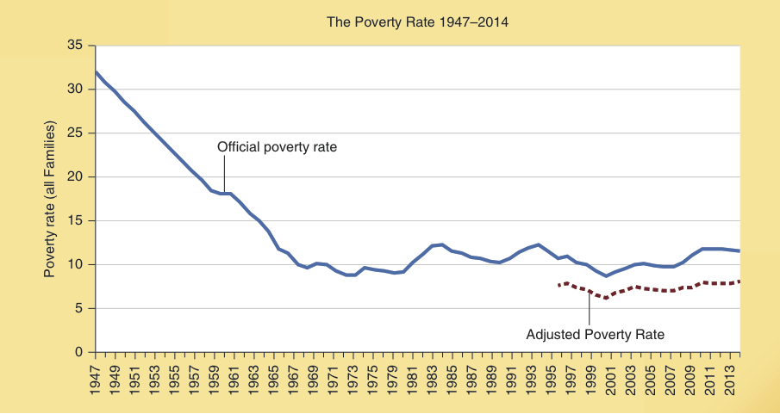
Poverty Rate, 1947-2014
The blue line indicates the official poverty rate of families during 1947-2014.
The red-dashed line indicates the drop in the poverty rate when taxes, in kind transfer benefits, and health insurance benefits provided by
benefits provided by employers are counted as income.
The adjusted poverty rate was between 7 percent and 8 percent throughout most of 1995–2014. On average, the adjusted rate was 3 percentage points lower than the official rate.
Sources: U.S. Dept. of Commerce, Characteristics of the Population Below the Poverty Level: 1982, Table 5; and http://www.census.gov .

Slide 16
Why Haven’t Anti-Poverty
Programs Been More Effective?
Anti-poverty transfers generate three unintended secondary effects that slow progress against poverty.
Income-linked transfers reduce the incentive of low-income individuals to earn, develop their skills, move up the job ladder, and escape poverty.
When poor families qualify for multiple programs, implicit marginal tax rates of 50, 60, 70 percent, and higher are not unusual.
Income transfers to the poor tend to reduce the opportunity cost of choices that lead to poverty.
Thus, the use transfers to reduce the hardship of poverty and discouraging behavior that leads to poverty are in conflict. This is called the Samaritan’s dilemma.

Slide 17
Why Haven’t Anti-Poverty
Programs Been More Effective?
Anti-poverty transfers generate three unintended secondary effects that slow progress against poverty.
Government antipoverty transfers crowd out private charitable efforts.
When people perceive that the government is providing for the poor, action by families, churches, and civic organizations becomes less urgent.

Slide 18
Implicit Marginal Tax Rates and the Incentive to Work and Earn
Here you see the CBO figures for the implicit marginal tax rate confronted by a single-parent family with one child in 2016 as earnings increase up to $70,000. The implicit marginal tax rate reflects both the additional taxes paid and loss of benefits as earnings increase.
Between $20,000 and $30,000, the implicit marginal tax rate is 72 percent.
For earnings between $30,000
Implicit Marginal Tax Rate on Earnings:
Single-Parent Family with One Child
and $40,000, the implicit rate was even higher, 77 percent. Thus, in this range, the family gets to keep only 23 percent of an additional $10,000 of earnings.
These high implicit marginal tax rates make it more difficult for families below and near the poverty level to move up the job ladder and escape poverty.
Source: Congressional Budget Office, Effective Marginal Tax Rates for Low- and Moderate-Income Workers in 2016, November 2015. The implicit marginal tax rates are derived for $10,000 incremental increases in earnings.

Slide 19
Income Inequality: Some Concluding Thoughts

Slide 20
Transfers and the Gains of Recipients
To non-economists, income transfers look like an easy way to help targeted beneficiaries. However, economic analysis indicates that it is actually quite difficult to transfer income to a group of recipients in a way that will improve their long-term well-being.
Governments must establish a criteria for receipt of transfers. Without a criteria, benefit programs would exhaust the budget.

Slide 21
Transfers and the Gains of Recipients
Typically governments require one of the following four criteria: recipients are required to do something, own something, buy something, or be something.
Meeting these qualifying criteria erodes much of the benefits.

Slide 22
Why Meeting the Four Criteria Erodes the Net Gain of Recipients
When beneficiaries have to do something (e.g. wait in line, fill out forms, lobby government officials, take an exam, endure delays, or contribute to selected political campaigns) in order to qualify for a transfer, much of their potential gain will be eroded.
When beneficiaries have to own something in order to get a subsidy, people will bid up the price of the asset needed to acquire the subsidy.

Slide 23
Why Meeting the Four Criteria Erodes the Net Gain of Recipients
When beneficiaries have to purchase something (e.g. health insurance or college education) in order to get the transfer, the transfer will increase the demand and drive up the price, eroding the net gain of the beneficiaries.
When beneficiaries have to be something (e.g. poor, unemployed, a farmer, homeowner in a flood prone area) it will increase the occurrence of the adverse event, thereby reducing their wellbeing.

Slide 24
Income Inequality
Positive economics cannot determine how much inequality should be present.
Income inequality reflects differences between individuals and influences their incentive to develop resources and engage in productive activities.
The nature of the process, as well as the pattern of income distribution, is relevant to the issue of fairness.

Slide 25
Questions for Thought:
What is the poverty threshold income level? How is it measured? Is the threshold adjusted for family size? Is it adjusted for inflation?
What impact did the expansion in government income transfers during the 1960s have on the poverty rate? Was the War on Poverty successful? Why or why not?
Why will the net gain of the beneficiaries generally be less, and often substantially less, than the transfers they receive?

Slide 26
Questions for Thought:
4. What determines whether a distribution of income is fair? Do you think that the major income transfer programs of the U.S. are fair? Why or why not?
5. The outcome of a state lottery game is certainly a very unequal distribution of the prize. Some players are made very rich while other lose their money. Is this outcome fair? Is the process fair? Discuss.

Slide 27
Questions for Thought:
6. In recent years, the grant and subsidized loan programs directed toward college students have expanded substantially. Have these programs enhanced the well-being of college students? Have college students gained as much as the spending on the programs? Why or why not?

Slide 28
End of
Chapter 28

