Slide 1
Investment, the Capital Market, and the Wealth of Nations

Slide 2
Why People Invest

Slide 3
Capital and Investment
Types of capital:
  physical capital
  human capital
Investment:
the purchase or development of a capital resource
Savings:
income not spent on current consumption

Slide 4
Savings and Investment
Investment and savings are closely linked:
  Savings is income minus consumption.
  Investment is the use of unconsumed income to produce a capital resource.
  Saving is required for investment
  – someone must save in order to free resources
  for investment.

Slide 5
Investment and Consumption
Often, more consumption goods can be produced by:
  using scarce resources to produce more
  physical & human capital today, and,
  then use this capital to produce more
  consumption goods in the future.
Consumption in the future is valued less than consumption now because people have a positive rate
of time preference – they prefer to consume goods and services sooner rather than later.

Slide 6
Interest Rates

Slide 7
Interest Rate
The interest rate is the price of earlier availability
of goods and services.
It is the premium that borrowers must pay lenders in order to acquire purchasing power now rather than later.
  These funds may be used for either consumption
  or investment.

Slide 8
Determination of Interest Rates
Interest rates are determined by the supply and demand
for loanable funds.
The demand for loanable funds comes from:
  productivity of capital resources
  – investment demand
  positive rate of time preference
  – consumers’ desire for earlier availability
Interest rewards lenders who curtail current consumption
(supply loanable funds) so others can buy now rather than later.
The market interest rate brings the quantity of funds demanded by borrowers into balance with the quantity supplied by lenders.

Slide 9
Determination of the Interest Rate
The demand for loanable funds stems from consumers’ desire for earlier availability and the productivity of capital.
As the interest rate rises, current goods become more expensive in comparison with future goods.
  Therefore, borrowers will
  demand fewer loanable funds.
On the other hand, higher interest rates stimulate lenders to supply additional funds to the market.
In equilibrium, the quantity of loanable funds demanded equals the quantity supplied.
The “price” is the interest rate i.
Interest Rate
S
i
D
Q
Quantity

Slide 10
Money Rate vs. Real Rate
During inflation, the nominal interest rate (money interest rate) is a misleading indicator of the true cost
of borrowing.
  The money interest rate will include an inflationary premium reflecting the expected rate of inflation.
  The real rate of interest is the money interest rate minus the inflationary premium.
    The real interest rate is a far better measure of
    the true cost of borrowing.

Slide 11
Interest Rates and Risk
More than one interest rate exists in the loanable funds market.
  Examples:
    mortgage rate
    credit card rate
    short-term loan rate
  Riskier loans will have higher interest rates.
  Long-term loans are generally riskier.

Slide 12
Components of the Money Interest Rate
The money interest rate reflects 3 components:
  Risk Premium:
    reflects probability of default
    large when the probability of borrower default is substantial
  Inflationary Premium:
  reflects expectations that loan will be paid back with dollars of less purchasing power
  large when decision makers expect a high rate of inflation during the period in which the loan is outstanding
Pure rate of interest:
  price of earlier availability
Risk Premium
Inflationary
Premium
Pure
Interest

Slide 13
The Present Value of
Future Income and Costs

Slide 14
Present Value
The interest rate connects the value of dollars today with the value of dollars in the future.
The present value (PV) of a single payment to be received
one year from now is:
Receipts 1 year from now
PV
=
interest rate + 1
where i = 6 %
PV
$ 100
$ 100
=
=
=
$ 94.34
1 + .06
1.06

Slide 15
Present Value n Years in the Future
The present value (PV) of a single payment to be received
n years from now is:
The present value of a future payment is inversely related to:
  the interest rate, and,
  how far in the future the payment will be received.
Receipts n year from now
PV
=
(interest rate + 1) ^{n}
where i = 6 % and n = 2
PV
$ 100
$ 100
=
=
=
$ 89.00
(1 + .06) ²
(1.06 ) ²

Slide 16
Present Value of Stream of Payments
The present value (PV) of a stream of payments
(each of nominal magnitude R) to be received each
year for n years is:
R₁
R₂
R₃
. . . . .
R _{n}
PV
+
+
+
+
=
(1 + i)
(1 + i)²
(1 + i)³
(1 + i) ^{n}
where i = 6 % and n = 3 and R = $100
$100
$100
$100
PV
=
=
+
+
$ 267.30
(1.06)
(1.06)²
(1.06)³

Slide 17
Present Value
Present Value of $100 to be Received n Years
in the Future at Interest Rates r
The columns indicate the present value of $100 to be received n years in the future at different interest rates r.
Note that the present value of $100 declines as either the interest rate or the number of years in the future increases.
n
2%
6%
12%
20%
1
$ 98.04
$ 94.34
$ 89.29
$ 83.33
2
$ 96.12
$ 89.00
$ 79.72
$ 69.44
3
$ 94.23
$ 83.96
$ 71.18
$ 57.87
4
$ 92.39
$ 79.21
$ 63.55
$ 48.23
5
$ 90.57
$ 74.73
$ 56.74
$ 40.19
10
$ 82.03
$ 55.84
$ 32.20
$ 16.15
15
$ 74.30
$ 41.73
$ 18.27
$ 6.49
20
$ 67.30
$ 31.18
$ 10.37
$ 2.61
30
$ 55.21
$ 17.41
$ 3.34
$ 0.42
50
$ 37.15
$ 5.43
$ 0.35
$ 0.01

Slide 18
Questions for Thought:
Why are investors willing to pay interest to acquire loanable funds? Why are lenders willing to loan these funds?
If the current interest rate is 8%, what is the present value of three $1,000 payments to be received at the end of each of the next 3 years? Would the present value increase or decrease if the interest rate were higher, say 10%?
A lender made the following statement to a borrower,
"You are borrowing $1,000, which is to be repaid in 12
monthly installments of $100 each. Your total interest
charge is $200, which means your interest rate is 20%."
– Is the effective interest rate on the loan really 20%?

Slide 19
Questions for Thought:
4. The interest rate charged on outstanding credit card balances is generally higher than the interest rate that banks charge customers with a good credit rating. Why?
Should the government impose an interest rate ceiling of,
for example, 10%? If it did, who would be hurt and who would be helped? Discuss.

Slide 20
Present Value,
Profitability, and Investment

Slide 21
Discounted Present Value
Discounted PV of $100,000 Truck Rental for 4 Years
(interest Rate = 8 Percent)
Expected future income
(received at years-end)
Discounted value
(8% rate)
Present value
of income stream
Year
1
$ 30,000
0.926
$ 27,780
2
$ 30,000
0.857
$ 25,710
3
$ 30,000
0.794
$ 23,820
4
$ 30,000
0.735
$ 22,050
$ 99,360
Suppose a truck rental firm is considering the purchase of a $100,000 truck. Experience dictates that the firm can rent out the truck for net revenues of $30,000 per year. The truck has an expected life of 4 years (it then has $0 value).
As the firm can borrow and lend the funds at an interest rate of 8 %, we discount the future expected income at 8%. How much is this 4 year stream of income worth today?
Because the present value of the future income stream is less than the cost of the endeavor ($99,360 < $100,000), the project should not be undertaken.

Slide 22
Expected Future Earnings
and Asset Value
The current value of an asset is determined by the
present value of its expected future net earnings.
An increase (decline) in the expected future earnings derived from an asset will increase (reduce) market value of that asset.

Slide 23
Investing in Human Capital

Slide 24
Investing in Human Capital
Consider the human-capital investment decision facing Juanita, an 18-year old who
just finished high-school.
We have graphed Juanita’s expected earnings both with …
Earnings
w/ college
Annual
earnings
or costs
and without college.
Earnings
w/o college
Should Juanita attend college?
C_{o}
If Juanita chooses to attend college, she will incur both
the direct cost of a college education (tuition, books, etc) C_{d} and …
$ 0
C_{d}
Age
the opportunity cost of earnings forgone while in college C_{o} .
18
22
65

Slide 25
Investing in Human Capital
With a college education, though, Juanita can expect higher future earnings during her career (area B)
– even though they may begin lower, they end higher.
If the discounted present value of the additional
future earnings exceeds
the discounted value
of the direct and indirect costs of the college education, then the college degree will be a profitable investment for Juanita.
Earnings
w/ college
Annual
earnings
or costs
B
Earnings
w/o college
C_{o}
$ 0
C_{d}
Age
18
22
65

Slide 26
Uncertainty, Entrepreneurship, and Profit

Slide 27
Economic Profit
Economic profit plays a central role in the allocation
of capital and the determination of which investment projects will be undertaken.
In a competitive environment, profit reflects:
  uncertainty, and,
  entrepreneurship
  – the ability to recognize and undertake profitable
  projects that have gone unnoticed by others.

Slide 28
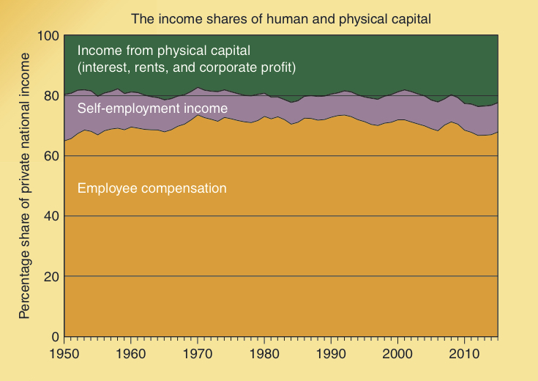
Income Shares of
Human & Physical Capital
Employee compensation
and self-employment income primarily represent returns
to human capital.
These two components have comprised approximately 80% of total national income in the U.S. for several decades.
Note that the share going to physical capital rose to 22% during 2011 and 2012, while the share of human capital fell to 78%.
At this point it is uncertain whether this recent larger earnings share of physical capital is a temporary fluctuation or reflective of a longer-term trend.

Slide 29
Why Is the Capital Market
So Important?

Slide 30
Keys to Prosperity:
Innovation and the Capital Market
If the potential gains from innovative ideas and human ingenuity are going to be fully realized, it must be relatively easy for individuals to try their
innovative and potentially ingenious ideas, but difficult to continue if the idea is a bad one.

Slide 31
Capital Market and the Wealth of Nations
To grow and prosper, a nation must have a mechanism that attracts savings and channels it into investment projects that create wealth.
  The capital market performs this function in a market economy.
  When property rights are defined and securely enforced, productive investments will also be profitable.
Without a capital market there is no mechanism that can be counted to consistently channel resources into wealth creating projects.

Slide 32
Political Allocation and the Structure of Incentives
When investment funds are allocated by government, rather than the market, an entirely different set of incentives comes into play.
Political influence rather than market returns will decide which projects will be undertaken.
Businesses will use contributions, lobbying, and other resources to attract favors from government.
  In turn, politicians use subsidies, tax breaks, and “bail outs” to help those most willing to provide them with political support.

Slide 33
Political Allocation and the Structure of Incentives
Profits and losses direct investors toward productive projects and away from those that are counterproductive.
The political process does not have anything similar to profit and loss that can be counted on to direct funds toward wealth creation.
As a result, the political process will lead to the inefficient allocation of capital.

Slide 34
Questions for Thought:
How are human‑ and physical‑capital investment decisions similar? How do they differ? Do human‑capital investors make profits? If so, what is the source of the profit?
In a market economy, investors have a strong incentive to undertake profitable investments. What makes an investment profitable? Do profitable investments create wealth? Why or why not?
How does the structure of incentives differ when capital is allocated politically rather than by markets? How will this affect the efficient use of capital?

Slide 35
Questions for Thought:
When entrepreneurs are investing their own money, how do they decide which projects they should undertake? When political decision-makers allocate the funds of others (taxpayers), how do they decide which projects to support? Explain.
Would investment funds be channeled more consistently into productive projects if elected political officials played a greater role in the allocation of capital? Why or why not?

Slide 36
End of
Chapter 27

