Slide 1
International Finance and the Foreign Exchange Market

Slide 2
Foreign Exchange Market

Slide 3
Foreign Exchange Market
Foreign Exchange market: Market where different currencies are traded, one for another.
The exchange rate enables people in one country to translate the prices of foreign goods into units of their own currency.
An appreciation of a nation’s currency will make foreign goods cheaper.
A depreciation of a nation’s currency will make foreign goods more expensive.

Slide 4
Foreign Exchange Rates, 2000-2016
U.S. Cents Price for Foreign Currency
103.8
.846
124.09
74.69
127.1
ª 2016 figures are as of December 15, 2016.

Slide 5
Determinants of the Exchange Rate

Slide 6
Determinants of the Exchange Rate
Under a flexible rate system, the exchange rate is determined by supply and demand.
The dollar demand for foreign exchange originates from U.S. purchases for foreign goods, services, and assets (real and financial).
The supply of foreign exchange originates from sales of goods, services, and assets from Americans to foreigners.
The foreign exchange market brings the quantity demanded and quantity supplied into balance.
Also brings the purchases of Americans from foreigners into equality with the sales of Americans to foreigners.

Slide 7
Foreign Exchange Market Equilibrium
The dollar price of the English pound is measured on the vertical axis. The horizontal axis indicates the flow of pounds in exchange for dollars.
The demand and supply of pounds are in equilibrium at the exchange rate of $1.50 = 1 English pound.
At this price, quantity demanded equals quantity supplied.
A higher price of pounds (like $1.80 = 1 pound), leads to an excess supply of pounds ...
Dollar price of foreign exchange (for pounds)
S_{(sales to} _{foreigners)}
Excess supply of pounds
$1.80
$1.50
c
Excess demand for pounds
causing the dollar price of the pound to fall (depreciate).
$1.20
D_{(purchases from} _{foreigners)}
A lower price of pounds (like $1.20 = 1 pound), leads to an excess demand for pounds …
Quantity of
foreign exchange (pounds)
causing the dollar price of pounds to rise (appreciate).
Q

Slide 8
Why Do Exchange Rates Change?

Slide 9
Changes in the Exchange Rate
Factors that cause a currency to depreciate:
a rapid growth of income (relative to trading partners) that stimulates imports relative to exports
a higher rate of inflation than one's trading partners
a reduction in domestic real interest rates (relative to rates abroad)
a reduction in the attractiveness of the domestic investment environment that leads to an outflow of capital

Slide 10
Foreign Exchange Market Equilibrium
Dollar price of foreign exchange (for pounds)
S_{(sales to} _{foreigners)}
Other things constant, if incomes increase in the United States, U.S. imports of foreign goods and services will grow.
The increase in imports will increase the demand for pounds (in the foreign exchange market)
$1.80
b
$1.50
a
causing the dollar price of the pound to increase from $1.50 to $1.80.
D₂
D₁
Quantity of
foreign exchange (pounds)
Q₁
Q₂

Slide 11
Inflation with Flexible Exchange Rates
Dollar price of foreign exchange (for pounds)
S₂
If prices were stable in England while the price level in the U.S. increased by 50% …
S₁
the U.S. demand for British goods (and pounds) would increase …
as U.S. exports to Britain would be relatively more expensive they would decline and thereby cause the supply of pounds to fall.
$2.25
b
$1.50
a
These forces would cause the dollar to depreciate relative to the pound.
D₂
D₁
Quantity of
foreign exchange (pounds)
Q₁
Q₁

Slide 12
Changes in the Exchange Rate
Factors that cause a currency to appreciate:
a slower growth rate relative to one’s trading partners
a lower inflation rate than one's trading partners
an increase in domestic real interest rates (relative to rates abroad)
an improvement in the attractiveness of the domestic investment environment that leads to an inflow of capital

Slide 13
Questions for Thought:
Other things constant, which of the following would cause the U.S. dollar to depreciate?
(a) less rapid growth of income than our trading partners
(b) a lower rate of inflation than our trading partners
(c) an outflow of capital because of fear that the U.S. stock market will perform poorly in the future
(d) an increase in the quantity of drilling equipment purchased in the United States by Pemex, the Mexican oil company, as a result of a Mexican oil discovery

Slide 14
Questions for Thought:
Other things constant, which of the following would cause the U.S. dollar to depreciate?
(e) an increase in the U.S. purchase of crude oil from Mexico as a result of the development of Mexican oil fields
(f) higher real interest rates in Europe, inducing many Americans to move their financial investments abroad
(g) an economic boom in Mexico, inducing Mexicans to buy more U.S. made automobiles, trucks, electric appliances, and personal computers

Slide 15
Questions for Thought:
“A euro could be purchased for a $1.14 in March of 2016 but it took only $1.04 to purchase a euro in December of 2016. This indicates that the dollar appreciated relative to the euro during this period.”
-- Is this statement true?
“Under a flexible exchange rate system, the equilibrium exchange rate will tend to bring the purchases of our goods, services and assets from foreigners into balance with our sales of goods, services and assets to foreigners.” -- Is this statement true?

Slide 16
International Finance and Alternative Exchange Rate Regimes

Slide 17
Three Major Types of Exchange Rate Regimes
There are three major types of exchange rate regimes:
flexible rates;
fixed-rate, unified currency; and,
pegged exchange rates.
We have discussed flexible exchange rate regimes extensively.
We will now explain the nature and operation of the other two major regimes.

Slide 18
Fixed Rate, Unified Currency Regime
Fixed rate, unified currency regime: a system where currencies are linked to each other at a fixed rate.
A single central bank conducts the monetary policy that influences the value of the unified currency relative to other world currencies.
The linkage may be either through the use of the same currency or through a currency board that agrees to trade the currencies, one for another, at a fixed rate.

Slide 19
Fixed Rate, Unified Currency Regime
Some examples of fixed rate, unified currency systems --
The U.S., Panama, Ecuador, El Salvador, and Hong Kong all of which use currencies that are unified with the U.S. dollar.
The 19 countries of the European Monetary Union all use the euro, which is managed by the European Central Bank. Several other countries, including Bulgaria and Bosnia and Herzegovina use a currency board to link their domestic currencies to the euro. Thus, the euro is a unified currency in all of these countries.

Slide 20
Fixed Rate, Unified Currency Regime
Countries such as El Salvador & Hong Kong, that link their currency to the dollar at a fixed rate, are no longer in a position to conduct monetary policy. They merely accept the monetary policy of the Federal Reserve.
The same can be said for the 19 countries of the European Monetary Union and the other countries that link their currency to the Euro, all of whom accept the monetary policy of the European Central Bank.

Slide 21
Pegged Exchange Rate Regimes
Pegged exchange rate system: a system where the country commits to using monetary & fiscal policy to maintain the exchange-rate value of the domestic currency at a fixed rate or within a narrow band relative to another currency (or bundle of currencies).
Unlike the case of a currency board, however, countries with a pegged exchange rate continue to conduct monetary policy.

Slide 22
When Pegged Regimes Lead to Problems
A nation can either:
follow an independent monetary policy, allowing its exchange rate to fluctuate, or,
tie its monetary policy to the maintenance of the fixed exchange rate.
It cannot, however:
maintain currency convertibility at a fixed exchange rate while following a monetary policy more expansionary than that of the country to which its currency is tied.

Slide 23
When Pegged Regimes Lead to Problems
Attempts to peg rates and follow a monetary policy that is too expansionary have led to several financial crises —a situation where falling foreign reserves eventually force the country to forego the pegged rate.
The experiences of Mexico in 1989-1994 and of Brazil, Thailand, South Korea, Indonesia, and Malaysia in 1997-1998 illustrate this point very clearly.

Slide 24
Questions for Thought:
Can a nation fix its exchange rate to another currency such as the dollar and at the same time follow an independent monetary policy? Why or why not?

Slide 25
Questions for Thought:
2. If a country operates under a currency board regime, the country commits itself to …
(a) an expansionary monetary policy in order to maintain the convertibility of its currency.
(b) issuing its currency at a fixed rate in exchange for an equivalent amount of another designated currency and investing the funds in bonds and liquid assets which provide 100% backing for the currency units issued.
(c) raising taxes in order to maintain the convertibility of its currency.

Slide 26
Balance of Payments

Slide 27
Balance of Payments
Balance of payments: accounts that summarize the transactions of a country’s citizens, businesses, and governments with foreigners
Any transaction that creates a demand for foreign currency (and a supply of the domestic currency) in the foreign exchange market is recorded as a debit item.
Example: Imports
Transactions that create a supply of foreign currency (and demand for the domestic currency) on the foreign exchange market are recorded as a credit item.
Example: Exports

Slide 28
Balance of Payments
Under a pure flexible rate system, the foreign exchange market will bring the quantity demanded and the quantity supplied into balance, and as a result, it will also bring the total debits into balance with the total credits.

Slide 29
Balance of Payments
Current account transactions: all payments (and gifts) related to the purchase or sale of goods and services and income flows during the current period
Four categories of current account transactions:
Merchandise trade (import and export of goods)
Service trade (import and export of services)
Income from investments
Unilateral transfers (gifts to and from foreigners)

Slide 30
Balance of Payments
Capital account transactions: transactions that involve changes in the ownership of real and financial assets
The capital account includes both
direct investments by foreigners in the United States and by Americans abroad, and,
loans to and from foreigners.
Under a pure flexible-rate system, official reserve transactions are zero; therefore:
a current-account deficit implies a capital-account surplus.
a current-account surplus implies a capital-account deficit.

Slide 31
U.S. Balance of Payments, 2015
Balance
Debits
Credits
deficit (-) / surplus (+)
Current account:
1. U.S. merchandise exports
+ 1513.5
2. U.S. merchandise imports
- 2272.8
3. Balance of merchandise trade (1 + 2)
- 759.3
4. U.S. service exports
+ 710.2
5. U.S. service imports
- 490.6
6. Balance on service trade (4 + 5)
+ 219.6
7. Balance on goods and services (3 + 6)
- 539.8
8. Income receipts of Americans from abroad
+ 783.1
9. Income receipts of foreigners in the U.S.
- 591.8
10. Net income receipts
191.3
11. Net unilateral transfers
- 135.6
12. Balance on current account (7 + 10 + 11)
- 484.1
Source: http://www.bea.gov
Continued on next slide …
* Figures are in Billions of Dollars

Slide 32
U.S. Balance of Payments, 2015
Balance
Debits
Credits
deficit (-) / surplus (+)
Current account:
12. Balance on current account (7 + 10 + 11)
- 484.1
Capital account:
13. Foreign investment in the U.S. (capital inflow)
+ 637.2
14. U.S. investment abroad (capital outflow)
-531.1
15. Net other currency transactions
+ 348.6
16. Balance on capital account (13 + 14 + 15)
+ 490.4
Official Reserve Transactions:
17. U.S. official reserve assets
-6.3
18. Total (12 + 16 + 17)
0.0
Source: http://www.bea.gov
* Figures are in Billions of Dollars

Slide 33
Exchange Rates, Current Account Balance, and Capital Inflow

Slide 34
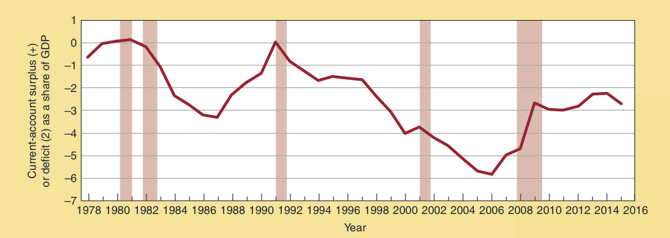
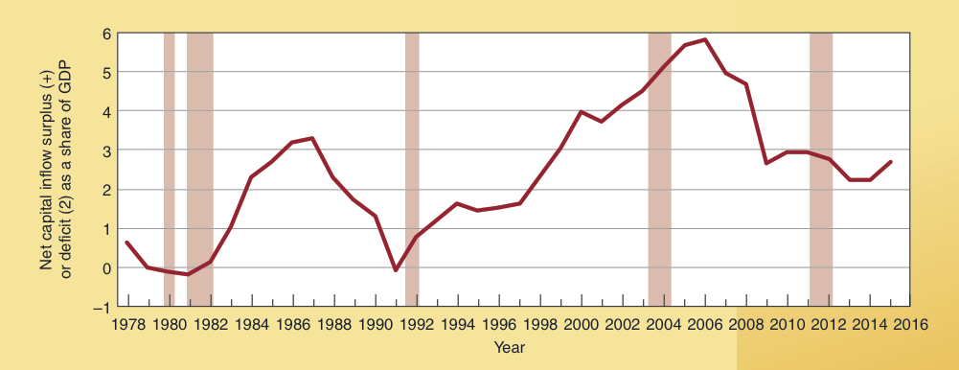
Current-Account Balance and Net Foreign Investment
Current Account Balance as % of GDP surplus (+) or deficit (-)
As the these figures for the United States indicate, under a flexible exchange rate system, the inflow and outflow of capital exert a major impact on current account balances.
Net Capital Inflow as % of GDP surplus (+) or deficit (-)

Slide 35
Are Trade Deficits Good or Bad?
With flexible exchange rates, an inflow of capital implies a trade (current account) deficit.
If a nation’s investment environment is attractive, it is likely to result in a net inflow of capital and trade deficit.
When this inflow of capital is channeled into productive investments, this is a positive development.
However, if the inflow of capital is used to finance current consumption or for the finance of unproductive projects, it will exert an adverse impact on future income.
In recent years a substantial share of the U.S. trade deficits have arisen from this source.

Slide 36
Should Trade Between Countries Balance?
Political leaders often imply that U.S. exports to a country, China or Japan for example, should be approximately equal to our imports from that country.
This is a fallacious view.
Under a flexible exchange rate system, overall purchases from foreigners will balance with overall sales to foreigners, but there is no reason why bilateral trade between any two countries will balance.

Slide 37
Should Trade Between
Countries Balance?
Rather than balance, economics indicates that a country will tend to experience …
trade surpluses with trading partners that buy a lot of goods that it supplies at a low cost, and,
trade deficits with trading partners that are economical suppliers of goods that can be produced domestically only at a high cost.

Slide 38
Questions for Thought:
Since the early 1980s, the U.S. has persistently run
a. a current account deficit and a capital account surplus.
both a current account and capital account deficit.
2. “Under a pure flexible exchange rate system, a nation that has a current account deficit will also have a capital account surplus.” -- Is this statement true? Explain.

Slide 39
Questions for Thought:
“Countries that offer attractive investment opportunities relative to those available elsewhere will often experience an inflow of capital and a trade deficit.” -- Is this statement true?
(a) No; if a country’s investment environment is attractive, this will generally lead to an outflow of capital.
(b) No; if the investment environment of a country is attractive, it will generally run a trade surplus.
(c) Yes; the statement is true.

Slide 40
Questions for Thought:
“If other countries did not impose trade barriers that limit our exports, the flexible exchange rate system of the United States would bring U.S. exports to a specific country (Japan, for example) into balance with U.S. imports from that country.” -- Is this statement true?
Will a healthy economy run a balance of trade surplus? Is a balance of trade deficit bad?

Slide 41
Questions for Thought:
6. In recent years, U.S. imports from China have been substantially greater than U.S. exports to China. This bi-lateral trade deficit is:
(a) proof that the Chinese treat U.S. produced goods unfairly.
(b) surprising, because the flexible exchange rates of the U.S. should bring its bilateral trade with another country into balance.
(c) not surprising, because there is no reason why bi-lateral trade between two countries should be in balance.

Slide 42
Questions for Thought:
In recent years the U.S. has run trade deficits with Japan, China, and Mexico. Does this indicate that these countries treat U.S. producers unfairly? Why or why not?
In recent years the U.S. has run trade surpluses with the United Kingdom, Belgium, Brazil, and Australia. Does this indicate that the U.S. treats the producers of these countries unfairly? Why or why not?

Slide 43
End of
Chapter 19

