Slide 1
Gaining From
International Trade

Slide 2
The Trade Sector of the United States

Slide 3
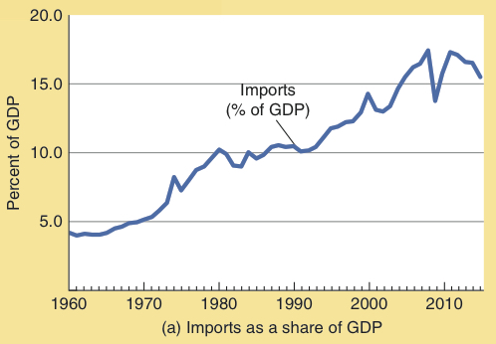
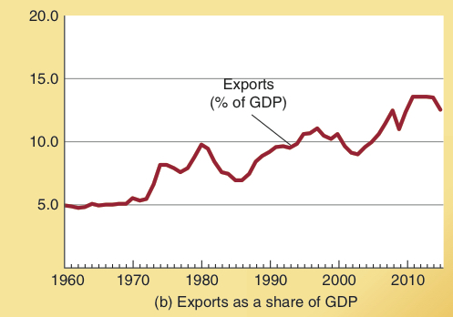
The Growth of the
U.S. Trade Sector
As is shown here, both exports & imports have grown substantially as a share of the U.S. economy since 1960. The size of the trade sector as a share of GDP more than doubled during 1960-2000.
Since 2000, the growth of the trade sector as a share of the economy has slowed.
Reductions in both transportation and communication costs, as well as lower trade barriers have contributed to this growth.
Imports as a Share of GDP
Exports as a Share of GDP

Slide 4
Leading Trading Partners of the U.S.
–––––––– Percent of Total U.S. Trade, 2015 ––––––––
Today, China, Canada, Mexico, and Japan are the leading trading partners with the United States.
The impact of international trade varies across industries. In some industries, U.S. firms are able to compete quite effectively, while in others they find it difficult to do so.
China
16.1%
Canada
14.0%
Mexico
12.9%
Japan
5.7%
Germany
4.1%
South Korea
2.9%
UK
2.6%
France
2.0%
Taiwan
1.9%
India
1.9%
All other
32.8%

Slide 5
Gains from
Specialization and Trade

Slide 6
Gains from Trade: An Overview
Most international trade is not between the governments
of different nations but rather between the people and firms located in different countries.
Like other voluntary exchanges, international trade occurs because both the buyer and seller expect to gain, and generally do.
  If both parties did not expect to gain, they would not agree to the exchange.
With trade, a country’s residents can gain by specializing in the production of goods they can produce economically.
  They can sell those goods in the world market and use the proceeds to import goods that would be expensive
  to produce domestically.

Slide 7
Law of Comparative Advantage
Law of Comparative Advantage:
A group of individuals, regions, or nations can produce a larger joint output if each specializes in the production of goods in which it is a low-opportunity cost producer and trades for goods for which it is a high opportunity cost producer.

Slide 8
Gains from Specialization and Trade
International trade leads to mutual gain because it allows each country to specialize more fully in the production of those things that it does best according to the law of comparative advantage.
Trade makes it possible for each country to use more of its resources to produce those goods and services that it can produce at a relatively low cost.
With trade, it will be possible for the trading partners to consume a bundle of goods that it would be impossible for them to produce domestically.

Slide 9
Gains from Trade:
Comparative Advantage
Columns (1) and (2) indicate the daily per worker output of the food and clothing industry in the U.S. & Japan.
Japanese workers can produce 3 units of food per day, compared to only 2 units per day for U.S. workers.
They can also produce 9 units of clothing per day, compared to 1 unit of clothing per day for U.S. workers.
Output per
worker day
Food
Clothing
Country
(1)
(2)
U.S.
2
1
Japan
3
9
Change in total output
* Change in output if US shifts 3 workers from clothing to
food industry and if Japan shifts one from food to clothing.
Thus, Japan has an absolute advantage—the Japanese workers are able to produce more of both food and clothing than U.S. workers.

Slide 10
Gains from Trade:
Comparative Advantage
Are gains from trade possible when one country, such as Japan, has an absolute advantage in the production of both commodities?
The answer is yes, because it is comparative advantage, not absolute advantage, that matters.

Slide 11
Gains from Trade:
Comparative Advantage
Which country is the low opportunity cost producer of food?
  The opportunity cost for a unit of food in Japan is 3 units of clothing. In the U.S. the opportunity cost for a unit of food is one-half a unit of clothing. Thus, the U.S. is the low opportunity cost producer of food.
Which country is the low opportunity cost producer of clothing?
  The opportunity cost for a unit of clothing in Japan is one-third of a unit of food. In the U.S., the opportunity cost of a unit of clothing is two units of food. Thus, Japan is the low opportunity cost producer of clothing.

Slide 12
Gains from Trade:
Comparative Advantage
What happens when each specializes in the area of its comparative advantage? Food for the U.S. and clothing for Japan.
If the U.S. moves 3 workers from clothing to food, it produces 6 more units of food and only 3 fewer of clothing.
If Japan moves 1 worker from food to clothing, it produces 9 more units of clothing and only
3 fewer of food.
With such a reallocation of labor, the U.S. and Japan are able to increase their aggregate output of both food and clothing.
Output per
worker day
Potential change
in output*
Food
Clothing
Food
Clothing
Country
(1)
(2)
(3)
(4)
U.S.
2
1
+ 6
- 3
Japan
3
9
- 3
+ 9
Change in total output
+ 3
+ 6
* Change in output if US shifts 3 workers from clothing to
food industry and if Japan shifts one from food to clothing.

Slide 13
PPC Before
Specialization and Trade
Clothing
(million units)
United States
450
400
350
300
Here we illustrate the daily production of the labor force of both the US (200 million) and Japan (50 million) given the production costs of food and clothing from the previous slide.
In the absence of trade, consumption possibilities will be restricted to points like US₁ in the U.S. & J₁ in Japan.
Each of these points lies along the production possibilities curve (PPC) of the respective nation.
250
Production possibilities, U.S.
200
M
150
100
US₁
50
N
Food
(million
units)
100
200
300
400
Clothing
(million units)
Japan
450
R
375
Production possibilities, Japan
300
J₁
225
150
75
S
Food
(million
units)
75
150
225
300
450

Slide 14
Trade Expands
Consumption Possibilities
Clothing
(million units)
United States
450
400
O
350
Consumption possibilities
of U.S. with trade
Specialization and trade expand consumption possibilities.
If the U.S. trades food for clothing
(1-for-1), it can specialize in the production of food and consume along the O-N line (rather than its original production-possibilities constraint, M-N).
Similarly, if Japan trades clothing for food (1-for-1), it can specialize in the production of clothing and consume any combination along the R-T line (rather than its original, R-S).
300
250
200
M
150
100
US₁
50
N
Food
(million
units)
100
200
300
400
Clothing
(million units)
Japan
450
R
375
Consumption possibilities
of Japan with trade
300
J₁
225
150
75
S
T
Food
(million
units)
75
150
225
300
450

Slide 15
Trade Expands
Consumption Possibilities
Clothing
(million units)
United States
450
400
O
350
300
250
200
M
200
200
For example, with specialization and trade, the U.S. could increase its consumption from US₁ to US₂, gaining 50 million units of clothing and 100 million units of food.
Simultaneously, Japan could increase consumption from J₁ to J₂, a gain of 125 million units of food and 25 million units of clothing.
150
US₂
100
US₁
50
N
Food
(million
units)
100
200
200
300
400
200
Clothing
(million units)
Japan
450
R
375
300
250
225
J₁
J₂
150
75
200
S
T
Food
(million
units)
75
150
225
300
450

Slide 16
Trade Expands
Consumption Possibilities
Clothing
(million units)
United States
450
400
O
350
300
250
200
M
How exactly do the U.S. and Japan consume at US₂ and J₂?
The U.S. produces 400 million units of food, consumes 200 million, and exports 200 million to Japan.
Japan produces 450 million units of clothing, consumes 250 million, and exports 200 million to the U.S..
Each consumes more than it could produce domestically.
200
150
US₂
100
US₁
US imports
50
N
US exports
Food
(million
units)
100
200
200
300
400
Clothing
(million units)
Japan
450
R
375
Japan exports
300
250
225
J₁
J₂
150
75
200
S
T
Japan imports
Food
(million
units)
75
150
225
300
450

Slide 17
Keys to Prosperity: International Trade
In addition to gains from specialization in areas of comparative advantage, international trade also leads to gains from:
  Economies of Scale:
  International trade allows both domestic producers and consumers to gain from reductions in per-unit costs that often accompany large-scale production, marketing, and distribution.
  More Competitive Markets:
  International trade promotes competition in domestic markets and allows consumers to purchase a wider variety of goods at economical prices.

Slide 18
Supply, Demand, and International Trade

Slide 19
U.S. Has a
Comparative Advantage
The price of soybeans and other internationally traded commodities is determined by the forces of supply and demand in the world market.
If U.S. soybean producers were prohibited from selling to foreigners, the domestic price would be P_{n}.
Free trade permits U.S. soybean producers to sell
Q_{p} units at the higher
world price of P_{w}.
U.S. Market
World Market
S_{d}
S_{w}
Price
Price
a
b
P_{w}
S_{w}
P_{w}
P_{n}
c
D_{w}
D_{d}
Soybeans
(bushels)
Soybeans
(bushels)
Q_{c}
Q_{n}
Q_{p}
Q_{w}

Slide 20
U.S. Has a
Comparative Advantage
At the world price of P_{w}, the quantity (Q_{p} – Q_{c}) is exported.
Compared to the no-trade situation, the producers’ gain from the higher price (area) P_{w} – b – c – P_{n} exceeds the cost imposed on domestic consumers (area) P_{w} – a – c – P_{n}
by the triangular (area)
a – b – c.
U.S. Market
World Market
S_{d}
S_{w}
Price
Price
a
b
P_{w}
S_{w}
P_{w}
P_{n}
c
D_{w}
D_{d}
U.S. exports
Soybeans
(bushels)
Soybeans
(bushels)
Q_{c}
Q_{n}
Q_{p}
Q_{w}

Slide 21
Foreigners Have a
Comparative Advantage
Consider the international market for manufactured shoes.
In the absence of trade, the domestic price would be P_{n}.
As many foreign producers have a comparative advantage in the production of shoes, international trade leads to lower prices P_{w}.
U.S. Market
World Market
S_{d}
Price
Price
S_{w}
P_{n}
a
P_{w}
D_{d}
D_{w}
Q_{n}
Shoes
(pairs)
Q_{w}
Shoes
(pairs)

Slide 22
Foreigners Have a
Comparative Advantage
U.S. Market
World Market
At the price P_{w}, U.S. consumers demand Q_{c}
units of which (Q_{c} – Q_{p})
are imported.
Compared to no trade, consumers gain (area)
P_{n} – a – b – P_{w}, while domestic producers lose (area) P_{n} – a – c – P_{w}.
A net gain of (area)
a – b – c results.
S_{d}
Price
Price
S_{w}
P_{n}
a
c
b
P_{w}
S_{w}
P_{w}
D_{d}
U.S. imports
D_{w}
Q_{p}
Q_{n}
Q_{c}
Shoes
(pairs)
Q_{w}
Shoes
(pairs)

Slide 23
Summary:
Supply, Demand, and Gains from Trade
International trade and specialization result in lower prices (and more domestic consumption) for imported products and higher prices (and less domestic consumption) for exported products.
Trade makes it possible for domestic producers to obtain higher prices for the items they export and for domestic consumers to buy imported items at lower prices.
As a result, the residents of each nation are able to focus more of their resources on the things they do best (produce at a low cost), while trading for those goods for which they are high opportunity cost producers.

Slide 24
Questions for Thought:
State the law of comparative advantage in your own words.
Under what conditions can a nation gain from international trade?
Do you think the 50 states of the United States would be
better off if each imposed trade barriers limiting trade across state boundaries? Do you think the countries of North and South America would be better off if there were no trade restrictions limiting trade across national boundaries?
Explain your response.

Slide 25
Questions for Thought:
4. Are the following statements true or false?
(a) “If a nation is going to produce its maximum potential
output and achieve full employment, it must impose
tariffs and quotas in order to protect domestic
industries & jobs.”
(b) “Everyone benefits when trade barriers (for example,
tariffs and quotas) are removed.”
(c) “When a country trades for those things for which it is
a high cost producer, it will be able to use more of its
resources to produce items it can produce at a low
cost.”

Slide 26
The Economics of
Trade Restrictions

Slide 27
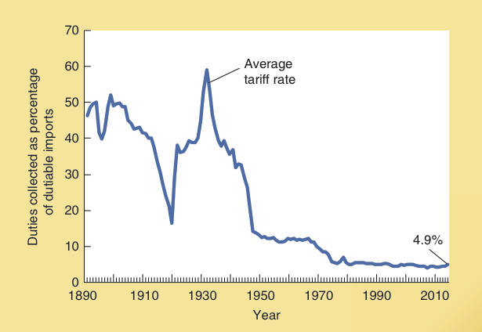
Economic Freedom and Growth
The average tariff rate (taxes levied upon imports) for the United States (since 1890) is illustrated here.
U.S. Average Tariff Rate
Duties Collected as a Percentage of Dutiable Imports

Slide 28
Trade Restrictions: Impact of a Tariff
Consider a tariff on auto imports.
Without a tariff, world price is P_{w}.
At P_{w} consumers in the U.S. purchase Q₁ units …
Price
S_{Domestic}
Q_{d1} from U.S. producers
and …
Q₁ – Q_{d1} from foreign producers.
A tariff (t ) makes it more costly for Americans to purchase autos from abroad. U.S. prices rise to P_{w}+ t and purchases fall from Q₁ to Q₂.
Imports after tariff
P_{w}+ t
U.S. purchases from domestic producers rise from Q_{d1} to Q_{d2} …
Tariff = t
S
U
T
V
imports fall to Q₂ – Q_{d2}.
P_{w}
Initial imports
T tax revenues (from the tariff) are generated …
Producers gain S …
D_{Domestic}
U & V are deadweight losses.
Consumers lose S + U + T + V in the form of higher prices and a reduction
of consumer surplus.
Q_{d1}
Q_{d2}
Q₂
Q₁
Quantity
(automobiles)

Slide 29
Trade Restrictions: Impact of a Quota
Consider a quota on peanuts.
Without trade restraints, P_{w} (world price) would be the domestic price. At P_{w} U.S. consumers would purchase Q₁ …
Price
S_{Domestic}
Q_{d1} from U.S. producers and …
Q₁ – Q_{d1} from foreign producers.
A quota of Q₂ – Q_{d2} imports pushes the U.S. price up to P₂.
Import quota:
Q₂ – Q_{d2}
P₂
While total U.S. purchases fall (from Q₁ to Q₂ ), those from U.S. rise (from Q_{d1} to Q_{d2}) and …
S
U
T
V
imports fall to Q₂ – Q_{d2}.
P_{w}
Initial imports
U.S. producers gain S. Area T goes to foreign producers with permits to import.
D_{Domestic}
Areas U & V are deadweight losses. Consumers lose S + U + T + V in the form of higher prices and a reduction of consumer surplus.
Q_{d1}
Q_{d2}
Q₂
Q₁
Quantity
(peanuts)

Slide 30
Why do Nations Adopt
Trade Restrictions?

Slide 31
Arguments Used to
Justify Trade Restrictions
Proponents of trade restrictions often use the following arguments in an effort to justify their position:
  National defense argument:
  domestic industry is needed for national defense purposes.
  Dumping:
  the sale of goods abroad at a price below the cost of production (and below the domestic market price of the exporting nation).
    Dumping is illegal under U.S. law.
  Infant Industry argument:
  new industry needs protection so it can mature.

Slide 32
A Few Additional Issues
Related to Dumping
When considering the merits of anti-dumping restrictions, remember that:
  Firms with large inventories (either domestic or abroad) may find it in their interest to offer goods
  at prices below their original cost of production.
  Domestic firms are legally allowed to engage in this practice.
  Lower prices benefit domestic consumers.

Slide 33
Trade Restrictions are a Special Interest Issue
“Protectionism is a politician's delight because it delivers
visible benefits to the protected parties while imposing
the costs as a hidden tax on the public.”
—Murray L. Weidenbaum
  The special interest effect provides the primary explanation for trade restrictions.
Trade restrictions almost always provide highly visible, concentrated benefits for a small group of people, while imposing widely dispersed costs that are often difficult to identify on the general citizenry.
Politicians have a strong incentive to favor special interest issues, even if they conflict with economic efficiency.

Slide 34
Trade Barriers and
Popular Trade Fallacies

Slide 35
Trade Fallacies
Trade fallacies abound because people often fail to consider the secondary effects.
Key elements of international trade are often linked – you cannot change one element without changing the other.
  This is the case with imports and exports; policies that restrain imports also restrain exports.

Slide 36
Trade Fallacies
Trade fallacy 1:
“Trade restrictions that limit imports save jobs
for Americans.”
  This view is false because if foreigners sell less to us they will have fewer dollars with which to buy things from us. Thus, restraints on imports will also restrain exports.
  Trade restrictions do not “save” jobs; they merely reshuffle them. Jobs “saved” in protected industries will be offset by jobs “lost” in export industries.
  As the result of trade restrictions, fewer Americans are employed in areas where we have a comparative advantage.

Slide 37
Trade Fallacies
Trade fallacy 2:
"Free trade with low-wage countries, such as Mexico and
China, will reduce the wages of Americans."
  Both high- and low-wage countries will gain when they are able to focus more of their resources on those productive activities that they do well.
  The key to this issue is how will U.S. resources be used.
  If a low-wage country can supply a good cheaper than
  we can produce it, the U.S. can gain by purchasing the good from the low-wage country and using its resources to produce other goods for which it has a comparative advantage.

Slide 38
Institutions and the Changing Nature of Global Trade

Slide 39
Economic Freedom as a
Measure of Institutional Quality
Gains from trade, entrepreneurial discovery, and investment are largely dependent on institutions and policies supportive of voluntary exchange, market allocation, freedom to compete, and protection of people and their property from aggressors.
These ingredients comprise the foundation of economic freedom.

Slide 40
Trade Openness,
Income, and Growth
The income levels and growth rates of the ten most and ten least open economies (as measured by the
Trade Openness Index – TOI)
are displayed here.
Note that more open economies both achieved higher income levels and grew more rapidly.
Source: Derived from Economic Freedom of the World 2015 Dataset and World Bank, World Development Indicators. The purchasing power parity method was used to convert the per capita GDP figures into 2011 international dollars.

Slide 41
Trade Openness, Income, and Growth
Countries like Hong Kong and Singapore that have persistently followed more open trade policies, have achieved higher income levels, and grown more rapidly than more closed economies.
During the last two decades, trade restrictions have declined sharply, particularly in less developed economies.
Following the passage of NAFTA, U.S. trade with both Canada and Mexico grew rapidly.
  The U.S. economy performed impressively, as the size of the trade sector grew during the 1990s.

Slide 42
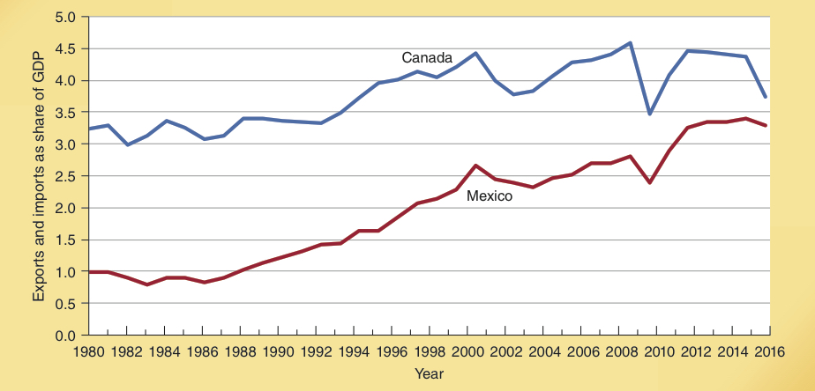
U.S. Trade with Canada and Mexico
Measured as a share of GDP, U.S. trade with both Canada and Mexico has increased sharply as a result of NAFTA during the last 18 years.
U.S. Trade with Canada and Mexico, 1980-2015
Source: Statistical Abstract of the United States (various years) and http://www.bea.gov

Slide 43
Trade Openness, Income, and Growth
Today, less developed countries are often at the forefront of those pushing for greater trade openness, while high-income countries often impose restrictions in order to protect various domestic industrial interests and preserve their farm subsidy programs.

Slide 44
Questions for Thought:
“If the revenue collected by the government is taken into
account, a tariff has no net impact on the welfare of a
society.”
-- Is this statement true?
2. Politicians have a strong incentive to support restrictions that limit international trade because
(a) trade restrictions generally benefit all, or nearly all,
voters.
(b) trade restrictions generally provide highly visible,
concentrated benefits for a relatively small number of
people while imposing hard-to-identify-costs on others.

Slide 45
Questions for Thought:
The imposition of tariffs, quotas, & other trade barriers are often referred to as protectionist policies. Who is being protected? What are they being protected from?
“Exports are good. They create jobs and help make
America prosperous. On the other hand, imports
destroy jobs and reduce our standard of living.”
Do you agree or disagree?
“Policies that reduce the volume of imports will also
reduce the volume of exports.”
-- Is this statement true?
Why would political officials want to prohibit their citizens from trading with foreigners?

Slide 46
Questions for Thought:
7. In 2002, the Bush administration imposed tariffs of up
to 25% on imported steel products. This action
(a) reduced the supply of steel in the domestic market
and led to higher steel prices.
(b) increased U.S. employment because it saved jobs in
the steel industry.
(c) reduced employment in the U.S. steel container
industry because the higher steel prices made it more
difficult for them to compete with foreign rivals.
(d) helped George Bush carry the state of Ohio in the
2004 presidential election.

Slide 47
End of
Chapter 18

