Slide 1
Institutions, Policies, & Cross-Country Differences in Income and Growth

Slide 2
How Large are Income Differences Across Countries?

Slide 3
Measuring Cross-Country Differences in Income
Countries use different currencies. Thus, the purchasing power of different currencies must be converted to a common denominator in order to compare incomes in different countries.
This could be done with exchange rates.
But, exchange rates are influenced by capital movements and will fail to reflect the prices of goods not traded in international markets.
They may be an inaccurate indicator of the purchasing power of different currencies.
Economists favor the purchasing power parity (PPP) method of income comparisons.

Slide 4
Measuring Cross-Country Differences in Income
Economists favor the purchasing power parity (PPP) method of income comparisons.
This method uses the cost of purchasing a common bundle of goods consumed in each country and uses this cost to estimate the purchasing power of each currency.
The purchasing power of each currency is then used to convert the income levels of each country to a common currency, typically the U.S. dollar.

Slide 5
Cross-Country Differences in Income
The following slide highlights the 2014 per person income for various high, middle and low-income countries.
The incomes in Singapore, Norway, and Switzerland are the highest in the world, in excess of $55,000.
The per-person income in the highest income countries is 30-50 times the lowest income countries.
The incomes of less-developed countries will be understated because GDP figures generally omit household production.
Even after making some allowance for this, it is clear that the income differences between the high and low-income countries are huge.

Slide 6
Cross-Country Differences in Income
The 2014 Per Person Income Levels for high-, Middle-, and Low-Income Countries
(measured in 2011 PPP U.S. dollars)
High-Income Countries
Middle-Income Countries
Low-Income Countries
Singapore
$78,958
Portugal
$26,175
China
$12,599
Norway
63,999
Greece
24,570
Egypt
10,049
Switzerland
55,275
Malaysia
24,460
Indonesia
10,033
Hong Kong
52,552
Poland
23,966
Ukraine
8,267
United States
52,118
Russia
23,293
Philippines
6,649
Ireland
48,400
Chile
Romania
21,980
Bolivia
6,325
Netherlands
45,662
19,104
Nigeria
5,639
Germany
43,559
Venezuela
16,751
India
5.439
Australia
43,256
Mexico
16,284
Bangladesh
2,979
Canada
42,774
Botswana
15,359
Uganda
1,689
United Kingdom
38,149
Brazil
15,162
Niger
895
Japan
35,635
Thailand
15,012
Malawi
784

Slide 7
How Do Growth Rates Vary Across Countries?

Slide 8
Cross-Country Differences in Growth
The following slide shows the growth of per person GDP during 1990-2014 for the countries with the best and worst growth records, along with the figures for high-income countries.
The ten fastest growing economies were LDCs at the beginning of the 1980s. The two most populace countries, China and India, are on the high-growth list.
The average growth rate of the high-growth economies was 4.7% (more than three times that of the high-income countries). Thus they have closed the gap relative to their richer counterparts.
While LDCs dominate the high-growth list, those with the worst growth records were also LDCs. Countries on the right side of the table are not only poor, they are falling further and further behind.

Slide 9
Economic Growth: 1990-2014
The Average Annual Growth Rate Per-Person GDP for High-Growth,
High-Income Industrial, and Low-Growth Countries (1990–2014)
High-Growth
High-Income Industrial
Low-Growth
China
9.2%
Australia
1.7%
Liberia
-0.3%
Vietnam
5.5%
Norway
1.6%
Kyrgyz Republic
-0.4%
India
4.8%
United Kingdom
1.6%
Madagascar
-0.8%
Sri Lanka
4.5%
The Netherlands
1.5%
Ukraine
-1.0%
South Korea
4.4%
United States
1.4%
Moldova
-1.3%
Panama
4.2%
Germany
1.4%
Tajikistan
-1.4%
Chile
3.7%
Canada
1.3%
Burundi
-1.5%
Dominican Republic
3.7%
France
1.0%
Zimbabwe
-1.6%
Poland
3.6%
Japan
0.8%
Central African Republic
-2.1%
Malaysia
3.6%
Italy
0.3%
Congo, Dem. Rep.
-2.4%

Slide 10
Economic Freedom as a Measure of Sound Institutions

Slide 11
Economic Freedom as a Measure of Institutional Quality
Gains from trade, entrepreneurial discovery, and investment are largely dependent on institutions and policies supportive of voluntary exchange, market allocation, freedom to compete, and protection of people and their property from aggressors.
These ingredients comprise the foundation of economic freedom.

Slide 12
Measuring Economic Freedom
The Economic Freedom of the World (EFW) index is designed to measure the consistency of a nation’s institutions and policies with economic freedom.
Leading scholars, including Nobel laureates Milton Friedman, Gary Becker, and Douglass North, helped to develop the EFW index.
The EFW index uses 42 separate components to measure the consistency of a nation’s institutions and policies with personal choice, voluntary exchange, open markets, and protection of private property.

Slide 13
Measuring Economic Freedom
To achieve a high economic freedom (EFW) rating, a country must:
provide secure protection of privately owned property,
provide evenhanded enforcement of contracts,
provide a stable monetary environment,
keep taxes low,
refrain from creating barriers to both domestic and international trade, and,
rely more fully on markets rather than governments to allocate goods and resources.
The EFW index reflects the institutional and policy factors that theory indicates are key sources of economic growth.

Slide 14
The Most and Least Free Economies of the World
Economic freedom (EFW) ratings are available for 113 countries during the 1990-2013 period.
The following slide indicates the ten highest and lowest rated economies, as well as the ratings of ten other large countries.
Hong Kong, Singapore, Switzerland, and New Zealand headed the list of the most persistently free economies.
Myanmar, Guinea-Bissau, Algeria, the Democratic Republic of Congo, and Venezuela had the least free economies.

Slide 15
EFW Ratings: 1990-2013
The Economic Freedom Rating for Top-, Middle-, and High-Rated Countries
EFW Index, Average 1990–2013
Top-Rated Countries
Middle-Rated Countries
Low-Rated Countries
Hong Kong
8.9
Germany
7.7
Nigeria
5.2
Singapore
8.6
Japan
7.6
Syria
4.8
Switzerland
8.4
Chile
7.6
Burundi
4.8
New Zealand
8.3
France
7.3
Congo, Republic of
4.8
United States
8.2
South Korea
6.9
Zimbabwe
4.6
United Kingdom
8.2
Indonesia
6.7
Venezuela
4.6
Canada
8.2
Mexico
6.6
Congo, Dem. Rep.
4.5
Australia
8.0
Argentina
6.0
Algeria
4.5
Ireland
8.0
Brazil
5.7
Guinea-Bissau
4.4
The Netherlands
7.9
China
5.6
Myanmar
4.0

Slide 16
Questions for Thought:
Why do economists believe the purchasing power parity (PPP) method is a more accurate way to compare cross-country incomes than comparisons based on exchange rates?
How large are the income differences across countries? Why are the per capita GDP figures likely to overstate the size of the income difference between high- and low-income countries?
How do growth rates vary across countries? Are the rich countries getting richer while the poor are getting poorer?

Slide 17
Questions for Thought:
4. What is the Economic Freedom of the World (EFW) index designed to measure? What determines whether the rating of a country will be high or low on this index?
5. “Economic freedom is present if a country is a political democracy.” – Is this statement true?

Slide 18
Institutions, Policies, and Economic Performance

Slide 19
Economic Freedom and Performance
If institutions and policies are important, then countries that are economically free should outperform those that are less free.
When considering the impact of institutions, it is important to focus on income and long-term growth rather than short-term growth, which may reflect mostly the ups and downs of business cycle conditions.

Slide 20
Economic Freedom and Income
The real per-person income (using a PPP adjustment) for countries ordered by economic freedom rating is shown here by quartiles.
Note the strong positive linkage. Income per person in the freest quartile of countries was five and a half times the figure for the least free.
2013 GDP Per Capita, PPP (in constant 2011 dollars)
$38,601
$18,414
$6,986
$10,737
Least-Free Quartile
Third Quartile
Second Quartile
Most-Free Quartile

Slide 21
Economic Freedom and Growth
The relationship between the economic freedom of a country and its growth rate (of GDP per capita) during the 1990-2013 period is shown here.
Countries in the most free quartile grew at an annual rate of 3.3% compared to the 1.2% growth rate for the least-free quartile.
Growth of GDP Per Capita 1990-2013 (Annual %)
3.3%
2.8%
2.8%
1.2%
Least-Free Quartile
Third Quartile
Second Quartile
Most-Free Quartile

Slide 22
Economic Freedom and Poverty
The extreme poverty rate in the most free quartile of countries was 2.0% compared to 31.9% in the least free quartile.
The pattern in the data for the moderate poverty rate is the same.
Clearly the countries with more economic freedom have lower poverty rates.
Extreme Poverty Rate (2013)
Moderate Poverty Rate (2013)
49.8%
31.9%
29.9%
16.1%
5.8%
14.6%
2.0%
3.4%
Least-Free Quartile
Third Quartile
Second Quartile
Most-Free Quartile
Least-Free Quartile
Third Quartile
Second Quartile
Most-Free Quartile

Slide 23
Economic Freedom, Institutions, and Investment

Slide 24
Economic Freedom and Private Investment
Here countries are divided into 3 groups, based upon their average EFW rating during 1980-2005.
Investment is positively linked to economic freedom.
Private investment was 18.7% of GDP in the freest group, while only 11.2% of GDP for the least free group.
Economic Freedom & Private Investment
as a Share of GDP (Groups are Average EFW Ratings for 1980-2005).
18.7%
15.6%
11.2%
< 5.0
5.0 – 7.0
> 7.0

Slide 25
Economic Freedom and the Productivity of Private Investment
Change in Growth Rate Per Percentage-Point Change in Investment (1980 – 2005)
The estimated impact of a 1 percentage point increase in investment as a share of GDP on annual growth rate during 1980-2005 is shown.
In the most free group, a 1 percentage point increase in private investment enhanced long-term growth by 0.25%, compared to 0.07% for the least free group.
0.25%
0.16%
0.07%
EFW < 5
EFW 5-7
EFW > 7

Slide 26
Economic Freedom – A Summary
Countries with institutions and policies more consistent with economic freedom (as measured by the EFW index) have achieved …
higher incomes per person,
more rapid growth rates,
lower poverty rates
higher investment rates, and,
greater productivity per unit of investment.

Slide 27
Economic Freedom, Institutional Quality, and the Dramatic Reduction in the World Poverty Rate

Slide 28
The Narrowing of the Economic Freedom Gap
The average EFW rating for 24 high-income OECD and the 85 less-developed countries are shown here for 1985–2013. Note that the gap between the two groups narrowed from 1.6 in 1985 to 0.8 in 2013.
Average Economic Freedom Rating for High-Income
Countries and Less-Developed Countries

Slide 29
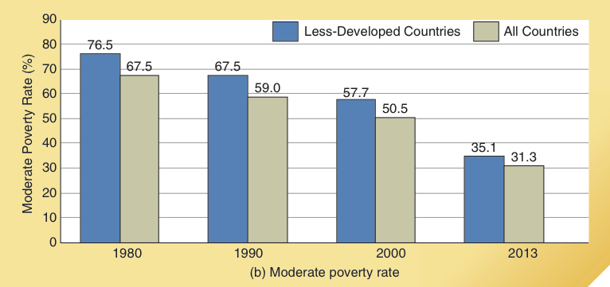
Poverty in the World and Less Developed Countries
Extreme Poverty Rate
As is shown here, the extreme poverty rate ($1.90/per day) of the world fell from 50.9% in 1980 to 13.4% in 2013. In less-developed countries, the extreme poverty rate fell from 58.8% in 1980 to 15.5% in 2013.
The moderate poverty rate ($3.10/day) followed a similar pattern.
Moderate Poverty Rate

Slide 30
Rich and Poor Nations Revisited

Slide 31
Per Capita Income and Income Inequality, 1800-1980
The last two centuries have been a remarkable period of history. The per person income of the world has expanded tenfold, and in the West, per capita income is now about 20 times the figure of 1800.
In 1800, the wealthy nations of the world had income levels 5 or 6 times those of poor countries, but by 1980, the income levels in the world’s richest countries were 30 or 40 times those present in the less-developed world.
Thus, during 1800–1980, worldwide income inequality increased decade after decade.

Slide 32
Per Capita Income and Income Inequality, 1980-2013
During the past three decades, for the first time, the world has achieved both higher levels of per capita income and a reduction in income inequality.
As less developed countries have improved their institutional quality, they have grown more rapidly, narrowed the income gap relative to high-income countries, and made historic progress toward the reduction of poverty.

Slide 33
Per Capita Income and Income Inequality, 1980-2013
As economists Sala-i-Martin and Pinkovskiy noted, the population weighted average growth rate of the developing economies exceeded that of the high-income countries during 1980-2000.
Since 2000, this trend has accelerated.
Driven by the rapid growth of India and China, the world’s two most populous countries, the population weighted growth of per capita GDP in the low-income developing countries was five times the rate of the high-income countries during 2000-2013.

Slide 34
Rich and Poor Nations Revisited
Countries with low per capita income in 1990 dominate the list of both (1) those that have grown most rapidly and (2) those that have regressed and experienced falling incomes since 1990.
When low-income economies have sound institutions, they can grow rapidly because:
they can merely copy or emulate technologies and business practices that have been successful in high-income countries
the rate of return on investment in these low-income countries will generally be higher than in capital-rich, more advanced economies

Slide 35
Rich and Poor Nations Revisited
In order for a low-income country to benefit from the borrowing of technologies and inflow of investment capital, it must have sound institutions.
Many low-income economies continue to perform poorly and even regress because their institutions and policies stifle gains from trade, entrepreneurship, and investment.

Slide 36
The Declining Economic Freedom of the United States

Slide 37
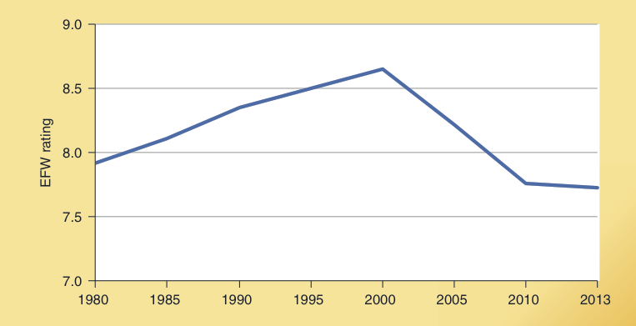
The Economic Freedom of the United States
While the EFW rating of the United States increased from 7.9 in 1980 to 8.6 in 2000, it has declined substantially since.
By 2013, the rating had fallen to 7.7, its lowest level in more than three decades.
U.S. Economic Freedom of the World (EFW)
Index Rating

Slide 38
The Economic Freedom of the United States
The U.S. was the world’s 3rd freest economy throughout 1980-2000 but its ranking fell to 8th in 2005 & 16th in 2013.
Between 2000 and 2013 the U.S. rating fell by almost a full point. While a one unit change may sound small, research indicates that it is associated with a 1% decline in the long-term, annual growth rate of real GDP.
The following elements contributed to the decline in the US EFW rating: higher levels of government spending, a reduction in the quality of the legal environment, higher non-tariff trade barriers, a smaller share of credit allocated to the private sector, and more restrictive regulation of business activity.

Slide 39
Origins of Institutions

Slide 40
The Influence of History
Research indicates that history matters.
Countries with colonial settlers who planned on staying tended to develop institutions and policies that protected individual property rights and limited the power of government.
The United States, Canada, Australia, and New Zealand provide examples.

Slide 41
The Influence of History
In contrast, colonizers settling in harsh climates or with short-term interests in the extraction of mineral resources were more likely to choose institutions that provided few limitations on the power of government and failed to provide for protection of ownership rights and unbiased enforcement of the law.
Even after independence, protective institutions have been largely absent in Africa and Latin America, where the European colonizers were primarily interested in resource extraction.

Slide 42
Three Factors That Now Make Institutional Change More Possible
While no country can entirely escape its past, at least three factors have increased the likelihood of institutional change.
The colonial era is over – countries that were previously colonized by European powers are now in a position to make their own institutional and policy choices.
The collapse of communism has also expanded the opportunity for institutional change.
Substantial reductions in transportation and communication costs have increased the potential gains from the adoption of sound institutions and policies.

Slide 43
Economic Rules and Political Decision Making

Slide 44
Politics and Sound Institutions
Economics provides direction with regard to institutions and policies that will lead to wealth creation, growth, and prosperity.
But, these institutions are an outgrowth of the political process and there is no assurance that political decision-making will lead to sound economic institutions.

Slide 45
Politics and Sound Institutions
Even democratic political decision-making will often lead to rules that encourage unproductive & counterproductive actions because of:
shortsightedness: bias toward adoption of unproductive programs providing immediate, highly visible benefits at the expense of difficult-to-identify future costs
special-interest politics: political incentives that lead politicians to “trade” favors to interest groups for political contributions to help them win the next election
rent-seeking and favoritism: activities that provide favors to some at the expense of others, that encourage people to divert resources away from productive activities and toward lobbying, campaign contributions, & other forms of political favor seeking

Slide 46
Politics and Economics
Achievement and maintenance of political power often conflict with sound economics.
In recent decades, a wide variety of political processes have generated moves toward economic institutions more consistent with prosperity.
Economists do not fully understand the linkage between political decision-making and the adoption of economic reforms consistent with growth and prosperity.
This is a subject of current research that will enrich the future study of economics.

Slide 47
Questions for Thought:
How do the income levels and growth rates of countries with institutions and policies more consistent with economic freedom compare with those that are less free? Is this surprising? Why or why not?
From the viewpoint of economic growth, why is the legal structure of a country important? What are some of the key attributes of a legal system that will encourage economic growth.
The fastest growing economies during the past quarter of a century were generally poor in 1990. Is this surprising? Why or why not?

Slide 48
Questions for Thought:
4. (a) When property rights are well defined and enforced, what determines if an exchange will take place in a market economy? (b) When political decisions are made democratically, what determines whether a political action will be undertaken?
(c) Is the difference in the structure of incentives accompanying markets and that of democratic political decision making important? Explain.

Slide 49
Questions for Thought:
5. (a) Do we count on majority rule to protect civil liberties such as the right to free speech, freedom of the press, the right to assembly, and religious freedom? (b) Should we count on majority rule to defend economic rights like protection of one’s property, freedom to trade, and the freedom to compete? Discuss each of these questions.

Slide 50
Questions for Thought:
6. Compared to countries with low levels of economic freedom, countries with a larger degree of economic freedom tend to have:
(a) higher per capita income levels, but slower rates of growth.
(b) lower per capita income levels, but more rapid rates of growth.
(c) both higher per capita income levels and more rapid growth.
(d) both lower income levels and slower rates of growth.

Slide 51
Addendum to Chapter 17: Economic Freedom

Slide 52
Economic Freedom of the World: 2014
Intuitions and policies generally change slowly.
Thus, we have generally focused on the quality of institutions and policies over a lengthy time frame such as 1980-2013.
However, the recent data are also of interest.
The following map indicates the Economic Freedom of the World (EFW) ratings for 2014.

Slide 53
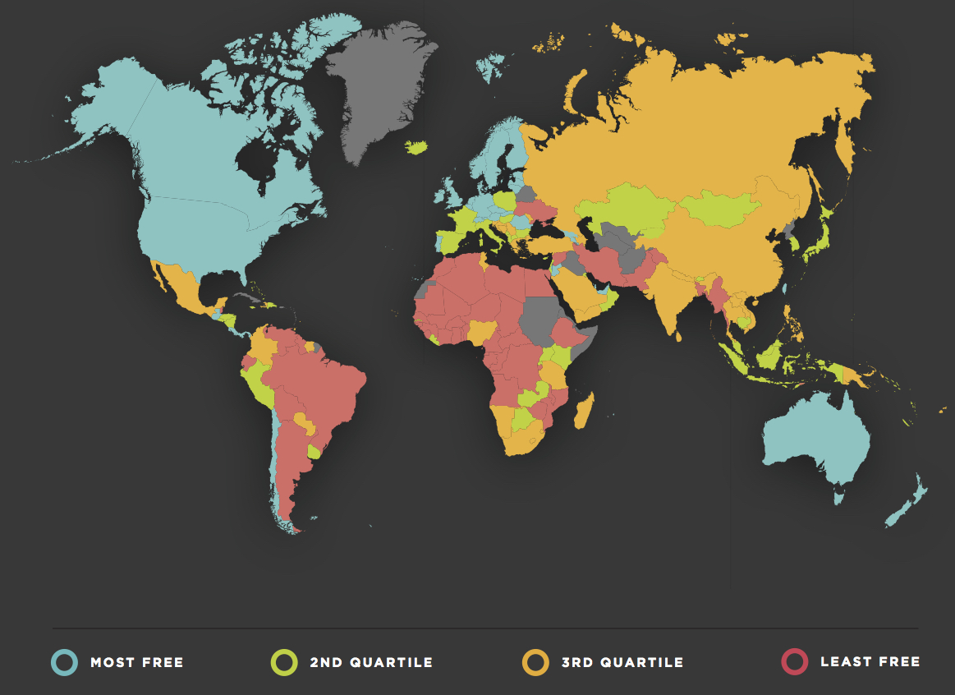
15th
edition
Gwartney-Stroup
Sobel-Macpherson

Slide 54
End of
Chapter 17

