Slide 1
Macroeconomic Policy, Economic Stability, and the Federal Debt

Slide 2
Economic Fluctuations: The Past 100 Years

Slide 3
Economic Fluctuations: the Historical Record
Historically, the United States has experienced substantial swings in real output.
Before the Second World War, year-to-year changes in real GDP of 5% to 10% were experienced on several occasions.
During the last six decades, the fluctuations of real output have been more moderate.

Slide 4
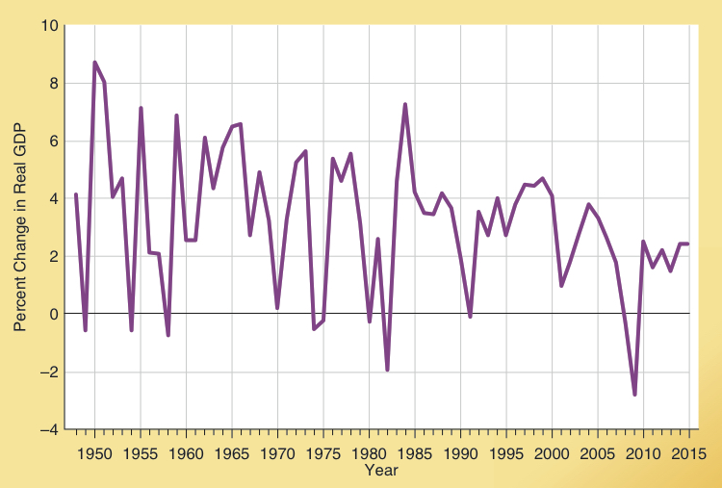
Economic Instability During the Last 100 Years
Annual changes in real GDP are illustrated here.
While economic ups and downs continue, the swings
have been more moderate in the last 60 years.
Economic Instability: The Record of the Past Century
Most economists attribute this stability to the more appropriate monetary policy of the recent decades.
Source: Historical Statistics of the United States, 224 and Bureau of Economic Analysis, http://www.bea.gov.

Slide 5
Can Discretionary Policy Promote Economic Stability?

Slide 6
The Goals of Stabilization Policy
Economists of almost all persuasions favor the following goals:
a stable growth of real GDP
a relatively stable level of prices
a high level of employment (low unemployment)
Even with agreement on these goals, there is disagreement about how these goals can be achieved.

Slide 7
Activist and Non-activist Views
If monetary and fiscal policies could inject stimulus during economic slowdowns and apply restraint during inflationary booms, this would help reduce the ups and downs of the business cycle.
Activists believe that policy-makers can respond to changing economic conditions and institute policy in a manner that will promote economic stability.
Non-activists argue that the discretionary use of monetary and fiscal policy in response to changing economic conditions is likely to do more harm than good.
Both activists and non-activists recognize that conducting macro policy in a stabilizing manner is not an easy task.

Slide 8
Practical Problems with Timing
The time lag problem: It takes time to identify when a policy change is needed, additional time to institute the policy change, and still more time before the change begins to exert an impact on the economy.
The forecasting problem: Because of the time lag problem, policy makers need to know what economic conditions will be like 12 to 24 months in the future. But, our ability to forecast future economic conditions is limited.
Forecasting tools like the index of leading indicators can help, but they sometimes give incorrect signals.
The political problem: Policy changes may be driven by political considerations rather than stabilization needs.

Slide 9
Forecasting Tools and Macro Policy

Slide 10
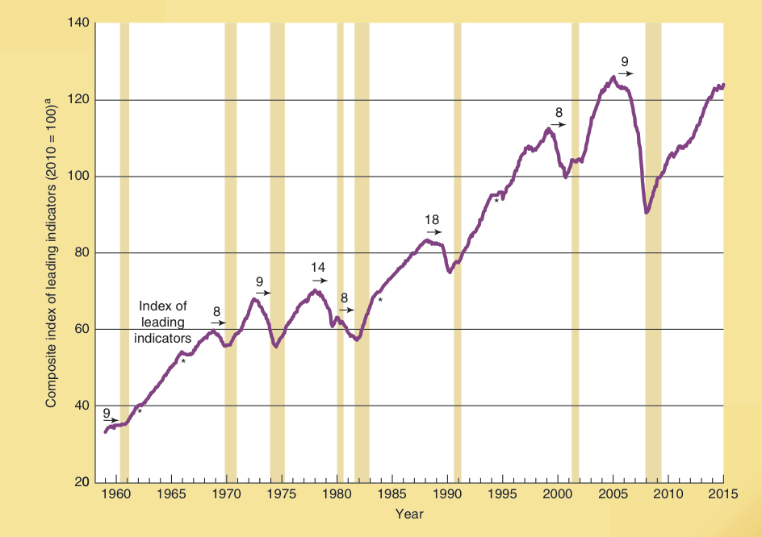
Index of Leading Indicators
Index of Leading Indicators is a composite statistic based on 10 key variables that generally turn down prior to a recession and turn up before the beginning of an expansion.
It is a forecasting tool.
Index of Leading Indicators
While it correctly forecast each of the 8 recessions during the 1959-2015 period, it forecast⁽*⁾ 4 recessions that did not occur.
The index predicts with variable advance notice. The arrows indicate how far ahead the index predicted a recession.
Source: http://www.conference-board.org.

Slide 11
Questions for Thought:
Why are macro policymakers interested in the index of leading indicators?
“Because policy changes exert an impact on the economy only after a period of time and forecasting is an imprecise science, trying to stabilize the economy with macroeconomic policy is likely to do more damage than good.”
Would an activist agree with this statement? Would a non-activist?
3. What are some of the practical problems that limit the effectiveness of discretionary macro-economic policy as a stabilization tool?

Slide 12
How Are Expectations Formed?

Slide 13
Two Theories of How Expectations are Formed
Adaptive Expectations: Individuals form their expectations about the future on the basis of data from the recent past.
Rational Expectations: assumes people use all pertinent information, including data on the conduct of current policy, in forming their expectations about the future.

Slide 14
Adaptive Expectations Theory
According to the adaptive expectations hypothesis, what actually occurs during the most recent period (or set of periods) determines an individual’s future expectations.
So, the expected future rate of inflation lags behind the actual rate by 1 period as expectations are altered over time.
Actual rate of inflation (%)
12
Actual rate
8
of inflation
4
Time period
Expected
rate of inflation (%)
Corresponding expected
rate of inflation in next period
12
8
4
Time period
1
2
3
4
5

Slide 15
Rational Expectations Theory
Under rational expectations, rather than simply assuming the future will be like the immediate past, people also consider the expected effects of changes in policy.
Policy changes cause people to alter their expectations about the future.
With rational expectations, the forecasts of individuals will not always be correct. But, people will not make systematic errors.
For example, people will not systematically under estimate (or over estimate) the effects of expansionary policies.

Slide 16
The Major Differences Between the Two Theories
If adaptive expectations is correct, people will adjust slowly.
For example, with adaptive expectations, when expansionary policy leads to inflation, there will be a significant time lag (maybe a few years), before people come to expect the inflation and incorporate it into their decision making.
Systematic errors will occur under adaptive expectations, but not rational expectations.
For example, when the inflation rate is rising, decision makers will systematically tend to underestimate the future rate of inflation under adaptive expectations, but not under rational expectations.

Slide 17
Macro Policy Implications of Adaptive and Rational Expectations

Slide 18
The Implications of Adaptive and Rational Expectations
With adaptive expectations, an unanticipated shift to a more expansionary policy will temporarily stimulate output and employment.
With rational expectations, decision-makers do not make systematic errors and therefore the impact of expansionary policies is unpredictable.
Both expectations theories indicate that sustained expansionary policies will lead to inflation without permanently increasing output and employment.

Slide 19
Stimulus with Adaptive Expectations
Price Level
LRAS
Under adaptive expectations, anticipation of inflation will lag behind its actual occurrence.
Thus, a shift to a more expansionary policy will increase aggregate demand (to AD₂) and lead to a temporary increase in GDP (to Y₂) and modest increase in prices (to P₂).
SRAS₁
P₂
e₂
P₁
E₁
AD₂
AD₁
Y_{F}
Y₂
Goods & Services (real GDP)

Slide 20
Stimulus with Rational Expectations
Under rational expectations, decision makers expect the inflationary impact of a demand-stimulus policy.
Thus, while the more expansionary policy does increase aggregate demand (to AD₂), resource prices and production costs rise just as rapidly (thereby shifting SRAS₁ to SRAS₂).
Prices increase but real output does not (even in the short run).
Price Level
LRAS
SRAS₂
SRAS₁
P₂
E₂
P₁
E₁
AD₂
AD₁
Y_{F}
Goods & Services (real GDP)

Slide 21
Questions for Thought:
“Under the adaptive expectations hypothesis, a shift to a more expansionary monetary policy will increase the real rate of output in the short run, but not the long run.” Is this statement true? Would it be true under the rational expectations hypothesis?

Slide 22
The Phillips Curve: The View of the 1960s versus Today

Slide 23
Phillips Curve View of the 1960s & 70s
A Phillips curve indicates the relationship between the rates of inflation and unemployment.
In the 1960s, most economists thought that there was a trade-off between inflation and unemployment – that a lower rate of unemployment could be achieved if we were willing to tolerate a little more inflation.
This view provided the foundation for the inflationary policies of the 1970s.
But the inflation of the 1970s led to high rates of both inflation and unemployment.
The early Phillips curve view was fallacious because it ignored the role of expectations.

Slide 24
Early View of the Phillips Curve
Inflation rate (% change in GDP price deflator)
This exhibit is taken from the 1969 Economic Report of the President. Dots represent the inflation and unemployment rate for the respective years.
The report states that the chart “reveals a fairly close association of more rapid price increases with lower rates of unemployment.”
68
Phillips curve
4%
57
66
56
55
3%
67
65
60
62
58
2%
59
64
63
54
1%
61
Unemployment rate (%)
3%
4%
5%
6%
7%

Slide 25
Expectations & Modern View of Phillips Curve
It is not the rate of inflation, but the actual rate of inflation relative to the expected rate that will influence both output and employment.
When inflation is greater than anticipated, profit margins will improve, output will expand, and unemployment will fall below its natural rate.
Alternatively, when the actual rate of inflation is less than the expected rate, profits will be abnormally low, output will recede, and unemployment will rise above its natural rate.
When the inflation rate is steady, people will come to anticipate the steady rate accurately. Under these conditions, profit margins will be normal, output will move toward the economy’s long-run potential, and the actual rate of unemployment will equal its natural rate.

Slide 26
Modern Expectational Phillips Curve
Actual minus expected rate of inflation
The modern view stresses that it is the actual rate of inflation relative to the expected rate that matters.
When the actual rate is greater than (less than) the expected rate, unemployment will be less than (greater than) its natural rate.
PC
10%
Persons under-estimate inflation
5%
Persons correctly forecast inflation
0%
Persons over-estimate inflation
-5%
-10%
Unemployment rate (%)
Natural rate

Slide 27
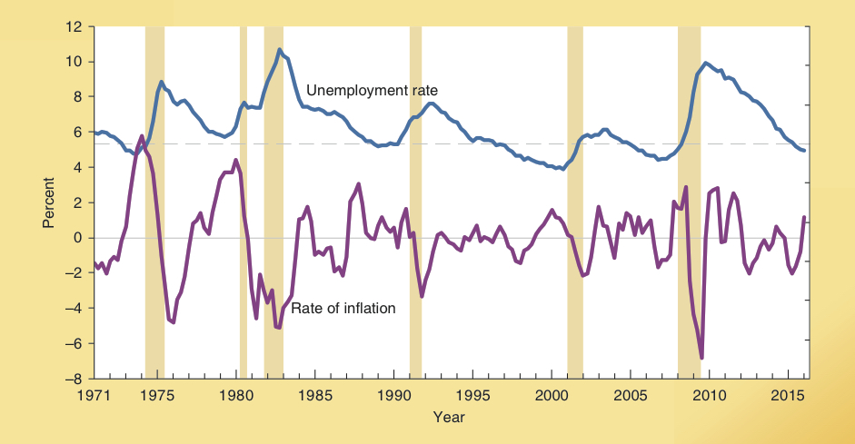
Unemployment and Changes in the Rate of Inflation
Consider how changes in the inflation rate and the rate of unemployment are related.
Note how the sharp reductions in the rate of inflation during the 1974, 1980-1981, and 1988-89 periods preceded recessions and substantial increases in the unemployment rate.
In contrast, the low and steady inflation rates during the 1990-2004 period were accompanied by low and more stable rates of unemployment.
Unemployment Rate and the Change in the Rate of Inflation, 1971-2015
Source: http://www.economagic.com

Slide 28
Questions for Thought:
1. What was the dominant view of the Phillips curve during the 1960s? Was this view correct? Did this view exert an impact on macro policy? How does the modern view differ?
2. Are the following statements true or false?
(a) Decision makers are likely to underestimate sharp and abrupt reductions in the inflation rate.
(b) Demand stimulus policies introduce inflation without permanently reducing unemployment.
(c) Demand stimulus policies that result in inflation that is higher than anticipated will temporarily reduce unemployment below the natural rate.

Slide 29
The Growing Federal Debt and Economic Stability

Slide 30
Deficits, Surpluses, and the National Debt
National debt: the sum of the indebtedness of the federal government in the form of interest-earning bonds. It reflects loans to the U.S. Treasury.
A budget deficit increases the size of the national debt by the amount of the deficit. Conversely, a budget surplus allows the federal government to pay off bondholders and so reduce the size of the national debt.
The national debt represents the cumulative effect of all the prior budget deficits and surpluses.

Slide 31
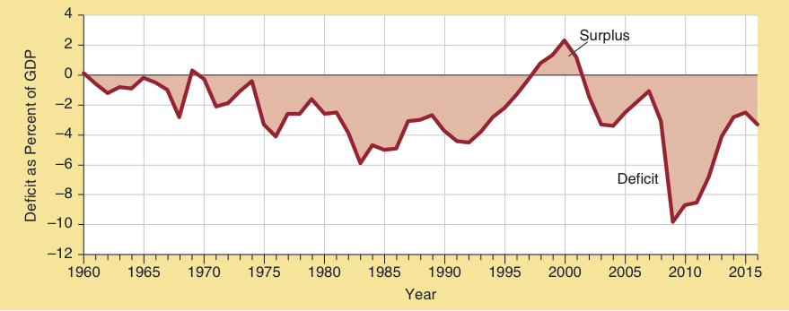
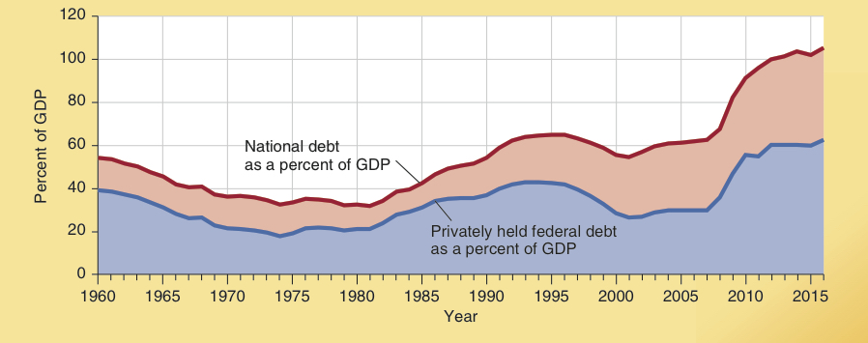
Budget Deficits and the National Debt
Federal budget deficit or surplus as a percent of GDP
Between WWII and 1973, federal budget deficits were small as a share of GDP.
During this period, the national debt declined as a share of GDP.
Gross and net federal debt as a percent of GDP
Source: http://www.whitehouse.gov/omb.

Slide 32
Budget Deficits and the National Debt
Federal budget deficit or surplus as a percent of GDP
During 1974-95, budget deficits were quite large, causing the national debt to increase as a share of GDP.
After falling during 1996-2001, the national debt increased from 2002 to 2007 and soared both during and following the 2008-09 recession.
The current federal debt to GDP ratio is now the largest since WWII.
Gross and net federal debt as a percent of GDP
Source: http://www.whitehouse.gov/omb.

Slide 33
Who Owns the National Debt?

Slide 34
Who Owns the National Debt? (December 31, 2015)
National Debt $18.95 trillion
Privately Held Federal Debt $10.89 trillion
U.S. Govt. Agencies
27.7%
Domestic Investors
42.8%
Foreign Investors
57.2%
Private Investors
57.5%
Federal Reserve Banks 14.8%
Of the $18.95 trillion debt, 42% is held by govt. agencies (primarily social security trust fund) and the Federal Reserve banks. The other 57.5% is held privately (domestic & abroad).
Of the $10.89 trillion of privately held federal debt, 57.2% is owned by foreigners and 42.8% is held by domestic investors.

Slide 35
How Does Debt Financing Influence Future Generations?

Slide 36
How Does Debt Financing Influence Future Generations?
How does debt financing influence future generations?
When considering this issue keep 3 key points in mind:
For domestically held debt (42.8% of total privately held debt), the future generations that pay the tax liability accompanying the debt will also receive the interest income.
Debt financing of a government activity cannot push the opportunity cost of the resources used by the government into the future.
Debt financing will influence future generations primarily through capital formation.

Slide 37
Borrowing from Foreigners
Borrowing from foreigners accounts for approximately 57% of the federal debt.
If the foreign borrowing is used to finance productive projects, future generations will inherit more productive assets that will make it possible for them to service the debt.
Alternatively, if the borrowing from foreigners is used to finance current consumption or unproductive investment projects, the earnings from the additional capital formation will be insufficient to cover the interest payments. In this case, future generations of Americans are harmed by the debt financing.

Slide 38
Budget Deficits of 2001-2016
As the U.S. experienced large budget deficits from 2001 to 2016, consumption increased as a share of GDP, private investment was weak, and trade deficits were large.
This pattern indicates that the current generation was the primary beneficiary of the deficits.

Slide 39
Why is Deficit Spending So Difficult to Control?

Slide 40
Political Attractiveness of Budget Deficits
Politicians like to spend in order to provide visible benefits to their constituents but they do not like to tax because this imposes a visible cost on voters.
Debt financing makes it possible for politicians to spend now while pushing the visible cost of the higher taxes into the future.

Slide 41
Unfunded Promises are a Form of Debt
Unfunded benefits (like Social Security and Medicare) also make it possible for politicians to take credit for the promised benefit now without having to levy the equivalent amount of visible taxes.
Thus, the political popularity of debt financing and unfunded benefits reflects the short-sightedness effect – the myopic nature of the political process.

Slide 42
Politics, Demographics, Federal Debt, and the Dangers Ahead
During 2009-2011, 40% of federal expenditures were financed by borrowing.
The large deficits have pushed the federal debt as a share of the economy to levels not seen since WWII.
The retirement of the baby boomers will push spending on Social Security and Medicare upward making it more difficult to control the growth of the federal debt.

Slide 43
Have Federal Debt Obligations Grown to a Dangerous Level?

Slide 44
Politics, Demographics, Federal Debt, and the Dangers Ahead
What will happen if the federal government does not control the growth of its debt?
Lending to countries with a large debt-to-GDP ratio is risky. As this ratio increases, governments will have to pay higher interest rates. This will make it still more difficult to control the budget deficit.
This happened in Ireland in 1986, Belgium in 1994, and Greece in 2011.

Slide 45
Politics, Demographics, Federal Debt, and the Dangers Ahead
A country such as the U.S. with a central bank, is highly unlikely to directly default on its debt.
Instead, it is far more likely to use money creation to meet its debt obligations.
In turn this will lead to inflation.

Slide 46
Perspective on Recent Macroeconomic Policy and Economic Instability

Slide 47
Reduction in the Incidence of Recession
Percent of Period U.S. in Recession
While reflecting on current problems we must not forget the relative stability of recent decades.
The U.S. economy was in recession 32.8% of the time during the 1910-59 period and 22.8% of the time between 1960-82, but only 8.6% of the time from 1983-2015.
32.8 %
22.8 %
8.6 %
1910–1959
1960–1982
1983–2015
Sources: R.E. Lipsey and D. Preston, Source Book of Statistics Relating to Construction (1966); and National Bureau of Economic Research, http://www.nber.org.

Slide 48
Questions for Thought:
Does the national debt have to be paid off at some time in the future? What will happen if it is not?
What is the difference between the national debt and the privately held federal debt? Is the difference between the two important? Why or why not?
"The national debt is a mortgage against the future of our children and grandchildren. We are forcing them to pay for our current consumption of goods and services." – Is this statement true?

Slide 49
Questions for Thought:
4. If the federal debt continues to grow as a share of the economy, is the government likely to default on its obligations to bond holders?

Slide 50
End of
Chapter 15

