Slide 1
Fiscal Policy, Incentives, and Secondary Effects

Slide 2
Alternative Views of Fiscal Policy – An Overview

Slide 3
Alternative Views of Fiscal Policy
The main difference between Keynes and modern economics is the focus on incentives. Keynes studied the relation between macroeconomic aggregates, without any consideration for the underlying incentives that lead to the formation of these aggregates. By contrast, modern economists base all their analysis on incentives.
–Luigi Zingales

Slide 4
Alternative Views of Fiscal Policy
Keynesians stress the potency of fiscal policy and its use to maintain AD at a level consistent with full employment.
Others argue there are secondary effects of fiscal policy which undermine its effectiveness.
Critics also argue that Keynesian analysis ignores important incentive effects of fiscal changes, including both changes in the composition of government spending and the supply-side effects of marginal tax rates.
This chapter will consider these views.

Slide 5
Fiscal Policy, Borrowing, and the Crowding-Out Effect

Slide 6
The Crowding-out Effect
The Crowding-out effect: Theory that an increase in borrowing to finance a budget deficit will push real interest rates up and thereby retard private spending, reducing the stimulus effect of expansionary fiscal policy
The implications of the crowding-out analysis are symmetrical.
Restrictive fiscal policy will reduce real interest rates and "crowd-in" private spending.
Crowding-out effect in an open economy: Larger budget deficits and higher real interest rates lead to an inflow of capital, appreciation in the dollar, and a decline in net exports.

Slide 7
Deficits and Interest Rates: The Crowding-out View
Deficit = $100 billion
Loanable Funds Market
Other things constant, if the government borrows an additional $100 billion to finance its budget deficit, this borrowing will increase the demand for loanable funds (shifting the demand for loanable fund from D₁ to D₂) and lead to higher interest rates.
How will higher interest rates influence aggregate demand?
Real interest rate
S₁
r₂
e₂
e₁
r₁
D₂
D₁
Q₁
Q₂
Quantity of loanable funds

Slide 8
Deficits and Interest Rates: The Crowding-out View
If government borrowing did not affect interest rates, the $100 billion increase in spending would increase aggregate demand to AD₂.
However, increased borrowing will push up interest rates, which will crowd out private investment and consumption.
As a result aggregate demand will remain unchanged at AD₁.
The crowding-out effect indicates that expansionary fiscal policy will have little or no impact on aggregate demand.
Price Level
SRAS₁
P₁
AD₂
AD₁
Y₁
Goods & Services (real GDP)

Slide 9
Crowding-Out in an Open Economy
An increase in government borrowing to finance an enlarged budget deficit places upward pressure on real interest rates.
This retards private investment and aggregate demand.
In an open economy, high interest rates attract foreign capital.
As foreigners buy more dollars to buy U.S. bonds and other financial assets, the dollar appreciates.
The appreciation of the dollar causes net exports to fall.
Thus, the larger deficits and higher interest rates trigger reductions in both private investment and net exports, which offset the expansionary impact of a budget deficit.
Decline in private investment
Increase in budget deficit
Higher real interest rates
Inflow of financial capital from abroad
Appreciation of the dollar
Decline in net exports

Slide 10
Fiscal Policy, Future Taxes, and the New Classical Model

Slide 11
The New Classical View of Fiscal Policy
The New Classical view stresses that:
debt financing merely substitutes higher future taxes for lower current taxes, and
budget deficits affect the timing of taxes, but not their magnitude.
New Classical economists argue that when debt is substituted for taxes:
people save the increased income so they will be able to pay the higher future taxes, thus,
the budget deficit does not stimulate aggregate demand.

Slide 12
The New Classical View of Fiscal Policy
Similarly, New Classical economists believe that the real interest rate is unaffected by deficits as people save more in order to pay the higher future taxes.
In the New Classical model, fiscal policy does not affect aggregate demand, output, employment, or real interest rates.
While the explanation differs, both the Crowding-out and New Classical models argue that fiscal policy exerts little impact on either aggregate demand or output.

Slide 13
Fiscal Policy: New Classical View
Expansionary Fiscal Policy: New Classical view stresses that deficits merely substitute future taxes for current taxes.
If households did not anticipate the higher future taxes, aggregate demand would increase (from AD₁ to AD₂).
However, when households fully anticipate the future taxes and save for them, demand remains unchanged at AD₁.
Price Level
SRAS₁
P₁
AD₂
AD₁
AD₁
Y₁
Goods & Services (real GDP)

Slide 14
Deficits: The New Classical View
To finance the budget deficit, the government borrows from the loanable funds market, increasing the demand (to D₂).
Under the new classical view, people save to pay expected higher future taxes (raising the supply of loanable funds to S₂.)
This permits the government to borrow the funds to finance the deficit without pushing up the interest rate.
Deficit = $100 billion
Loanable Funds Market
Real interest rate
S₁
S₂
e₁
e₂
r₁
D₁
D₂
Q₁
Q₂
Quantity of
loanable funds
Here, fiscal policy exerts
no effect on the interest rate, real GDP, or unemployment.

Slide 15
Questions for Thought:
“When the federal government runs a budget deficit, it finances the deficit by issuing additional U.S. Treasury bonds.” – Is this statement true?
When an economy is operating below its potential capacity, Keynesian economists argue that
(a) taxes should be raised if the government is currently running a budget deficit.
(b) the government should cut taxes and/or increase expenditures in order to stimulate aggregate demand.
(c) government spending should be cut and the budget shifted toward a surplus.

Slide 16
Questions for Thought:
3. The crowding out effect indicates that budget deficits …
(a) will stimulate aggregate demand and so exert a strong impact on both output & employment.
(b) will lead to additional borrowing and higher interest rates that will reduce the level of private spending.
4. “New classical economists stress that an increase in government expenditures financed by borrowing rather than taxes will lead to higher interest rates.” – Is this statement true?

Slide 17
Political Incentives and the Effective Use of Discretionary Fiscal Policy

Slide 18
Political Incentives and the Use of Discretionary Fiscal Policy
Public choice analysis indicates that legislators are delighted to spend money on programs that directly benefit their own constituents but are reluctant to raise taxes because they impose a visible cost on voters.
Given the political incentives, budget deficits will be far more attractive than surpluses.
As a result, deficits will be far more common than surpluses and discretionary fiscal policy is unlikely to be instituted in a counter-cyclical manner.

Slide 19
Is Discretionary Fiscal Policy An Effective Stabilization Tool?

Slide 20
Fiscal Policy: Countercyclical vs. Response during a Severe Recession
Substantial agreement has emerged between the Keynesians and non-Keynesians on the following:
Proper timing of discretionary fiscal policy is both difficult to achieve and crucially important.
Automatic stabilizers reduce fluctuations in AD and help direct the economy toward full employment.
Fiscal policy is much less potent than the early Keynesian view implied.

Slide 21
Supply-side Effects of Fiscal Policy

Slide 22
Supply-side Effects of Fiscal Policy
From a supply-side viewpoint, the marginal tax rate individuals face is of crucial importance.
A reduction in marginal tax rates increases the reward derived from added work, investment, saving, and other activities that become less heavily taxed.
High marginal tax rates will tend to retard total output as:
they discourage work effort and reduce the productive efficiency of labor,
they adversely affect the rate of capital formation and efficiency of its use, and,
they encourage individuals to substitute less desired tax-deductible goods for more desired non-deductible goods.

Slide 23
Supply-side Effects of Fiscal Policy
Changes in marginal tax rates, particularly high marginal rates, may exert an impact on aggregate supply because marginal tax rates influence the relative attractiveness of productive activity compared to leisure and tax avoidance.
Supply-side policies are designed to influence long-run growth (not short-run fluctuations).
Impact of supply-side effects:
There is some evidence that countries with high taxes grow more slowly—France & Germany versus the U.K..
While the debate about the potency of supply-side effects continues, there is evidence they are important for taxpayers facing extremely high marginal rates – say those 40% or above.

Slide 24
Supply Side Economics and Tax Rates
What are the supply-side effects of a cut in marginal tax rates?
Lower marginal tax rates increase the incentive to earn and use resources efficiently. AD₁ shifts out to AD₂, and SRAS & LRAS shift to the right.
If the tax cuts are financed by budget deficits, AD may expand by more than supply, bringing an increase in the price level.
LRAS₁
LRAS₂
Price Level
SRAS₁
SRAS₂
E₁
P₀
E₂
AD₁
AD₂
Y_{F1}
Y_{F2}
Goods & Services (real GDP)
With time, lower tax rates promote more rapid growth (shifting LRAS and SRAS out to LRAS₂ and SRAS₂).

Slide 25
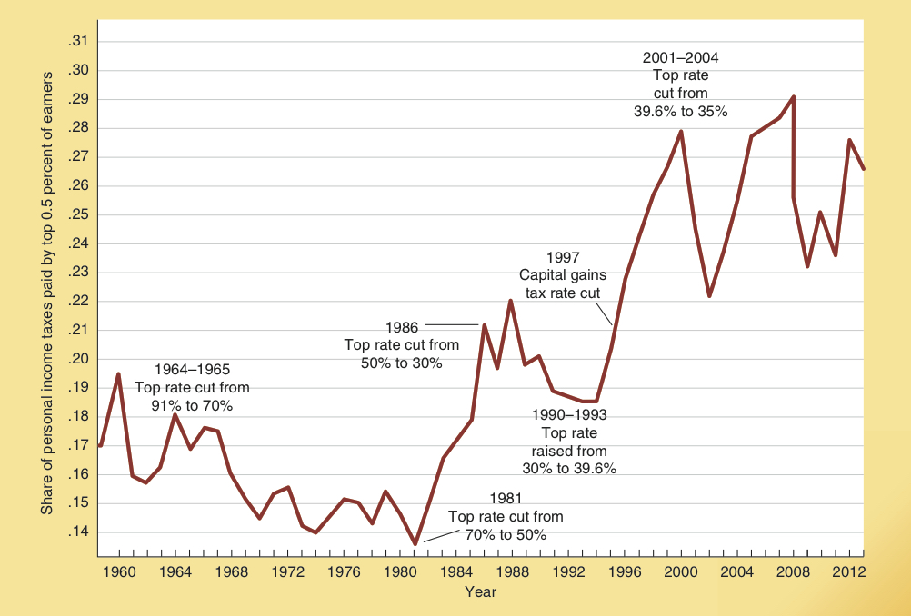
Share of Taxes Paid By the Rich, 1960-2013
The share of personal income taxes paid by the top one-half percent of earners is shown here.
Marginal Tax Rates and the Share of Taxes Paid by the Rich
Over the last half century, the share of taxes paid by these earners has increased even though their rates have declined. This is consistent with the view the that supply side effects are strong for these taxpayers.
Source: http://www.irs.gov.

Slide 26
Have Supply-siders Found a Way to “Soak the Rich?”
Since 1986 the top marginal personal income tax rate in the United States has been less than 40% compared to 70% or more prior to that time.
Nonetheless, the top one-half percent of earners have paid more than 22% of the personal income tax every year since 1997.
This is well above the 14% to 19% collected from these taxpayers in the 1960s and 1970s when much higher marginal personal income tax rates were imposed on the rich.

Slide 27
Fiscal Policy and Recovery from Recessions

Slide 28
Fiscal Policy and Recovery from Recessions: Keynesian View
Keynesians believe that increases in government spending financed by borrowing will speed recovery from a severe recession because:
the expansion in government spending will offset reductions in private spending,
interest rates will be extremely low during a severe recession and therefore crowding out of private spending will be minimal, and
increased government spending will trigger a substantial multiplier effect when widespread unemployment is present.

Slide 29
Fiscal Policy and Recovery from Recessions: Non-Keynesian View
Keynesian critics argue that increased government spending financed by debt will retard growth and slow recovery, as:
expansion in government debt will mean higher future interest payments and tax rates that will retard future growth.
government spending is driven by political considerations; it does not have anything like profit and loss that will consistently direct resources toward productive and away from unproductive projects.
Political allocation leads to favoritism and more rent seeking; ironically, most of this rent-seeking will be counted in GDP.

Slide 30
Tax Cuts vs. Spending Increases
Some argue that increases in government spending will expand GDP by more than tax reductions, because 100% of an increase in government purchases will be pumped into the economy, whereas part of the tax reduction will be saved or spent abroad.
However, the issue is more complex than this simple multiplier analysis implies.

Slide 31
Tax Cuts vs. Spending Increases
There are several reasons why a permanent tax cut will promote recovery more effectively than either a temporary tax cut or a spending increase.
A tax cut will stimulate AD more rapidly.
Compared to an increase in government spending, a tax cut is less likely to increase structural unemployment and reduce the productivity of resources.
A permanent tax rate reduction will increase the incentive to earn, invest, & employ others.
In contrast, a temporary tax cut generates uncertainty and creates only a windfall increase in income.

Slide 32
Questions for Thought:
Why do Keynesians believe that discretionary fiscal policy will help promote recovery from a severe recession? Why do the Keynesian critics disagree?
Will spending increases be more effective than tax reductions as a stabilization tool? Why or why not?
3. How does the supply-side view of fiscal policy differ from the demand-side view? Is supply-side economics a strategy for the control of economic fluctuations?

Slide 33
U.S. Fiscal Policy: 1990-2015

Slide 34
Fiscal Policy Indicators: 1990-2000 versus 2000-2010
Changes in government expenditures and the budget deficit (or surplus) provide evidence on the direction of fiscal policy.
Both real government spending and federal spending as a share of GDP grew far more rapidly during 2000–2010 than during the 1990s.
The federal budget moved from deficit to surplus during the 1990s, but it shifted in the opposite direction during 2000–2010.
Thus, both government spending and the federal budget indicate that fiscal policy moved toward restriction during the 1990s and expansion during the years following 2000.

Slide 35
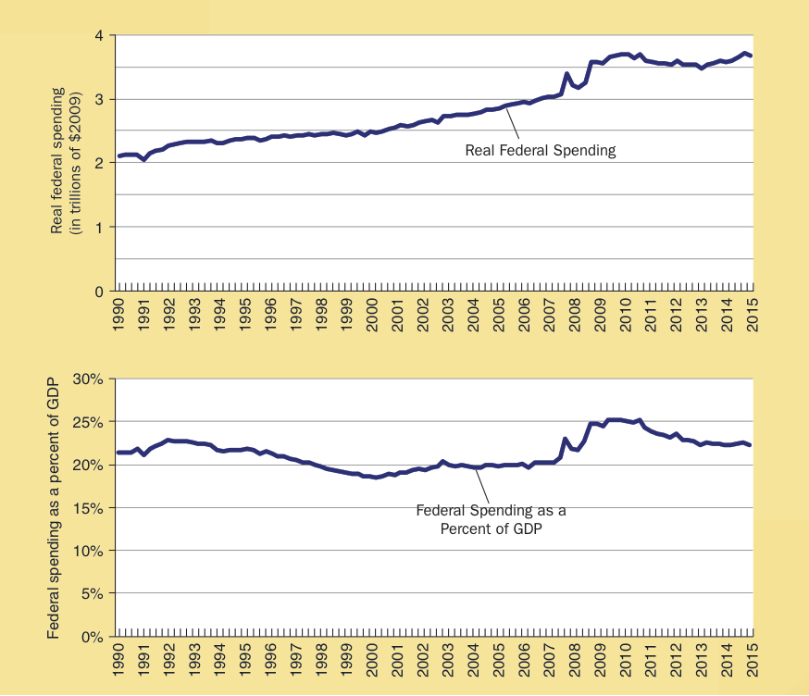
Federal Spending, 1990-2015
Real federal spending (top frame) was relatively constant during the 1990s, rose steadily from 2000 to 2007, and grew rapidly during 2008-2010.
Federal spending as a share of GDP (bottom frame) fell modestly during the 1990s, was relatively constant during 2000-2007, and increased rapidly during 2008-2010.
In 2015, federal spending was 23% of GDP, about 3% higher than the average of the past two decades.

Slide 36
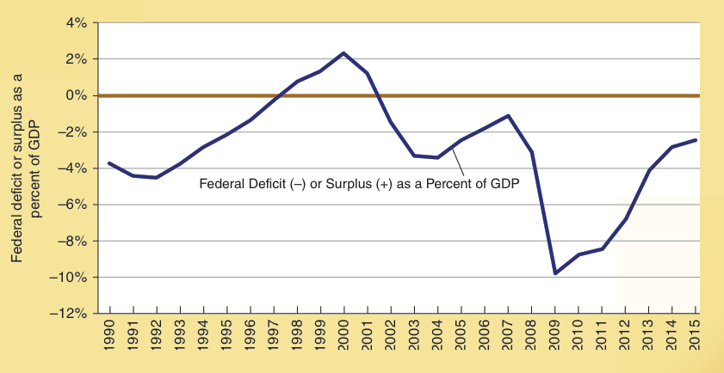
Federal Deficit (Surplus) 1990-2015
During the 1990s, the federal budget shifted from deficit to surplus. But it shifted back to deficit during 2002-2007.
There was a substantial increase in the deficit during and following the 2008-2009 recession.
Source: http://www.economagic.com and http://www.cbo.gov (see tables e-2 and 1–1).

Slide 37
Fiscal Policy During the Recession of 2008-2009
As the economy dipped into the recession of 2008-2009, both the Bush and Obama administrations moved to increase federal spending and enlarge the deficit just as Keynesian analysis proscribes.
Was the expansionary fiscal policy effective?
Keynesians answer “Yes.” They believe the recession would have been much worse in the absence of the expansionary fiscal policy.
Critics respond “No.” The recovery was the weakest of the post WWII era.

Slide 38
Is the U.S. on the Path to a Debt Crisis?
Total federal debt as a share of GDP rose to more than 100% in 2012, its highest level since World War II.
Privately held debt (net federal debt), is comprised of funds the federal govt. has borrowed from private investors. This measure has also increased sharply in recent years.
Even if it is never paid off, higher future taxes will be required to pay the interest on the privately held debt.
Federal borrowing from foreigners increased from 10% of GDP in 2000 to 34% in 2015. In contrast with domestically held debt, the interest payments on foreign debt will be paid to foreigners.

Slide 39
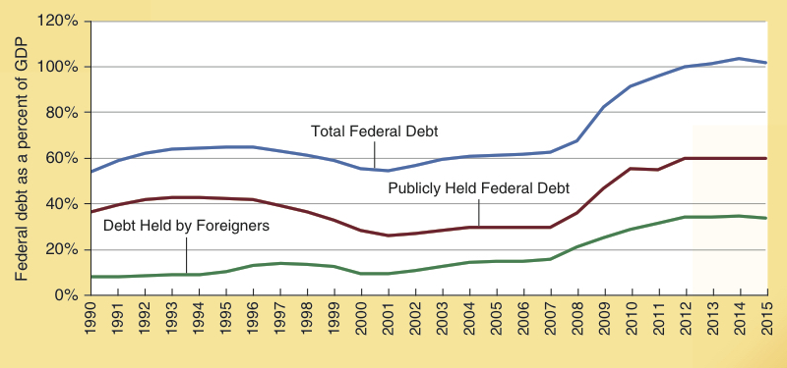
Alternative Measures of Federal Debt: 1990-2015
The total federal debt, publically held federal debt, and debt held by foreigners as a share of GDP are shown here.
Note how these measures soared during 2008-2015.
The total federal debt and publicly held federal debt as a share of GDP have doubled between 2001 and 2015.
Federal debt held by foreigners as a share of GDP has tripled during this same time span.
Measures of Federal Debt, 1990-2015
Year

Slide 40
Are the Current High Levels of Government Debt Dangerous?
When thinking about this question, consider:
The short-sightedness effect indicates that debt financing is attractive to elected political officials.
Unfunded promises are another form of debt finance
The tax burden of Social Security & Medicare will increase as the large baby-boom generation moves into retirement in the future.
Political incentives explain how countries can get caught in a vicious circle of debt financing, higher taxes, and sluggish growth. Greece provides an example. Other high-debt countries could fall into a similar trap.

Slide 41
Are the Current High Levels of Government Debt Dangerous?
Can countries escape from the ‘debt trap?’
The answer is clearly ‘yes,’ but control in the growth of spending and debt will be required.
The experiences of both Ireland in the late 1980s and Canada in the latter half of the 1990s illustrate this point.

Slide 42
Questions for Thought:
Why do the Keynesians believe that the fiscal stimulus during and following the 2008-2009 recession was effective? Why do the Keynesian critics believe it was ineffective?
What do the large deficits during and following the great recession reveal about the validity of the Keynesian, Crowding Out, and New Classical theories of fiscal policy?
Has the federal debt of the U.S. grown to a dangerously high level? Why or why not?

Slide 43
End of
Chapter 12

