Slide 1
Economic Fluctuations, Unemployment, and Inflation

Slide 2
Swings in the Economic Pendulum

Slide 3
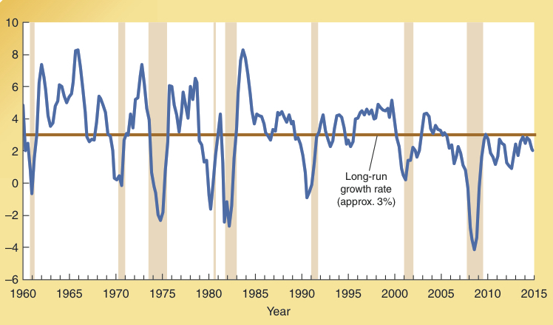
Instability in the Growth of Real GDP: 1960-2015
Although real GDP in the United States has grown at an average rate of approximately 3%, the growth has been characterized by economic ups-and-downs. Note: periods of recession are indicated with shading.
Instability in the Growth of Real GDP, 1960-2015
Annual rate of growth in real GDP
Source: Economic Report of the President (Washington, DC: Government Printing Office, various issues).

Slide 4
The Hypothetical Business Cycle
The four phases of the hypothetical business cycle are expansion, peak, contraction, and recessionary trough.
In contrast with the business cycle represented here, as the previous exhibit illustrated, real world business cycles are characterized by expansions and contractions of varying duration and magnitude.
Real GDP
Business
Trend line
peak
Business
peak
Recessionary
Expansion
trough
Contraction
Recessionary
trough
Time

Slide 5
Economic Fluctuations and the Labor Market

Slide 6
Labor Market Classifications
Employed – a person (16 years old or over) who is:
working for pay at least one hour per week,
self employed, or,
working 15 hours or more each week without pay in a family-operated enterprise.
Unemployed – a person not currently employed who is:
actively seeking a job, or,
waiting to begin a job, or,
on layoff, waiting to return to a previous job.

Slide 7
Labor Market Classifications
Civilian Labor force – civilians (16 years & older) who are:
either employed or unemployed.
Not in the labor force – persons (16 years & older) who are:
neither employed nor unemployed (like retirees, students, homemakers, or disabled persons).

Slide 8
Labor Market Indicators
The non-institutional civilian adult population is grouped into two broad categories:
Persons not in the labor force, and,
persons in the labor force (this group includes both the employed and unemployed).
Labor Force Participation Rate
=
# in the Labor Force
Civilian population (16+)
Recall the Labor Force =
Employed + Unemployed

Slide 9
U.S. Population, Employment, and Unemployment: February 2016
252.6 million
Civilian population
16 and over
158.9 million
93.7 million
Not in the
Civilian
7.8 million
labor force
labor force
Household workers
Students
Retirees
Unemployed
Disabled
Employed
Employees
New entrants
Self-employed
Reentrants
151.1 million
workers
Lost last job
Quit last job
Laid off
Labor Force Participation Rate
=
Civilian labor force
=
158.9
=
Civilian population (16+)
252.6
62.9%
Employment / Population Ratio
=
Number employed
=
151.1
=
Civilian population (16+)
252.6
59.8%
Rate of Unemployment
=
Number unemployed
=
7.8
=
Civilian labor force
158.9
4.9%

Slide 10
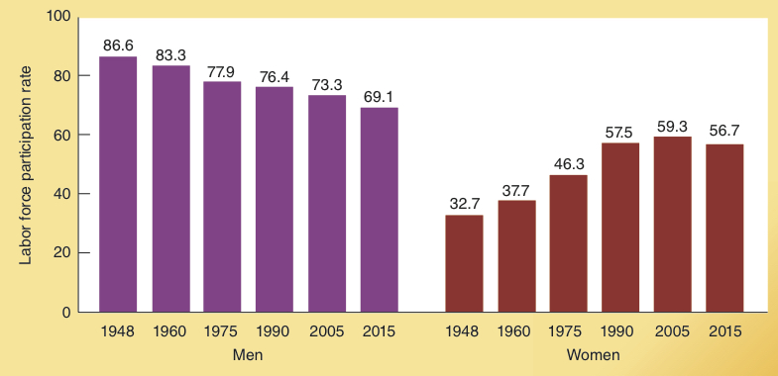
Labor Force Participation Rate of Men and Women, 1948-2015
The labor force participation rate of women has been steadily increasing for several decades.
During the same period the rate of men has been falling.
Labor Force Participation Rate of Men and Women, 1948-2015
Source: www.bls.gov.

Slide 11
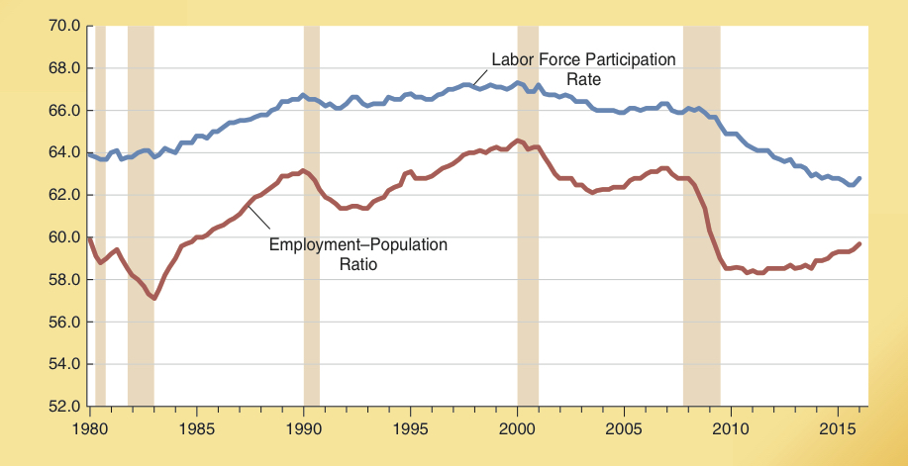
Labor Force Participation Rate and Employment-Population Ratio: 1980-2016
Both the labor force participation rate and the employment-population ratio trended upward from 1980-2000, but have been declining since.
Both figures fell sharply during the 2008-2009 recession. Each has had a weak rebound during the recovery phase of this business cycle. In 2016, both were still below their 2007 levels.
Sources: Willem Van Zandweghe, “Interpreting the Recent Decline in Labor Force Participation,” Federal Reserve Bank of Kansas Economic Review (Quarter 1, 2012): 5-34; and Daniel Aaronson, Jonathan Davis, and Loujia Hu, “Explaining the Decline in the U.S. Labor Force Participation Rate,” Chicago Fed Letter, no. 296, (March 2012):1-4.

Slide 12
Composition of the Unemployed by Reason in 2016 (February)
Breakdown of Unemployed 2016 (February)
There are various reasons why persons were unemployed in February of 2016.
Nearly two-fifths (37.2%) of the unemployed were dismissed from their previous jobs.
More than two-fifths (42.3%) of the unemployed were either new entrants or reentrants into the labor force.
Job leavers
New entrants
9.9%
10.6%
Reentrants
30.6%
37.2%
Dismissed from Previous Job
11.7%
On Layoff

Slide 13
The Unemployment Rate By Age and Gender: February 2016
Civilian Rates of Unemployment (February 2016)
In 2016, the unemployment rate was 4.9% for men and women.
The unemployment rates of younger men are higher than the rates for women.
The unemployment rate itself was also much higher for those under the age of 25 than for those over the age of 25.
16.8%
14.3%
9.3%
7.9%
4.9%
4.9%
4.9%
4.0%
4.1%
16-19
20-24
25+
All men
Both
All women
16-19
20-24
25+
–– Men aged ––
–– Women aged ––
Source: www.bls.gov.

Slide 14
Questions for Thought:
1. Classify the following as employed, unemployed, or not in labor force:
a) person who is not working but applied for a job at Target last week
b) person working part-time and searching diligently for a full-time job
c) auto worker vacationing in Florida during a layoff at a General Motors plant who expects to be recalled in a couple of weeks
d) 17-year-old who works 6 hours per week throwing newspapers
e) homemaker working 70 hours a week preparing meals and performing other household services
f) college student who spends between 50 and 60 hours per week attending classes and studying
g) a retired Social Security recipient

Slide 15
Questions for Thought:
2. The following are for the U.S. in October of 2016 (in millions)
Population 324.9
Civilian pop. (age 16 and over) 254.3
Employed 151.9
Unemployed 7.8
a) Calculate the unemployment rate
b) Calculate the labor force participation rate
c) Calculate the employment / population ratio

Slide 16
Three Types of Unemployment

Slide 17
Three Types of Unemployment
Frictional Unemployment:
Caused by imperfect information.
Occurs because:
employers are not aware of all available workers and their qualifications, and,
available workers are not fully aware of all the jobs being offered by employers.

Slide 18
Three Types of Unemployment
Structural Unemployment:
Reflects an imperfect match of employee skills to skill requirements of the available jobs.
Also reflects structural and demographic characteristics of the labor market.
Cyclical Unemployment:
Reflects business cycle conditions
When there is a general downturn in business activity, cyclical unemployment increases.

Slide 19
Employment Fluctuations: The Historical Record

Slide 20
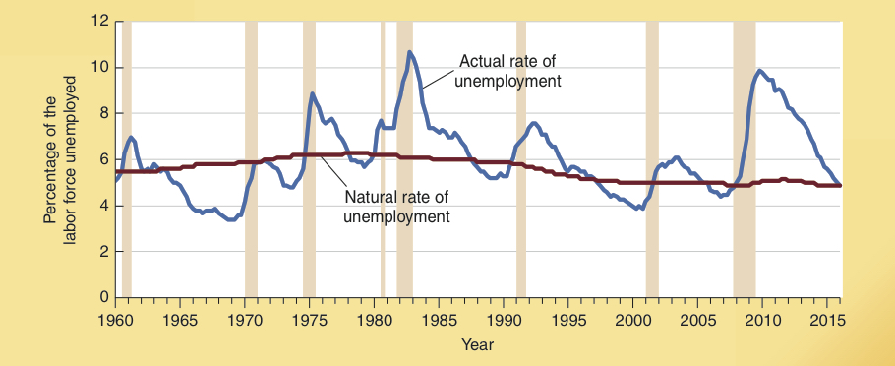
Unemployment and Output Are Linked Over the Business Cycle
The unemployment rate from 1960-2016 is illustrated here.
As expected, unemployment rose rapidly during each of the eight recessions (the shaded years indicate periods of recession).
In contrast, after each recession ended, the unemployment rate began to decline soon after the economy moved into an expansionary phase of the business cycle.
Note that the actual rate of unemployment was greater than the natural rate during and immediately following each recession.
Source: https://research.stlouisfed.org/fred2/.

Slide 21
The Concept of Full Employment
Full Employment: Level of employment resulting when the rate of unemployment is normal, considering both frictional and structural factors.
Full employment is closely related to the concept of the natural rate of unemployment.
Natural Rate of Unemployment: Level of unemployment that reflects “job shopping” in an economy of imperfect information and dynamic change.

Slide 22
The Concept of the Natural Rate of Employment
The natural rate of unemployment is:
neither a temporary high nor temporary low.
a rate that is both achievable and sustainable.
the level of unemployment accompanying an economy’s “maximum sustainable rate of output.”
Both demographic factors (e.g. young workers as a share of the labor force) and public policy (e.g. the level of unemployment benefits) influence the natural rate of unemployment.
Actual rate of unemployment generally rises above natural rate during a recession and falls below the natural rate during a boom.

Slide 23
Actual and Potential GDP

Slide 24
Actual and Potential GDP
Potential output: Maximum sustainable output level consistent with the economy’s resource base, given its institutional arrangements.
Actual and potential output will be equal when the economy is at full employment.

Slide 25
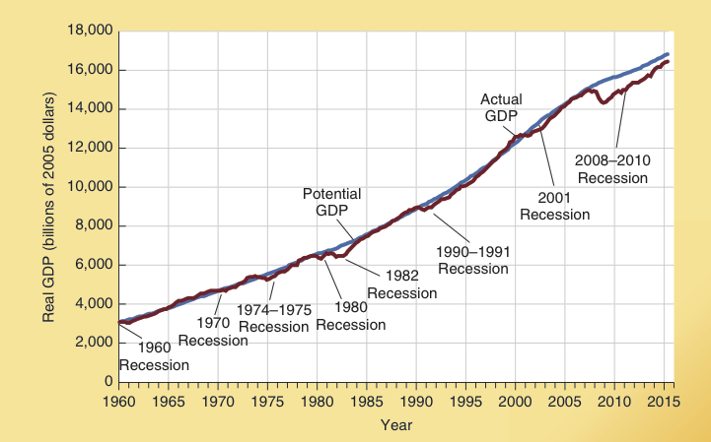
Actual and Potential GDP, 1960-2016
Here we illustrate both actual GDP & potential GDP.
Note the gap between actual and potential GDP during periods of recession.
Source: http://www.bls.gov

Slide 26
Questions for Thought:
1. During a recession, which of the following will be true?
a. Actual rate of unemployment will be lower than the natural rate.
b. Actual GDP will be lower than potential GDP.
c. Actual employment will exceed what is considered as full employment.
2. How will increased usage of the Internet by employers and employees influence the job search process? Will it tend to increase or decrease the natural rate of unemployment?
3. (True or false) When full employment is present the rate of unemployment will be zero.

Slide 27
Questions for Thought:
4. What is the relationship between full employment and the natural rate of unemployment? Why might the natural rate change?
5. Frictional unemployment is a result of:
(a) not enough jobs for everyone to be employed
(b) unemployed workers’ skills not matching those needed for available jobs
(c) a decline in the demand for labor, such as during a recession
(d) imperfect information & temporary periods of unemployment while workers change jobs

Slide 28
The Effects of Inflation

Slide 29
Inflation
Inflation is a change in the general level of prices as measured by a price index such as the GDP deflator or the consumer price index.
Inflation is generally measured at an annual rate.
When inflation is high, the year-to-year changes in the inflation rate are nearly always highly variable, making them difficult to predict.

Slide 30
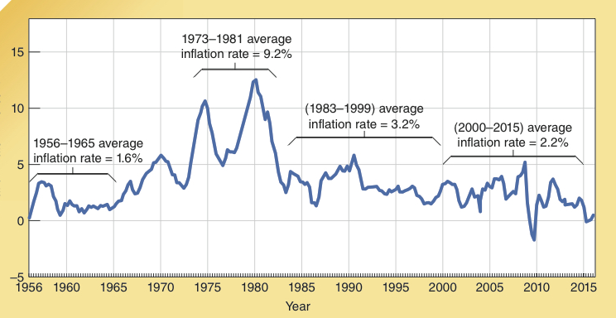
The Inflation Rate, 1956-2015
Between 1956 and 1965, the general price level increased at an average annual rate of only 1.6%.
In contrast, the inflation rate averaged 9.2% from 1973 to 1981, reaching double-digits during several years.
During 1983-1999 the inflation rate was much lower (3.2%).
Since 2000, the inflation rate has been lower still (2.2%).
Inflation Rate in Percent

Slide 31
Unanticipated and Anticipated Inflation
There are two different kinds of inflation:
Unanticipated inflation: An increase in the price level that comes as a surprise, at least for most individuals.
Anticipated inflation: A widely expected change in the price level.

Slide 32
Effects of Inflation
High and variable rates of inflation are harmful for several reasons:
Because unanticipated inflation alters the outcomes of long-term projects like the purchase of a machine or operation of a business, it will both increase the risks and retard the level of investment.
Inflation distorts the information delivered by prices.
People will respond to high and variable rates of inflation by spending less time producing and more time trying to protect their wealth and income from the uncertainty created by inflation.

Slide 33
What Causes Inflation?
Nearly all economists believe that rapid expansion in the money supply is the primary cause of inflation.

Slide 34
Questions for Thought:
Suppose that the CPI was 150 at the end of last year and 157.5 at the end of this year. What was the inflation rate during the year?
If decision makers anticipate an inflation rate of 3% at the start of a year and prices rise by 7% during the year, this is an example of
a. anticipated inflation.
b. an inflation rate higher than the anticipated.
c. an inflation rate lower than the anticipated.
3. (True or false) When the inflation rate is high and variable, decision makers will generally be able to anticipate year-to-year changes in inflation quite accurately.

Slide 35
Questions for Thought:
4. How would an unanticipated jump in inflation impact the wealth of:
a. Joe, who has a 30-yr home mortgage at a fixed interest rate
b. The McCoy's, who hold most of their wealth in long-term fixed yield bonds
c. Hanna, a retiree drawing a pension of a fixed dollar amount
d. Jose, a heavily indebted small-business owner.
e. Mike, the owner of an apartment complex with substantial debt at a fixed interest rate
f. Tina, a worker whose wages are determined by a 3-year union contract ratified three months ago

Slide 36
Questions for Thought:
5. What impact will high and variable rates of inflation have on the economy? How will they influence the risk accompanying long-term contracts and related business decisions?
6. Compared to the United States, labor markets in France, Italy, and Spain are characterized by more generous unemployment benefits. Other things constant, how will this influence the unemployment rate in in these countries compared to that in the U.S.? Explain.

Slide 37
End of
Chapter 8

