Slide 1


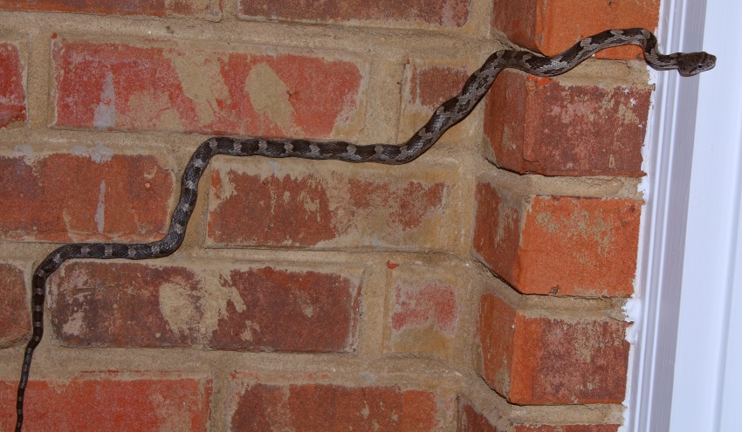
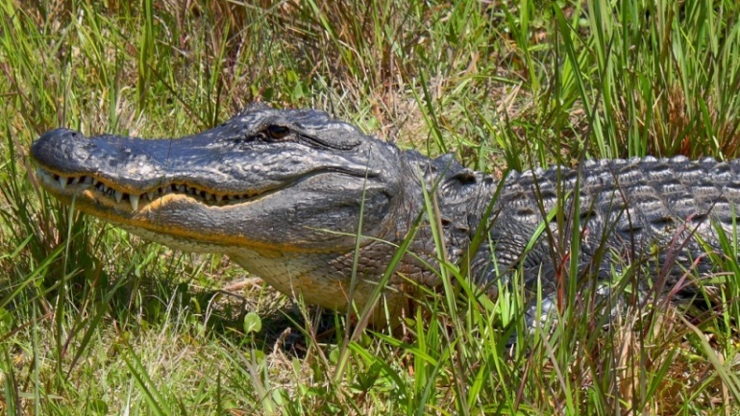
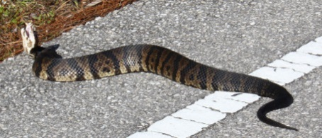
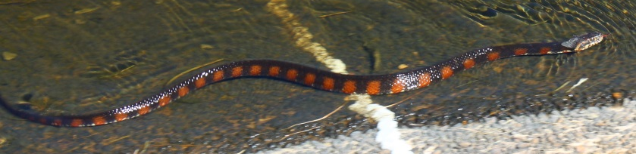



High-Field EPR Studies on Weak Exchange Interactions in Transition Metal Cluster Complexes
Andrew Ozarowski National High Magnetic Field Laboratory, Florida State University, Tallahassee, FL, USA
https://nationalmaglab.org
49th SEMRC (Oct 22-24, 2021)

Slide 2
Acknowledgments
Some of the results presented here were obtained in cooperation with:
Prof. Armando Pombeiro, Universidade de Lisboa
Prof. Vladimir Arion, University of Vienna
Prof. Alina Bienko, Wroclaw University, Poland
Prof. Rudolf van Eldik, University of Erlangen
NHMFL is supported by the NSF through the Cooperative Agreement No. DMR-1644779 and the State of Florida.
49th SEMRC (Oct 22-24)

Slide 3
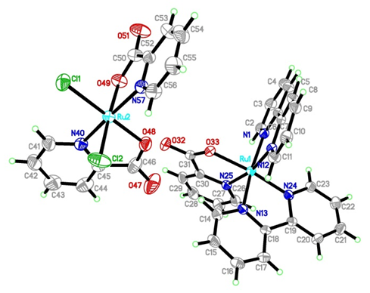
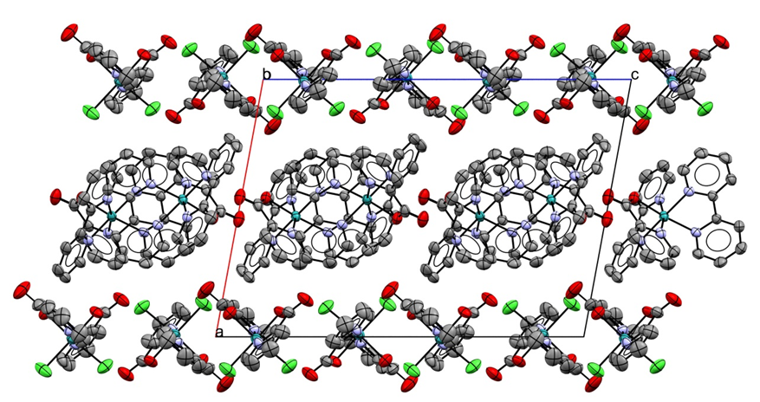
A Strange S=1/2 Complex [Ru^{II}(bipy)₂(pic)]⁺[cis-Ru^{III}Cl₂(pic)₂]⁻
49th SEMRC (Oct 22-24)
Notes:
Both Ru ions are six-coordinate in the deformed octahedral geometry. The Ru3+ ion is low-spin, as demonstrated by the magnetic susceptibility measurements. The Ru2+ and Ru3+ molecules are contained in separate layers in the crystal structure.

Slide 4
HFEPR Spectra – Frequency Dependence
g_{x} = 2.533, g_{y} = 2.440 and g_{z} = 1.705
typical for a low-spin d⁵ configuration (like low-spin Fe³⁺)
49th SEMRC (Oct 22-24)
Notes:
High-field EPR exhibits rhombic spectra with three very different g values, 2.533, 2.440 and 1.705. More interestingly, the feature corresponding to the largest g value was split into two components, separated by approximately 700 Gauss over a frequency range of 140–500 GHz. The lack of dependence of this splitting on the microwave frequency indicates that it is not due to two slightly different g values, as in such case the splitting would be proportional to frequency. The higher-field component of that pattern can be “frozen out” when recording spectra at sufficiently low temperatures. The feature at g = 1.705 also appears to consist of two components. The splitting between them is smaller than seen in the g = 2.533 feature and they are not clearly resolved. At sufficiently low temperature, only the higher-field component of that pair is seen. This behavior is consistent with a model of a S = 1 system resulting from the interactions between two S = ½ Ru(III) ions.

Slide 5
HFEPR Spectra – Temperature Dependence
g_{x} = 2.533, g_{y} = 2.440 and g_{z} = 1.705
The high-field component of the g_{x} signal disappears at low temperature,
indicating a negative D: D = ‒0.051 cm^{‒1}
49th SEMRC (Oct 22-24)
Notes:
The high-field component of the g_{x} signal disappears at low temperature,
indicating a negative D

Slide 6
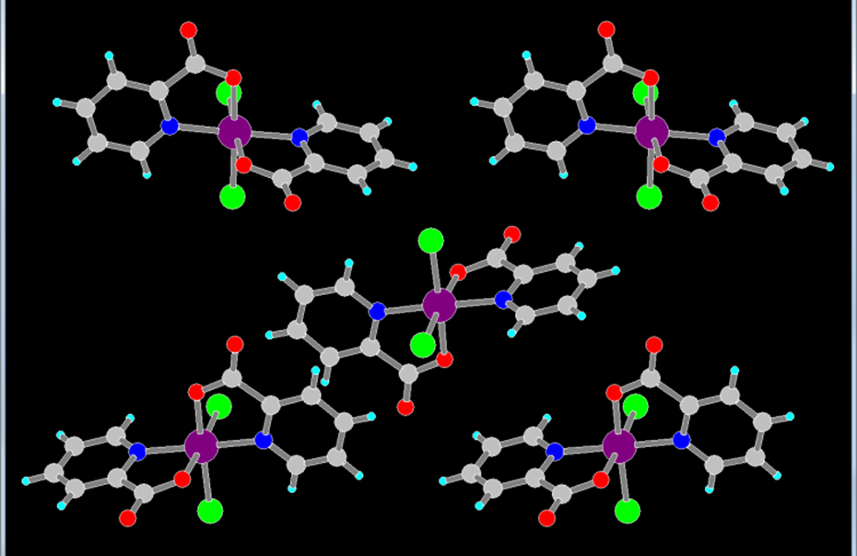
Notes:
The reason for the observed zero-field splitting appears to be a weak interaction between neighboring monomeric molecules.

Slide 7
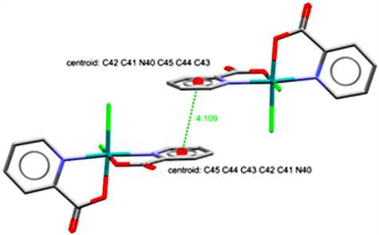
Conclusions:
A weak interaction mediated by the ligand, leads to the formation of an S=1 state, which exhibits zero-field splitting.
The splitting is loo large to be ascribed to the dipolar interactions only, and therefore the anisotropic exchange must be involved.
Impert, O., et al., Inorganic Chemistry, 59, 8609-8619 (2020) .
Notes:
The Ru-Ru distance is 8.699 Å and the π-π stacking interactions are observed between two pyridine rings. The magnitude of the D parameter, while very small, is still too large to be attributed to the dipole-dipole interactions between electrons localized on the Ru(III) ions at such distances. A possible explanation could be electron delocalization onto the pyridine rings, bringing some fraction of the two electronic densities closer to each other. Strengthening of the dipolar interactions due to electron delocalization has been reported. This effect is, however, still insufficient in the present case and presumably the anisotropic exchange must contribute to the zero-field splitting.

Slide 8
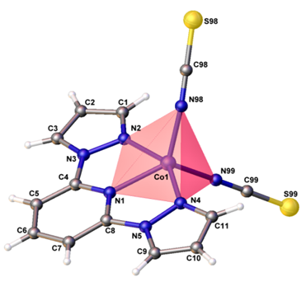
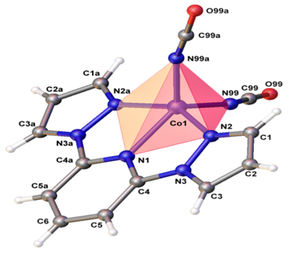
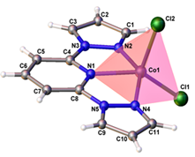
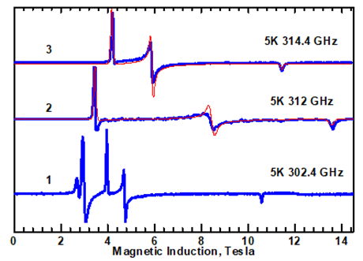
Pentacoordinate Cobalt(II) complexes

Slide 9
The distance between line 1 and 2 is 2600 G, independently of the frequency. Line 1 becomes weaker at higher fields and at lower temperatures (that’s why the 624 GHz spectrum needed to be run at 30 K).
Notes:
Unlikely the other two complexes, 1 exhibits additional major resonances at a lower magnetic field of ca. 3 T in Figure 12. The distance between these two lowest field resonances is about 2500 Gauss and is frequency independent, thus indicating a zero-field splitting. The effective g value read out in the middle between these lowest-field resonances equals 7.66. That 2500 G splitting is presumably associated with the presence of quasi-dimers in the lattice, in which the Co−Co distance equals 6.16 A. An effective g value as large as observed here can be generated from the intrinsic gx, gy values on the order of 2.8 when the E/D ratio is close to 1/3.

Slide 10
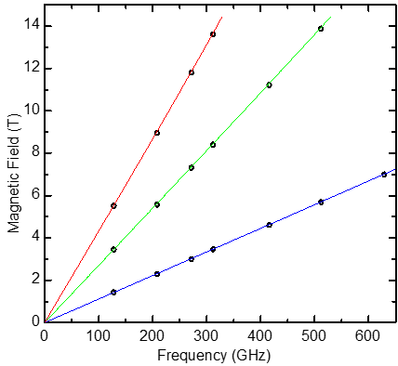

Slide 11
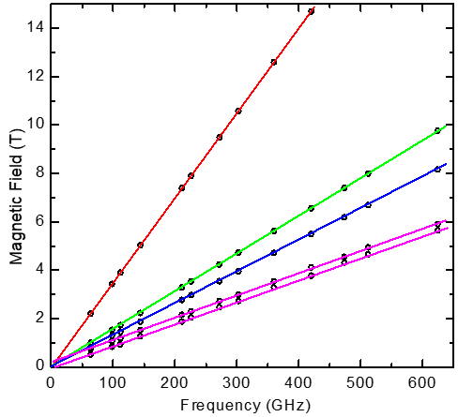

Slide 12
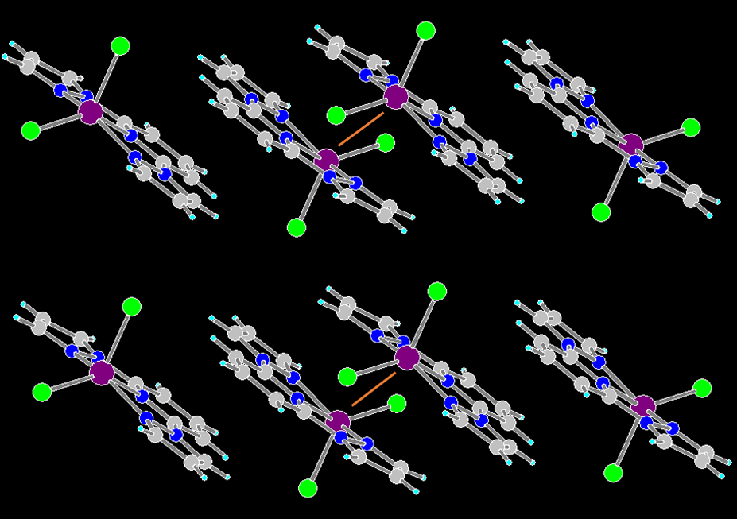
Switlicka, A., et al., Inorg. Chem. 2018, 57, 12740−12755

Slide 13
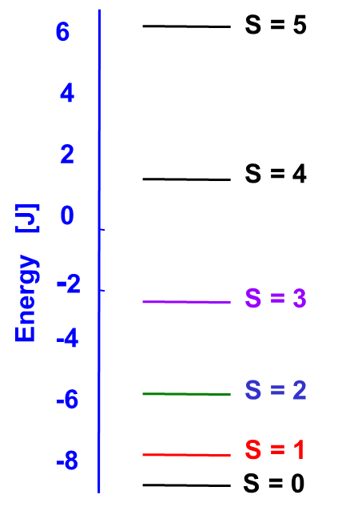
Non-Surprising Manifestation of Isotropic Exchange
49th SEMRC (Oct 22-24)

Slide 14
Detecting small isotropic exchange interactions by EPR
[Cu₂(H^{t}BuDea)₂(OAc)₂] [Cu₂(H^{n}BuDea)₂Cl₂] ₂
Compounds prepared by Prof. Pombeiro group, Lisbon
Nesterova, O. V., et al., Inorg. Chem., 57, 19, 12384 (2018)
49th SEMRC (Oct 22-24)

Slide 15
Cu-Cu: 2.947 Å Cu-Cu_{intra}= 2.963, 2.971 Å
Cu-Cu_{inter}: 2x 5.255, 2x 5.296 Å
49th SEMRC (Oct 22-24)

Slide 16
Simple Dimer
Ĥ = μ_{B}B·{g}·Ŝ + D { Ŝ_{z}² – S(S+1)/3 } + E (Ŝ_{x}² – Ŝ_{y}²)
g_{x} = 2.063, g_{y} = 2.063, g_{z} = 2.337, D = – 1.327 cm⁻¹, E = – 0.065 cm⁻¹
49th SEMRC (Oct 22-24)

Slide 17
Solid-state spectra of the dimer and of the tetramer
208.0 GHz, 80 K
Dimer
Tetramer
2
4
6
8
Magnetic Induction, Tesla
49th SEMRC (Oct 22-24)

Slide 18
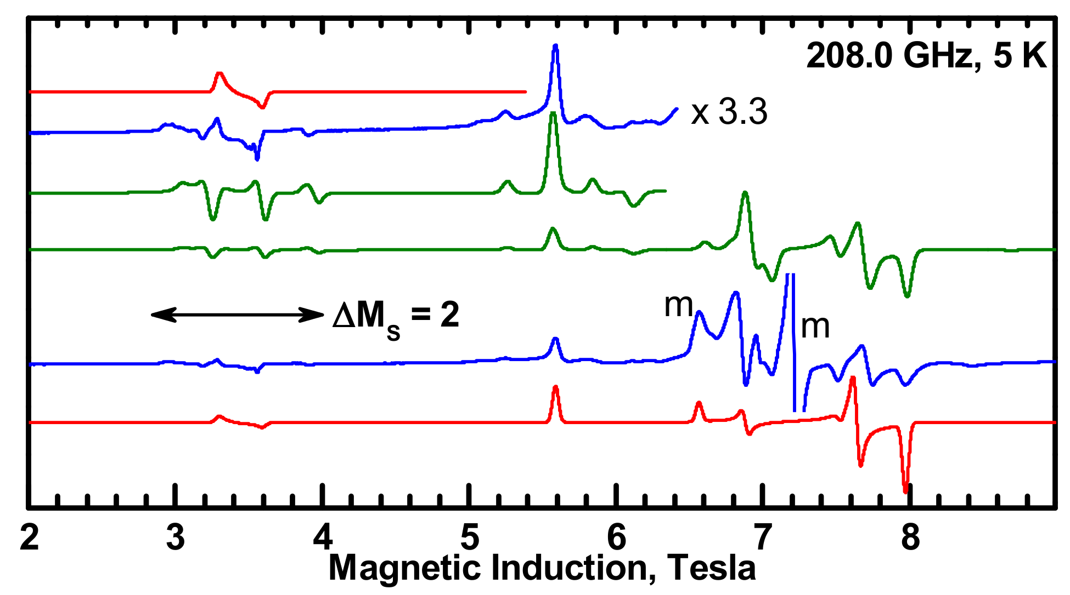
Spectra of the tetramer dissolved in DMSO + py
g_{x} = g_{y} = 2.04, g_{z} = 2.265, D = – 1.03 cm⁻¹, E = – 0.093 cm⁻¹
49th SEMRC (Oct 22-24)

Slide 19
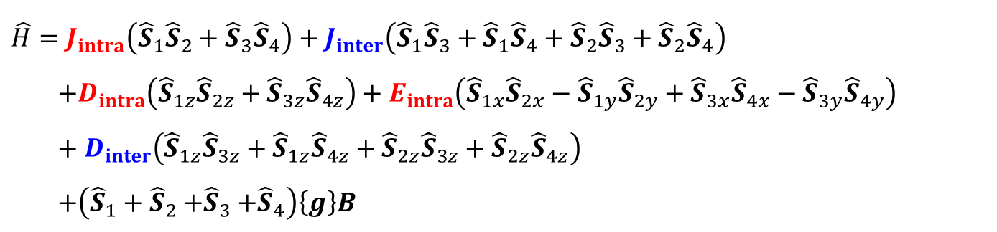
Ĥ = μ_{B}B·{g}·Ŝ + D { Ŝ_{z}² – S(S+1)/3 } + E (Ŝ_{x}² – Ŝ_{y}²)
$$\hat{H}=J_{intra}\left({\hat{S}}_{1}{\hat{S}}_{2}+{\hat{S}}_{3}{\hat{S}}_{4}\right)+J_{inter}\left({\hat{S}}_{1}{\hat{S}}_{3}+{\hat{S}}_{1}{\hat{S}}_{4}+{\hat{S}}_{2}{\hat{S}}_{3}+{\hat{S}}_{2}{\hat{S}}_{4}\right)$$
$$+D_{intra}\left({\hat{S}}_{1z}{\hat{S}}_{2z}+{\hat{S}}_{3z}{\hat{S}}_{4z}\right)+E_{intra}\left({\hat{S}}_{1x}{\hat{S}}_{2x}−{\hat{S}}_{1y}{\hat{S}}_{2y}+{\hat{S}}_{3x}{\hat{S}}_{4x}−{\hat{S}}_{3y}{\hat{S}}_{4y}\right)+D_{inter}\left({\hat{S}}_{1z}{\hat{S}}_{3z}+{\hat{S}}_{1z}{\hat{S}}_{4z}+{\hat{S}}_{2z}{\hat{S}}_{3z}+{\hat{S}}_{2z}{\hat{S}}_{4z}\right)$$
$$+\left({\hat{S}}_{1}+{\hat{S}}_{2}{+\hat{S}}_{3}+{\hat{S}}_{4}\right)\left\{g\right\}B$$
g_{x} = 2.04, g_{y} = 2.04, g_{z} = 2.255, D_{intra} = – 2.056 cm⁻¹, E_{intra} = – 0.186 cm⁻¹
D_{inter} = – 0.046 cm⁻¹ (dipolar interaction)
J_{intra} not determined
J_{inter} = – 0.3 cm⁻¹
Note: D_{intra} , E_{intra} correspond to 2D, 2E in a dimer
49th SEMRC (Oct 22-24)

Slide 20
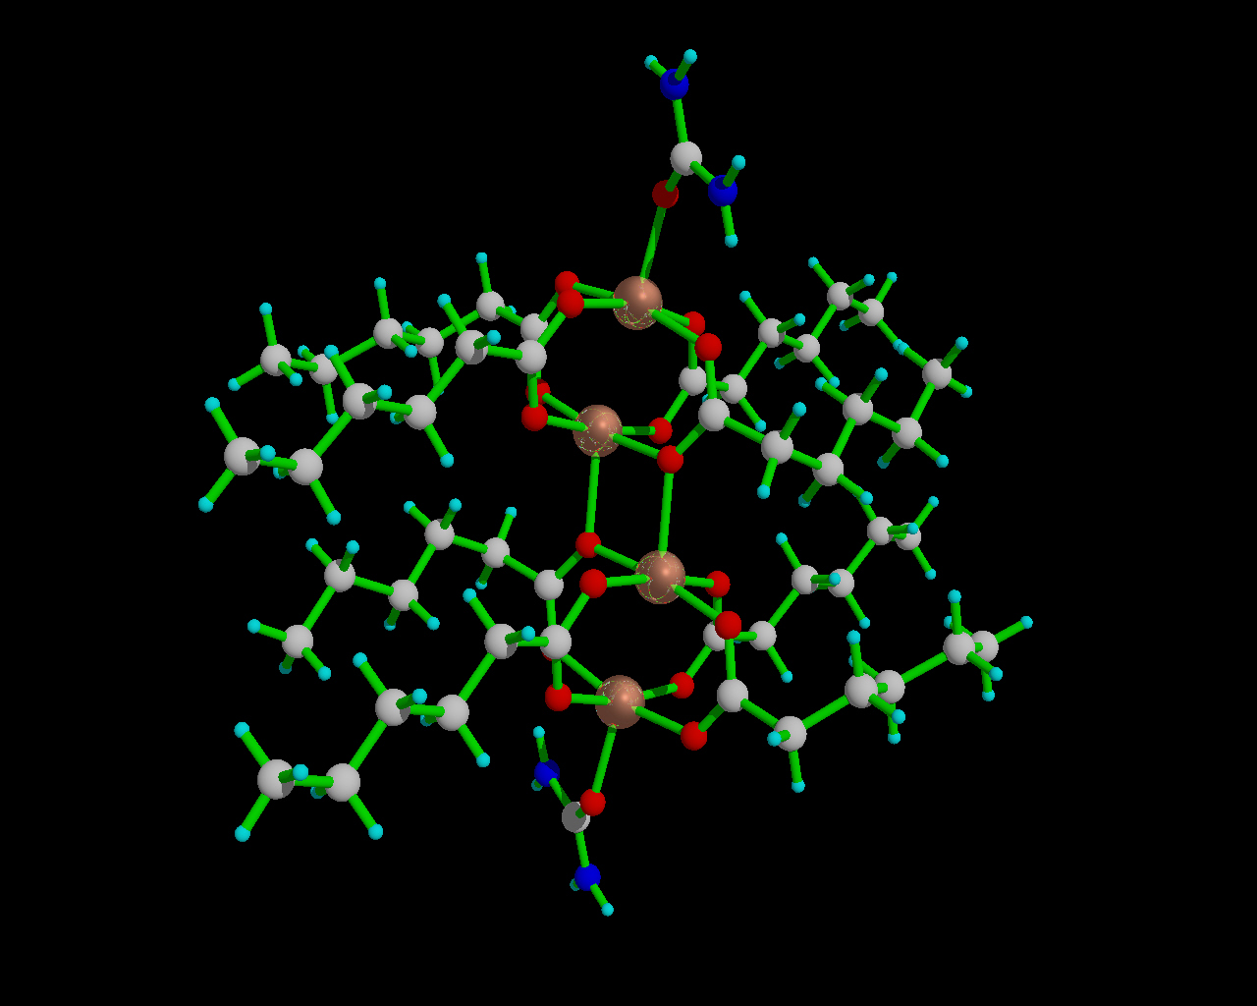
[{Cu(C₅H₁₁COO)₂}₂(urea)]₂
Synthesis and magnetism: Bojan Kozlevčar, et al., Inorganica Chimica Acta 357 (2004) 4220
49th SEMRC (Oct 22-24)

Slide 21
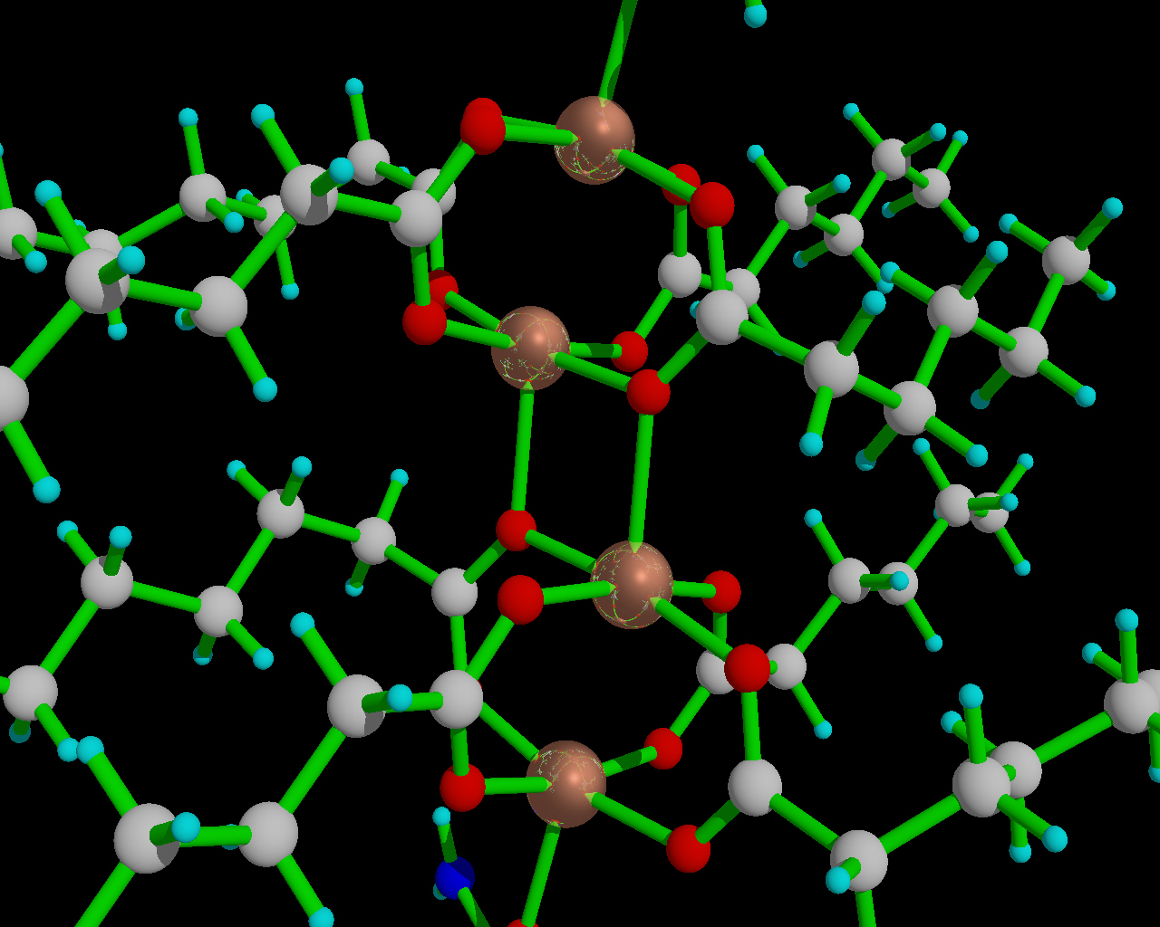
[{Cu(C₅H₁₁COO)₂}₂(urea)]₂
J₁₂ = 260 cm⁻¹ J₂₃ = ?

Slide 22
49th SEMRC (Oct 22-24)

Slide 23
49th SEMRC (Oct 22-24)

Slide 24
49th SEMRC (Oct 22-24)

Slide 25
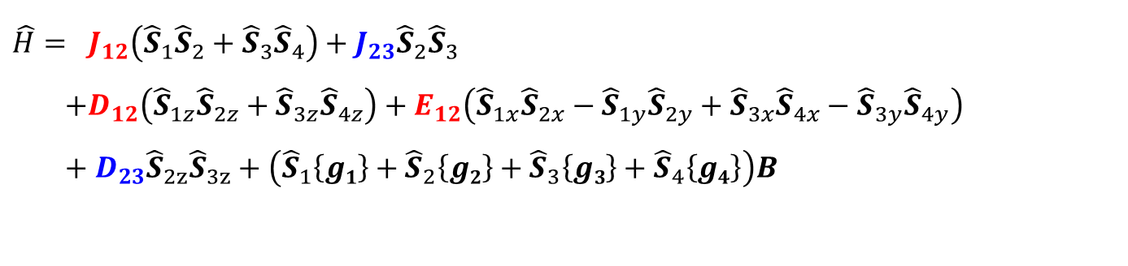
$$\hat{H}= J_{12}\left({\hat{S}}_{1}{\hat{S}}_{2}+{\hat{S}}_{3}{\hat{S}}_{4}\right)+J_{23}{\hat{S}}_{2}{\hat{S}}_{3}$$
$$+D_{12}\left({\hat{S}}_{1z}{\hat{S}}_{2z}+{\hat{S}}_{3z}{\hat{S}}_{4z}\right)+E_{12}\left({\hat{S}}_{1x}{\hat{S}}_{2x}−{\hat{S}}_{1y}{\hat{S}}_{2y}+{\hat{S}}_{3x}{\hat{S}}_{4x}−{\hat{S}}_{3y}{\hat{S}}_{4y}\right)+D_{23}{\hat{S}}_{2z}{\hat{S}}_{3z}+\left({\hat{S}}_{1}\left\{g1\right\}+{\hat{S}}_{2}{\left\{g2\right\}+\hat{S}}_{3}\left\{g3\right\}+{\hat{S}}_{4}\left\{g4\right\}\right)B$$
J₁₂ = 260 cm⁻¹ J₂₃ = ? D₁₂ = – 0.674 cm⁻¹, 2 x D_{dimer} for the Giant Spin Hamiltonian
D₂₃ = -0.17 cm⁻¹ calculated from the point-dipole model
R_{Cu2-Cu3} = 3. 23 Å all g tensors assumed parallel, their components are known

Slide 26
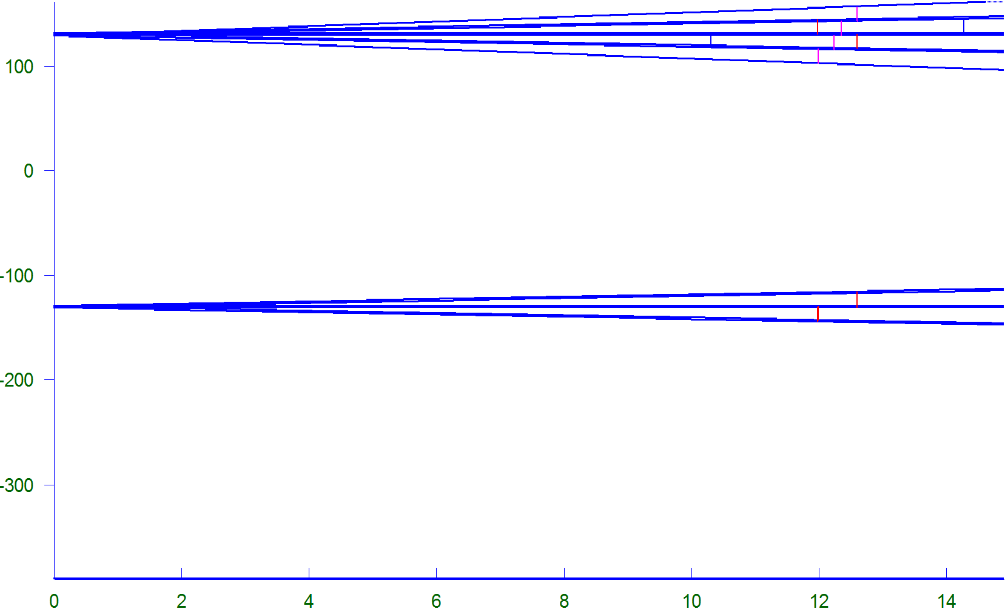
Energy levels of a Tetramer, J₁₂ >> J₂₃
1x S=2, 1x S=1, 1x S=0
2x S=1
1S=0
49th SEMRC (Oct 22-24)

Slide 27
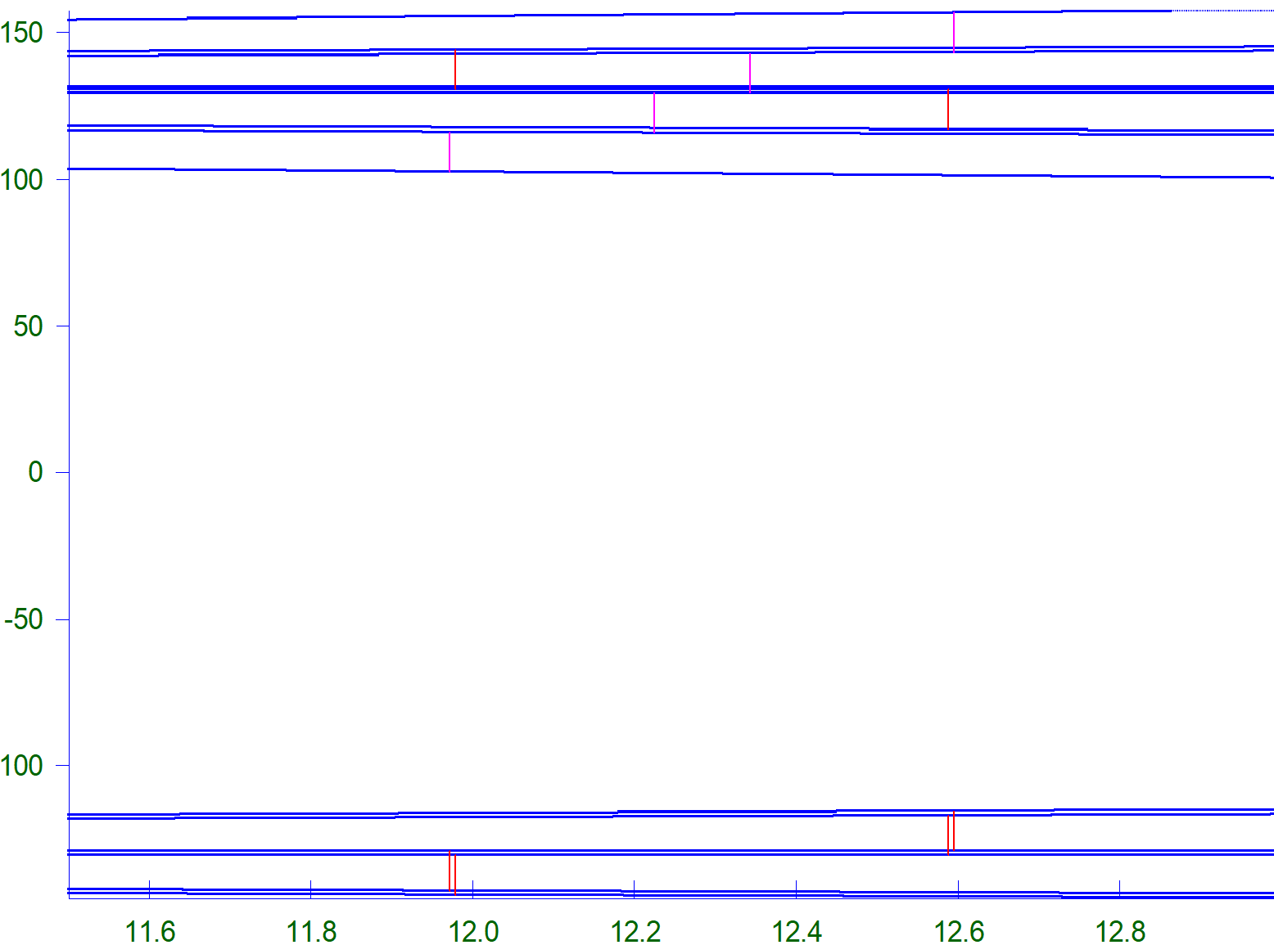
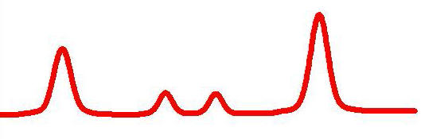
J₂₃ = - 3.0 cm⁻¹ must be assumed o obtain the observed pattern
1x S=2, 1x S=1, 1x S=0
2x S=1
49th SEMRC (Oct 22-24)

Slide 28
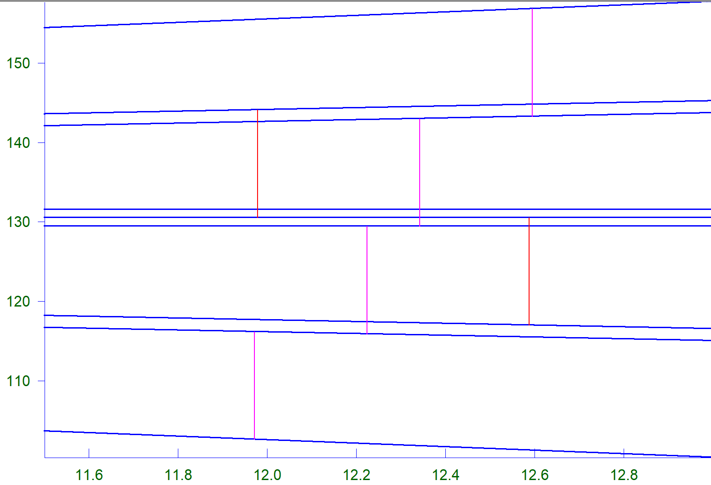
Q
S=0, M_{S}=0
T
Q
Q
T
S=1, M_{S}=0
S=2, M_{S}=0
Q
49th SEMRC (Oct 22-24)

Slide 29
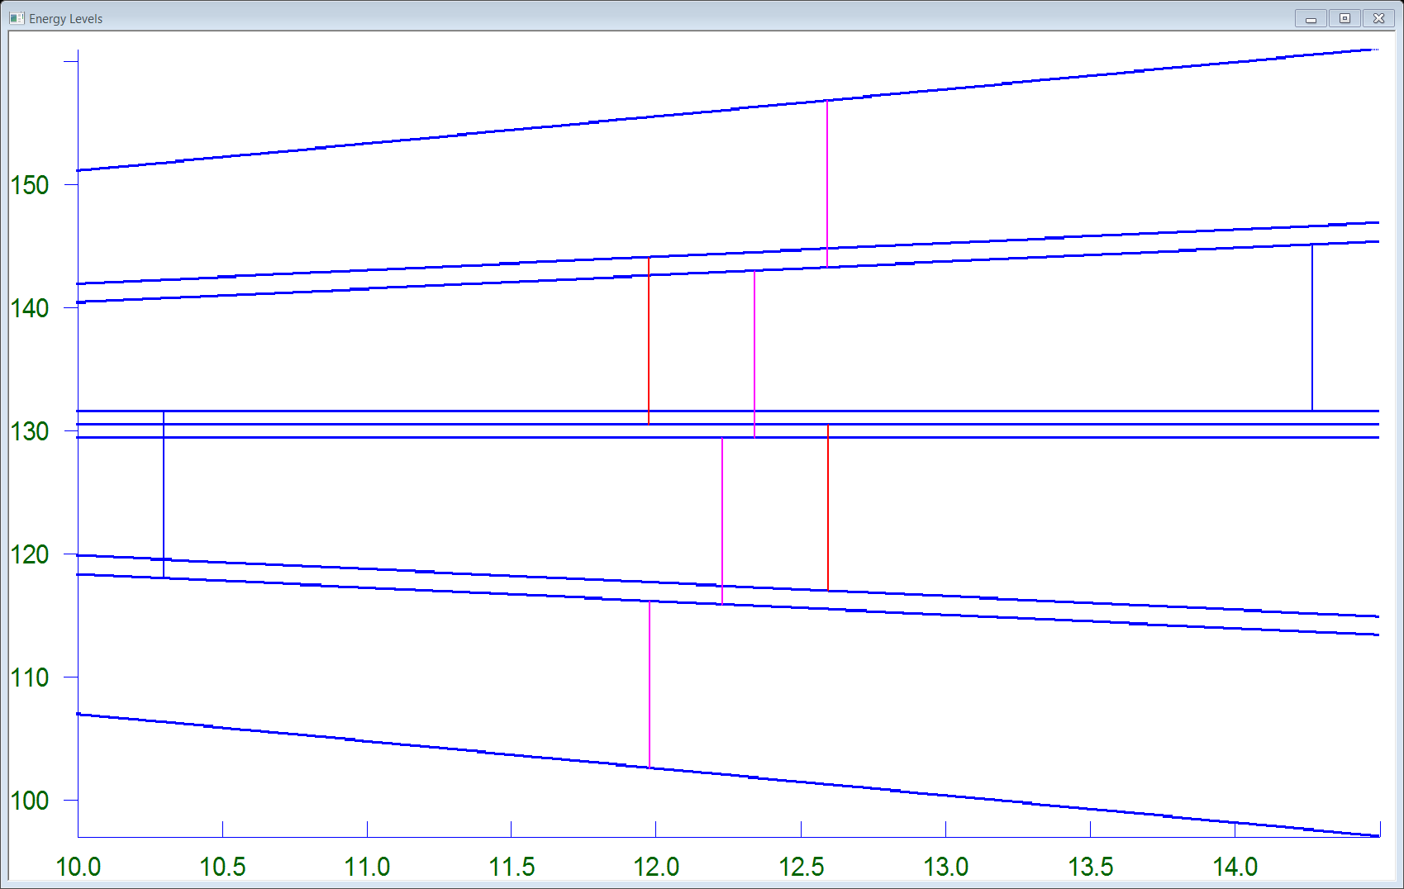
|0,0>  |2,1>
|0,0>  |2,-1>
49th SEMRC (Oct 22-24)

Slide 30
Simulated powder spectrum
49th SEMRC (Oct 22-24)

Slide 31
Simulated powder spectrum, 100 K
49th SEMRC (Oct 22-24)

Slide 32
X-Band Spectrum
49th SEMRC (Oct 22-24)

Slide 33
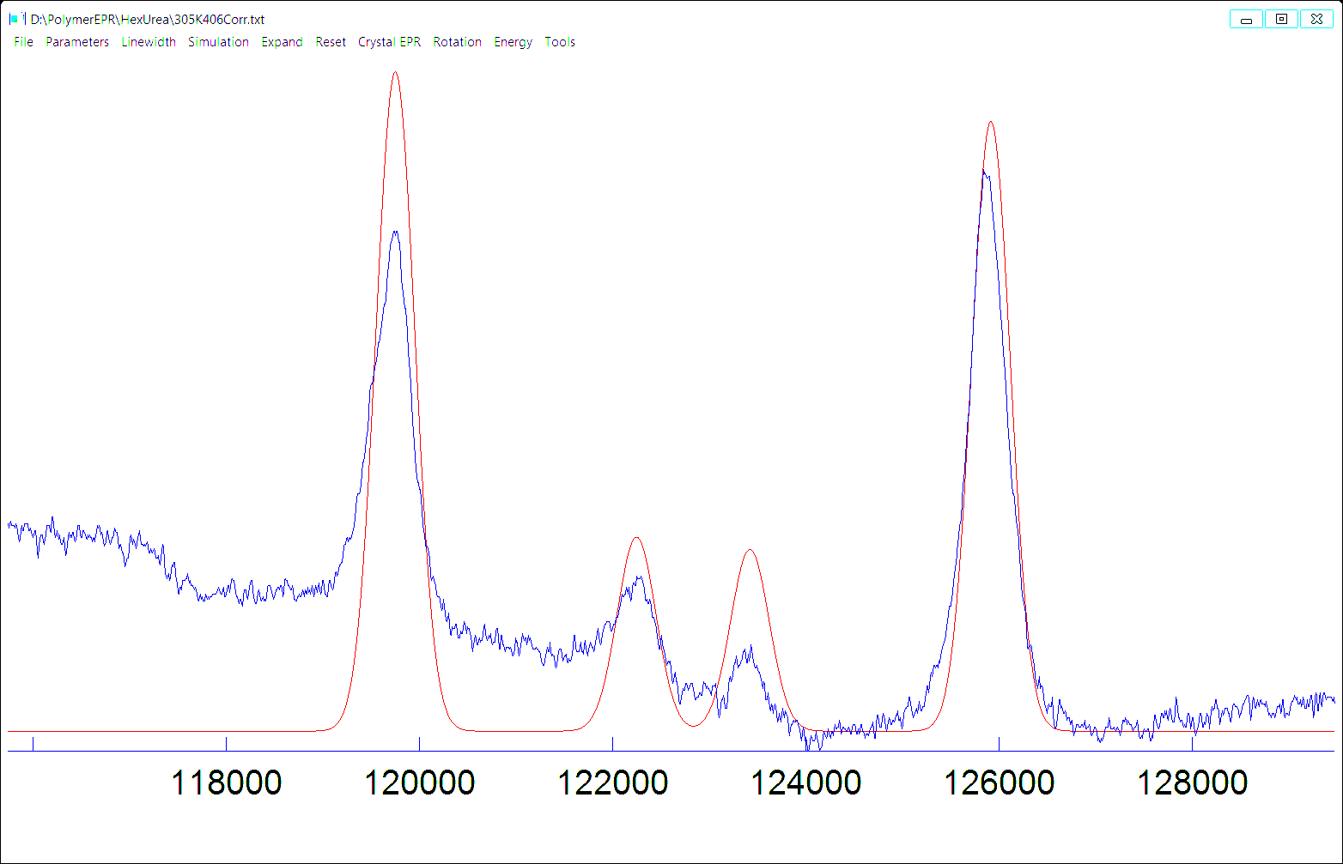
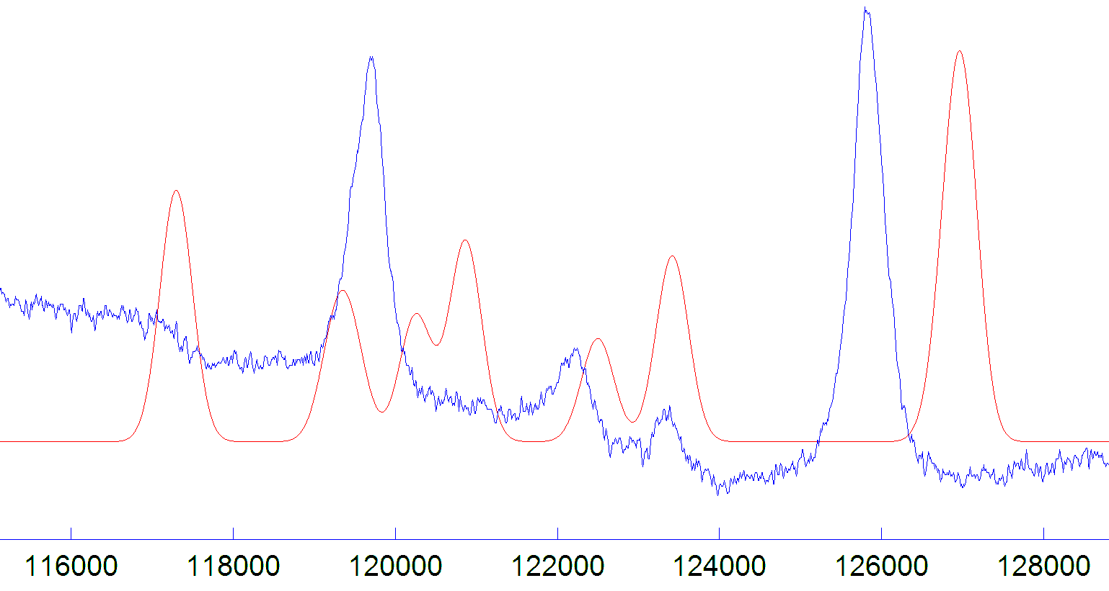
49th SEMRC (Oct 22-24)

Slide 34
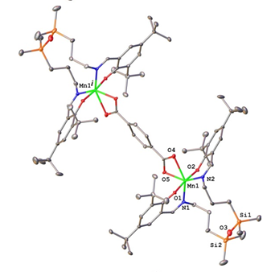
Dinuclear Manganese(III) Complexes
g_{x} = g_{y} = g_{z} = 1.991, D = + 2.997 cm⁻¹, E = 0.53 cm⁻¹
Shova, S.; et al., Dalton Trans., 48, 18, 5909 (2019)
49th SEMRC (Oct 22-24)

Slide 35

7.5
8.0
8.5
9.0
9.5
Magnetic Field (T)
D₁₂ = -0.004 cm⁻¹,(calculated dipolar interaction), J = 0.035 cm⁻¹
49th SEMRC (Oct 22-24)

Slide 36
49th SEMRC (Oct 22-24)

Slide 37
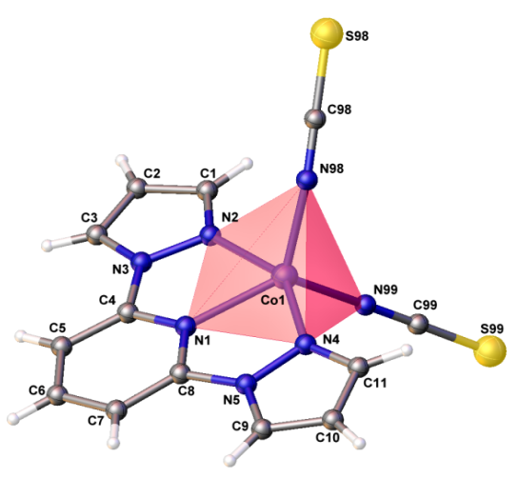
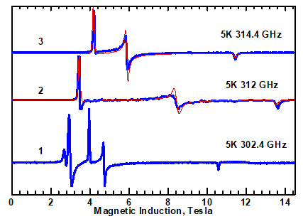
Pentacoordinate High-Spin Co(II) Complexes
Switlicka, A., et al., Inorg. Chem., 57, 12740 (2018)
49th SEMRC (Oct 22-24)

Slide 38
Taking J = -0.14 cm⁻¹ reproduces the observed splitting
49th SEMRC (Oct 22-24)

Slide 39
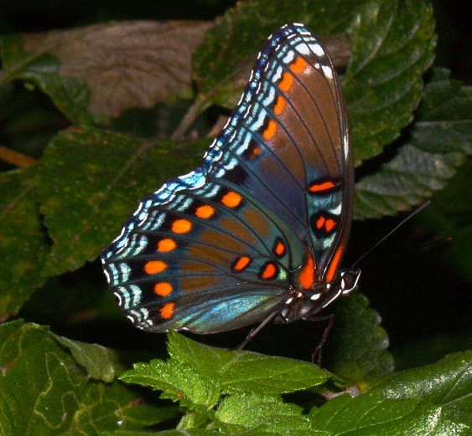
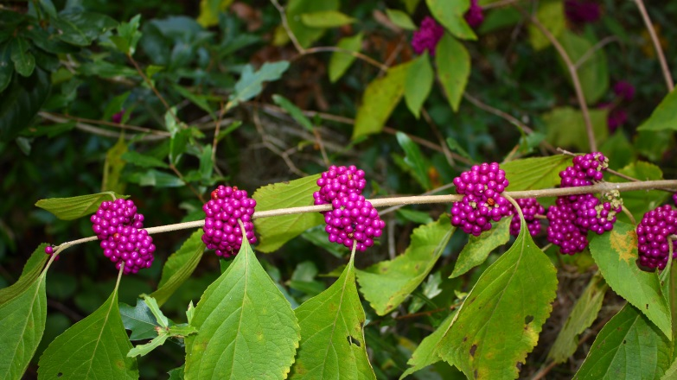
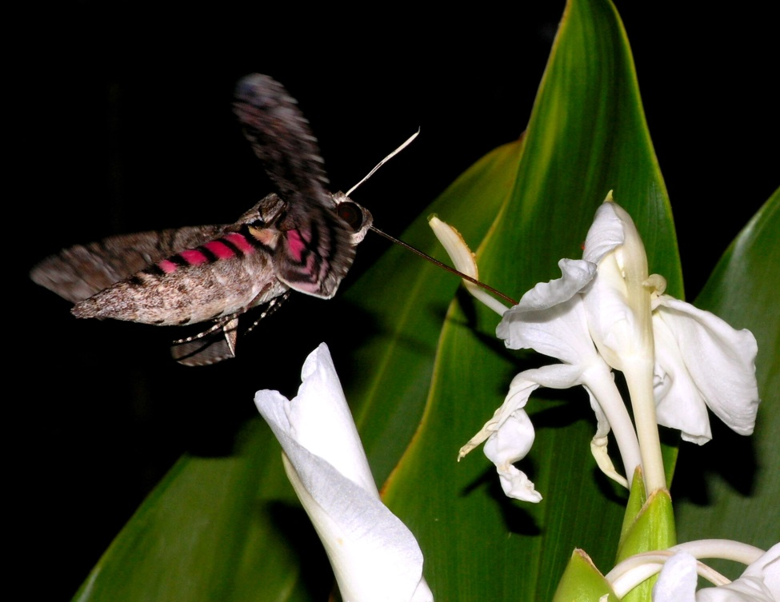
Thank you for your attention
49th SEMRC (Oct 22-24)

