Slide 1
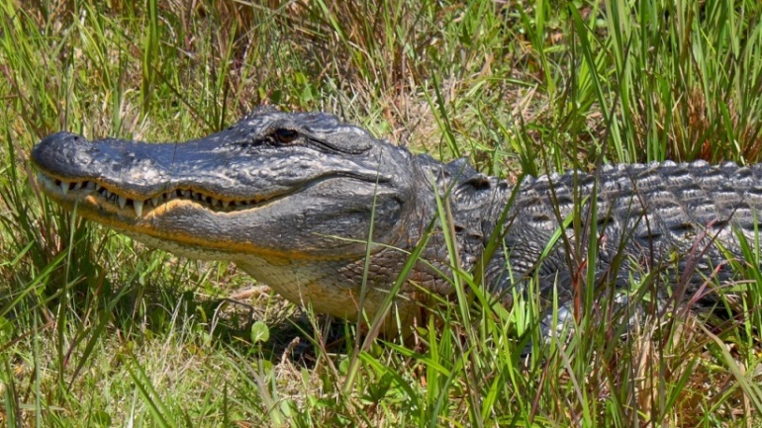
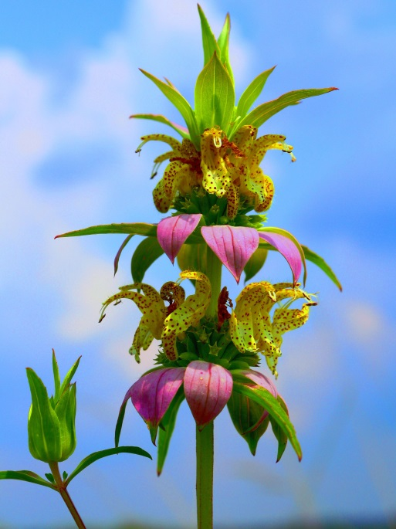



High-field and -frequency Electron Paramagnetic Rresonance studies on metal-metal interactions in transition metal complex compounds
Andrzej Ożarowski National High Magnetic Field Laboratory, Florida State University, Tallahassee, FL, USA
https://nationalmaglab.org
62. Zjazd Naukowy PTChem
4 września 2019, Warszawa

Slide 2

Acknowledgments
NHMFL is supported by the NSF through the Cooperative Agreement No. DMR-1644779 and the State of Florida.
62. Zjazd Naukowy PTChem
4 września 2019, Warszawa

Slide 3
Binuclear Oxygen-Bridged Fe(III) Complexes
H=JS₁S₂

Slide 4
[Fe(phen)₂]₂O(NO₃)₄·7H₂O
Q-Band simulated for S=2
Q-Band experimental
X-Band simulated for S=2
x20: S = 1 !
X-Band experimental
Ozarowski, A.; et al., Inorganic Chemistry, 34, 5558 (1995)
0.2
0.4
0.6
0.8
1.0
1.2
1.4
Magnetic Induction, Tesla

Slide 9
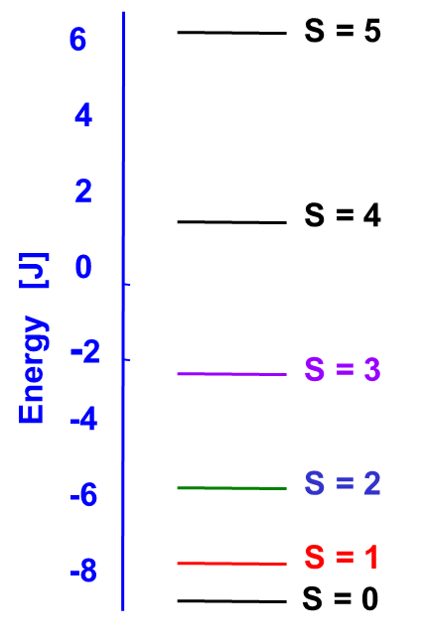
Binuclear, Oxygen-Bridged Fe(III) Complexes
J = 200 cm⁻¹
Ĥ = μ_{B}B·{g}·Ŝ + D { Ŝ_{z}² – S(S+1)/3 } + E (Ŝ_{x}² – Ŝ_{y}²)
62. Zjazd Naukowy PTChem
4 września 2019, Warszawa

Slide 11
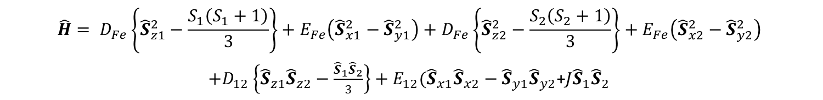
$$\hat{H}= D_{Fe}\left\{{\hat{S}}_{z1}^{2}−\frac{S_{1}\left(S_{1}+1\right)}{3}\right\}+E_{Fe}\left({\hat{S}}_{x1}^{2}−{\hat{S}}_{y1}^{2}\right)+D_{Fe}\left\{{\hat{S}}_{z2}^{2}−\frac{S_{2}\left(S_{2}+1\right)}{3}\right\}+E_{Fe}\left({\hat{S}}_{x2}^{2}−{\hat{S}}_{y2}^{2}\right)$$
$+D_{12}\left\{{\hat{S}}_{z1}{\hat{S}}_{z2}−\frac{{\hat{S}}_{1}{\hat{S}}_{2}}{3}\right\}+E_{12}({\hat{S}}_{x1}{\hat{S}}_{x2}−{\hat{S}}_{y1}{\hat{S}}_{y2}$+$J{\hat{S}}_{1}{\hat{S}}_{2}$
↔
Ĥ_{S} = D_{S} { Ŝ_{z}²-S(S+1)/3 } + E_{S} (Ŝ_{x}²- Ŝ_{y}²)
Each spin state has its own g matrix as well as D and E
The transition from one Hamiltonian to the other is accomplished by using the coefficients α_{S} and β_{S}:
D_{S} = α_{S} D₁₂ + β_{S} (D_{Fe1} + D_{Fe2}) D₁₂ = D_{dipole-dipole} + D_{exchange}
E_{S} = α_{S} E₁₂ + β_{S} (E_{Fe1} + E_{Fe2}) E₁₂ = E_{dipole-dipole} + E_{exchange}

Slide 12
Let’s use the “Giant Spin” Hamiltonian
In the Fe(III) dimers, d⁵ – d⁵,
D_{S=1} = 3.7 D₁₂ - 6.4 D₁ E_{S=1} = 3.7 E₁₂ - 6.4 E₁
D_{S=2} = (41/42) D₁₂ - (20/21) D₁ E_{S=2} = (41/42) E₁₂ - (20/21) E₁
D_{S=1} = 12.66 cm⁻¹ E_{S=1} = 1.31 cm⁻¹
D_{S=2} = 0.915 cm⁻¹ E_{S=2} = 0.255 cm⁻¹
D₁₂ = - 2.276 cm⁻¹ D₁ = - 3.294 cm⁻¹
E₁₂ = 0.141 cm⁻¹ E₁ = - 0.123 cm⁻¹

Slide 13
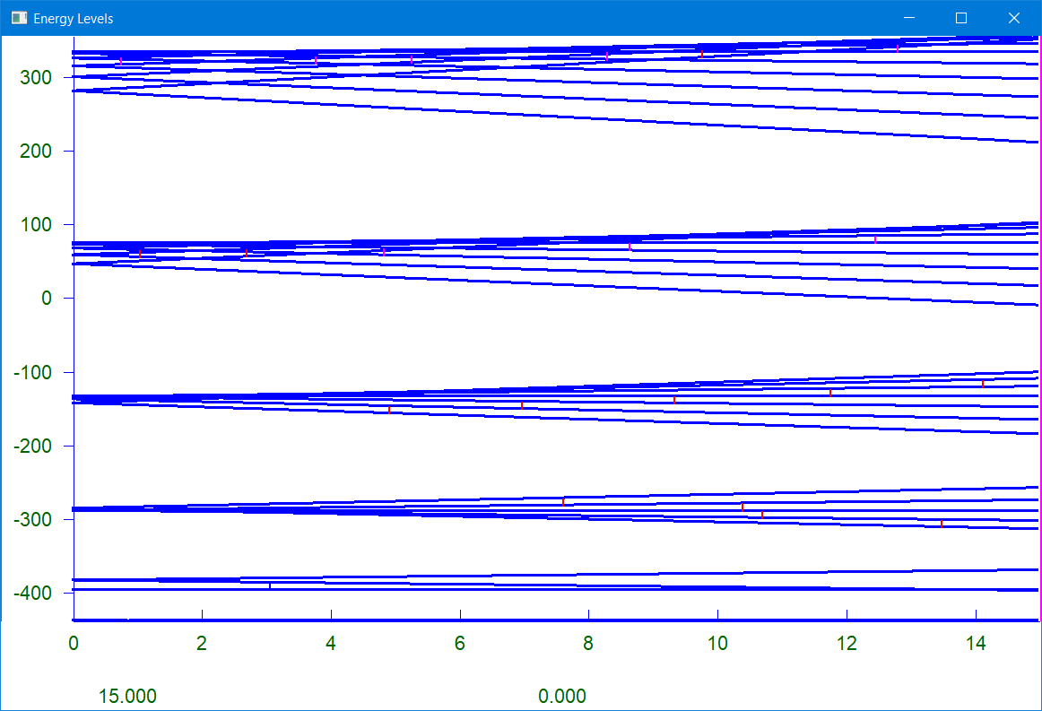

Slide 14
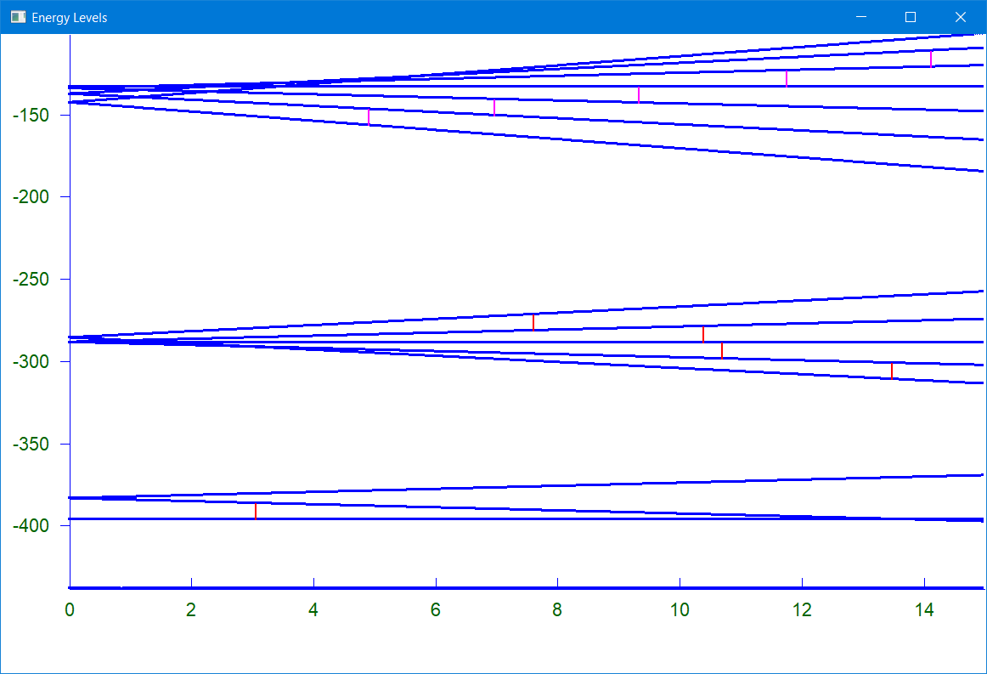

Slide 15
Detecting small isotropic exchange interactions by EPR
[Cu₂(H^{t}BuDea)₂(OAc)₂] [Cu₂(H^{n}BuDea)₂Cl₂] ₂
N-tert-butyldiethanolamine N-butyldiethanolamine
Compounds prepared by Prof. Pombeiro group, Lisbon
Nesterova, O. V., et al., Inorg. Chem., 57, 19, 12384 (2018)
62. Zjazd Naukowy PTChem
4 września 2019, Warszawa

Slide 16
Cu-Cu: 2.947 Å Cu-Cu_{intra}= 2.963, 2.971 Å
Cu-Cu_{inter}: 2x 5.255, 2x 5.296 Å
62. Zjazd Naukowy PTChem
4 września 2019, Warszawa

Slide 17
Simple Dimer
Ĥ = μ_{B}B·{g}·Ŝ + D { Ŝ_{z}² – S(S+1)/3 } + E (Ŝ_{x}² – Ŝ_{y}²)
g_{x} = 2.063, g_{y} = 2.063, g_{z} = 2.337, D = – 1.327 cm⁻¹, E = – 0.065 cm⁻¹
62. Zjazd Naukowy PTChem
4 września 2019, Warszawa

Slide 18
Solid-State Spectra of the Dimer and of the Tetramer
208.0 GHz, 80 K
Dimer
Tetramer
2
4
6
8
Magnetic Induction, Tesla
62. Zjazd Naukowy PTChem
4 września 2019, Warszawa

Slide 19
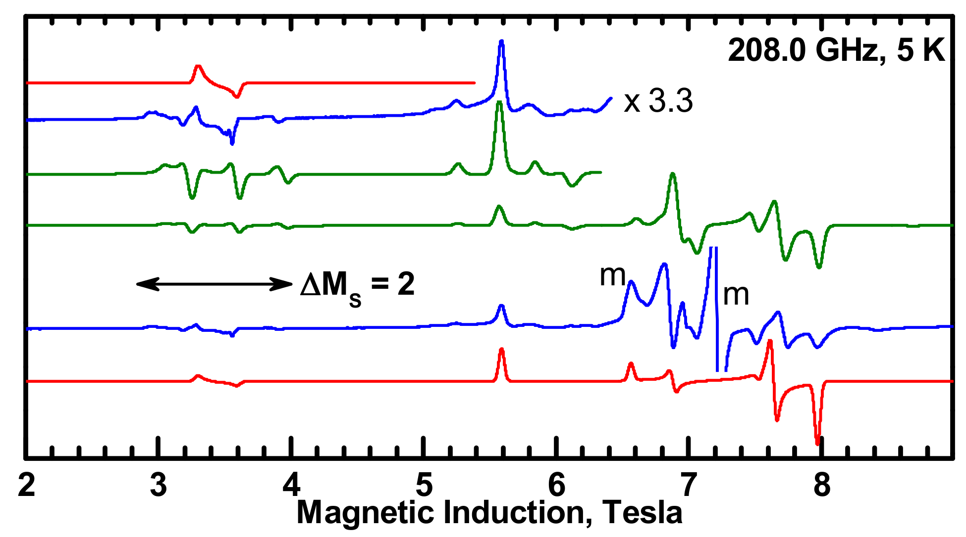
Spectra of the tetramer dissolved in DMSO + py
g_{x} = g_{y} = 2.04, g_{z} = 2.265, D = – 1.03 cm⁻¹, E = – 0.093 cm⁻¹
62. Zjazd Naukowy PTChem
4 września 2019, Warszawa

Slide 20
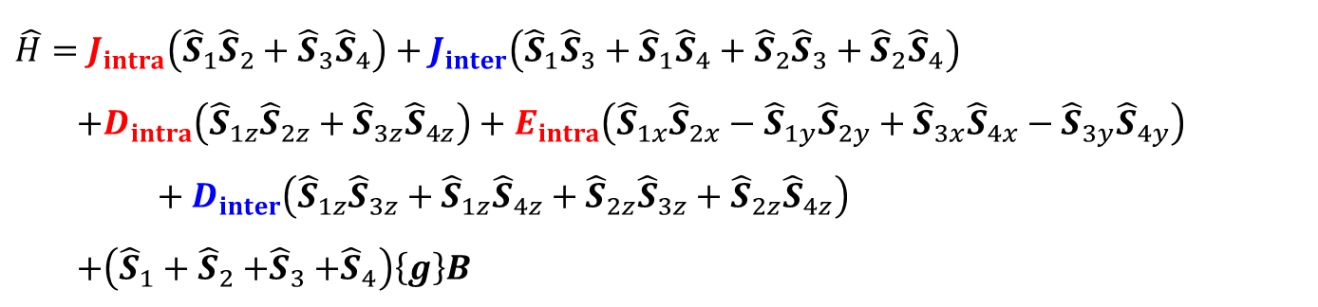
$$\hat{H}=J_{intra}\left({\hat{S}}_{1}{\hat{S}}_{2}+{\hat{S}}_{3}{\hat{S}}_{4}\right)+J_{inter}\left({\hat{S}}_{1}{\hat{S}}_{3}+{\hat{S}}_{1}{\hat{S}}_{4}+{\hat{S}}_{2}{\hat{S}}_{3}+{\hat{S}}_{2}{\hat{S}}_{4}\right)$$
$$+D_{intra}\left({\hat{S}}_{1z}{\hat{S}}_{2z}+{\hat{S}}_{3z}{\hat{S}}_{4z}\right)+E_{intra}\left({\hat{S}}_{1x}{\hat{S}}_{2x}−{\hat{S}}_{1y}{\hat{S}}_{2y}+{\hat{S}}_{3x}{\hat{S}}_{4x}−{\hat{S}}_{3y}{\hat{S}}_{4y}\right)+D_{inter}\left({\hat{S}}_{1z}{\hat{S}}_{3z}+{\hat{S}}_{1z}{\hat{S}}_{4z}+{\hat{S}}_{2z}{\hat{S}}_{3z}+{\hat{S}}_{2z}{\hat{S}}_{4z}\right)$$
$$+\left({\hat{S}}_{1}+{\hat{S}}_{2}{+\hat{S}}_{3}+{\hat{S}}_{4}\right)\left\{g\right\}B$$
g_{x} = 2.04, g_{y} = 2.04, g_{z} = 2.255, D_{intra} = – 2.056 cm⁻¹, E_{intra} = – 0.186 cm⁻¹
D_{inter} = – 0.046 cm⁻¹ (dipolar interaction)
J_{intra} not determined, as spectra are not sensitive to its magnitude
J_{inter} = – 0.3 cm⁻¹
62. Zjazd Naukowy PTChem
4 września 2019, Warszawa

Slide 21
Spectra of the tetramer dissolved in DMSO + py
*
*
*
*
g_{x} = g_{y} = 2.04, g_{z} = 2.265, D = – 1.03 cm⁻¹, E = – 0.093 cm⁻¹
62. Zjazd Naukowy PTChem
4 września 2019, Warszawa

Slide 22
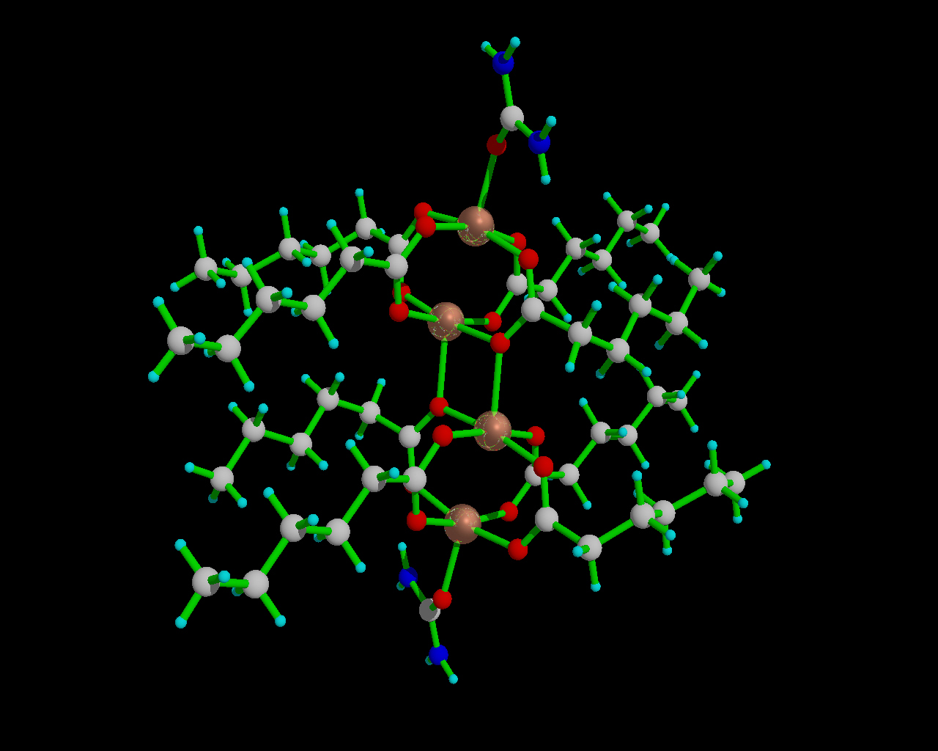
[{Cu(C₅H₁₁COO)₂}₂(urea)]₂
Synthesis and magnetism: B. Kozlevčar, et al., Inorganica Chimica Acta 357 (2004) 4220
62. Zjazd Naukowy PTChem
4 września 2019, Warszawa

Slide 23
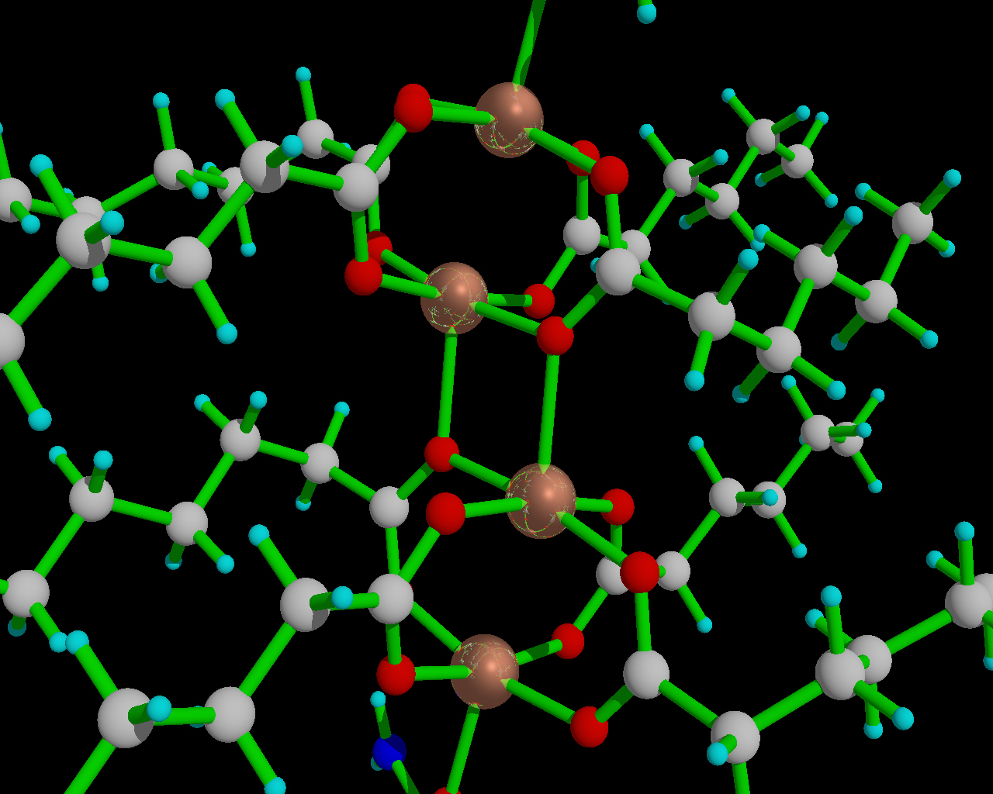
[{Cu(C₅H₁₁COO)₂}₂(urea)]₂
J₁₂ = 260 cm⁻¹ J₂₃ = ?

Slide 24
62. Zjazd Naukowy PTChem
4 września 2019, Warszawa

Slide 25
62. Zjazd Naukowy PTChem
4 września 2019, Warszawa

Slide 26
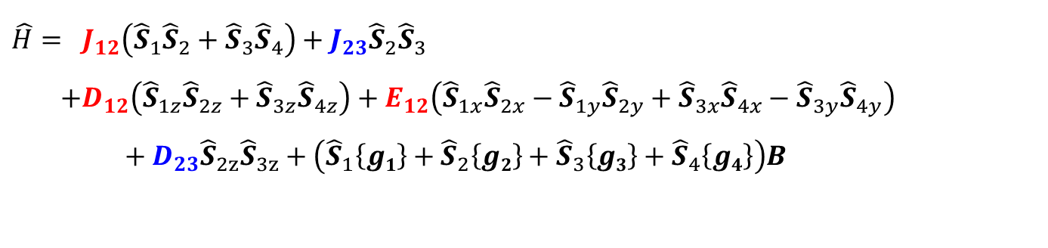
$$\hat{H}= J_{12}\left({\hat{S}}_{1}{\hat{S}}_{2}+{\hat{S}}_{3}{\hat{S}}_{4}\right)+J_{23}{\hat{S}}_{2}{\hat{S}}_{3}$$
$$+D_{12}\left({\hat{S}}_{1z}{\hat{S}}_{2z}+{\hat{S}}_{3z}{\hat{S}}_{4z}\right)+E_{12}\left({\hat{S}}_{1x}{\hat{S}}_{2x}−{\hat{S}}_{1y}{\hat{S}}_{2y}+{\hat{S}}_{3x}{\hat{S}}_{4x}−{\hat{S}}_{3y}{\hat{S}}_{4y}\right)+D_{23}{\hat{S}}_{2z}{\hat{S}}_{3z}+\left({\hat{S}}_{1}\left\{g1\right\}+{\hat{S}}_{2}{\left\{g2\right\}+\hat{S}}_{3}\left\{g3\right\}+{\hat{S}}_{4}\left\{g4\right\}\right)B$$
J₁₂ = 260 cm⁻¹ J₂₃ = ? D₁₂ = – 0.674 cm⁻¹, 2 x D of the Giant Spin Hamiltonian
D₂₃ = -0.17 cm⁻¹ calculated from the point-dipole model
R_{Cu2-Cu3} = 3. 23 Å all g tensors assumed parallel, their components are known
62. Zjazd Naukowy PTChem
4 września 2019, Warszawa

Slide 27
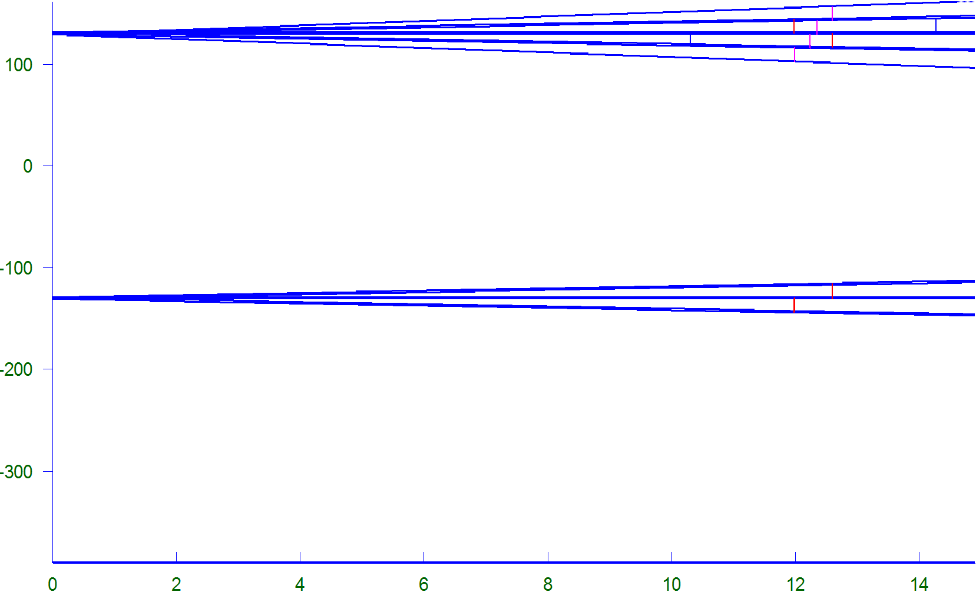
Energy levels of a Tetramer, J₁₂ >> J₂₃
Energy, cm⁻¹
1x S=2, 1x S=1, 1x S=0
2x S=1
1S=0
Magnetic Field (T)
62. Zjazd Naukowy PTChem
4 września 2019, Warszawa

Slide 28
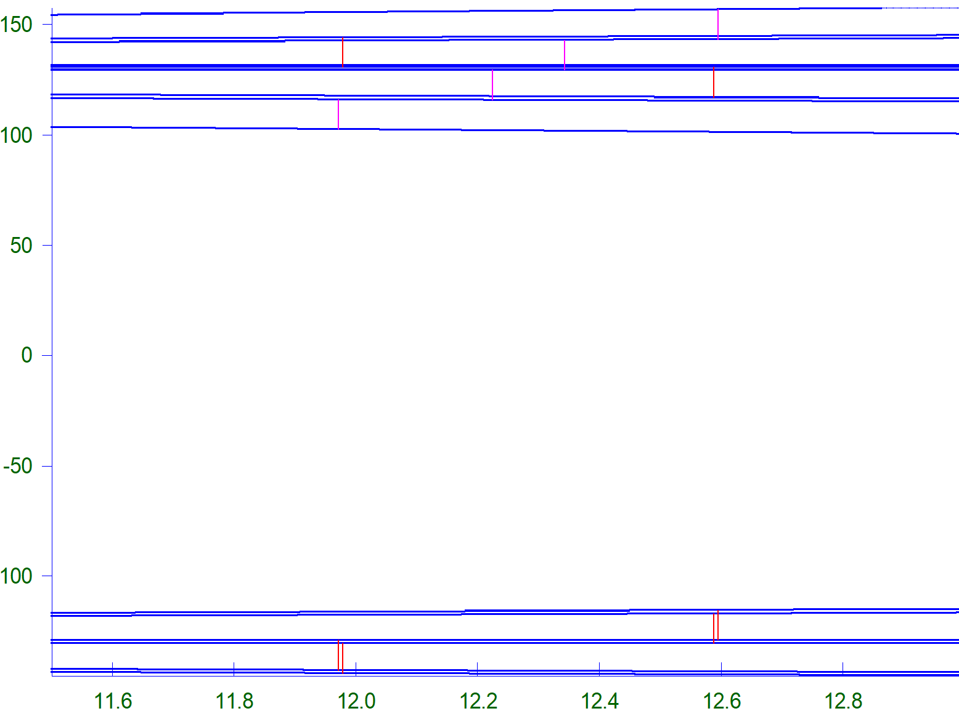
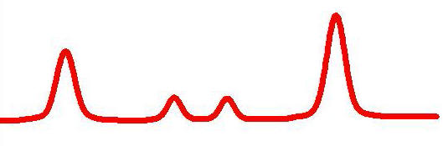
J₂₃ = - 3.0 cm⁻¹ must be assumed to obtain the observed pattern
1x S=2, 1x S=1, 1x S=0
Energy, cm⁻¹
2x S=1
62. Zjazd Naukowy PTChem
4 września 2019, Warszawa

Slide 29
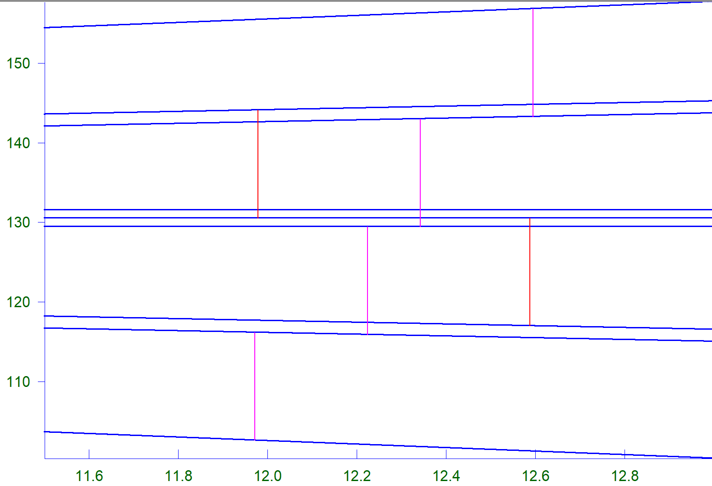
Q
S=0, M_{S}=0
T
Q
Q
T
S=1, M_{S}=0
S=2, M_{S}=0
Q
62. Zjazd Naukowy PTChem
4 września 2019, Warszawa

Slide 30
Simulated powder spectrum
62. Zjazd Naukowy PTChem
4 września 2019, Warszawa

Slide 31
Simulated powder spectrum, 100 K
62. Zjazd Naukowy PTChem
4 września 2019, Warszawa

Slide 32
X-Band Spectrum
62. Zjazd Naukowy PTChem
4 września 2019, Warszawa

Slide 33
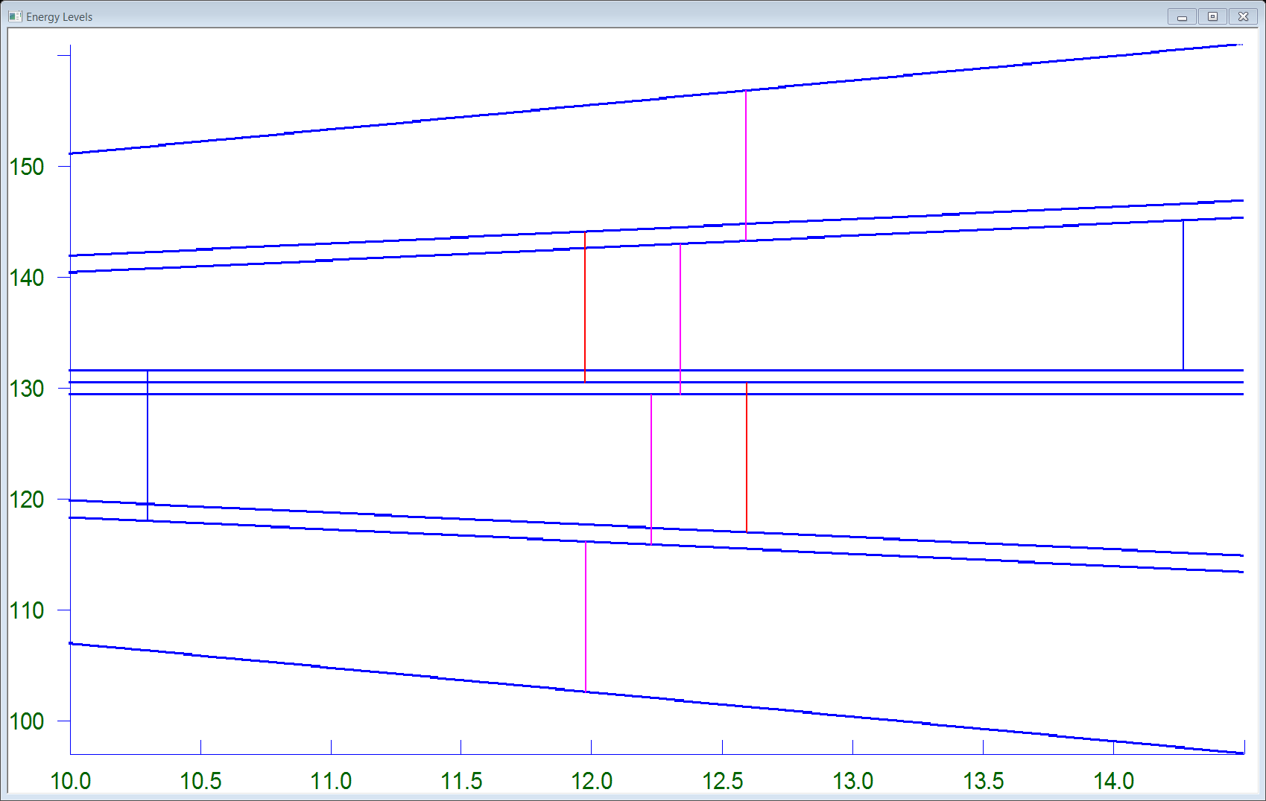
|0,0>  |2,1>
|0,0>  |2,-1>
62. Zjazd Naukowy PTChem
4 września 2019, Warszawa

Slide 34
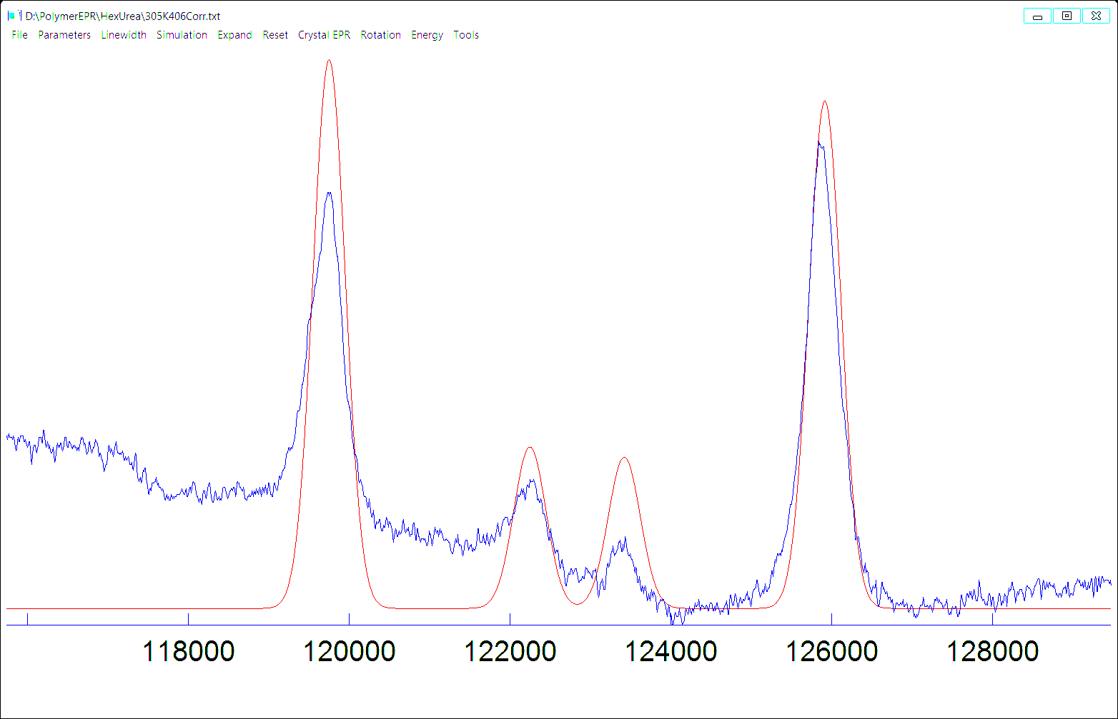
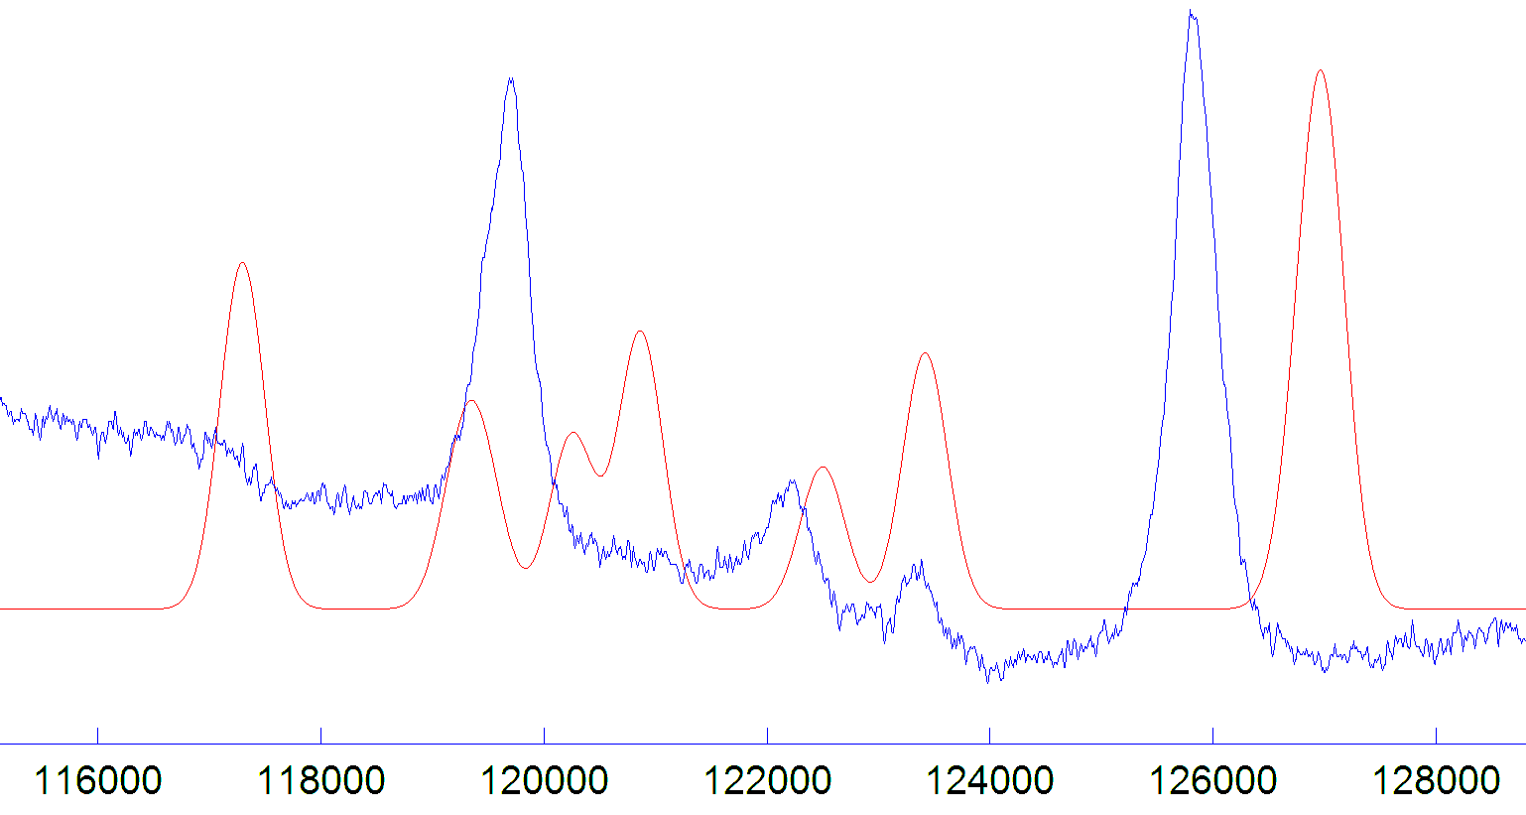
Could This Be Due to the Common ZFS?
62. Zjazd Naukowy PTChem 4 września 2019, Warszawa

Slide 35
Dinuclear Manganese(III) Complexes
g_{x} = g_{y} = g_{z} = 1.991, D = + 2.997 cm⁻¹, E = 0.53 cm⁻¹
Shova, S.; et al., Dalton Trans., 48, 18, 5909 (2019)
62. Zjazd Naukowy PTChem
4 września 2019, Warszawa

Slide 36

Dinuclear Manganese(III) Complexes
D₁₂ = -0.004 cm⁻¹,(calculated dipolar interaction), J = 0.035 cm⁻¹
62. Zjazd Naukowy PTChem
4 września 2019, Warszawa

Slide 37
Energy Levels and Transitions in the Dimer and in the Monomer Model
62. Zjazd Naukowy PTChem
4 września 2019, Warszawa

Slide 38
Pentacoordinate High-Spin Co(II) Complexes
Taking J = -0.14 cm⁻¹ reproduces the observed splitting
62. Zjazd Naukowy PTChem
4 września 2019, Warszawa

Slide 39
Conclusions
Compounds with very large zero-field splitting can be studied in HF EPR
Small isotropic exchange may be sometimes observed as splitting in the spectra, rather than just as intensity / line width effects.
Single-crystal studies may prove to be much more effective than powder
The effect is more likely to be observed in HF EPR due to better separation of the g values and possibility of engaging states strongly differing in energy, up to ~20 cm⁻¹
62. Zjazd Naukowy PTChem
4 września 2019, Warszawa

Slide 40
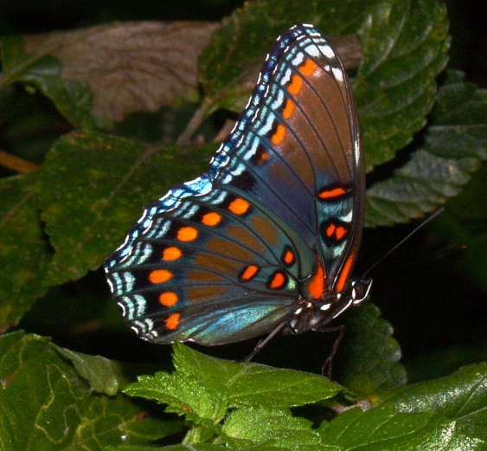
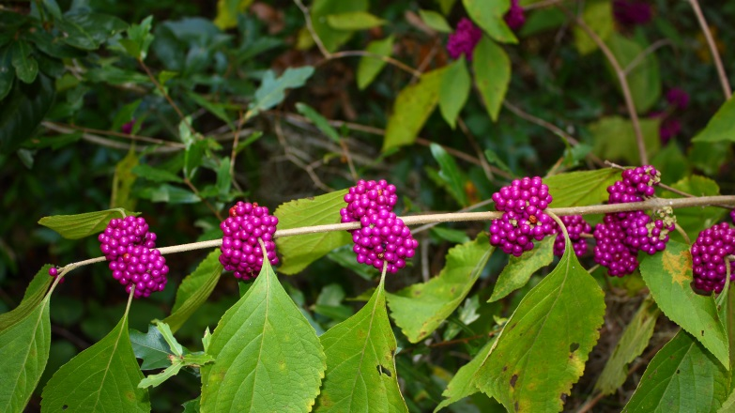
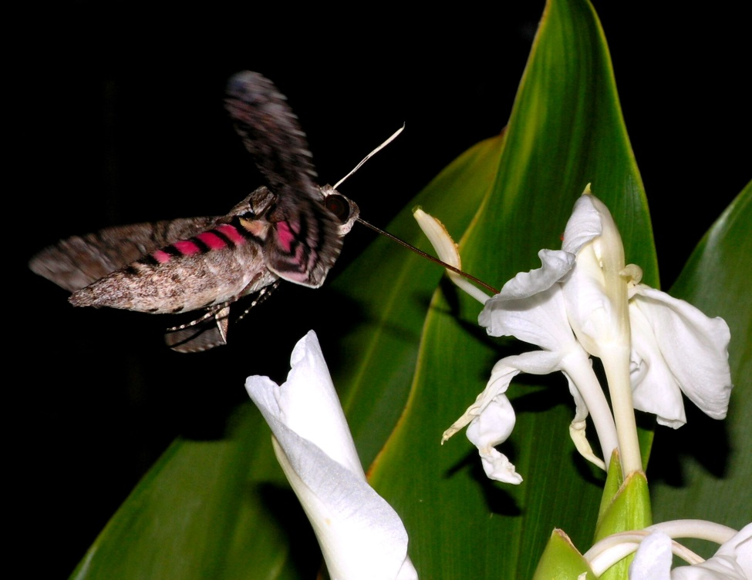
Thank you for your attention
62. Zjazd Naukowy PTChem 4 września 2019, Warszawa

Slide 41
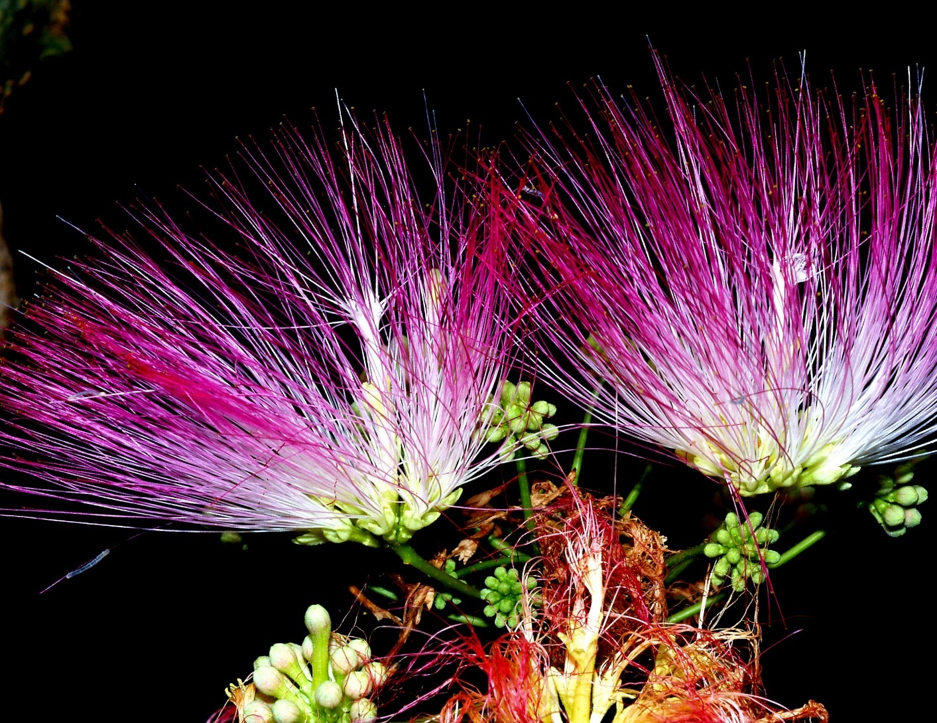

Slide 42
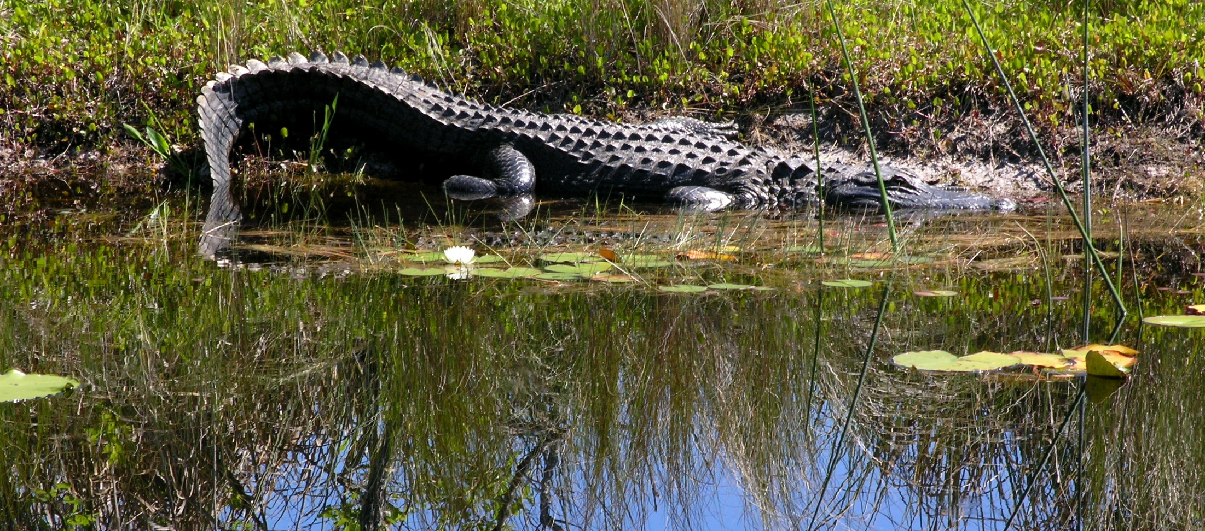
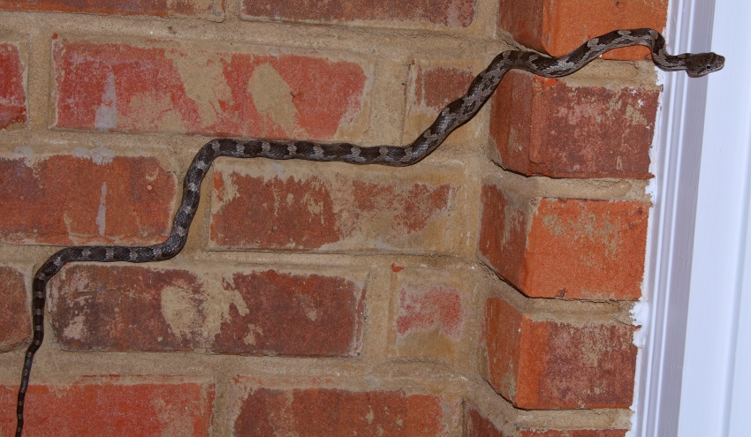
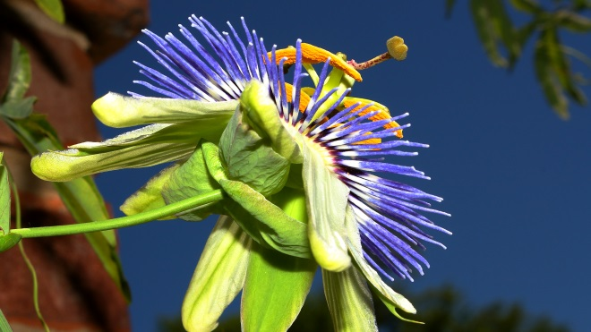
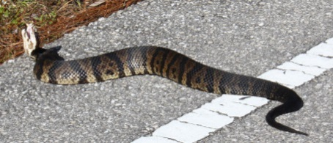
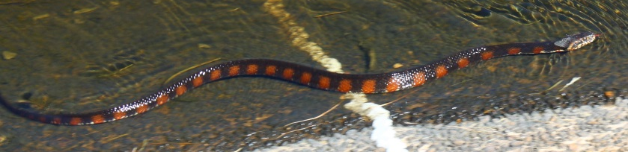

Slide 43
