Slide 1

The Sequencing of Instructional Events in High vs. Low Rated Audio Podcasts
Dr. Allan Jeong - Associate Professor
Instructional Systems Program Florida State University

Slide 2
A O R C G P F T E A O R C G P F T E A O R C G P F T E A O R C G P F T E A O R C G P F T E A O R C G P F T E A O R C G P F T E A O R C G P F T E
A O R C G P F T E A O R C G P F T E A O R C G P F T E A O R C G P F T E A O R C G P F T E A O R C G P F T E A O R C G P F T E A O R C G P F T E A O R C G P F T E
Gagne’s Nine Events of Instruction Attention
Objectives
Recall
Content Guidance
Practice
Feedback
Transfer
Elicit Performance
Gagne (1985)
A O R C G P F T E A O R C G P F T E A O R C G P F T E A O R C G P F T E A O R C G P F T E A O R C G P F T E A O R C G P F T E A O R C G P F T E

Slide 3

Background
Instruction should follow prescribed sequence, but ordering can be altered
Not all events are necessary
Studies examine effects of each individual event and event combinations on learning, attitudes & study time (Martin & Klein, 2008)

Slide 4
Research Questions
To what extent are the prescribed event sequences implemented in audio podcasts?
Which variations in event sequencing are associated with audio podcasts with high vs. low viewer ratings?

Slide 5
Method
Selected 13 iTune podcast with ratings at and below 3.5 out of 5
Selected 13 iTune podcast with ratings above 3.5.
Identifed instructional events & sequence

Slide 6
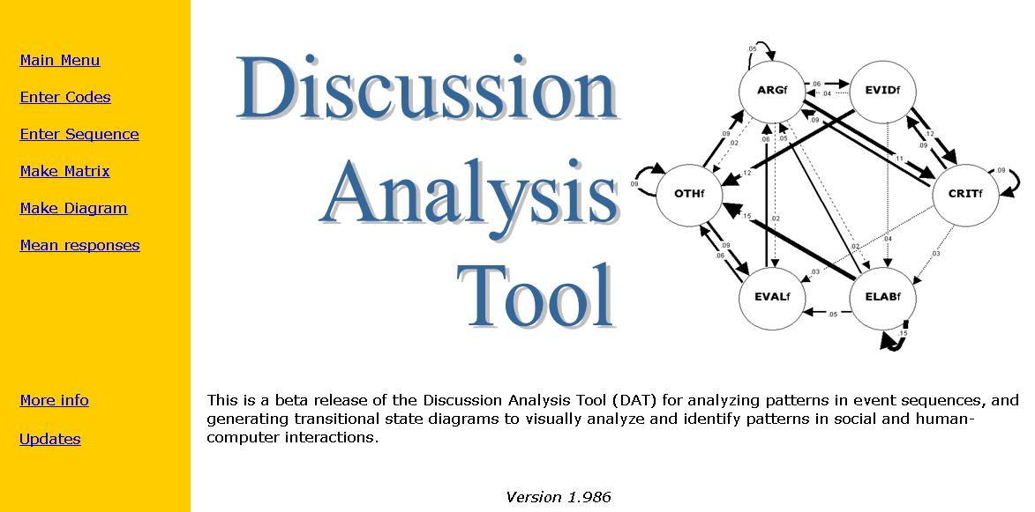
Sequential Analysis

Slide 7
Sequential Analysis
Count number of times event B follows event A, etc.
Translate into relative frequencies or “transitional probabilities”
Use z-scores to determine if probabilities are higher than expected probabilities

Slide 8
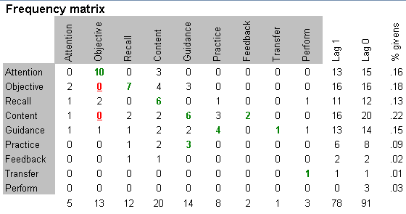
Low-Rated Podcasts

Slide 9
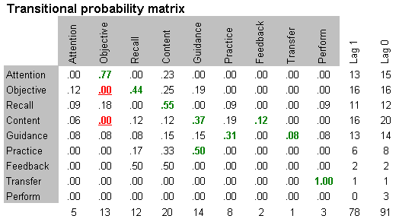
Low-Rated Podcasts

Slide 10
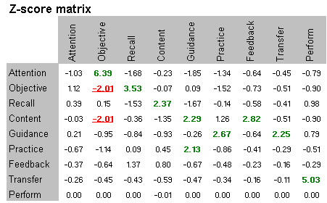
Low-Rated Podcasts
Bakeman, R., & Gottman, J.M. (1997). Observing interaction: An introduction to sequential analysis. Cambridge: Cambridge University Press.

Slide 11
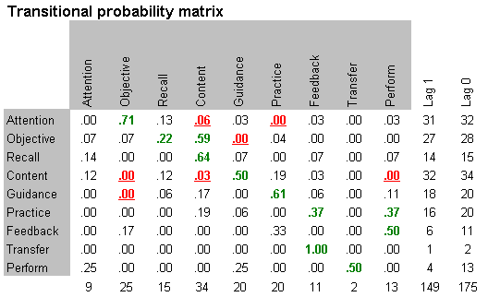
Low-rated Podcasts
High-rated Podcasts

Slide 12
Gain Attention
State Objective
77
12
10
09
07
44
09
20
Provide Practice
Stimulate Recall
10
17
21
09
23
25
50
19
14
36
60
Provide Guidance
33
Present Content
18
43
18
14
Low rated audio podcasts

Slide 13
13
Gain Attention
State Goals
71
13
25
16
13
24
Provide Practice
Stimulate Recall
26
60
06
33
16
62
50
67
Provide Guidance
12
Present Content
50
37
05
High rated audio podcasts

Slide 14

Main Findings & Implications
Omit “stimulate recall”
Omit “provide guidance”
Though rare, high-rated podcasts included more feedback & eliciting performance

Slide 15
Directions for Future Research
Increase sample size
Compare podcasts based on learning achievement (not user ratings)
Collect viewer perceptions on usefulness of each instructional event

Slide 16
For more information
Allan Jeong
ajeong@fsu.edu
bit.ly/podcastevents

