Slide 1
Lessons from the Great Depression

Slide 2
The Economic Record of the Great Depression

Slide 3
Conditions During the Great Depression
Large reductions in output
Soaring unemployment
Farm and home foreclosures
Bank failures
Human suffering

Slide 4
Real GDP, 1929-1940
Real GDP Growth (%) 1929-1940
13.0
10.9
Real GDP plunged during 1929-1933
After a modest recovery during 1934-1936, real GDP fell again in 1938.
8.9
8.1
8.8
4.0
5.1
- 1.3
- 3.4
- 6.5
- 8.6
- 13.1
1929
1930
1931
1932
1933
1934
1935
1936
1937
1938
1939
1940

Slide 5
Rate of Unemployment, 1929-1940
The rate of unemployment rose from 3.2% in 1929 to 8.7% in 1930 and 15.9% in 1931.
In 1932-1933, unemployment soared to nearly one-quarter of the labor force.
After declining to 14.3% in 1937, unemployment rose to 19% in 1938 and it stood at 17% in 1939 – a decade after the catastrophic decline began
Unemployment Rate (%) 1929-1940
23.6
24.9
21.7
20.1
19.0
15.9
16.9
17.2
14.3
14.6
8.7
3.2
1929
1930
1931
1932
1933
1934
1935
1936
1937
1938
1939
1940

Slide 6
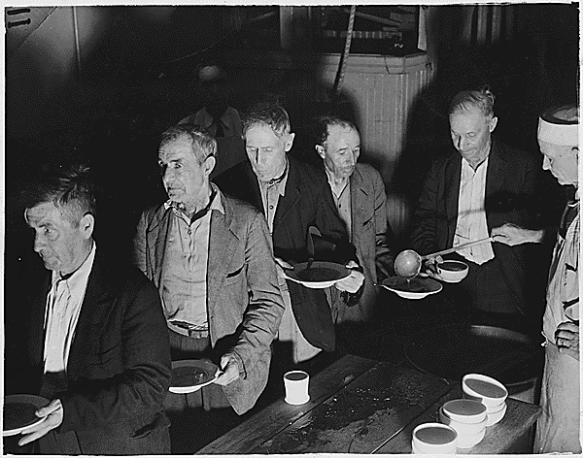
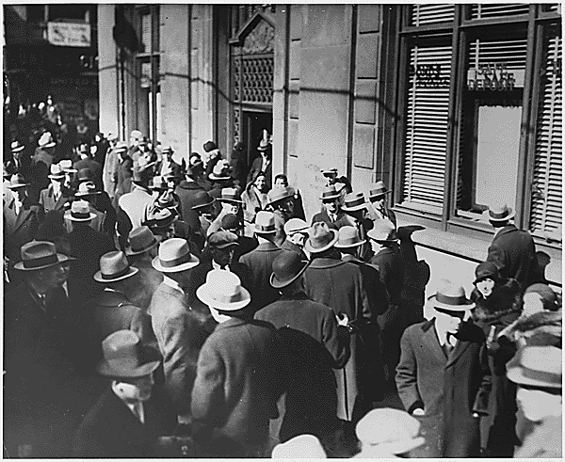
The Great Depression
The Great Depression was a time of high unemployment, soup lines, and banking panics

Slide 7
Was the Great Depression Caused by the 1929 Stock Market Crash?

Slide 8
Stock Market, 1928-1930
Stock prices plunged in September-October 1929
They recovered during the five months from mid-November 1929 through mid-April 1930.
However, they continued on a downward path during May and for the rest of 1930. Why?
Dow Jones Industrial Average 1928-1930
400
Smoot-Hawley debated & passed
300
200
100
Jan-28
Jul 28
Jn-29
Jul29
Jan-30
Jul-30

Slide 9
Stock Market, 1931-1940
Dow Jones Industrial Average 1931-1940
400
The Dow continued to fall throughout 1931 & 1932.
There was a sharp rebound in stock prices during 1933.
Even so, the Dow never reached 200 throughout the remainder of the decade.
300
200
100
1931
1932
1933
1934
1935
1936
1937
1938
1939
1940

Slide 10
Stock Prices and Recessions
The 1929 decline in stock prices reduced wealth, aggregate demand, and real output.
Stock prices have fallen by 50% or more during other recessions, but the economy still moved toward a recovery within a year or two.
While the decline in stock prices may have triggered the initial economic decline, the length and severity of the Great Depression were the result of other factors.

Slide 11
Why Was the Great Depression So Lengthy and Severe?

Slide 12
Causes of the Great Depression
The length and severity of the Great Depression were the result of four major policy mistakes:
Contraction in the money supply
Large increase in tariffs
Huge tax increases in 1932 and again in 1936
Price controls, perverse regulations, and constant policy changes during the New Deal era

Slide 13
Factor 1: Contraction of the Money Supply
The supply of money expanded slowly but steadily throughout the 1920s.
Even though prices were relatively stable in the 1920s, the Fed increased the discount rate, four times between January 1928 and August 1929, pushing it up from 3.5% to 6%.
After the October stock market crash, the Fed aggressively sold government bonds, which drained reserves from the banking system and reduced the money supply.

Slide 14
Change in Money Supply, 1925-1940
The money supply fell by 3.9% during 1930, by 15.3% in 1931, and by 8.9% in 1932
The quantity of money at year-end 1933 was 33% less than in 1929.
The money supply increased during 1934-1937, but dipped again in 1938.
Annual Change of M1 Money Supply (%) 1925-1940
13.8
15.9
11.5
12.5
10.0
7.7
5.9
4.5
3.6
0.0
- 1.5
- 2.2
- 3.9
- 8.9
- 9.5
- 15.3
1925
1926
1927
1928
1929
1930
1931
1932
1933
1934
1935
1936
1937
1938
1939
1940

Slide 15
Change In Consumer Prices, 1925-1940
Annual Change Consumer Price Index (%) 1925-1940
Monetary contraction during 1929-1933 led to deflation
The deflation changed the terms of loans, investments, and other economic activities that take place across time periods
3.1
3.6
2.3
2.2
1.5
1.1
0.7
0.0
-1.7
-1.7
- 2.3
-2.1
-1.4
- 5.1
- 9.0
- 9.9
1925
1926
1927
1928
1929
1930
1931
1932
1933
1934
1935
1936
1937
1938
1939
1940

Slide 16
Monetary Policy and the Great Depression
Sound monetary policy is about monetary and price stability.
The Fed failed during the 1930s:
The initial monetary contraction, during 1929-1933, plunged the economy into recession, and,
the 2nd monetary contraction, during 1937-1938, stifled the prospects for recovery.
The monetary instability of the 1930s generated uncertainty and undermined the exchange process.

Slide 17
Factor 2: Smoot-Hawley Tariff Increases of 1930
The legislation for the Smoot-Hawley tariff, which passed June 1930, increased tariffs by more than 50% on almost 3,200 imported products
Like proponents of trade restrictions today, the Smoot-Hawley supporters argued the bill would “save jobs”
“I want to see American workers employed producing American goods for American consumption” – Rep. Willis Hawley.

Slide 18
Factor 2: Smoot-Hawley Tariff Increases of 1930
Recognizing the restrictions would reduce both trade and output, more than 1,000 economists pleaded with President Hoover to veto the bill; he rejected their advice.
The stock market, which had rebounded to levels prior to the October 1929 crash, moved steadily downward as Congress debated and passed the Smoot-Hawley bill.
Sixty countries responded with higher tariffs on American exports and the volume of trade fell by more than 50%.

Slide 19
Factor 2: Smoot-Hawley Tariff Increases of 1930
Smoot-Hawley reduced the gains from specialization and trade, generated less tariff revenue even though the rates were higher, and plunged the economy further into recession
The unemployment rate was 7.8% when Smoot-Hawley was passed, but it ballooned to 23.6% just two years later

Slide 20
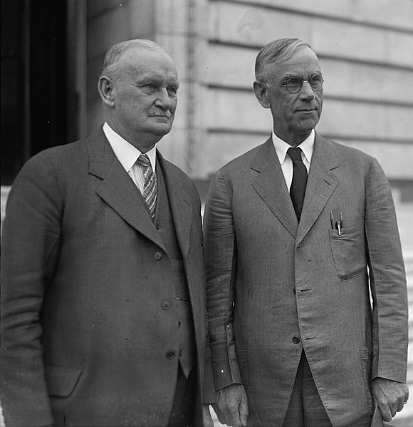
Smoot- Hawley
Sen. Reid Smoot (R) and Rep. Willis (L) Hawley thought their tariff increases would “save jobs.”
Instead, the Smoot-Hawley tariff of 1930 reduced output and plunged the economy deeper into recession.

Slide 21
Factor 3: Tax Increases in the Midst of a Severe Downturn
As the Federal budget fell into deficit in 1931, Congress and the Hoover Administration instituted a huge tax increase in order to balance the federal budget.
This tax increase both reduced aggregate demand and the incentive to earn and invest, plunging the economy still deeper into recession

Slide 22
Marginal Income Tax Rates, 1925-1940
The top marginal income tax rate was increased from 25% in 1931 to 63% in 1932 – other rates were increased by a similar amount.
In 1932, real GDP fell by 13.3% and the unemployment rate soared to nearly a quarter of the labor force.
Top and Bottom Marginal Income Tax Rates (%) 1925-1940
90
80
70
60
50
40
30
20
10
0
1925
1926
1927
1928
1929
1930
1931
1932
1933
1934
1935
1936
1937
1938
1939
1940
Top Marginal Rate
Lowest Marginal Rate

Slide 23
Marginal Income Tax Rates, 1925-1940
The top marginal tax rate was pushed still higher to 79% in 1936, and the tax on the retained earnings of business was also sharply increased.
These tax increases contributed to the recession of 1937-1938.
Top and Bottom Marginal Income Tax Rates (%) 1925-1940
90
80
70
60
50
40
30
20
10
0
1925
1926
1927
1928
1929
1930
1931
1932
1933
1934
1935
1936
1937
1938
1939
1940
Top Marginal Rate
Lowest Marginal Rate

Slide 24
Factor 4: Price Controls, Regulations, and Constant Policy Changes
Many history books credit the New Deal policies with the eventual end of the Great Depression
Some New Deal policies were helpful:
The Federal Deposit Insurance program
Re-evaluation of gold and the expansion in the money supply during 1934-1936
But other policies were harmful, and increased the length and severity of the Great Depression

Slide 25
The Agricultural Adjustment Act (AAA)
Under the AAA, adopted in 1933, the Roosevelt Administration tried to push prices up by restricting supply.
Farmers were paid to plow under portions of cotton, corn, wheat, and other crops
Potato Farmers were paid to spray their potatoes with dye so they would be unfit for human consumption
Cattle, sheep, and pigs were slaughtered
AAA was declared unconstitutional in 1936.

Slide 26
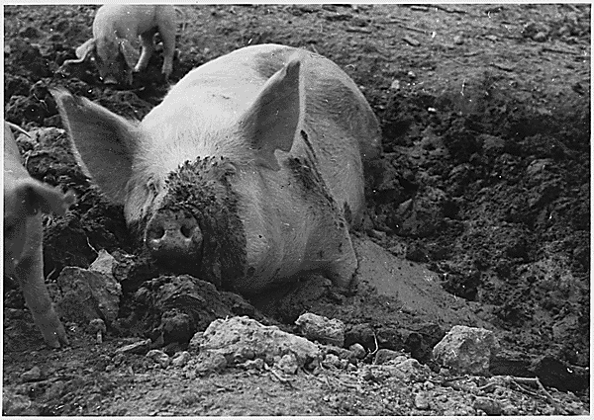
The Agricultural Adjustment Act (AAA)
In an effort to push farm prices up, 6 million pigs were slaughtered under the AAA in 1933 alone.

Slide 27
National Industrial Recovery Act (NIRA)
Under the National Industrial Recovery Act (NIRA) legislation passed in June 1933:
More than 500 industries ranging from automobiles and steel to dog food and dry cleaners were organized into cartels.
Government and business leaders set production quotas, prices, wages, working hours, and distribution methods for each industry.

Slide 28
National Industrial Recovery Act (NIRA)
Under the National Industrial Recovery Act (NIRA) legislation passed in June 1933:
Once approved by a majority of the firms, the regulations were legally binding on all of the firms in the industry
Businesses that did not comply were fined and subject to jail sentences
Prior to this legislation, price fixing of this type would have been a violation of anti-trust legislation
All of this reduced competition, promoted monopoly pricing, and undermined the market process

Slide 29
NIRA-Industrial Production, 1932-1936
During April-July 1933, industrial output increased sharply.
In July 1933, NIRA was implemented and industrial output fell more than 25% over the next 6 months.
Output did not reach the June 1933 level again until after the NIRA was declared unconstitutional in May 1935.
U.S. Industrial Production (index) 1932-1936
125
NIRA is declared
NIRA passed
unconstitutional
100
75
50
1932
1933
1934
1935
1936

Slide 30
Did the New Deal Policies End the Great Depression?
Many history books argue this was the case, but the evidence is inconsistent with this view.
Prior to the Great Depression, recessions lasted only 1 or 2 years (3 years at the most) and recovery that followed pushed income to new highs.
The Great Depression was different

Slide 31
Did the New Deal Policies End the Great Depression?
In 1933, the monetary contraction was reversed and there was evidence of a private sector recovery.
But the NIRA, AAA and the 1936 tax increases dampened productive activity.
Also the second monetary contraction pushed the economy into another recession within the depression.

Slide 32
Did the New Deal Policies End the Great Depression?
Constant policy changes of the New Deal Era generated uncertainty and undermined recovery.
The unemployment rate was 19% in 1938 and 17% in 1939, 7 years after the start of the New Deal.
The Great Depression was eventually diminished by the military build-up prior to World War II.

Slide 33
Fiscal Policy During the Great Depression

Slide 34
Fiscal Policy During the Great Depression
Prior to the Keynesian Revolution, the view that the Federal Budget should be balanced was widely accepted.
Both the Hoover and Roosevelt Administrations raised taxes in an effort to reduce the size of the budget deficit.
Many Keynesian economists argued that prior to World War II the budget deficits were too small to provide sufficient demand stimulus.

Slide 35
Government Expenditures, 1929-1940
Government spending as a share of the economy was small during the 1930s
Total govt. spending (federal, state, and local) increased from 8% of GDP in 1929 to 16% in 1933.
After 1933, govt. spending fluctuated around 15% the remainder of the decade.
Government Expenditures as a Share of GDP (%) 1929-1940
18
16
14
12
10
8
6
4
2
0
1929
1930
1931
1932
1933
1934
1935
1936
1937
1938
1939
1940
Federal
Total

Slide 36
Federal Budget Deficits, 1929-1940
Federal Budget Deficit (-) and Surplus (+) as a Share of GDP (%) 1929-1940
The Federal budget was in surplus in 1929 and 1930.
Except for 1934 and 1936, Federal deficits in the 1930s fluctuated around 2% of GDP.
1.1
0.2
0.2
-0.3
- 1.4
- 1.5
- 2.4
-2.3
- 2.7
-2.6
-3.2
-3.8
1929
1930
1931
1932
1933
1934
1935
1936
1937
1938
1939
1940

Slide 37
Lessons From the Great Depression

Slide 38
What Are the Lessons from the Great Depression?
Monetary contraction will undermine economic activity such as investment and thereby retard output and employment.
Trade restrictions will reduce the gains from specialization and exchange.
They will not save domestic jobs
Instead they will lead to inefficient use of resources and reductions in output

Slide 39
What Are the Lessons from the Great Depression?
Raising taxes during a recession will reduce output and make matters worse.
Constant policy changes will generate uncertainty, retard private investment, reduce business activity, and thereby prolong the depressed conditions.

Slide 40
What Are the Lessons from the Great Depression?
Good intentions are no substitute for sound policies.
Key decision-makers such as Presidents Hoover and Roosevelt, Sen. Smoot, Rep. Hawley, other members of congress, and the monetary policy-makers of the 1930s had good intentions, but their actions tragically turned what would have been a recession into the Great Depression.

Slide 41
Questions for Thought:
Was the Great Depression caused by the 1929 stock market crash?
Did the New Deal policies bring the Great Depression to an end? Why or Why not?
What are the most important lessons Americans should learn from the Great Depression? Do you think we have learned them?

Slide 42
End of
Special Topic 6

