Slide 1
Government Spending and Taxation

Slide 2
Government Expenditures

Slide 3
Growth of Government
During the first 125 years of U.S. history, federal expenditures per person were small and they grew at a relatively slow rate. (See following slide)
In contrast, federal spending soared throughout most of the 20th century. In 2012, real federal spending per person was roughly 80 times the $142 figure of 1916.
During the 1990s per capita real federal spending was relatively constant. In fact, it declined slightly during the decade.
Since 2000, per capita real federal spending has once again been increasing rapidly.

Slide 4
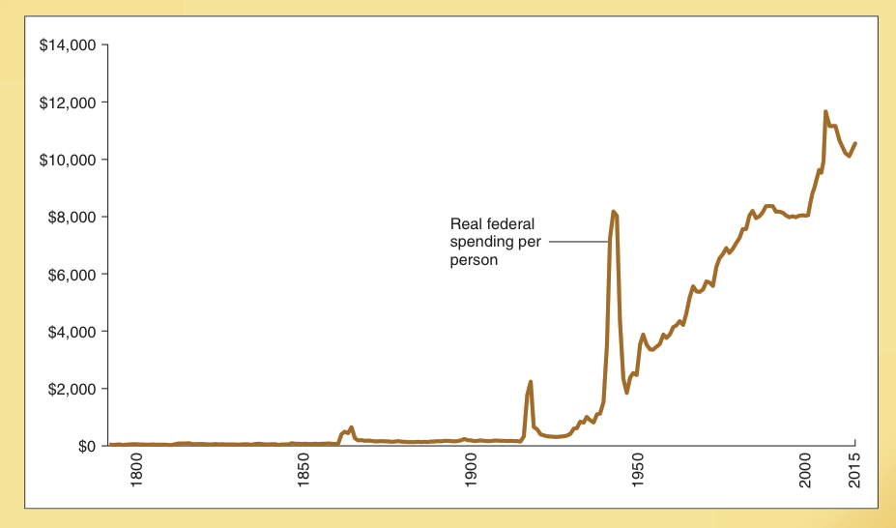
Real Federal Expenditures Per Capita: 1792-2015
Real Federal Spending Per Person (in 2010 U.S. dollars)
Real federal spending per person (measured in 2010 dollars) grew slowly during the first 125 years of U.S. history, but soared throughout most of the 20th century.

Slide 5
Changing Composition of Federal Spending
Defense Expenditures (share of federal spending)
52.2%
41.8%
22.7%
23.9%
During the last five decades, federal spending has shifted sharply away from national defense and toward spending on income transfers and health care.
In 2015, national defense accounted for only 16.0% of the federal budget, down from 52.2% in 1960.
In contrast, spending on income transfers and health care rose from 21.5% of the federal budget in 1960 to 65.8% in 2015.
16.5%
20.1%
16.0%
1960
1970
1980
1990
2000
2010
2015
Health & Income Transfer Expenditures (share of federal spending)
65.8%
62.2%
56.7%
44.1%
44.1%
29.7%
21.5%
15th
edition
1960
1970
1980
1990
2000
2010
2015
Gwartney-Stroup
Sobel-Macpherson
Health care
Income transfers

Slide 6
Taxes and the Finance of Government

Slide 7
Taxes and Other Revenue Sources
Governments are financed through the use of taxes, user charges, and borrowing.
Borrowing implies higher future taxes.
The power to tax is a distinguishing characteristic of government.
The major sources of federal revenue are the personal income tax (accounting for 47.4% of federal revenue in 2015) and the payroll tax (accounting for 32.8% of the total in 2015).
Major revenue sources at the state and local level are sales and excise taxes, personal income taxes, user charges, and grants from the federal government.

Slide 8
Sources of Government Revenue
Federal Government Revenue 2015 -- $ 3,250 billion
State & Local Government Revenue 2013 -- $ 2,690 billion
Interest Earnings 1.9%
Personal Income 12.6%
Property 16.9%
User Charges 16.5%
Payroll 32.8%
Personal income 47.4%
Sales & Excise 18.5%
from Fed. Govt. 21.7%
Other 9.9%
Other 5.1%
Corp. Income 2.0%
Customs
duties 1.1%
Corporate income 10.6%
Excise 3.0%

Slide 9
Taxes and the Cost of Government

Slide 10
Taxes and the Cost of Government
A dollar of taxation costs the economy more than a dollar because:
it is costly to administer, enforce, and comply (for both individuals and firms) with the tax legislation
taxes distort incentives and eliminate productive exchanges (and cause people to undertake some counterproductive activities)
Economists refer to this as the “dead weight loss” of taxation.

Slide 11
How Has the Structure of the Personal Income Tax Changed

Slide 12
How Has the Structure of the Federal Personal Income Tax Changed?
The share of the income tax paid by high-income taxpayers has risen steadily during the past 50 years – especially since 1980. (This is demonstrated graphically on the next slide).
Why has the share paid by those with high-incomes risen?
The decline in marginal tax rates has created greater “incentive effects” for high-income tax payers to earn taxable income.
The standard deduction and personal exemption have increased substantially over the past two decades.

Slide 13
Share of Federal Income Taxes Paid By Various Income Groups
Upper-income Americans pay the bulk of the federal income tax and the share they pay has risen steadily during the last 5 decades.
At the same time, the share paid by the bottom 50% has fallen.
The share of personal income taxes paid by the 50% of earners with the lowest incomes was 2.8% in 2013.
Share of Total Federal Personal Income Tax Paid
Income group
1963
1980
1990
2013
Top 1%
18.3 %
19.1 %
25.1 %
37.8 %
Top 5%
35.6 %
36.8 %
43.6 %
58.6 %
Top 10%
47.0 %
49.3 %
55.4 %
69.8 %
Top 25%
68.8 %
73.0 %
77.0 %
86.3 %
Top 50%
89.6 %
93.0 %
94.2 %
97.2 %
Bottom 50%
10.4 %
7.1 %
5.8 %
2.8 %

Slide 14
Income Levels and Overall Tax Payments

Slide 15
Total Federal Taxes As a Share of Income, 2011
Federal Taxes as a Share of Income (%)
(2011)
Here we show the payment of federal taxes as a share of income for each income quintile in 2011.
Note how the overall federal tax structure is highly progressive.
23.4 %
15.2 %
11.2 %
7.0 %
1.9 %
Lowest
Second
Third
Fourth
Highest
–––– Family income groups –––– (quintiles)

Slide 16
Size of Government: A Cross-Country Comparison

Slide 17
Size of Government: U.S. Versus Other Countries
The size of government in the U.S. is smaller than that of Japan and the major Western European countries, but larger than for a number of high-growth Asian economies. (See the following slide)

Slide 18
Size of Government: An International Comparison
Government Expenditures as a Share of GDP, 2014
France
57.5%
Denmark
56.0%
Belgium
55.1%
Austria
52.7%
Sweden
51.7%
Portugal
51.7.8%
Italy
51.2%
Greece
49.9 %
Netherlands
46.3%
Norway
44.9%
Spain
44.5%
Germany
44.3%
United Kingdom
41.0%
Japan
39.8%
Canada
39.0%
Ireland
38.2%
Australia
36.9%
United States
35.6%
New Zealand
34.3%
Thailand
22.2%
South Korea
20.8 %
Singapore
18.1%
Hong Kong
17.3%

Slide 19
How Does the Size of Govt. Affect Economic Growth

Slide 20
The Size of Government
and Economic Growth
The core functions of government such as a sound legal system, access to money of stable value, and provision of public goods that are difficult to provide through markets will promote economic growth and help citizens achieve high income levels.
But, when government expands beyond these core functions and into areas for which it is ill-suited, it will retard economic growth.

Slide 21
Size of Government – Growth Curve
If governments undertake activities in the order of their productivity, the growth of government will initially promote economic growth (move from point A to point B).
At some point, however, continued expansion of government will retard growth (moves beyond B).
Growth rate of the economy
B
6%
3%
A
Size of government (percent of GDP)

Slide 22
Government Spending and Economic Growth, 1960-2009
The relationship between the size of government at the beginning of the decade and the growth rate of real GDP for each decade during the 1960-2009 period is shown here.
An increase in government spending of 10% (as a share of GDP) reduces annual growth by about 1%.
Growth rate (respective decade)
Data are for the 23 long-standing
member countries of the OECD
10 %
8 %
6 %
4 %
2 %
0 %
10 %
20 %
30 %
40 %
50 %
60 %
Total government expenditures (start of respective decade)

Slide 23
Expenditures, Taxes, Debt Finance, and Democracy

Slide 24
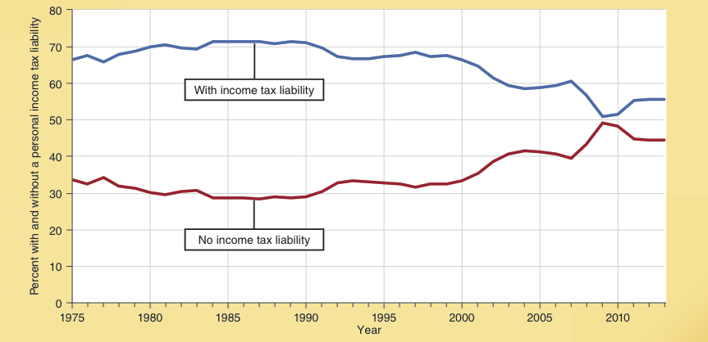
Share of Population (18 and older) With and Without Income Tax Liability
Between 1975 and 2000, the share of Americans (18 and older) who paid federal personal income taxes was between 66 and 71%.
Since 2000, that figure has declined to 55.6%.
Between 1975 and 2000, the share of Americans (18 and older) who had no federal personal income tax liability was approximately 33%.
By 2013, that figure had increased to 44.6%.
% of Population With/Without Personal Income Tax Liability
(18 and older)

Slide 25
Share of Americans Deriving Income from Government, 1991-2013
More than half of U.S. families derive income from at least one transfer program.
This figure declined from 54.1% in 1991 to 49.5% in 2000 but by 2013 had risen again to 54.8%.
If government employees are included, 63.4% of American families derived either income transfers or income from government.
When only families with individuals younger than 62 are included, the share receiving transfers is somewhat lower, but the pattern over the past two decades is the same.
Government Programs and Government Employees
Government Programs
63.9%
62.8%
63.4%
59.1%
61.2%
54.1%
53.6%
54.8%
53.8%
57.4%
51.9%
52.7%
53.1%
49.5%
48.2%
43.1%
41.0%
47.5%
41.9%
36.1%
1991
1995
2000
2005
2013
1991
1995
2000
2005
2013
All
Younger than Age 62

Slide 26
Implications of the Structure of Taxes and Transfers
When individuals are not paying for government programs, they are more likely to support their expansion.
Similarly, people dependent on the government for a sizable share of their income will be more supportive of government programs.
Debt financing and unfunded promised future benefits also make it possible for politicians to provide voters with current benefits without having to increase current taxes.

Slide 27
Implications of the Structure of Taxes and Transfers
18th century Scottish philosopher Alexander Tytler argued … “A democracy cannot exist as a permanent form of government, it can only exist until the voters discover that they can vote themselves largesse from the public treasury. From that moment on, the majority always votes for the candidates promising the most benefits from the public treasury with the result that a democracy always collapses over loose fiscal policy.” – Is Tytler correct?

Slide 28
Government Spending, Debt, and the Fiscal Future of the U.S.
The modern political process, to a large degree, involves politicians trading government favors for campaign contributions and other forms of political support to win the next election.
Measured as a share of GDP, total government expenditures are now about 7% higher than a decade ago.
From 2009-2010 the Federal government financed approximately 40% of it expenditures by borrowing.
The Federal debt is now more than 100% of GDP, its highest level since World War II.

Slide 29
Government Spending, Debt, and the Fiscal Future of the U.S.
A major share of U.S. government spending (e.g. Social Security and Medicare) is directed towards the elderly.
The unfunded future benefits promised under Social Security & Medicare are 3 times the official federal debt.
If not reformed, spending on these programs will drive Federal spending to even higher levels.
In turn, the higher level of government spending is likely to slow the growth rate of the economy.

Slide 30
Government Spending, Debt, and the Fiscal Future of the U.S.
Several European countries including Greece, Portugal, Italy, and Spain already confront financial difficulties because of their high debt levels and unfunded promises.
We are in the midst of a great fiscal experiment that will affect both economic prosperity and the future of democracy.

Slide 31
Questions for Thought:
A century ago, federal taxes and spending per person were substantially lower than today. How would the U.S. economy be affected if the federal government was, for example, one-third its current size? What programs would you favor cutting?
Can democracy survive if a majority of the citizenry pay little or nothing in taxes while benefiting directly from a higher level of government spending? Why or why not?

Slide 32
Questions for Thought:
The marginal tax rates imposed on those with high incomes are now substantially lower than in 1980. Would you like to see higher tax rates imposed on high income Americans? Do you think higher rates would increase the tax revenues collected from high-income Americans?
Are the following statements true or false?
(a) During first 125 years of U.S. history, federal expenditures per person were small and grew at a relatively slow rate.
(b) In 2012, real federal spending per person was about 80 times its level of 1916.

Slide 33
End of
Special Topic 1

