Slide 1
Earnings, Productivity, and the Job Market

Slide 2
Why Do Earnings Differ?

Slide 3
Why Do Earnings Differ?
Earnings would be equal if:
  all individuals were identical
  all jobs were equally attractive
  workers were perfectly mobile among jobs

Slide 4
Earnings Differentials
Due to Non-identical Workers
Worker productivity:
  More productive workers have greater earnings.
Worker preferences:
  Workers motivated by monetary objectives are likely
  to pursue jobs with higher wages.
Race and gender:
  Discrimination may lower earnings opportunities
  of minorities and women.
Worker Attitudes:
  Attributes such as honesty, dependability, persistence, reliability, trustworthiness, creativity, desire to learn and improve, and ability to work with others will increase productivity

Slide 5
Earnings Differences of
Skilled and Unskilled Workers
The productivity and, thus, marginal product of skilled workers is greater than that of unskilled workers.
Hence, demand for skilled workers D_{s} exceeds demand for unskilled workers D_{u}.
Education & training enhance skill.
As upgrading skills through investment in human capital is costly, the supply
of skilled workers S_{s} is smaller than
the supply of unskilled workers S_{u}.
Wage
Wage
S_{s}
S_{u}
D_{s}
D_{u}
Quantity
Quantity

Slide 6
Earnings Differences of Skilled and Unskilled Workers
Wages
S_{s}
The wages of skilled workers are high relative to those of unskilled workers due to the strong demand and small supply of skilled workers relative to that of unskilled workers.
S_{u}
W_{s}
D_{s}
W_{u}
D_{u}
Quantity

Slide 7
Level of Education and Earnings
Mean Earnings ($)
of Year-Round,
Full-Time Workers (2014)
Less than
high school
36,926
The mean earnings
of males & females by education level in 2014 are listed to the right.
Earnings of both men and women increase with education.
Note: the earnings
of women were only about two-thirds
those of similarly educated men.
26,804
Men
Women
High
school
46,688
34,394
Some
college
56,398
40,486
Bachelor’s
degree
84,576
58,894
Master’s
degree
107,619
69,233
Doctoral
degree
150,354
109,381

Slide 8
Earnings Differentials
Due to Non-Identical Jobs
Jobs with undesirable working conditions will command higher wages (compensating wage differentials).
Compensating wage differentials arise from a variety of
factors, such as:
  Job risk
  Job location
  Working hours
  Work environment

Slide 9
Earnings Differentials
Due to Immobility of Labor
Some wage differentials result from an incomplete adjustment to a change in labor demand because of labor immobility.
Immobility can result from:
  Specialized labor
  Institutional barriers
    minimum wage
    occupational licensing
    labor unions

Slide 10
The Economics of
Occupational Licensing
Occupation licensing requires individuals to pay fees, take training courses, and pass examinations in order to work in the occupation.
  These programs reduce supply and drive up wages in the occupation.
  Occupational licensing now covers 30 percent of the labor force, up from 5 percent in 1952.

Slide 11
The Economics of
Occupational Licensing
Proponents often use consumer protection to justify the licensing, but consumers are capable of evaluating quality in many of the licensed occupations.
  For example: make-up artist, florist, hair braider, shampoo specialist, athletic trainer, tour guide, casket seller, ferret breeder, and palm reader.
Certification is an alternative to licensing.
  Certification would require suppliers to provide consumers with information on their qualifications, but would not prohibit practice of the occupation.

Slide 12
The Economics of
Employment Discrimination

Slide 13
Wage Discrimination
When white workers are preferred to minority workers
(or men to women), the demand for minority workers
is reduced.
  Minority workers receive lower wages.

Slide 14
Impact of Wage Discrimination
Wages
If there is employment discrimination against minorities (or women), the demand for their services
will decline.
As a result of this lower demand, equilibrium wage
for minorities will be lower,
W_{w} > W_{M}.
S
W_{w}
A
W_{m}
B
D_{whites}
D_{minorities}
Q_{m}
Q_{w}
Quantity
(Employment)

Slide 15
Employment Discrimination
When discrimination is present, the entry of minority workers into some types of jobs and occupations may
be restricted.
  If so, the supply in unrestricted jobs will increase,
  causing wages to fall in these jobs.
  When the supply of minorities (or women) to an occupation is restricted, the wages of white males
  will rise.

Slide 16
Employment Discrimination
Discrimination is costly to employers.
  When employers can hire equally productive minorities
  (or women) at a lower wage than whites (men), the profit motive gives them a strong incentive to do so.
    Employers who ignore minority and gender status when employing workers will have lower wage costs than employers who discriminate.

Slide 17
Employment Discrimination
and Earnings of Minorities
Earnings may differ among groups for reasons besides employment discrimination.
To measure the extent of employment discrimination,
we must
  adjust earnings for differences between groups in productivity-related factors such as education, and,
  then make comparisons between similarly qualified groups of workers who differ only in race or gender.

Slide 18
Actual and Productivity-Adjusted Wages of Minorities Compared to Whites 2012-15*
Men
Women
Actual
Adjusted
Actual
Adjusted
White
100
100
100
100
African-American
75
85
85
90
American Indian
80
93
84
96
Asian-American
105
97
107
99
Mexican-American
66
88
72
91
Other Hispanic
74
88
79
90
* Data were supplied by David MacPherson, as derived from the 2012-2015 Current Population Surveys (CPS). Data were adjusted for years of schooling, work experience, region, industry, sector of employment, union status, and marital status.

Slide 19
Questions for Thought:
What are the major factors that would help explain earnings differences between the following:
(a) a lawyer and a minister,
(b) an accountant and a school teacher,
(c) a business executive and a social worker,
(d) a country lawyer and a Wall Street lawyer,
(e) an experienced, skilled craftsperson and a 20‑year‑old
high school dropout
(f) an upper‑story and ground‑floor window washer?

Slide 20
Questions for Thought:
2. “If it were not for employment discrimination
against minorities, the average earnings of
minorities and whites would be equal.” -- Is this true?
3. “When employment discrimination results from the personal prejudices of employers, economic theory suggests that discrimination by an employer will reduce production costs since the employer can pay lower wages.”
-- Is this statement true, false, or uncertain?

Slide 21
Questions for Thought:
4. How does licensing of occupations such as interior decorator, florists, and athletic trainers impact the welfare of the following groups:
(a) consumers,
(b) workers in the occupation,
(c) potential entrants into the occupation.

Slide 22
The Link Between
Productivity and Earnings

Slide 23
Keys to Prosperity:
Productivity and Earnings
Productivity is the source of high wages.
Workers in the U.S. earn high wages because their output per hour is high as a result of:
  Greater worker knowledge and skills (human capital)
  The use of modern machinery (physical capital)

Slide 24
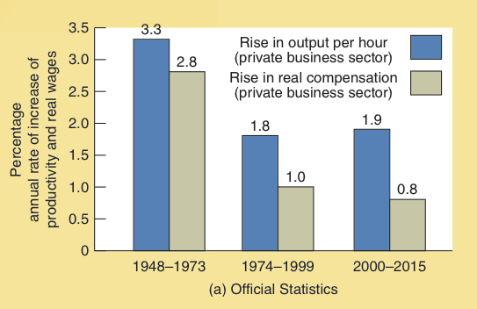
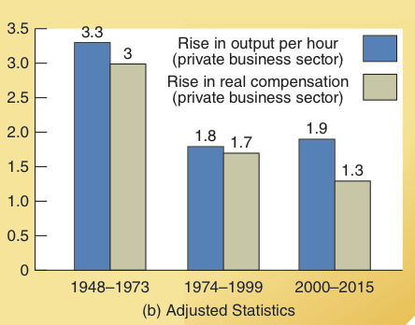
Productivity and Earnings, 1948-2015
As shown in the top panel, worker productivity has been increasing at a faster rate than real compensation per hour in the official statistics.
The consumer price index is used to derive real compensation, while the implicit price deflator is used to calculate productivity.
The bottom panel shows that the gap between productivity and compensation is largely eliminated when both productivity and compensation are converted into real terms using the implicit price deflator.
Percentage
annual rate of increase of productivity and real wages

Slide 25
Productivity and Compensation
Theory indicates that increased productivity is the major source of higher earnings.
When the same price index is used to adjust both productivity and wage data, the change in productivity and employee compensation are closely related.
Since 2000, even when the same price index is used to adjust both productivity and wage growth, compensation has lagged behind productivity. Improvements in the work environment provide part of the explanation.
  Hourly compensation does not reflect movements towards less strenuous work, a more comfortable work environment, and greater job safety.

Slide 26
Automation
Automated methods of production will only be adopted
if they reduce costs.
Automation may reduce employment in a specific industry.
  But, as it does so it also releases resources that can be employed in other areas.
Improved technology permits us to achieve larger output
and income levels.

Slide 27
Questions for Thought:
Why are wages higher in the U.S. than in India or China?
“Jobs are the key to economic progress. Unless we create
more jobs, our standard of living will fall.”
-- Is this statement true or false?
Do you think the market system of wage determination is fair? Why or why not? Can you think of a more equitable system? If so, explain why it is more equitable.

Slide 28
Questions for Thought:
4. If Congress passed legislation that required all U.S. workers to receive the same annual pay, then we would expect…
(a) less human capital investment
(b) a shortage of workers to fill undesirable jobs
(c) a surplus of workers to fill easy, desirable jobs

Slide 29
End of
Chapter 26

