Slide 1
Modern Macroeconomics and Monetary Policy

Slide 2
The Impact of Monetary Policy:
A Brief Historical Background

Slide 3
Impact of Monetary Policy
A brief historical background:
  The Keynesian view dominated during the 1950s and 1960s.
    Keynesians argued that money supply did not matter much.
  Monetarists challenged the Keynesian view during the 1960s and 1970s.
    Monetarists argued that changes in the money supply caused both inflation and economic instability.
  While minor disagreements remain, the modern view emerged from this debate.
    Modern Keynesians and monetarists agree that monetary policy exerts an important impact on the economy. The following slides present this modern view.

Slide 4
Impact of Monetary Policy
Every major contraction in this country has been either
produced by monetary disorder or greatly exacerbated
by monetary disorder. Every major inflation episode has
been produced by monetary expansion.
— Milton Friedman (1968)

Slide 5
The Demand and
Supply of Money

Slide 6
The Demand for Money
Money
interest
rate
The quantity of money people want to hold (the demand for money) is inversely related to the money rate of interest, because higher interest rates make it more costly to hold money instead of interest-earning assets like bonds.
Money Demand
Quantity
of money

Slide 7
The Supply of Money
Money
interest
rate
Money Supply
The supply of money is vertical because it is established by the Fed and, hence, determined independently of the interest rate.
Quantity
of money

Slide 8
The Demand and Supply of Money
Money
interest
rate
Money Supply
Excess supply
at i₂
Equilibrium:
The money interest rate gravitates toward the rate where the quantity of money people want to hold (demand) is just equal to the quantity of money the Fed has supplied.
i₂
At i_{e}, people are willing to hold the money supply set
by the Fed.
i_{e}
i₃
Excess demand
at i₃
Money Demand
Quantity
of money

Slide 9
How Does Monetary Policy
Affect the Economy?

Slide 10
Transmission of
Monetary Policy
Money
interest
rate
S₁
S₂
Money Balances
When the Fed shifts to a more expansionary monetary policy, it usually buys additional bonds, expanding the money supply.
This increase in the money supply (shift from S₁ to S₂ in the market for money) provides banks with additional reserves.
The Fed’s bond purchases and the bank’s use of new reserves to extend new loans increases the supply of loanable funds (shifting S₁ to S₂ in the loanable funds market) and puts downward pressure
on real interest rates (a reduction to r₂).
i₁
i₂
D₁
Q_{s}
Q_{b}
Quantity
of money
Real
interest
rate
S₁
Loanable Funds
S₂
r₁
r₂
15th
edition
D
Qty of loanable funds
Gwartney-Stroup
Sobel-Macpherson
Q₁
Q₂

Slide 11
Transmission of
Monetary Policy
Real
interest
rate
S₁
Loanable Funds
S₂
r₁
As the real interest rate falls, AD increases (to AD₂).
When the monetary expansion is unanticipated, the expansion in AD leads to a short-run increase in output (from Y₁ to Y₂) and an increase in the price level (from P₁ to P₂) – inflation.
The impact of a shift in monetary policy
is transmitted through interest rates, exchange rates, and asset prices.
r₂
D
Qty of loanable funds
Q₁
Q₂
Price
Level
AS₁
P₂
P₁
AD₂
AD₁
Goods &
Services
(real GDP)
Y₁
Y₂

Slide 12
Transmission of Monetary Policy
Here, a shift to an expansionary monetary policy is shown.
The Fed buys bonds (expanding the money supply), which increases bank reserves—pushing real interest rates down—leading to a direct increase in investment and consumption. There will also be, a depreciation of the dollar, (increased net exports), an increase in asset prices (increasing personal wealth), and indirectly increasing investment and consumption.
So, an unanticipated shift to a more expansionary monetary policy will stimulate AD and, thereby, increase both output and employment.
Increases in investment & consumption
This
increases
money
supply
and bank
reserves
Fed
buys
bonds
Real interest rates
fall
Net exports
rise
Depreciation of the dollar
Increase in aggregate demand
Increases in investment & consumption
Increase in asset prices

Slide 13
Expansionary Monetary Policy
Price
Level
LRAS
If expansionary monetary policy leads to an in increase in AD when the economy is below capacity, the policy will help direct the economy toward LR full-employment output (Y_{F}).
Here, the increase in output from Y₁ to Y_{F} will be long-term.
SRAS₁
P₂
E₂
P₁
e₁
AD₂
AD₁
Y₁
Y_{F}
Goods & Services
(real GDP)

Slide 14
AD Increase Disrupts Equilibrium
Price
Level
LRAS
SRAS₁
Alternatively, if demand-stimulus effects occur when economy is already at full-employment Y_{F}, they will lead to excess demand, higher product prices, and temporarily higher output (Y₂).
P₂
e₂
P₁
E₁
AD₂
AD₁
Y_{F}
Y₂
Goods & Services
(real GDP)

Slide 15
AD Increase: Long-Run
Price
Level
LRAS
SRAS₂
In the long-run, strong demand pushes up resource prices, shifting short-run aggregate supply (from SRAS₁ to SRAS₂).
The price level rises (from P₂
to P₃) and output recedes to
full-employment output again
(Y_{F} from its temp high,Y₂).
SRAS₁
P₃
E₃
P₂
e₂
P₁
E₁
AD₂
AD₁
Y_{F}
Y₂
Goods & Services
(real GDP)
Y_{F}

Slide 16
A Shift to More
Restrictive Monetary Policy
Suppose the Fed shifts to a more restrictive monetary policy. Typically it will do so by selling bonds which will:
  depress bond prices and
  drain reserves from the banking system,
  which places upward pressure on real interest rates.
As a result, an unanticipated shift to a more restrictive monetary policy reduces aggregate demand and thereby decreases both output and employment.

Slide 17
Short-run Effects of More
Restrictive Monetary Policy
S₂
Real
interest
rate
S₁
r₂
A shift to a more restrictive monetary policy, will increase real interest rates.
Higher interest rates decrease aggregate demand (to AD₂).
When the change in AD is unanticipated, real output will decline (to Y₂) and downward pressure on prices will result.
r₁
D
Qty of loanable funds
Q₂
Q₁
Price
Level
AS₁
P₁
P₂
AD₁
AD₂
Goods &
Services
(real GDP)
Y₂
Y₁

Slide 18
Restrictive Monetary Policy
The stabilization effects of restrictive monetary policy depend on the state of the economy when the policy exerts its impact.
Restrictive monetary policy will reduce aggregate demand.
If the demand restraint occurs during a period of strong demand and an overheated economy, then it may limit or prevent an inflationary boom.
Price
Level
LRAS
SRAS₁
P₁
e₁
P₂
E₂
AD₁
AD₂
Y_{F}
Y₁
Goods & Services
(real GDP)

Slide 19
AD Decrease Disrupts Equilibrium
Price
Level
LRAS
SRAS₁
In contrast, if the reduction
in aggregate demand takes
place when the economy is at
full-employment, then it will disrupt long-run equilibrium, and result in a recession.
P₁
E₁
P₂
e₂
AD₁
AD₂
Y₂
Y_{F}
Goods & Services
(real GDP)

Slide 20
Shifts in Monetary Policy and Economic Stability
If a change in monetary policy is timed poorly, it can be a source of instability.
  It can cause either recession or inflation.
Proper timing of monetary policy:
  If expansionary effects occur during a recession and restrictive effects during an inflationary boom, the impact would be stabilizing.
  However, if expansionary effects occur when an economy is already at or beyond full employment and restrictive effects occur when an economy is in a recession, the impact would be destabilizing.

Slide 21
Questions for Thought:
If the Fed shifts to more restrictive monetary policy, it typically sells bonds. How will this action influence the following?
(a) the reserves available to banks
(b) real interest rates
(c) household spending on consumer durables
(d) the exchange rate value of the dollar
(e) net exports
(f) the price of stocks & real assets (like apartments
or office buildings)
(g) real GDP

Slide 22
Questions for Thought:
2. What are the determinants of the demand for money?
The supply of money?
3. The demand curve for money:
(a) shows the amount of money balances that individuals
and businesses wish to hold at various interest rates.
(b) reflects the open market operations policy of the
Federal Reserve.

Slide 23
Monetary Policy in the Long-Run

Slide 24
The Quantity Theory of Money
P
*
Y
=
GDP
=
M
*
V
Y = Income
Money
Price
Velocity
The AD-AS model illustrates that nominal GDP is the product of
the price (P) and output (Y) of each final-product good purchased during the period.
GDP can also be visualized as the money stock (M) multiplied by the number of times the money stock is used to buy those final goods & services (V).
If V and Y are constant, then an increase in M will lead to a proportional increase in P.

Slide 25
Long-run Impact of Monetary Policy
—The Modern View
Long-run implications of expansionary policy:
  When expansionary monetary policy leads to rising prices, decision makers eventually anticipate the higher inflation rate and build it into their choices.
  As this happens, money interest rates, wages, and incomes will reflect the expectation of inflation, and so real interest rates, wages, and real output will return to long-run normal levels.
  Thus, in the long run, money supply growth will lead primarily to higher prices (inflation) just as the quantity theory of money implies.

Slide 26
Long-run Effects of a Rapid
Expansion in Money Supply
Money supply
growth rate (%)
9
8% growth
6
Here we illustrate the long-term impact of an increase in the annual growth rate of the money supply from 3% to 8%.
Initially, prices are stable (P₁₀₀) when the money supply is expanding by 3% annually.
The acceleration in the growth rate of the money supply increases aggregate demand (shift to AD₂).
3
3% growth
Time
periods
1
2
3
4
(a)
Growth rate of the money supply.
LRAS
Price level
(ratio scale)
SRAS₁
P₁₀₀
E₁
AD₂
AD₁
Real
GDP
Y_{F}
(b)
Impact in the goods & services market.

Slide 27
Long-run Effects of a Rapid
Expansion in Money Supply
Money supply
growth rate (%)
9
8% growth
6
At first, real output may expand beyond the economy’s potential Y_{F}. However, low unemployment and strong demand create upward pressure on wages and other resource prices, shifting SRAS₁
to SRAS₂.
Output returns to its long-run potential Y_{F}, and price level increases to P₁₀₅ (E₂).
3
3% growth
Time
periods
1
2
3
4
(a)
Growth rate of the money supply.
LRAS
Price level
(ratio scale)
SRAS₂
SRAS₁
P₁₀₅
E₂
P₁₀₀
E₁
AD₂
AD₁
Real
GDP
Y_{F}
Y₁
(b)
Impact in the goods & services market.

Slide 28
Long-run Effects of a Rapid
Expansion in Money Supply
Money supply
growth rate (%)
9
8% growth
6
3
3% growth
If the more rapid monetary growth continues, then AD and SRAS will continue to shift upward, leading to still higher prices (E₃ and points beyond).
The net result of this process is sustained inflation.
Time
periods
1
2
3
4
(a)
Growth rate of the money supply.
LRAS
SRAS₃
Price level
(ratio scale)
SRAS₂
P₁₁₀
E₃
SRAS₁
P₁₀₅
E₂
AD₃
P₁₀₀
E₁
AD₂
AD₁
Real
GDP
Y_{F}
(b)
Impact in the goods & services market.

Slide 29
Long-Run Effects of Rapid Expansion in Money Supply on Loanable Funds Market
With stable prices, supply and demand in the loanable funds market are in balance at a real & nominal interest rate of 4%.
If rapid monetary expansion leads to a long-term 5% inflation rate, borrowers and lenders will build the higher inflation rate into their decision making.
As a result, the nominal interest rate i will rise to 9%.
Loanable Funds
Market
Interest
rate
S₂
(expected rate
of inflation = 5 %)
S₁
(expected rate
i_{.09}
of inflation = 0 %)
r_{.04}
D₂
(expected rate
of inflation = 5 %)
D₁
(expected rate
of inflation = 0 %)
Quantity of loanable funds
Q
Recall: the nominal
interest rate is the
real rate plus the
inflationary premium.

Slide 30
Money and Inflation
The impact of monetary policy differs between the
short-run and the long-run.
  In the short run, shifts in monetary policy will affect real output and employment. A shift toward monetary expansion will temporarily increase output, while a shift toward monetary restriction will reduce output.
  But, in the long-run, monetary expansion will only lead
  to inflation. The long-run impact of monetary policy is consistent with the quantity theory of money.

Slide 31
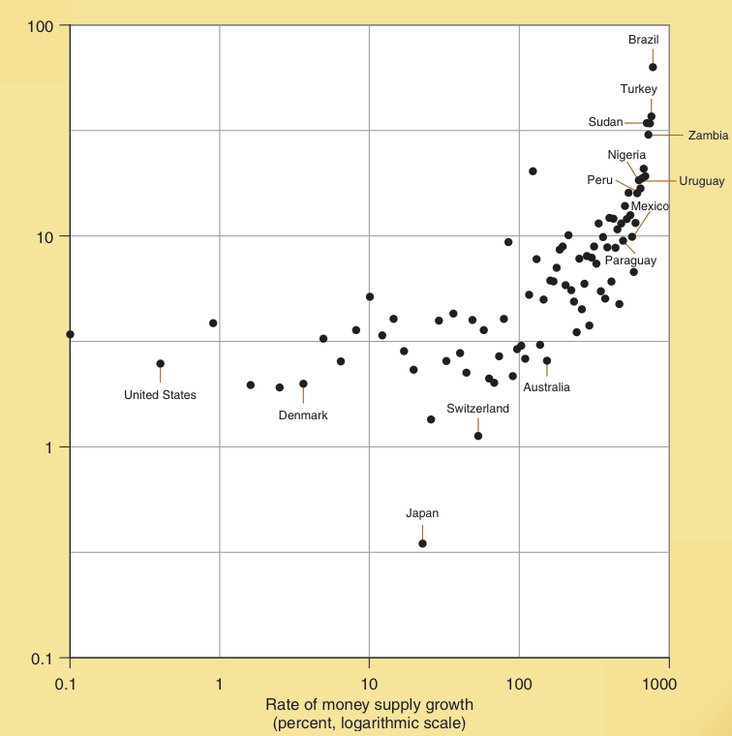
Money and Inflation
– An International Comparison 1990-2014
The relationship between the avg. annual growth rate of the money supply and the rate of inflation is shown here for the 1990-2014 period.
The relationship between the two is clear: higher rates of money growth lead to higher rates of inflation.
Note:
Money supply data are the actual growth rate of the money supply minus the growth rate of real GDP.
Rate of inflation per year
(percent, logarithmic scale)

Slide 32
Time Lags, Monetary Shifts, and Economic Stability
While the Fed can institute policy changes rapidly, there will be a time lag before the change exerts much impact on output and prices.
  This time lag is estimated to be 6 to 18 months in the
  case of output.
  In the case of the price level, the lag is estimated to be
  12 to 30 months.

Slide 33
Money, Economic Stability, and Proper Monetary Policy

Slide 34
Two Important Points
About Monetary Policy
Expansionary monetary policy cannot loosen the bonds
of scarcity and therefore it cannot increase the long-term growth rate of an economy. Rapid growth of the money supply will
lead to inflation.
Shifts in monetary policy will influence the general level
of prices and real output only after time lags that are long
and variable.

Slide 35
Why Proper Timing of Monetary
Policy Changes is Difficult
The long and variable time lags between a monetary policy shift and their impact on the economy will make
it difficult for policy-makers to institute changes in a manner that will promote economic stability.
Given our limited forecasting ability, policy errors are likely.
If monetary policy makers are constantly shifting back
and forth, policy errors will occur. Thus, constant policy shifts are likely to generate instability rather than stability. Historically this has been the case.

Slide 36
Keys to Prosperity: Price Stability
Monetary policy that provides approximate price stability (persistently low rates of inflation) is the key to sound stabilization policy.
Modern living standards are the result of gains from trade, specialization, division of labor, and mass production processes. Price stability will facilitate the smooth operation of the pricing system and the realization of these gains.
In contrast, high and variable rates of inflation create uncertainty, distort relative prices, and reduce the efficiency of markets.

Slide 37
Recent Monetary Policy of the United States

Slide 38
Evaluating Monetary Policy
How can you tell whether monetary policy is expansionary or restrictive? Other things constant:
  Rapid growth of the money supply, low (and declining) short-term interest rates, and inflation are indicative of expansionary monetary policy.
  On the other hand, slow growth of the money supply, rising short-term interest rates, and deflation imply restrictive monetary policy.

Slide 39
Monetary policy, 1990-2008
In the 1990s:
The Fed focused on price stability. Monetary policy was relatively stable and kept inflation low.
During 2002-2004:
The Fed shifted towards a more expansionary policy, M2 grew rapidly, and interest rates were pushed to low levels.
  This expansionary monetary policy contributed to the 87% increase in housing prices between 2002 and mid-2006.
Between 2005-2007:
As inflation rose in 2005, the Fed shifted to a more restrictive monetary policy. M2 growth slowed and interest rates rose.
  This shift contributed to the housing price bust and the recession that followed. (See graphics that follow).

Slide 40
Monetary policy, 1990-2008
As interest rates rose, housing prices reversed. By 2007, housing prices were falling and mortgage default rates rising. The housing bust soon spread to the rest of the economy and resulted in the severe 2008-2009 recession.
Government regulations that eroded lending standards and promoted the purchase of housing with little or no down payment (begun in the latter half of the 1990s) were an important cause of the housing boom and bust, but monetary policy was also a contributing factor.

Slide 41
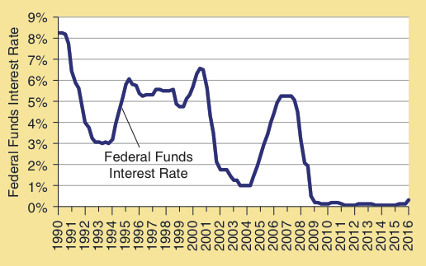
The Fed Funds Rate: 1990-2016
Between 2002 and 2004 the fed pushed short-term interest rates to historic lows (< 2%).
As the inflation rate accelerated, the fed switched to a more restrictive policy in 2005-2006, pushing short-term interest rates above 5%.
As the economy slipped into a recession in 2008, the Fed again shifted to expansion, pushing interest rates to nearly 0%.
Federal Funds Interest Rate

Slide 42
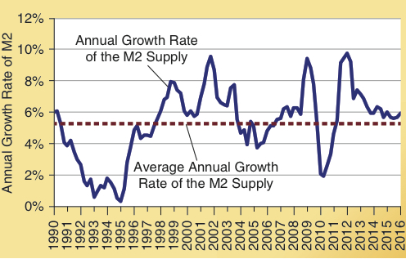
Annual Growth Rate of M2: 1990-2016
The annual growth rate of the M2 money supply spiked above 10% in 2002-2003 and declined to less than 4% in 2005-2006.
These shifts contributed to the housing boom and bust.
In response to the recession of 2008-2009, M2 growth spiked up (again) to nearly 10%.
In 2011-2012 the M2 money supply grew rapidly.
Annual Growth Rate of M2

Slide 43
Fed Policy During and
Following the 2008 Financial Crisis
Fed response to 2008 financial crisis:
  The fed responded to the recession by injecting a huge quantity of reserves into the banking system.
  In the 12 months beginning in July of 2008, the fed doubled both its asset holdings and the monetary base, pushing short-term interest rates to near zero.
But, the demand for investment was weak and therefore…
  expansion in credit was small, and,
  banks held huge excess reserves.
While the recession ended in June 2009, growth of real GDP was slow and the unemployment rate high.
  The fed responded with additional rounds of bond purchases that were referred to as quantitative easing.

Slide 44
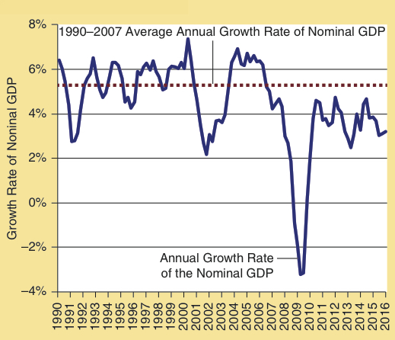
Annual Growth Rate in Nominal GDP: 1990-2016
The growth rate of nominal GDP reflects the combination of changes in the money supply
and its velocity.
During 1990-2007, the annual growth rate of nominal GDP averaged 5.4% and was generally in the 4% to 6% range.
After plunging in 2008-2009, nominal GDP grew at an annual rate of 3.7% during 2010-2016, even lower than the 1990s.
This modest growth of nominal GDP implies that monetary policy was not highly expansionary following the recession.
Growth Rate of Nominal GDP

Slide 45
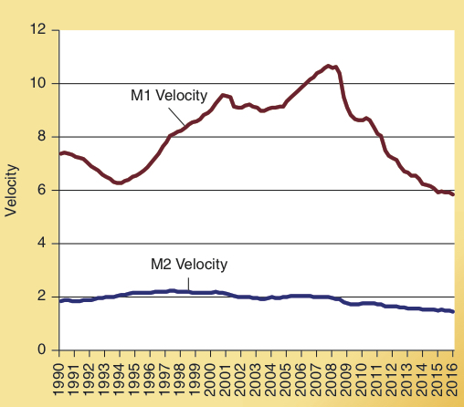
The Velocity of the M1 and M2
Money Supply: 1990-2016
Note how the velocity of the
M1 money supply increased
for more than a decade prior
to 2007 but plunged in the aftermath of the 2008-2009 recession.
As short-term interest rates hovered near zero, the velocity of the M1 and M2 money supply fell substantially during 2008-2016.
This reduction in the velocity of money blunted the impact of the Fed’s expansionary monetary policy.
Velocity of M1 and M2

Slide 46
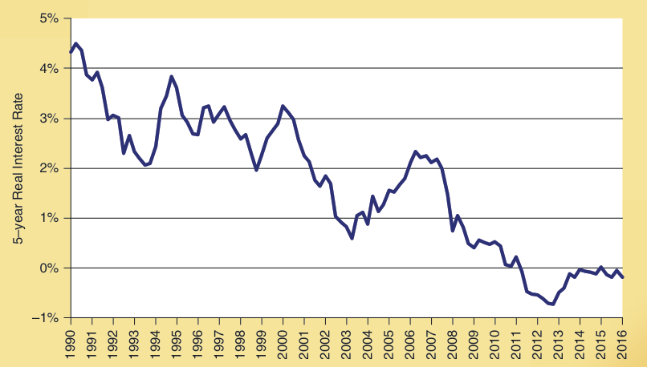
The Real Interest Rate in the United States, 1990-2016
The real interest rate was persistently below 1 percent and occasionally fell below zero during 2008–2016.
It is unlikely that expansionary monetary policy would be able to keep the interest rate this low for such a prolonged time period.
The Real Interest Rate in the United States, 1990-2016

Slide 47
How Expansionary Was Monetary Policy in the Aftermath of the Great Recession?
Although the Fed’s huge injection of bank reserves and the low interest rates are indicative of expansionary monetary policy, other indicators are inconsistent with this view. Consider the following:
  Low inflation: Inflation remained low during the period.
  Slow growth of nominal GDP: see nominal GDP graphic.
  Persistently low real and nominal interest rates during 2011-2016: While monetary expansion can temporarily reduce interest rates, it cannot do so for a lengthy time period.
  Inflow of capital: The U.S. experienced an inflow of capital even though both real and nominal interest rates were low.

Slide 48
Low Interest Rates: Alternative Views
The recent low interest rates are a global phenomenon.
  Japan, Canada, most of Europe, and several other areas of the world have also experienced low interest rates.
Why have interest rates been so low?
  Weak demand for loanable funds:
    The technological changes of the Information Age do not involve production of a tangible product that requires large capital investment.
    Constant policy changes have generated uncertainty and reduced the demand for loanable funds.

Slide 49
Low Interest Rates: Alternative Views
Why have interest rates been so low? continued…
  Increase in the supply of loanable funds:
    High oil prices and rapid growth of Asian economies
      The high oil prices throughout most of 2003-2014 generated huge income increases for oil producers; leading to savings and an increase in the global supply of loanable funds.
      Historically, Asian economies have had high savings rates. Therefore, their rapid growth increases the global supply of loanable funds.
      Former Fed chairs, Alan Greenspan and Ben Bernanke, believe these factors have generated a worldwide “savings glut.”

Slide 50
Low Interest Rates: Alternative Views
Why have interest rates been so low? continued…
  Increase in the supply of loanable funds:
    Demographic changes worldwide:
      In the developed world, there has been a large increase in the share of the population in age groups (50 to 75) that are generally net suppliers of loanable funds and a decline in the share in age groups (under age 50) that generally have a strong demand for loanable funds.
      These changes will increase the supply and reduce the demand for loanable funds, pushing interest rates downward.

Slide 51
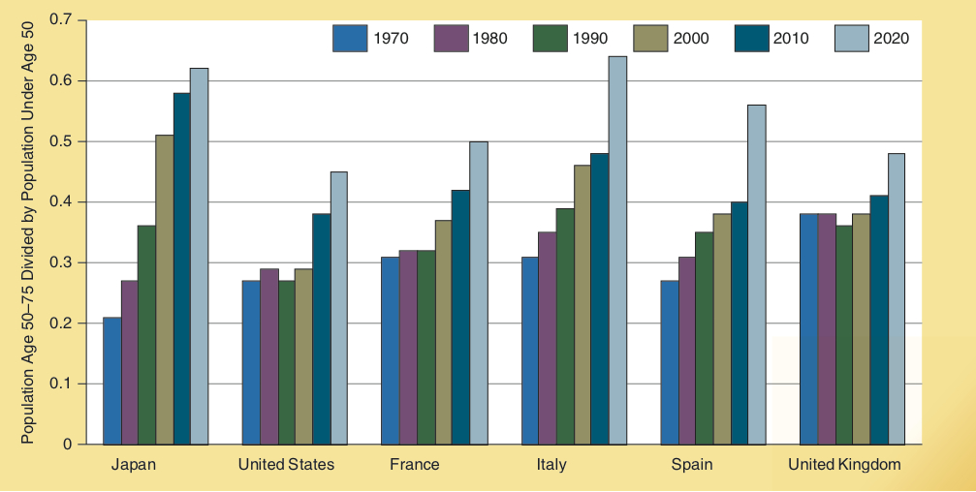
Demographic Changes, 1970-2020
Households with people under age 50 tend to be net borrowers, while persons age 50 to 75 are generally net lenders.
As shown here, the population age 50 to 75 has increased substantially relative to the population under age 50 in high-income countries in recent decades.
An increase in the share of the population age 50 to 75 relative to the under age 50, will expand the supply of loanable funds relative to demand, and thereby place downward pressure on real interest rates.
Changes in the Size of the Lending and Borrowing Age Categories
in Various High-Income Countries, 1970-2020

Slide 52
The Future: Monetary Policy and Low Interest Rates
Does it matter why the interest rates are low?
  Answer: Yes, because the implications of the alternative theories are different.
    If the low interest rates are the result of expansionary monetary policy, as full recovery is achieved, this policy will eventually lead to:
      Stronger demand for investment and increased use of the huge excess bank reserves to extend more loans.
      Upward pressure on the general level of prices and inflation.
      Higher money interest rates as the inflation continues and people begin to anticipate it.
    Even if the Fed moved quickly to control inflation, improper timing could result in a recession.

Slide 53
The Future: Monetary Policy and Low Interest Rates
Does it matter why the interest rates are low? continued…
  If the low interest rates are the result of high oil prices during 2003-2014, recent changes in oil markets could undo the “savings glut” and lead to higher interest rates in the near future.
  Higher interest rates lead to increased borrowing costs which would adversely affect heavily indebted countries such as Greece, Italy, and Spain.
  These countries would have to increase taxes or make other fiscal adjustments in order to cope with the higher interest rates.

Slide 54
The Future: Monetary Policy and Low Interest Rates
Does it matter why the interest rates are low? continued…
  If the low interest rates are the result of demographic changes then interest rates will remain low for some time.
  In the event this occurs, low real interest rates, weak demand, and slow economic growth will likely be present in high-income developed economies in the decade ahead.

Slide 55
Questions for Thought:
Did Fed policy contribute to the Crisis of 2008?
Why or why not?
The expansionary monetary policy of the Fed is responsible for the low interest rates of 2010-2016.” Indicate why you either agree or disagree with this statement. Cite empirical evidence to support your view.
Explain why the substantial increase in the share of population age 50 to 75 compared to the share under age 50 in most high-income countries since 1990 may be a contributing factor to the low interest rates of recent years.

Slide 56
Questions for Thought:
Why do the large excess reserves currently held by banks confront the Fed with a dilemma? How can the Fed prevent the lending from these excess reserves from providing the fuel for future inflation.
Timing a change in monetary policy correctly is difficult because:
  monetary policy makers cannot act without congressional approval.
  Central banks do not have the tools that will permit them to alter the supply of money.
  it is often 6 to 18 months in the future before the primary effects of the policy change will be felt.

Slide 57
End of
Chapter 14

